Slide 1
Career Readiness Skills
(AKA: Soft Skills)

Slide 3
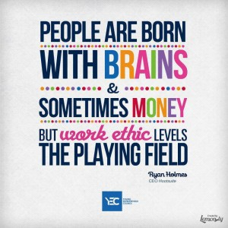
Character, Work
Ethic and Soft Skills :
What you want your references to say about you!

Slide 4
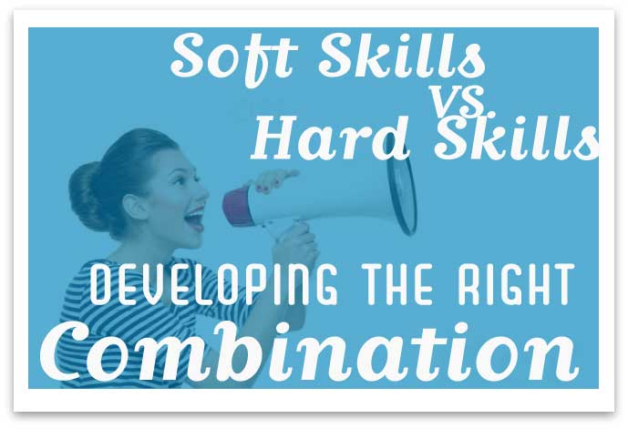
Positive Attitude
Teamwork
Communication
Top 3
Soft skills- personal attributes that enhance an individual's interactions, job performance and career prospects.
Hard skills- about a person's skill set and ability to perform a certain type of task or activity.

Slide 5
Six Soft skills…
Communication
Enthusiasm and Attitude
Teamwork
Networking
Problem Solving and Critical Thinking
Professionalism
77 % of businesses- believe that soft skills (less tangible skills associated with one’s personality, such as a positive attitude) are just as important as hard skills (skills that are learned to perform a specific job function and can be measured, such as operating a computer program). 16% of employers said soft skills are more important than hard skills when evaluating candidates for a job.

Slide 6
Networking
“It’s not what you know, it’s who you know.” This common when it comes to finding a job, you’ve got to network!
According to Cornell University’s Career Center, 80% of available jobs are not advertised. These jobs are often referred to as the “hidden job market.”
Everyone has a network, even if you don’t realize it, and when it comes to job searching, this network may be just as important as your skills and experience. A personal network is that group of people with whom you interact every day – family, friends, parents of friends, friends of friends, neighbors, teachers, bosses, and co-workers.

Slide 7
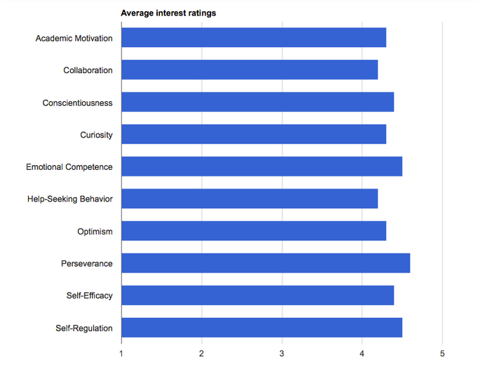
Perseverance garners most attention in soft skills poll

Slide 8
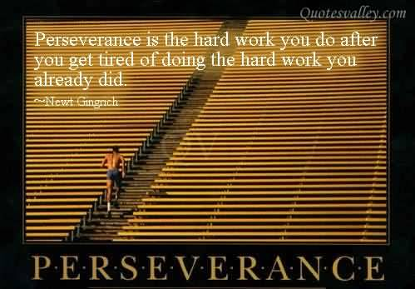
perseverance
The capacity to stick to a goal or complete a task despite difficulties.
Qualities like grit, tenacity, delayed gratification, self-discipline, self-control, and passion for long-term goals.

Slide 9
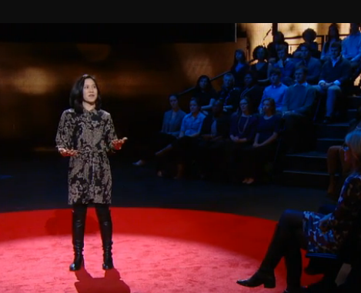
Personal Grit as Key to Success
Passion, perseverance, and stamina outweigh IQ
as a predictor of success.
GRIT
Self-control
Motivation

Slide 10
Grit Discussion
What is GRIT?
Why is GRIT important for YOU now?
Why might GRIT be important for YOU in the future?
How GRITTY are you?
Grit Scale Questions

Slide 11
12-Item grit Scale
I have overcome setbacks to conquer an important challenge.
Very much like me
Mostly like me
Somewhat like me
Not much like me
Not like me at all
New ideas and projects sometimes distract me from previous ones.
Very much like me
Mostly like me
Somewhat like me
Not much like me
Not like me at all

Slide 12
12-Item grit Scale
My interests change from year to year.
Very much like me
Mostly like me
Somewhat like me
Not much like me
Not like me at all
Setbacks don’t discourage me.
Very much like me
Mostly like me
Somewhat like me
Not much like me
Not like me at all

Slide 13
12-Item grit Scale
I have been obsessed with a certain idea or project for a short time but later lost interest.
Very much like me
Mostly like me
Somewhat like me
Not much like me
Not like me at all
I am a hard worker.
Very much like me
Mostly like me
Somewhat like me
Not much like me
Not like me at all

Slide 14
12-Item grit Scale
I often set a goal but later choose to pursue a different one.
Very much like me
Mostly like me
Somewhat like me
Not much like me
Not like me at all
I have difficulty maintaining my focus on projects that take more than a few months to complete.
Very much like me
Mostly like me
Somewhat like me
Not much like me
Not like me at all

Slide 15
12-Item grit Scale
I finish whatever I begin.
Very much like me
Mostly like me
Somewhat like me
Not much like me
Not like me at all
I have achieved a goal that took years of work.
Very much like me
Mostly like me
Somewhat like me
Not much like me
Not like me at all

Slide 16
12-Item grit Scale
I become interested in new pursuits every few months.
Very much like me
Mostly like me
Somewhat like me
Not much like me
Not like me at all
I am diligent.
Very much like me
Mostly like me
Somewhat like me
Not much like me
Not like me at all

Slide 17
12-Item grit Scale Scoring
For questions 1, 4, 6, 9, 10 and 12 assign the following points:
5 pts - Very much like me
4 pts - Mostly like me
3 pts - Somewhat like me
2 pts - Not much like me
1 pt - Not like me at all
For questions 2, 3, 5, 7, 8 and 11 assign the following points:
1 pt - Very much like me
2 pts - Mostly like me
3 pts - Somewhat like me
4 pts - Not much like me
5 pts - Not like me at all
Add up all the points and divide by 12. The maximum score on this scale is 5 (extremely gritty), and the lowest score on this scale is 1 (not at all gritty).

Slide 18
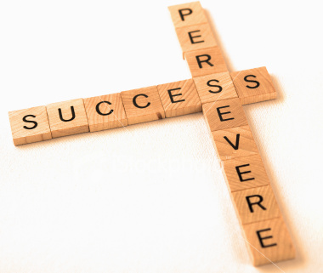
Perseverance
Think of a task that you started but did not finish. What happened to stop your progress?
Think of an activity that required you to do lots of practice before you got good at it. Why did you stick with it?
Who is a person in your life or a famous person you admire who never seems to give up on a goal?

Slide 19
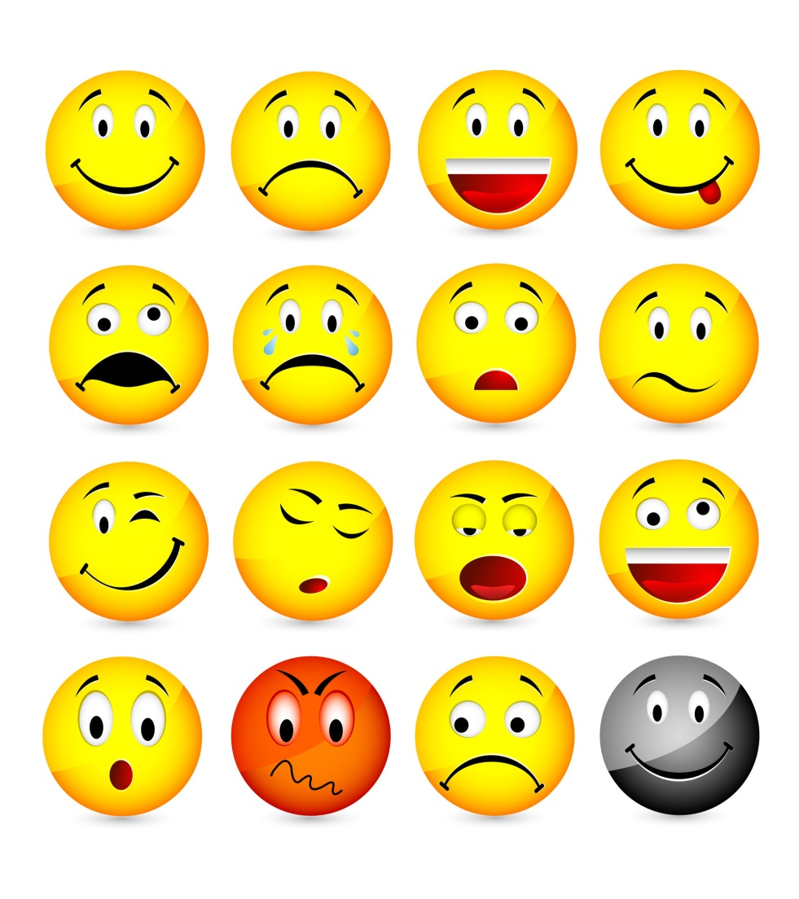
Emotional Competence
The capacity to experience and express feelings in ways that are appropriate and effective in a given situation as well as the capacity to understand and sympathize with the feelings and experiences of others.
Emotional competence includes empathy, emotion management, self-awareness, and social awareness.

Slide 20
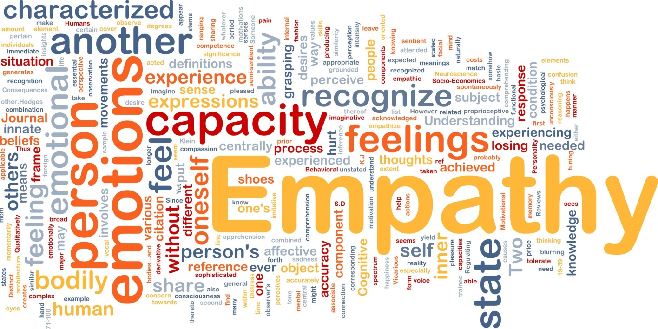
Emotional Competence
Have you ever felt an emotion but didn’t understand why?
How much do you care about how other people are feeling? Are there some people whose feelings you care about more than others?
Have you ever been surprised at how someone felt about something?
How well do you manage feelings of anger and frustration?

Slide 21
Qualities of a successful _____________________:
Persistence
Independence
Positive attitude
Self-discipline
Energetic
Confident
Creative
Organized
Work Ethic
Risk-Taker
Action-oriented
Strong desire to achieve
Good business sense
Goal Setter
Good communicator
Tolerance for uncertainty
Soft Skills are important for EVERY job!

