Slide 1
Creating a rÉsumÉ of “hire” quality

Slide 2
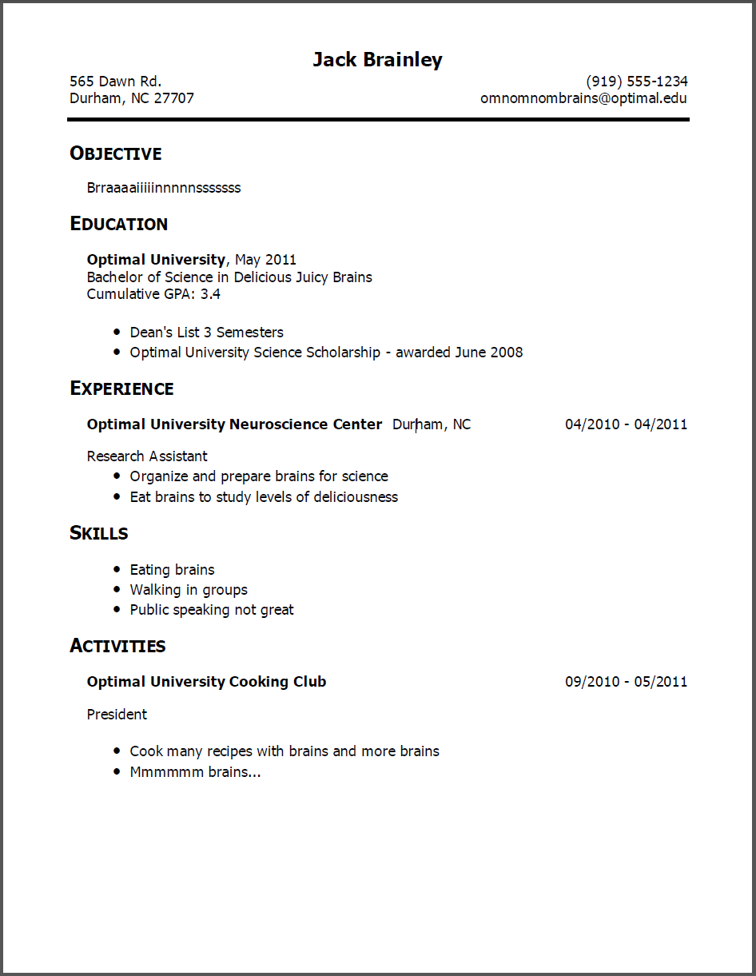
What IS a Resume?
Selling/marketing tool for presenting yourself to a potential employer
Instrument to get a company interested in meeting you
A summary, not an autobiography.
It is a written inventory of your skills and experiences.
Be well organized and concise.
An accurate representation of you. Never lie on your resume.
Notes:
A selling tool – an advertisement for yourself. It gives your prospective employer the first impression of you.

Slide 3
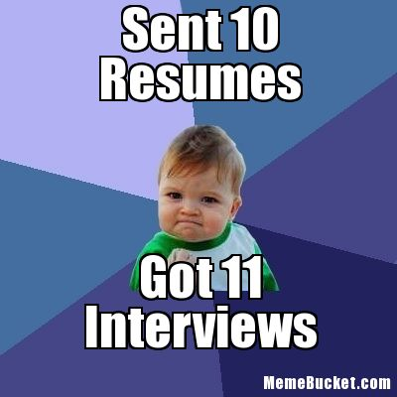
Why is the format & presentation important?
Employers generally do not “read” resumes (at least not at first)
Your resume will be in stack of 40-hundreds-thousands of others
PRESENTATION IS IMPORTANT!
You need to stand out!

Slide 4
Presentation/Layout
In one simple glance, the person reading your resume should catch:
What you have accomplished
What it is you do
Your skills/abilities/experience
Present these in a way that captures the reader’s attention!
NO TYPOS – Proofread, Proofread, Proofread!
Lincoln Northeast Highschool – is this right?
Notes:
According to a recent survey, even one typo on your resume may be enough to disqualify you from consideration for a job. Researchers polled 150 human resources and other managers from the nation’s 1,000 largest companies.
Impression that you are not detail oriented or that you lack a genuine interest in the position.
Be sure to proofread your resume and cover letter several times for typographical and grammatical errors, and have a friend or relative look at it, too

Slide 5
Presentation/Layout Tips
Always use the “Tab” key, do not use the “space bar” to line up things
The reason is that character sizes are not universal
I ≠ W
Do not abbreviate (except the state → NE)
Spell out “Street”
2635 N 63rd ST
Lincoln NE 68507
2635 North 63rd Street
Lincoln, NE 68507

Slide 6
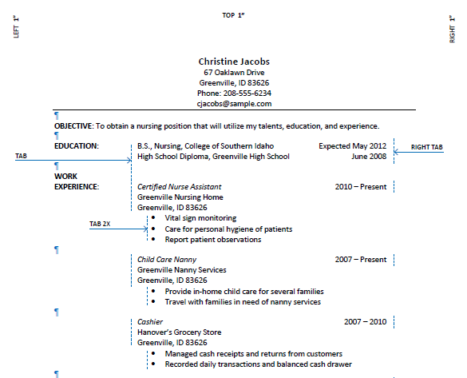

Slide 7
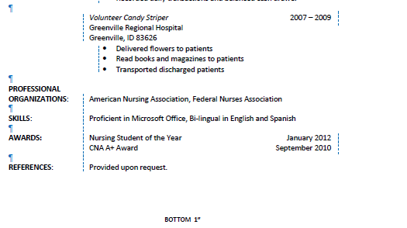

Slide 8
Sections of a Resume
Heading
Objective
Education
Work Experience
Volunteer Experience/Community Involvement
Activities and Honors
Strengths / Skills

Slide 9
Sections of a Resume: Heading
Things to include
Real Name
Permanent Address
No Abbreviations
Permanent Phone
An acceptable email address
bsmith@yahoo.com – YES
midnightmama@hotmail.com – NO
This heading will be used for every page of your resume.

Slide 10
Sections of a Resume: Objective
Your career objective
Your career goals
Helps employers understand your intended career direction

Slide 11
Sections of a Resume: Objective
Do I need an objective?
Yes - if you do NOT attach a cover letter
No – if you DO attach a cover letter, although still OK to do so
Objective Examples:
To obtain a Summer Retail Trainee position with Walgreens.
Dedicated and motivated engineering graduate seeking entry level assistant quality control manager position with Dyna Tech, LLC.
Hard working business management graduate with proven leadership and organizational skills seeking to apply my abilities to the position of junior assistant to the CEO at Warbucks Financial.

Slide 12
Sections of a Resume: Education
Reverse chronological order (start with current level of education)
Include:
Name of school
City it is located
Anticipated graduation date – don’t need specific date
Anticipated graduation – June 2011
Tell what your degree would be in (when doing your resume in college)
List GPA
If it is less than 3.0, do NOT list it
Class rank, if known

Slide 13
Sections of a Resume: Work Experience
Reverse chronological order (start with most recent –current– job)
List the following information:
Can start with name of business OR the Job Title
Hugh’s High End Homes OR Finish Carpenter
City located in
Lincoln, NE
When did you work
August 2008 – present
List your title
Business Education Teacher (Grades 9-12)
Explain what you do (be honest, but sell yourself)
Responsibilities of job; skills gained
Start with action verb
Do NOT list your beginning/ending salary

Slide 14
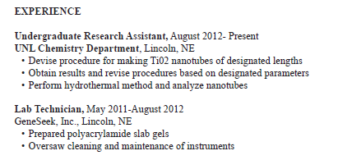
Sections of a Resume: Work Experience

Slide 15
Sections of a Resume: Volunteer Experience/Community Involvement
Community Service Activities
Volunteer service
Food drives
Fundraising

Slide 16
Sections of a Resume: Activities & Honors
People want to see there is more to you than just one thing!
Possible honors and activities could be:
Athletics
Organizations/Clubs
Leadership roles
Scholarship awards
Honor Roll, Academic All-State, etc.
National Honor Society
Committees
Perfect Attendance
**Anything significant that can separate you from your neighbor!
Be sure to list in reverse chronological order and include dates of participation (most recent/current first)

Slide 17
Sections of a Resume: Activities & Honors
Include those that show sincere interest in learning, helping others, or developing a skill!
Examples:
Vice President of Future Business Leaders of America
Volunteer at the Ambassador Nursing Home
Active member of LNE Math Club
Monthly volunteer at City Mission
Promoter of LNE’s “Make a Wish” campaign
Others?

Slide 18
Sections of a Resume: Activities & Honors
For example:
Lincoln Northeast Soccer (Spring 2013, 2012, 2011)
OR
Lincoln Northeast Soccer (March 2013 - May 2013; March 2012 - May 2012, March 2011 - May 2011)
Lincoln Northeast Honor Roll (Fall 2013, Spring 2012, Fall 2012, Spring 2012)
OR
Lincoln Northeast Honor Roll (October 2012 - Present)

Slide 19
Sections of a Resume: Skills / Strengths
Be specific
List KEY skills, such as:
Leadership
Technical skills
Communication
Interpersonal relationships / Teamwork
Problem solving
List anything that is TANGIBLE, CREDIBLE, and can be VALIDATED (references)

Slide 20
Sections of a Resume: Skills / Strengths
Use ACTION WORDS to start your points & maximize impact
Use correct tense
If it is your current job, they need to be present tense
If it is a previous job, then use past tense
Which is more specific and lets the reader know what you can do?
Completed Computer Applications
OR
Created a product campaign for Marketing class using Microsoft PowerPoint

Slide 21
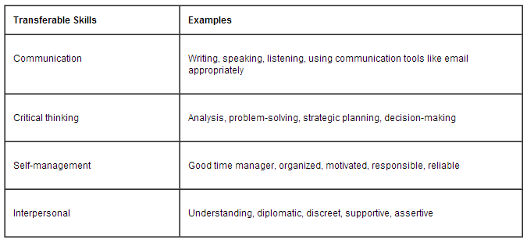
Sections of a Resume: Skills / Strengths
Transferable Work Skills

Slide 22
Qualities of a successful ___________________:
Persistence
Independence
Positive attitude
Self-discipline
Energetic
Confident
Creative
Organized
Work Ethic
Risk-Taker
Action-oriented
Strong desire to achieve
Good business sense
Goal Setter
Good communicator
Tolerance for uncertainty
Soft Skills are important for EVERY job!

Slide 23
Action Words/Phrases
Keep it Simple Stupid (KISS)!
Use short, phrased bullet points
Use ACTION words to start each bullet
Responsible for…
Wrote…
Led…
Managed…
Sold…
Developed…

Slide 24
Action Words / Phrases
Examples:
Walmart – Used problem-solving skills to assist customers with returns and exchanges or comments regarding the store
Babysitter – Interacted and supervised three small children during summer break. Gained experience taking initiative and making decisions when situations would arise and prompt action was required.
Others?

Slide 25
The Technical!
Omit GPA if not 3.0 or better
Keep it to 1 or 2 pages & NEVER use a partial page
Use figures to quantify and verify facts
Example: Supervised 7 employees
Do not use I, me or my – it’s already all about YOU!
ALWAYS list most recent education first!

Slide 26
The Technical!
Always use “Reference available upon request” and have reference page with you
Have letters of recommendation in portfolio
Do not use clip art or watermarks
Have same letterhead and stationary for everything (Cover Letter, Resume, and References) – make sure they match!

Slide 27
The Technical!
Use specific examples when you demonstrated “transferable skills”
Format data in two columns if needed
Use bullets and borders to increase appeal/appearance
Begin experience descriptions with ACTION verbs
Use appropriate email address
ABSOLUTELY NO ERRORS! Do necessary editing and use spellcheck!
Make sure periods, commas, spaces are correct

Slide 28
Resume Writing Tips
Always use the tab key instead of space bar to line up information
LOOK carefully – check and DOUBLE-CHECK your work for spelling, punctuation, and capitalization errors
Your resume will be evaluated by YOU, a PEER, and an ADULT after your first draft.
Peer and adult must proof and SIGN the Resume sheet “I have proofread this” and their signature.
TEACHER only proofs ONCE! Points deducted after that!
Abbreviate state only (NE). Do not abbreviate Street, Avenue, etc.

Slide 29
Resume Writing Tips
After you have had your resume proofed by PEER and ADULT, make necessary changes.
AFTER PROOFS are done, submit final Resume to Google Classroom to be printed
Write it yourself
Make it error free
Looks matter
Be brief
Be honest
Be positive
Be specific
Use action words and short sentences
Choose words carefully
Update often
SAVE often

Slide 30
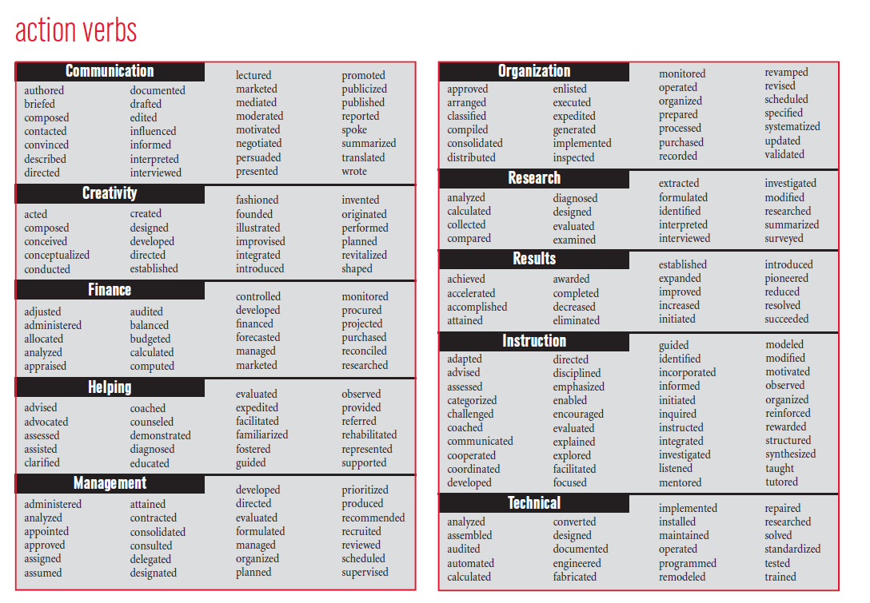

Slide 31
Example of Proper Reference Format
Mrs. Jocelyn Crabtree, Business Teacher
Lincoln Northeast High School
2635 N. 63rd Street
Lincoln, NE 68507
(402) 436-1303
jcrabtr@lps.org
Always identify your reference’s relationship to you

Slide 32
Questions?

