Slide 1
Sports & Entertainment Marketing
Mascots & Logos

Slide 2
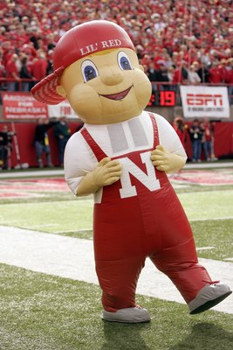
Mascots
What is a mascot?
Provide a few examples of mascots…
Sports?
Entertainment?
Other?

Slide 3
Mascot Defined
According to Meriam-Webster Collegiate Dictionary:
A mascot is “a person, animal, or object adopted by a group as a symbolic figure especially to bring them luck”
What about in SEM?
A mascot also represents team identity, as well as provides its fans with feelings of pride and joy.

Slide 4
Native Mascots
For decades, Indian mascots, symbols, and names used by high school, college, and professional teams have rallied team spirit and generated widespread support throughout America

Slide 5
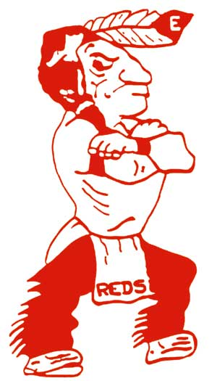
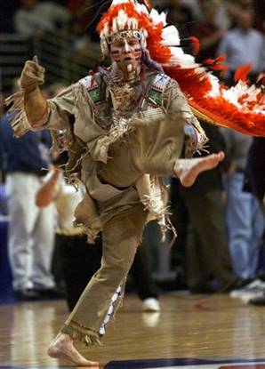
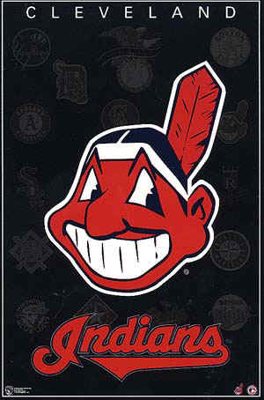
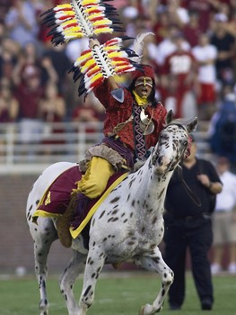
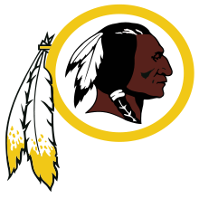

Slide 6
Mascots in the US
Mascots in Nebraska
Prior to 2000, Millard South was not the Patriots… they were the Indians

Slide 7
Retiring Native Mascots
The formal campaign to retire Indian mascots began in 1970 with colleges that had Indian mascots, continued in the 1980s with high schools, and moved into professional sports in the 1990s.

Slide 8
Retiring Native College Mascots
1970 – University of Oklahoma in Norman discontinued the use of its “Little Red” mascot
1971 – Marquette University in Milwaukee retired their cartoon logo “Willie Wampum”
1972 – Stanford University voted to retire their “Indian” mascot
1974 – Dartmouth College retired its “Indians” mascot and returned to its “Big Green”
1975 – Syracuse University in NY, discontinued their “Saltine Warrior” mascot

Slide 9
Some retired, some didn’t
Why do you think colleges are opposed to changing Indian mascots?
NCAA in 2005 announced that any school with a nickname or logo considered racially or ethnically “hostile” or “abusive” by the NCAA would be prohibited from using them in post-season events. Mascots would no longer be allowed to perform at tournament games. (Starting in Feb 2006)
By 2008, band members and cheerleaders would also be barred from using American Indians on their uniforms

Slide 10
What about Florida State?
Aug 2005 – NCAA granted a waiver
Have agreement with Florida Seminole Tribe
The Debate

