Slide 1
Sports & Entertainment Marketing
Legal Aspects of SEM
Chris Dorman – Harrison High School – Harrison, Arkansas

Slide 2
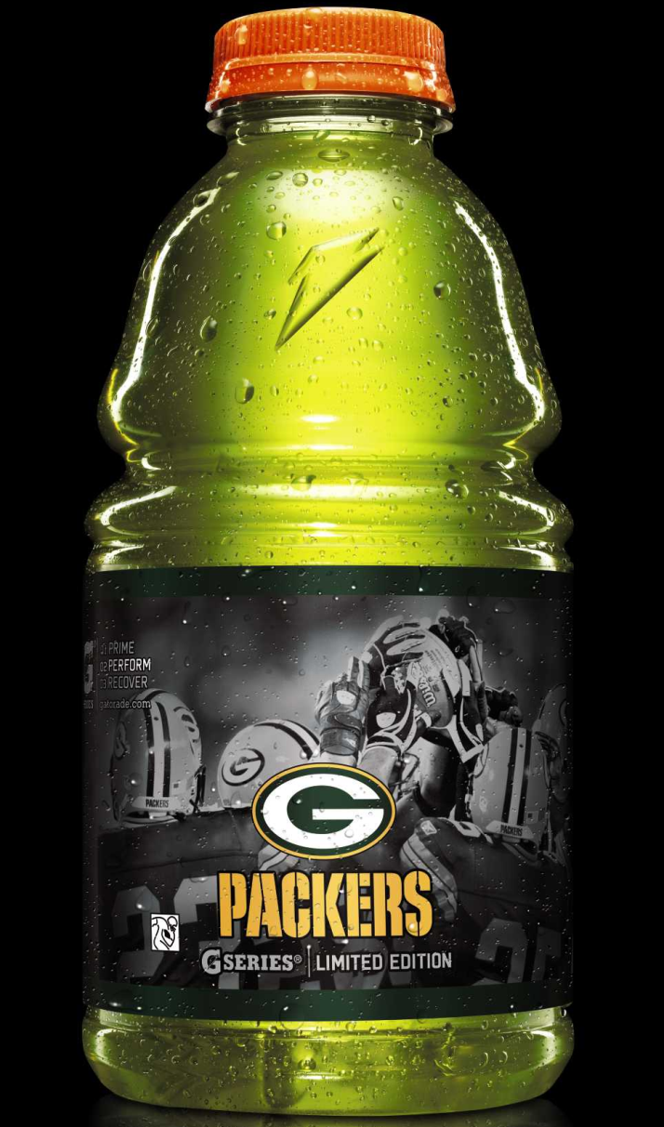
The Pepsi Cola Company Partners With the National Football League
The Pepsi Cola Company, owner of Gatorade, Frito-Lay, Tropicana, and Quaker Oats is an official marketing partner of the NFL at a cost of nearly $100 million a year.

Slide 3
Legal Aspects of Sports & Entertainment
A trademark is a device that legally identifies ownership of a registered brand or trade name.
A trademark is typically a name, word, phrase, logo, symbol, design, image, or a combination of these elements
A trademark may be designated by the following symbols:
™ (for an unregistered trade mark, that is, a mark used to promote or brand goods)
℠ (for an unregistered service mark, that is, a mark used to promote or brand services)
® (for a registered trademark)

Slide 4
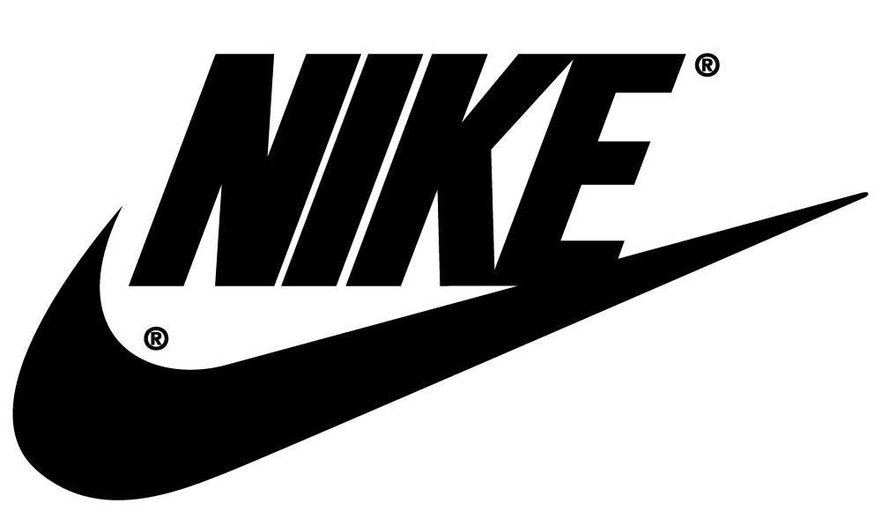
Legal Aspects of Sports & Entertainment
A trademark registration may remain in force indefinitely.

Slide 5
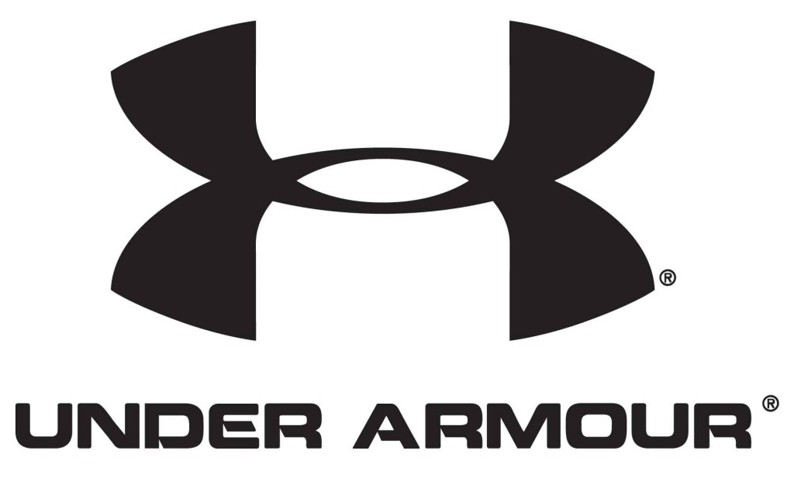
Legal Aspects of Sports & Entertainment
For a trademark registration to remain valid, the owner must continue to use it.

Slide 6
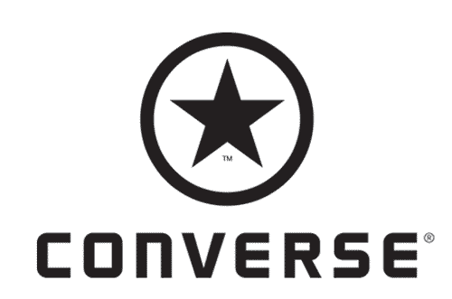
Legal Aspects of Sports & Entertainment

Slide 7
Legal Aspects of Sports & Entertainment

Slide 8
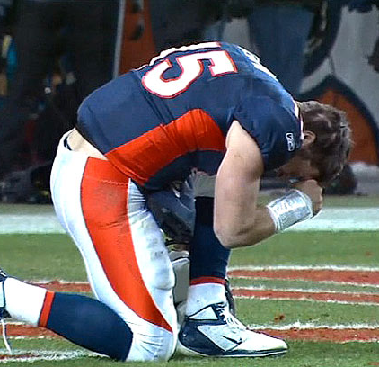
Legal Aspects of Sports & Entertainment
Dropping to a knee like Tim Tebow might cost you now.
The New York Jets backup quarterback has officially trademarked "Tebowing."
After Tebow led the Denver Broncos to a series of fourth-quarter comeback victories last season, "Tebowing" swept the country.
New York's Newsday first reported that the trademark was approved in October 2012 after paperwork was filed in April 2012.
http://youtu.be/AzoxlNPj0VY

Slide 9
Legal Aspects of Sports & Entertainment
A copyright is the legal protection of a creator’s intellectual property or products.
A copyright is valid for the life of the owner plus 70 years.
When the period of copyright protection has ended, the written document, musical composition, book, picture, or other creative work is in the public domain.
Being in the public domain means that no one owns a copyright to the work, and everyone is free to copy, use and change them without having to ask for permission or pay the owner.

Slide 10
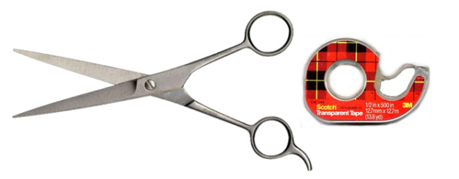
Legal Aspects of Sports & Entertainment
Copying someone else’s creative work and passing it off as your own is plagiarism and a violation of their copyright.
Plagiarism: Stopping Word Thieves
The Internet and cut-and-paste have made stealing others' writing easier than ever - and technology also makes catching plagiarists easier, too.
See handout if video is unavailable.

Slide 11
Legal Aspects of Sports & Entertainment

Slide 12
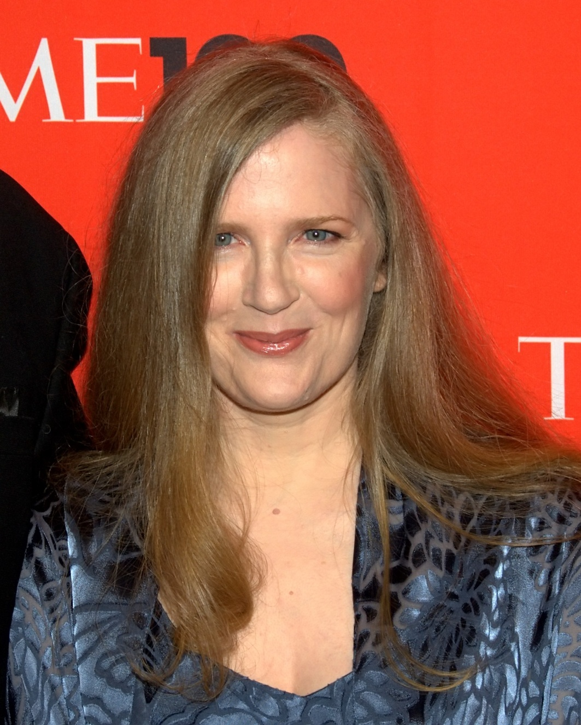
Legal Aspects of Sports & Entertainment
Suzanne Collins , author of the Hunger Games, sold the movie rights to her series of novels for $17 million.
She will own her copyrighted novels for the remainder of her life – plus 70 years.

Slide 13
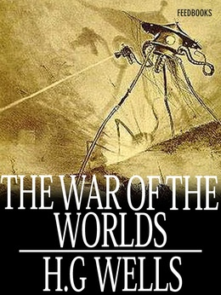
Legal Aspects of Sports & Entertainment
These books have passed into the public domain and are essentially free.

Slide 14
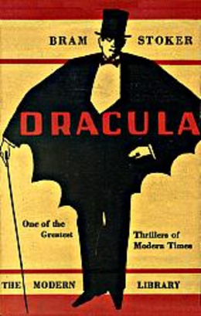
Legal Aspects of Sports & Entertainment

Slide 15
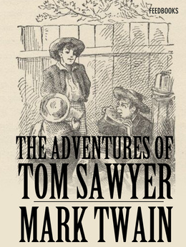
Legal Aspects of Sports & Entertainment

Slide 16
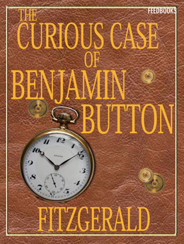
Legal Aspects of Sports & Entertainment

Slide 17
Legal Aspects of Sports & Entertainment
Intellectual property refers to the unique works of writers, artists, and musicians that can be protected under copyright laws.
Royalty is a payment for material that has been copyrighted or legally declared as belonging to the creator.

Slide 18
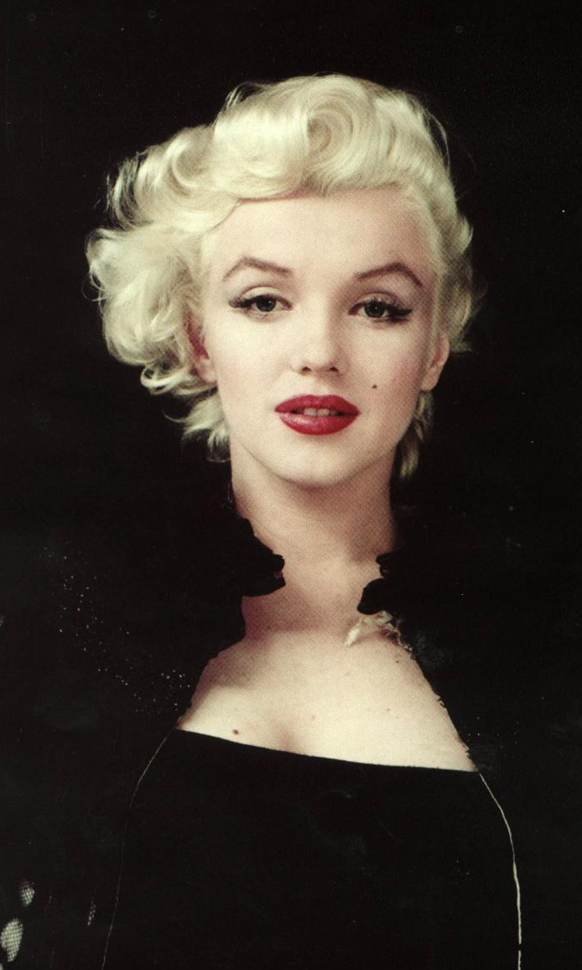
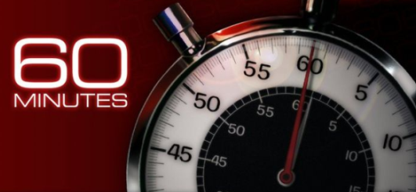
The Intellectual Property of Dead Celebrities
http://www.cbsnews.com/news/how-celebs-make-a-living-after-death-19-06-2010/
Who owns the likeness and intellectual property of dead celebrities? (These people also receive royalties due the deceased celebrity.)
How has technology enhanced the earning power of dead celebrities?
In terms of risk management what are the advantages of hiring dead celebrities to endorse products?

Slide 19
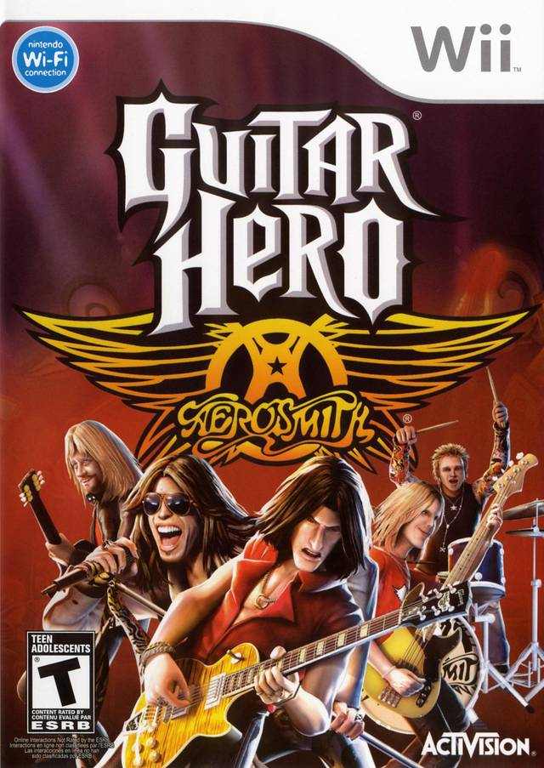
Legal Aspects of Sports & Entertainment
The band Aerosmith has made more money from royalties off Guitar Hero than it has from any of their actual albums.

Slide 20
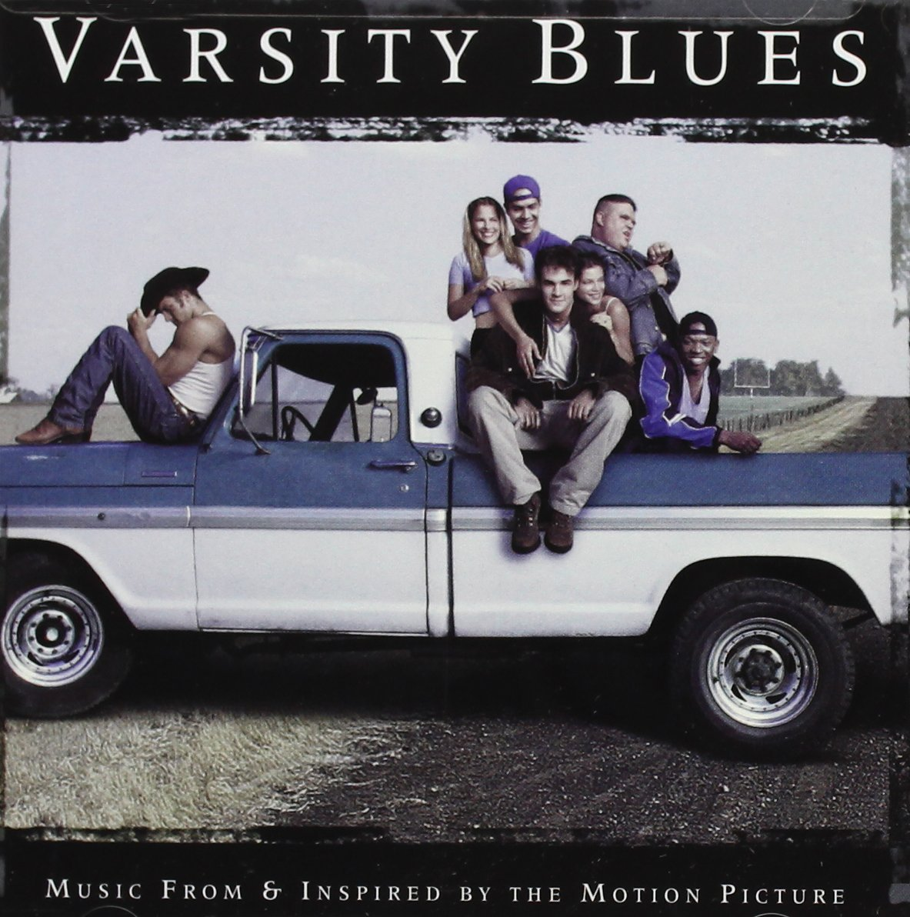
Legal Aspects of Sports & Entertainment
The most money ever spent for a song placed in a movie was for ACDC’s song Thunderstruck.

Slide 21
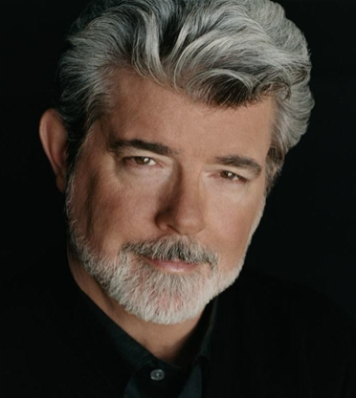
Legal Aspects of Sports & Entertainment
George Lucas will make more money from royalties than any other writer, producer, or director in Hollywood.

Slide 22
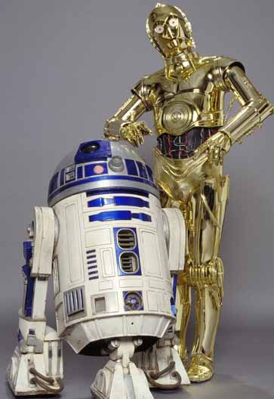
Legal Aspects of Sports & Entertainment
The word “droid” is a trademarked term owned by George Lucas .
Motorola pays a royalty fee to the creator of Star Wars for every “droid” phone sold in the United States.

Slide 23
Legal Aspects of Sports & Entertainment
A licensed product is a good or service that legally uses a logo or image owned by another company or person.

Slide 24
Legal Aspects of Sports & Entertainment
The University of Missouri recently sent a Cease and Desist letter to the Green Forest school district.
Why would the University of Missouri decide to enforce their trademark against a small school in Arkansas?

Slide 25
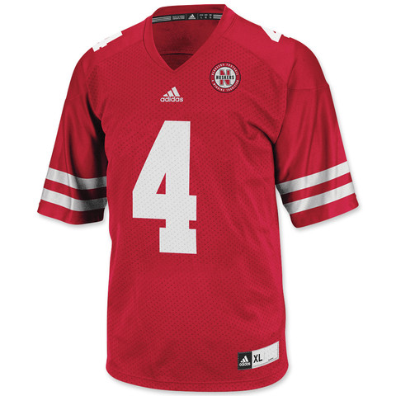
Legal Aspects of Sports & Entertainment

Slide 26
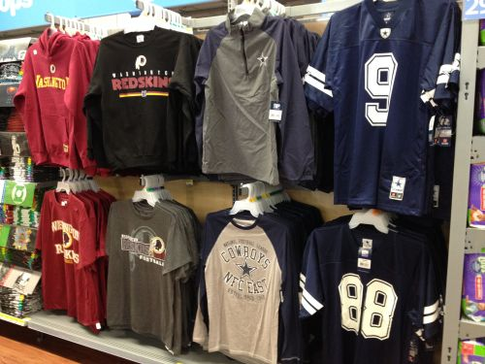
Legal Aspects of Sports & Entertainment

Slide 27
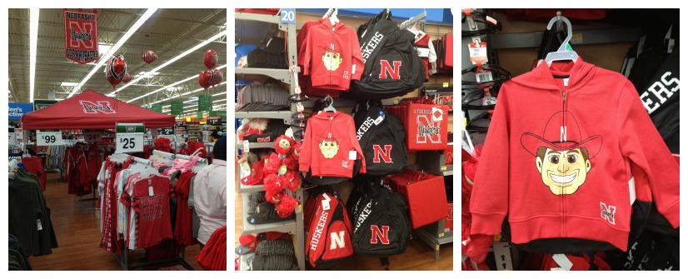
Legal Aspects of Sports & Entertainment

Slide 28
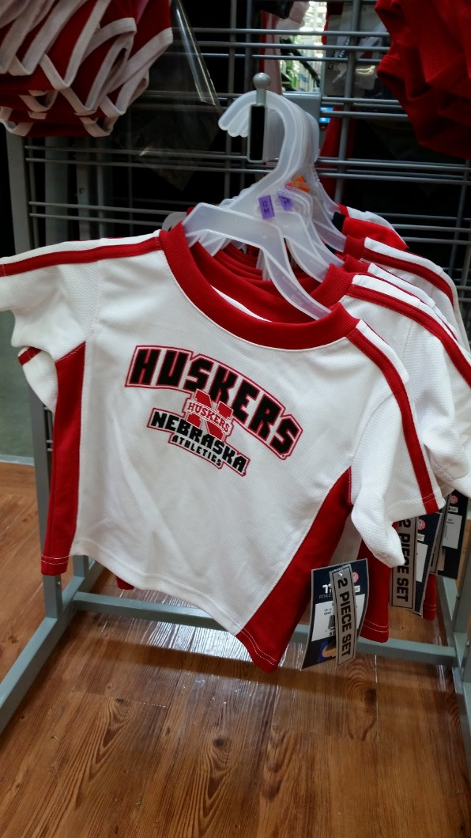
Legal Aspects of Sports & Entertainment

Slide 29
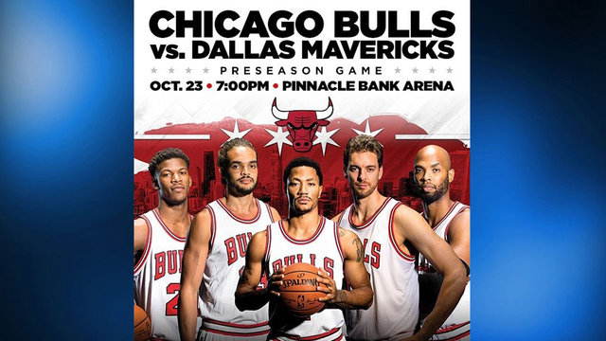
Legal Aspects of Sports & Entertainment

Slide 30
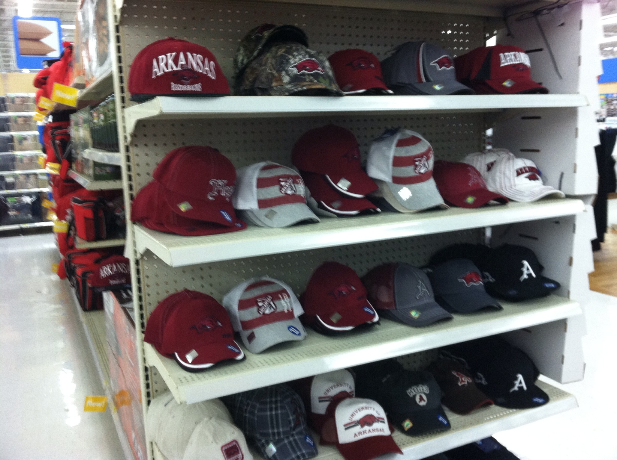
Legal Aspects of Sports & Entertainment

Slide 31
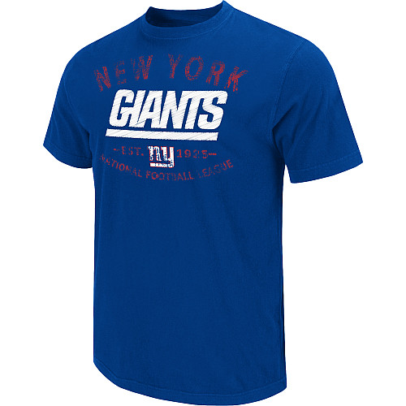
Legal Aspects of Sports & Entertainment

Slide 32
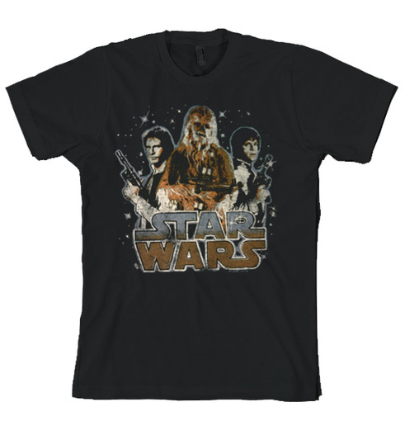
Legal Aspects of Sports & Entertainment

Slide 33
Copyright Piracy
Piracy is the theft of any copyrighted material; music, movies, and software.
The Motion Picture Association of America states that “23.8% of global internet traffic involves the illegal distribution of copyrighted work.”
The film industry loses $6.1 billion annually to digital piracy
The downloading program BitTorrent is responsible for nearly half of the piracy activity.

Slide 34
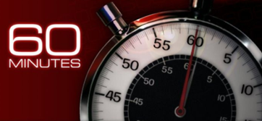
Fighting Piracy
More than 200,000 people have been sued for allegedly sharing copyrighted material using BitTorrent online.
The lawsuits are being settled out of court.
The defendants don’t want to risk the potential fine of up to $150,000.
Most out of court settlements have averaged $2,500.
http://www.cbsnews.com/video/watch/?id=5486510n

Slide 35
The Stop Online Piracy Act
The Stop Online Piracy Act (SOPA) is a United States bill introduced to expand the ability of U.S. law enforcement to fight online trafficking in copyrighted intellectual property.
Provisions include the requesting of court orders to bar advertising networks and payment facilities from conducting business with infringing websites, and search engines from linking to the sites, and court orders requiring Internet service providers to block access to the sites.

Slide 36
Merchandising
Planning and promotion of sales by presenting a product to the right market at the proper time, by carrying out organized, skillful advertising, using attractive displays, etc.
You don’t see displays for the SuperBowl in June – why?
When do you see ads/merchandise for March Madness?
When do you see ads/merchandise for the Olympics?
Fanatics Video

Slide 37
Merchandising Cont.
Fanatics Video
Discussion Questions:
According to Fanatics CEO, what is the #1 predictor of merchandise sales?
What quarter of the fiscal year is best for sales? Why?
Who is buying the merchandise?
What is the difference between customer and consumer?
Do you think scandals affect merchandise sales? Why or why not?

Slide 38
Review
Main Take Aways:
Trademarks – What are they? Why are they important?
Copyrights – What are they? Why are they important?
Royalties – What are they? Why are they important?
Intellectual Property – What is this?
Piracy – What is this? Why is it a problem?
Merchandising - What is this? How does it play a role in SEM?

