Slide 1
Interview Fair Preparation
Take Charge
Lincoln Northeast High School

Slide 2
Interview Fair – What will happen?
Report directly to the Media Center (on time!)
Your teacher will handout out your packet of information before you go to your interviewer (Interview Evaluation Sheet, Job Application, Cover Letter, and Resume).
No passes to locker – come prepared to class!
No opportunity to get on computer.
Location:
We’ll sit at the tables and chairs towards the front of the Media Center
Interviews will take place at the tables in the back and middle of Media Center
Procedure:
Teacher will call your name and assign you to an interviewer
When NOT interviewing, you will work quietly at a table/chair

Slide 3
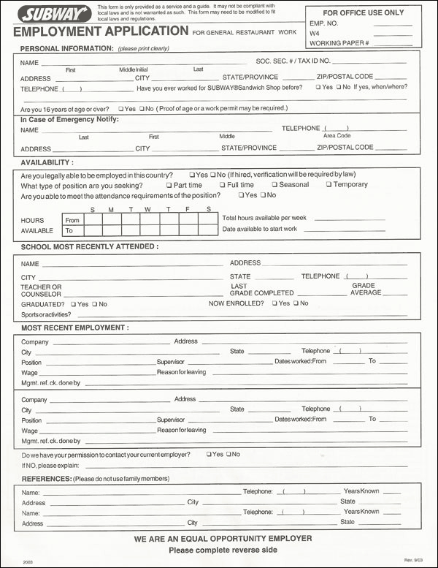
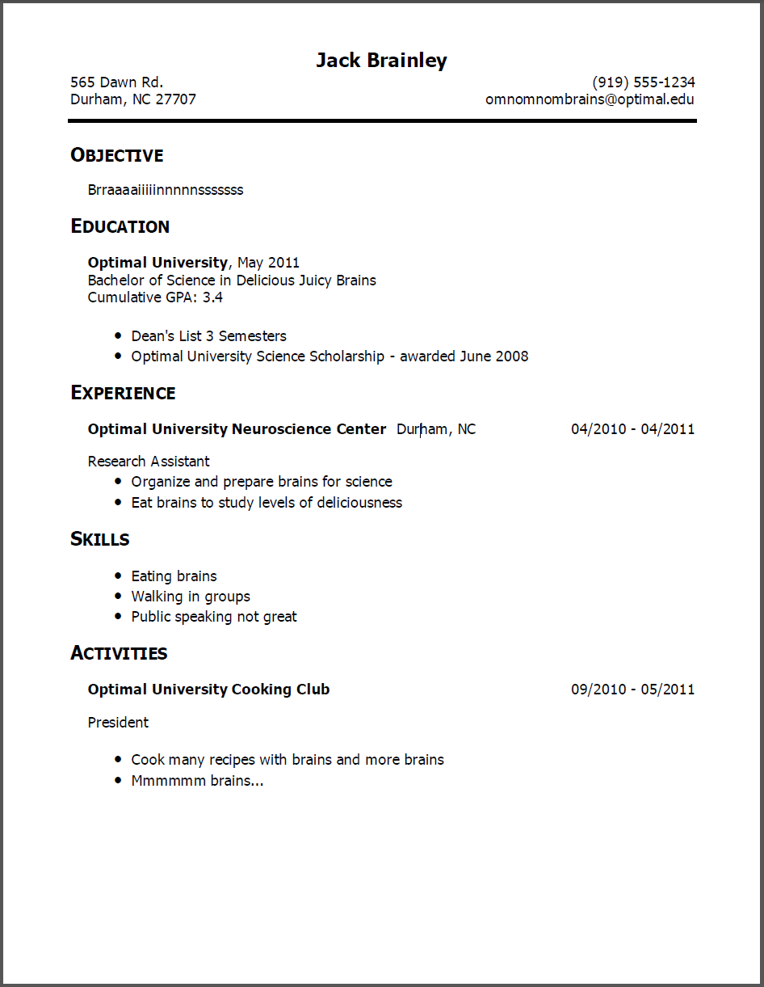
Interview Fair – Misc Information
You will not be allowed to leave to change your clothes – come prepared!
Clothes, Resume, Job Application, Cover Letter
Respect the Media Center’s rules
Be quiet, respectful, etc.

Slide 4
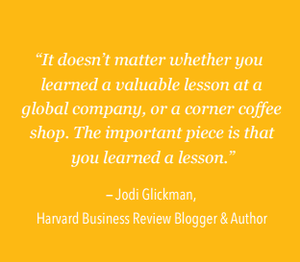
The Student Job Hunting Handbook
LinkedIn’s suggestions on interview preparation
Student Job Hunting Handbook (begin on page 15-26)

Slide 5
Interview Preparation
Identify traits or skills that are your strength.
Give examples of how that is your strength. i.e. perseverance, emotional competence, teamwork, independence, etc.
Focus on your potential—what kind of employee will you be like?
Focus on educational experience—are you on-time, do you work hard, do you have a special talent?
Focus on other experiences like babysitting or lawn mowing.
Transfer your experiences into qualities that describe you!

Slide 6
Interviewing Tips
Before the interview:
Research the company
Always be early.
Bring an extra copy of your resume and cover letter in a nice folder or binder.
Research questions an interviewer may ask and research great answers and make them fit you.
PRACTICE, PRACTICE, PRACTICE your answers to interview questions.

Slide 7
During the interview:
Make sure you give a “good” handshake.
Be attentive and take your time to answer questions.
It is alright to say you are nervous!
Remember to smile (soft skill: attitude and enthusiasm)!
Make sure you have questions prepared (you can bring an index card).
After the interview:
Thank them for their time and ask, “When can I expect to hear from you?”
Be sure to send a thank you as soon as you finish.

Slide 8
Video on interview tips: https://www.youtube.com/watch?v=S1ucmfPOBV8

Slide 9
Interview Questions
Tips for answering them!

Slide 10
Question #1: Tell me about yourself.
This will most likely be your first question.
Video: https://www.monster.com/career-advice/article/interview-tell-me-about-yourself
Sample answer:
I am a senior at Lincoln Northeast High School. I am involved in Student Council, volleyball, club volleyball, and FCCLA. I have been on high honor roll since I was a freshman. I am currently taking college courses through Southeast Community College. I am a very motivated individual and I have a very strong work ethic. My goal is to become a Dietitian and I plan on attending Northwest Missouri State in Maryville, Missouri in the fall.

Slide 11
#7 & 8 -What are your strengths and weaknesses?
Video: https://www.youtube.com/watch?v=ydvg6IgfcdA
Strengths: I have an extremely strong work ethic. When I’m working on a project, I don’t want to just meet deadlines. Rather, I prefer to complete the project well ahead of schedule. Last year, I even earned a bonus for completing my three most recent reports one week ahead of time.
Weakness: I like to make sure that my work is perfect, so I tend to perhaps spend a little too much time checking it. However, I’ve come to a good balance by setting up a system to ensure everything is done correctly the first time.

Slide 12
#19, #20 What are you short and long term goals?
Video on long term goals: https://www.youtube.com/watch?v=mSILLx1m5ks
"I am working to make the most of my remaining schooling by not only taking the classes required for my major, but also as many other 400 level elective courses as possible. This classroom experience, combined with my recent internship experience, have developed me to make an immediate contribution, which is my near term objective. After starting my new role, I plan to study for industry certification, with a goal to complete it within the first year of work. I would like to become the one of the best in my role in 2-3 years…"

Slide 13
Potential Interview Questions:
How would you describe yourself?
What would you like to tell me about yourself?
What are your major strengths? Major weaknesses?
What type of work do you like to do best? Least?
What accomplishment has given you the greatest satisfaction?
What was your worst mistake?
What would you change in your life?
What courses do you like best in school? Least?
What are your short-term goals? Long-term goals?
How do you plan to accomplish your goals?
What do you hope to be doing in 5 years? 10?
What salary do you expect?

Slide 14
More Interview Questions:
How would your managers describe you?
Are you a leader or a follower? Why?
Are you a team player?
What would your dream job be?
What is the biggest challenge you have faced in work or school in the past 12 months?
Why should we hire you? Why should we pick you over all other applicants?
How would your best friends describe you?
What does work ethic mean to you?
What is your favorite subject in school? Why?
Why do you want this job_______________?
What excites you the most?
Tell me about a difficult obstacle you had to overcome recently at work? How did you overcome this?

Slide 15
What to wear to a job interview

Slide 16
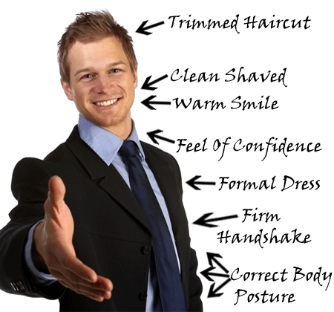
Dress for Success

Slide 17
Dress Tips
Khakis
No jeans
Suit (solid color-navy or dark grey)
Polo or Button-up shirt
Tucked in
Buttoned appropriately
Belt, Tie, Dark socks
Clean shave
If you have facial hair, make sure it is trimmed neatly
Limit aftershave
No earrings, clean nails

Slide 18
Dress Tips
Pants (no jeans or leggings)
Skirt – appropriate length
Roughly knee length
Nice shirt
Be careful of showing cleavage
Rule of 7
The number of accessories you wear does not exceed 7
Each earring counts as 1
Light make-up and perfume
Neatly trimmed nails

Slide 19
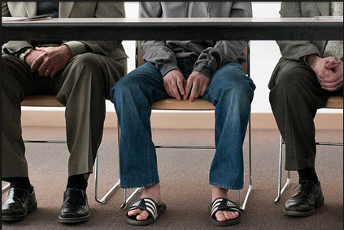
Dress Tips
Socks need to match
Not just each other, but what you are wearing
Appropriate Shoes
No “flip-flops”
No open-toed shoes
No sneakers
Don’t have messages written on you
Don’t be distractive
Cover tattoos, no gum/cell phone/iPod/coffee/soda

Slide 20
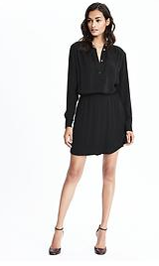
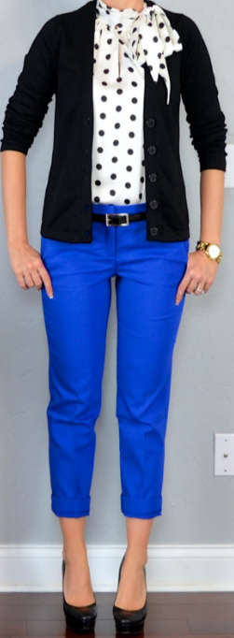
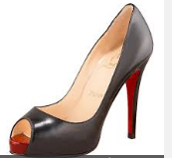
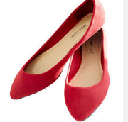
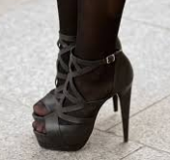
What to wear for the interview...Girls
YES!
YES!
NO!
NO!

Slide 21
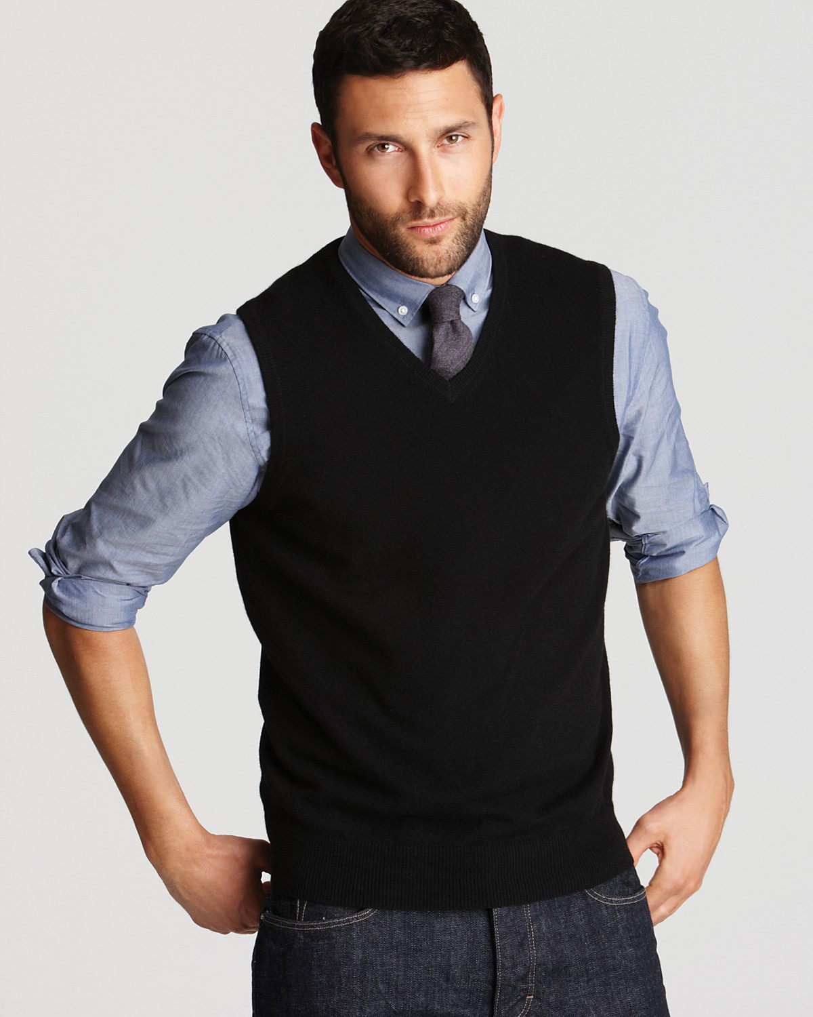
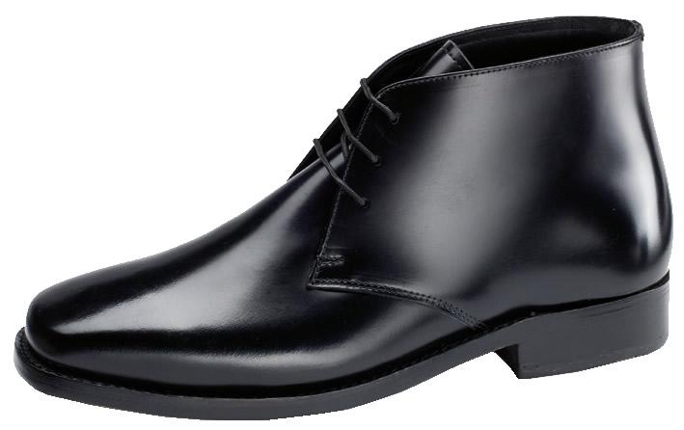
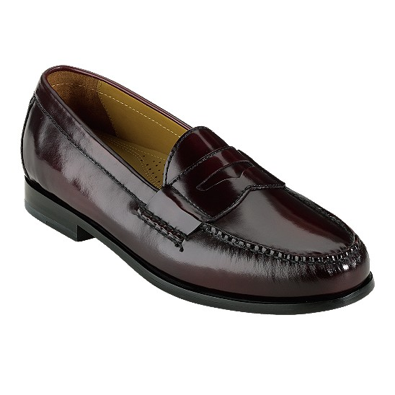
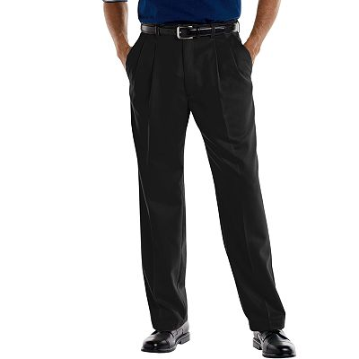
What to wear for the interview...boys

Slide 22
Questions to ask the Interviewer:
What would a day on this job be like?
To whom would I report? May I meet this person?
Would I supervise anyone? May I meet them?
What training programs are offered?
What advancement opportunities are offered?
Why did the last person leave this job?
What is the greatest challenge of this position?
What plans does the company have with regard to… (here’s your opportunity to mention some project you’ve read or heard about)?
Is the company growing?
What do people like about working at…?

Slide 23
Questions to ask the Interviewer (cont.)
How do you see someone with my background and skills-set fitting within this organization?
Why should I work for your organization?
What is your vision for this department/role?
What is your background? How long have you been with the company, and why do you stay?
How do you remain competitive in the marketplace?
How quickly do you want to fill this position? How many people are you considering for this role?
Throughout our conversation today, is there anything you see in my background, skills, or impact I can have on this organization that still concerns you?

Slide 24
Before the Interview
Know where you are going and get there on-time!
Do a practice run if necessary
Research, research, research!
Make a list of common interview questions and prepare your answers
Make a list of questions YOU can ask
PRACTICE!
Consider recording yourself (pay attention to body language)
Know your availability (when can you start?
Be prepared for drug or other necessary testing

Slide 25
Before the Interview (cont.)
Dress appropriately
Avoid perfume/cologne if possible
Cover up piercings/tattoos
Be conscious of your jewelry choices
Brush your teeth! (dragon breath never makes a good impression)
NO gum – spit it out before you even go in the building
Be punctual – arrive at least 10 min early (15 is even better)

Slide 26
During the Interview
Greet EVERY single person in the room
Eye contact
Handshake
Handshakes – firm, but not too firm
Voice control
No slang
Use good posture
No slouching
Don’t cross legs above knee
Don’t shake your legs (RLS)

Slide 27
During the Interview (cont.)
Don’t sit down until you are asked to
Don’t fidget (you’ll look nervous)
Watch your body language
Keep hand talking to a minimum (some is OK, don’t overdue it)
Be ready to SELL YOURSELF!
This is about YOU!
If you are given something to drink, sip it – no gulping/chugging

Slide 28
During the Interview (cont.)
SMILE ☺
Nod your head on occasion when they are talking to you (you don’t want to look like a mannequin)
Look interested in what the interviewer(s) have to say (even if they are boring)
Be specific and give details – yet try to be short and to the point
Avoid ‘uh’ or ‘umm’
Be confident
Maintain eye contact

Slide 29
During the Interview (cont.)
Multiple interviewers?
Look at them all while talking (don’t leave anyone out)
Ask questions!
This isn’t an interrogation! Plan on asking AT LEAST 1
DON’T ask things like “How many days off do I get?” or “When is my first vacation?”
Don’t clock watch
If left alone, don’t do anything you wouldn’t do in front of a group of people (you might be on candid camera)
Don’t flirt with anyone you meet!

Slide 30
After the Interview
When the interview has ended, SHAKE HANDS with EVERYONE once again and THANK them for their time
If you are still interested in the job, now is the time to say it!
Ask when an decision will be made
Send a THANK YOU note to your interviewer(s) immediately after leaving the interview
Go home, write down everything you can about the interview
What went well
What didn’t go so well?
Questions that stumped you?
Don’t be afraid to follow-up

Slide 31
Thank You Notes/Emails
Send a note or within 24-48 hours after the interview
Short and to the point (no more than a few paragraphs)
Emphasize again how much you would like to be part of their team
Demonstrate appreciation for the opportunity and the interviewer’s time
Add a personal touch
Highlight best parts of the conversation
Cover your qualifications
Quick recap of why you’d be perfect for the job
Forget to tell them something during the interview – here is your chance

Slide 32
Thank You Notes/Emails
Demonstrate a specific reason for your interest
Use what you learned in the interview to call out 1 or 2 aspects of the company/culture you like, and reasons you want to work there
Close with clarity
Firm reiteration of your interest “I look forward to taking the next step in the hiring process. Thank you again for your time and I hope to talk to you soon.”
Be authentic
Hiring managers are on the hunt for UNIQUE candidates. Read your letter aloud. Make sure it sounds conversational, authentic, and unique.

Slide 33
Additional Resources
#1 Tell me about yourself.
https://admitspit.wordpress.com/2006/09/23/tell-me-about-yourself-interview-samples/
#7 & #8: What are your strengths and weaknesses?
http://www.binghamton.edu/ccpd/students/undergraduate/resumes-cover-letters-interviews/explaining-strengths-and-weaknesses.html
#19 and #20 What are your long term and short term goals?
http://oureverydaylife.com/difference-between-short-term-goals-long-term-goals-high-school-students-14923.html
https://collegegrad.com/tough-interview-questions/what-are-your-short-term-goals

