Slide 1
Credit Reports and Scores
Advanced Level

Slide 2
The Credit Process
Credit – goods, services, and/or money received in exchange for a promise to pay back a definite sum of money at a future date
Borrower
Someone who receives something with the promise to return it or to repay what is borrowed
Lender
Credit History
Person or organization who makes funds available for others to borrow
Record of the borrower’s past loan and credit-related transactions

Slide 3
How Credit Reports are Created
Lender
Reports a consumer’s account history to CRA’s
Credit Report Agencies (CRA’s)
Keep a record of a consumer’s account history (credit history)
Credit Reports
Record, created by a CRA, of an individual’s credit history

Slide 4
Credit Reporting Agencies
Three U.S. Agencies:
- Equifax
- Experian
- TransUnion
If credit has never been used (or reported) an individual will not have a credit report
A person’s credit report may vary across the three CRA’s

Slide 5
Credit Report Detectives
Meet Isabella, your new client
In small groups, read about Isabella
Underline any areas of financial concern
Your Mission:
Help Isabella understand her credit report
Identify what she did to get into this situation
Decide what she can do to improve her credit report

Slide 6
Information in a Credit Report
Four Categories
Consumer (personal) Information
Credit Account Information
Public Record Information
Inquiry Information

Slide 7
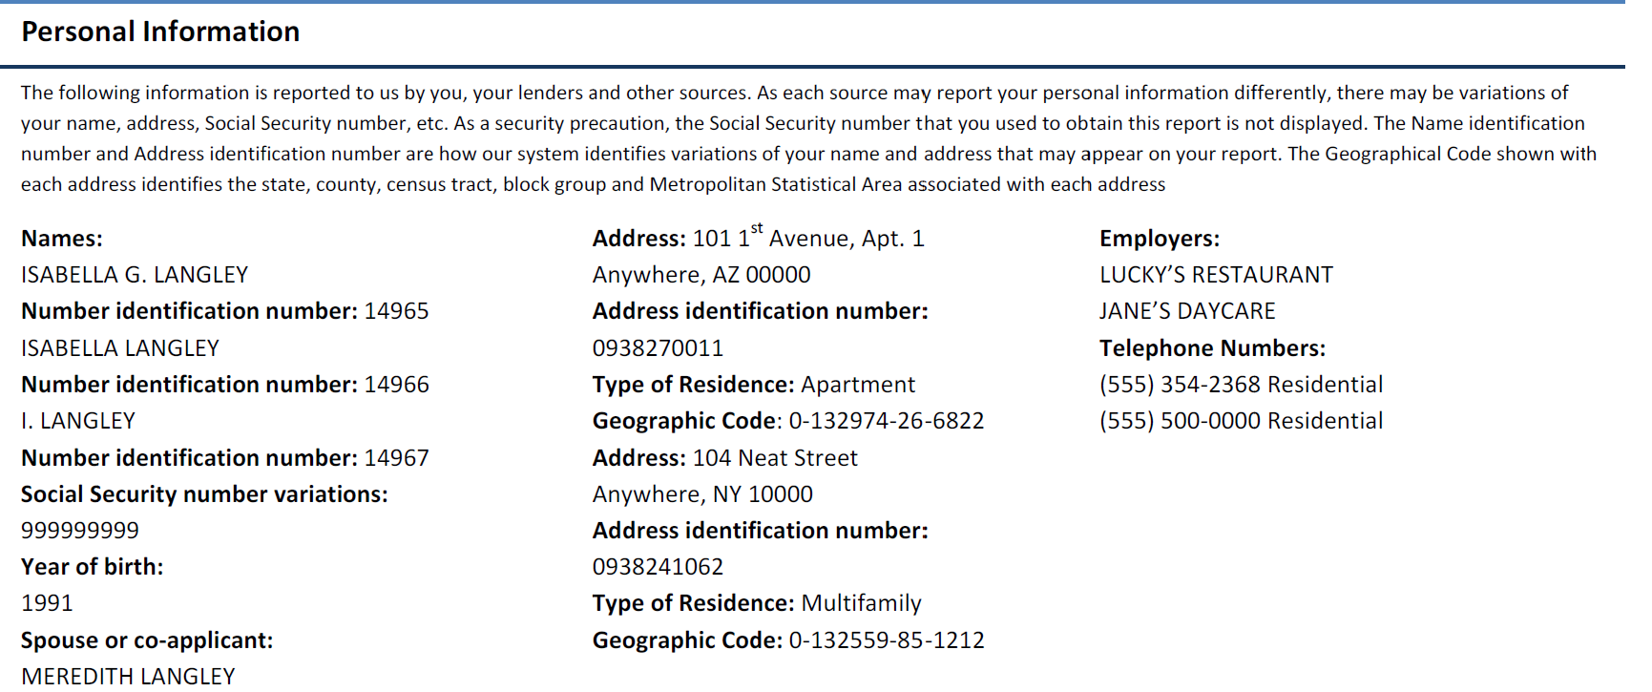
Consumer (personal) Information
Information provided to lenders when applying for credit
Name
Current and previous addresses
Telephone number
Full or partial social security number
Date of birth
Employment history
Place a  next to Isabella’s personal information

Slide 8
Credit Account Information
Specific information about each credit account you have or have had
Types of Information
Type of Credit
Loan Amount or Credit Limit
Account Balance
Date
Payment Information

Slide 9
Types of Credit
Closed-end credit (installment)
Open-end credit (revolving)
Borrower repays a specified number of equal payments
Line of credit established in advance
Definition
Contract outlines repayment terms
Borrower chooses how much to pay
Features
Examples
Automobile loans Education loans Mortgages
Credit cards

Slide 10
Types of Credit
What section of the Sam’s Electronic
World account on Isabella’s credit
report describes the type of credit?
SAM’S ELECTRONIC WORLD
Address: Account Number: 123 MAIN STREET 3624**** ANYWHERE, AZ 00000
Status: Open/Past due 60 days.
Date Opened: 02/2009 Reported Since: 02/2010 Date of Status: 10/2012 Last Reported: 10/2012 | Type: Revolving Terms: N/A Monthly Payment: $0 Responsibility: INDIVIDUAL | Credit Limit/Original Amount: $500 High Balance: $550 Recent Balance: $84 as of 11/2012 Recent Payment: $0
Account History: 60 days as of 10-2012 30 days as of 09-2012
Is this a closed-end or open-end credit account?

Slide 11
Loan Amount/Credit Limit
Closed-end Total amount of loan
Open-end Credit limit
(maximum dollar amount that can be borrowed)
SAM’S ELECTRONIC WORLD
Address: Account Number: 123 MAIN STREET 3624**** ANYWHERE, AZ 00000
Status: Open/Past due 60 days.
Date Opened: 02/2009 Reported Since: 02/2010 Date of Status: 10/2012 Last Reported: 10/2012 | Type: Revolving Terms: N/A Monthly Payment: $0 Responsibility: INDIVIDUAL | Credit Limit/Original Amount: $500 High Balance: $550 Recent Balance: $84 as of 11/2012 Recent Payment: $0
Account History: 60 days as of 10-2012 30 days as of 09-2012
What sections of Sam’s Electronic World account describe loan amount/ credit limit?

Slide 12
Date Account Was Opened
What section of Sam’s Electronic World account describes date opened?
SAM’S ELECTRONIC WORLD
Address: Account Number: 123 MAIN STREET 3624**** ANYWHERE, AZ 00000
Status: Open/Past due 60 days.
Date Opened: 02/2009 Reported Since: 02/2010 Date of Status: 10/2012 Last Reported: 10/2012 | Type: Revolving Terms: N/A Monthly Payment: $0 Responsibility: INDIVIDUAL | Credit Limit/Original Amount: $500 High Balance: $550 Recent Balance: $84 as of 11/2012 Recent Payment: $0
Account History: 60 days as of 10-2012 30 days as of 09-2012

Slide 13
Account Balance
Amount the borrower still has to pay back to the lender
What section of Sam’s Electronic World account describes account balance?
SAM’S ELECTRONIC WORLD
Address: Account Number: 123 MAIN STREET 3624**** ANYWHERE, AZ 00000
Status: Open/Past due 60 days.
Date Opened: 02/2009 Reported Since: 02/2010 Date of Status: 10/2012 Last Reported: 10/2012 | Type: Revolving Terms: N/A Monthly Payment: $0 Responsibility: INDIVIDUAL | Credit Limit/Original Amount: $500 High Balance: $550 Recent Balance: $84 as of 11/2012 Recent Payment: $0
Account History: 60 days as of 10-2012 30 days as of 09-2012

Slide 14
Payment Information
What sections of Sam’s Electronic World account describe payment information?
SAM’S ELECTRONIC WORLD
Address: Account Number: 123 MAIN STREET 3624**** ANYWHERE, AZ 00000
Status: Open/Past due 60 days.
Date Opened: 02/2009 Reported Since: 02/2010 Date of Status: 10/2012 Last Reported: 10/2012 | Type: Revolving Terms: N/A Monthly Payment: $0 Responsibility: INDIVIDUAL | Credit Limit/Original Amount: $500 High Balance: $550 Recent Balance: $84 as of 11/2012 Recent Payment: $0
Account History: 60 days as of 10-2012 30 days as of 09-2012

Slide 15
Public Records
Information from federal, state and county
public court records
Collection Agencies
Bankruptcy
Tax liens
Foreclosure
Businesses hired by lenders to pursue payments on debts not paid back according to contract terms
Taxes not paid in full
Borrower fails to keep up with mortgage payments and the lender takes possession of the property
When an individual or business is not able to repay outstanding debts
Does Isabella have any public records?

Slide 16
Potentially Negative Items
Public Records Credit lenders may carefully review the listed items below when they check your credit history. Please note that the account information with some public records, such as a lien or judgment, may also appear later in this report.
CITY OF ANYWHERE COURT CLERK
Address: Identification Number: 1 COURTHOUSE LANE 10-11-15 ANYWHERE, AZ 11000 |  | Plaintiff: CITY OF ANYWHERE
Status: Collection account. $680 past due as of 12-2012 |  | Status Details: The item was verified and updated as in Dec 2012.
Date Filed: 06/01/2012 Date Resolved: N/A Responsibility: INDIVIDUAL | Claim Amount: $358 Liability Amount: N/A
MAIN COLLECTION AGENCY
Address: Account Number: 1001 TOWN BLVD 000102331**** ANYWHERE, AZ 10000
Status: Collection account. $680 past due as of 01-2013
Date Opened: 07/2004 Reported Since: 08/2004 Date of Status: 10/2012 Last Reported: 10/2012 | Type: Revolving Terms: N/A Monthly Payment: $0 Responsibility: INDIVIDUAL | Credit Limit/Original Amount: $550 High Balance: $680 Recent Balance: $680 as of 10/2012 Recent Payment: $0
Account History: 90 days as of 05-2012 60 days as of 04-2012 30 days as of 03-2012
Unpaid traffic ticket which City of Anywhere turned over to Main Collection Agency

Slide 17
Inquiry Information
Requests for an individual’s credit report
Must be a result of actions by the consumer
Or
Be a result of a permissible purpose
Place a ☺ next to Isabella’s inquiry information
Isabella’s Actions:
- Keeping You Insured
Permissible Purpose:
- The Dream Sales Job
- Flexperian
- Keeping You Insured
- Need More Credit?

Slide 18
Inquiry Information
Potentially Negative
Typically No Impact
Seeking additional credit
Inquiries not initiated by you
Impact is reduced if shopping for the same type of loan within a 14-day period
Inquiries not related to credit
Checking your own report

Slide 19
Types of Lenders Who Report to CRA’s
Depository institutions
Credit card companies
Retail stores that offer credit accounts
Mortgage and finance companies
Lenders report
all information, positive and negative
What type of lenders have reported about Isabella?

Slide 20
Types of Data Furnishers Who Report to CRA’s
Landlords
Cell phone companies
Utility accounts
Medical providers (payment information only)
Data Furnishers report
when money is owed
to them
CRA’s are encouraging regular payment information to be reported to help consumers build a positive credit history.
What is an example of a data furnisher on Isabella’s report?

Slide 21
Information Not in a Credit Report
Medical information about where the person was treated and for what
Race & Gender
Religion & Nationality
Non-credit depository institution accounts
Criminal background
Buying habits

Slide 22
Your Present Self Impacts Your Future Self
Some items remain on your credit report longer than others
Always
Accounts in good standing
10 years
Closed accounts in good standing
7 years
Late or missed payments
7-10 years
Public record information
2 years
Inquiries

Slide 23
Credit Score
Reflects information in the entire credit report
At a particular point in time
Numeric “grade” of a consumer’s financial reliability
Examples: Fair Isaac, Corp (FICO) and VantageScore
Mathematical number created to help evaluate the risk with lending a consumer money

Slide 24
Credit Scores
Most common scoring systems are produced by credit reporting agencies:
Scoring System | Score Range
FICO | 300 - 850
VantageScore | 501 - 990
Generally, higher score = higher chance of credit repayment
How the score is calculated depends on the credit scoring model

Slide 25
Credit Score Impact
Credit history helps a lender determine the terms of credit granted
Example: $15,000 loan (3 year fixed automobile)
FICO Score | Interest Rate | Monthly Payment | 3 Year Amount
730
6.16%
$457
$16,452
660
8.77%
$475
$17,100
590
14.43%
$516
$18,576
$2,124 can be saved over the lifetime of this loan because of a good credit score!

Slide 26
Credit History Affects More than Credit
Insurance Rates
Employment
Public Utility Services
Housing
What are examples of how Isabella’s credit history is affecting her financial well-being?

Slide 27
Positive Credit History
Pay your bills consistently and on time
Maintain reasonable amounts of available credit
Apply for credit sparingly
Have a mix of different types of credit accounts
Do not have too many of one type of account
Check your credit report annually
Positive Credit History
Higher Credit Score

Slide 28
Strategies to Build Credit
Acquire and positively manage small lines of credit
Small closed-end loan
From a depository institution
Credit card with a co-signer
Secured credit card
Requires a cash security deposit
Ensures the credit card company will be paid
Authorized user on a credit card
Set up automatic payments
Co-signer – person who is equally responsible for paying back debt
Authorized user is not legally responsible for the debt but they will build a credit history
Having no credit history may be just as challenging to a consumer as having a negative history

Slide 29
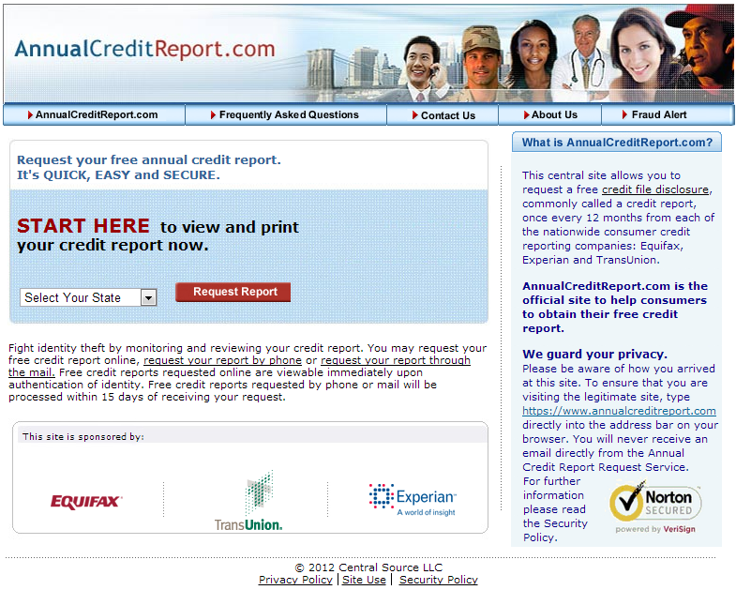
Requesting a Credit Report
One free credit report annually from each of the three credit reporting agencies
If denied credit, the applicant can request a free copy within 60 days
Important to request your report even if you have not used credit
Only government-sponsored free website

Slide 30
Accessing Your Credit Score
Must be ordered separately
Usually costs a fee
The 3 CRA’s are the primary source
Scores may differ between each CRA

Slide 31
If an Error is Found
Contact the CRA & company that provided the incorrect information
Credit agency has 30 days to investigate
If error found, correct information must be provided to all three CRA’s
If dispute is not resolved, consumer may add a dispute statement to their report
Place a ◻ next to Isabella’s personal statement section

Slide 32
Credit Repair Agencies
Offer to help a consumer “fix” his/her negative credit report
According to the Better Business Bureau (BBB) and the Federal Trade Commission (FTC):
Consumers can do just as good of a job repairing their credit report errors as a fee-based debt repair agency
Be cautious of debt repair agencies promising instant help because there is no immediate fix for negative credit

Slide 33
Talitha and Brendan’s Advice
Review Isabella Langley’s Story
Identify two pieces of advice both Talitha and Brendan provided
Determine if the advice was good and why or why not

Slide 34
Advice Isabella Was Given
From Talitha
Credit ratings improve as people get older and earn more
From Brendan
Shopping around too much for credit is not good because it increases inquiries
From Both
Close old accounts, including those with loans not paid on time to wipe the slate clean
Isabella’s credit score will improve as soon as she:
Settles her delinquent accounts
gets a better interest rate on existing loans
Opening new accounts, even if not used, provides evidence of credit worthiness
Pay someone else to fix her credit
Isabella’s credit score will improve as soon as she:
Opening new accounts, even if not used, provides evidence of credit worthiness
Pay someone else to fix her credit
Settles her delinquent accounts
gets a better interest rate on existing loans

Slide 35
Credit Report Detective’s Advice
What are three pieces of advice for Isabella?
Pay her Sam’s Electric World card so it is not past-due
Settle her traffic ticket so she is no longer in collections
Create and use a spending plan so as not to rely so heavily on credit
Set up automatic payments so that her credit payments are never late
Contact her school loan agencies to set up a payment plan
Pay down her credit card balances by paying more than the minimum payment
Continue monitoring her credit reports
Talk to Talitha and Brendan to educate them on what she learned.

Slide 36
Summary
Credit history
Used to assess financial risk
Credit score
Enables lenders to make more objective lending decisions
Manage your money responsibly
To develop a positive credit history
Your Present Self Impacts Your Future Self

