Slide 1
Branding
Sports & Entertainment Marketing

Slide 2
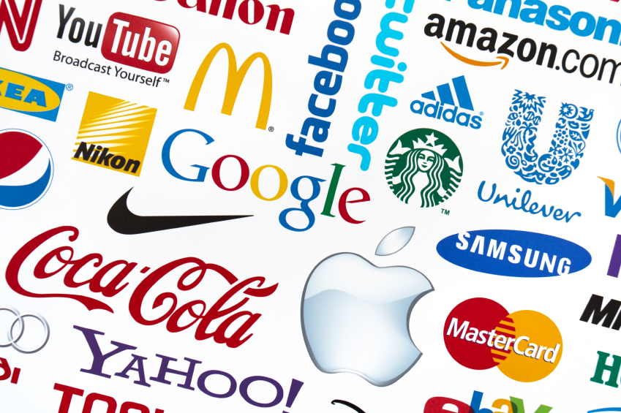
Review
What is a brand?
The use of a name, design, symbol, or a combination of those elements to help differentiate a company’s products from the competition

Slide 3
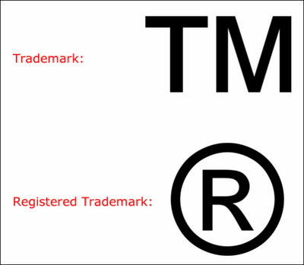
Review
What is a trademark?
When a brand is registered (identifies legal ownership of the brand)

Slide 4
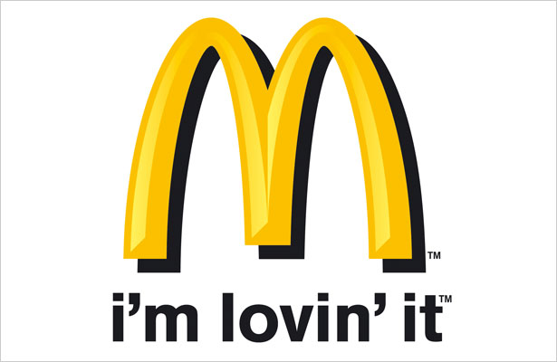
Slogans
What is a slogan?
A catch phrase or small group of words that are combined in a special way to identify a product or company (also called catch line/tag line)
Often accompanying a logo

Slide 5
Slogans Quiz 7
Betcha can't eat just one
An American Revolution
Drivers wanted
Breakfast of champions
Just Do It
Ultimate Driving Machine
Sometimes you feel like a nut, sometimes you don’t
Raise your hand if your sure
It’s everywhere you want to be
Plop, plop, fizz, fizz, oh what a relief it is
Don’t leave home without it
Have it your way
It’s the cheesiest

Slide 6
More Slogans
Can you name other slogans?
Why are some so easy to remember?

Slide 7
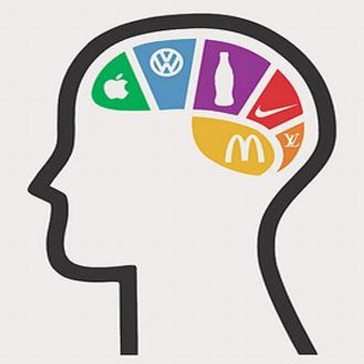
Brand Building
Brand Awareness
Process of working toward maximizing recognition of a particular brand
Brand Image
Consumer perceptions linked to a particular brand (health, excitement, fun, family, etc.)
Example: Disney brand is associated with family fun and entertainment

Slide 8
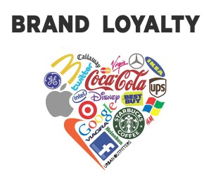
Brand Building Cont.
Brand Equity
Value placed on a brand by consumers
Example: Nike has strong brand equity because consumers have long associated the brand with top level athletes and quality products
Brandy Loyalty
Consumer preference for a particular brand as compared to competitor products or services

Slide 9
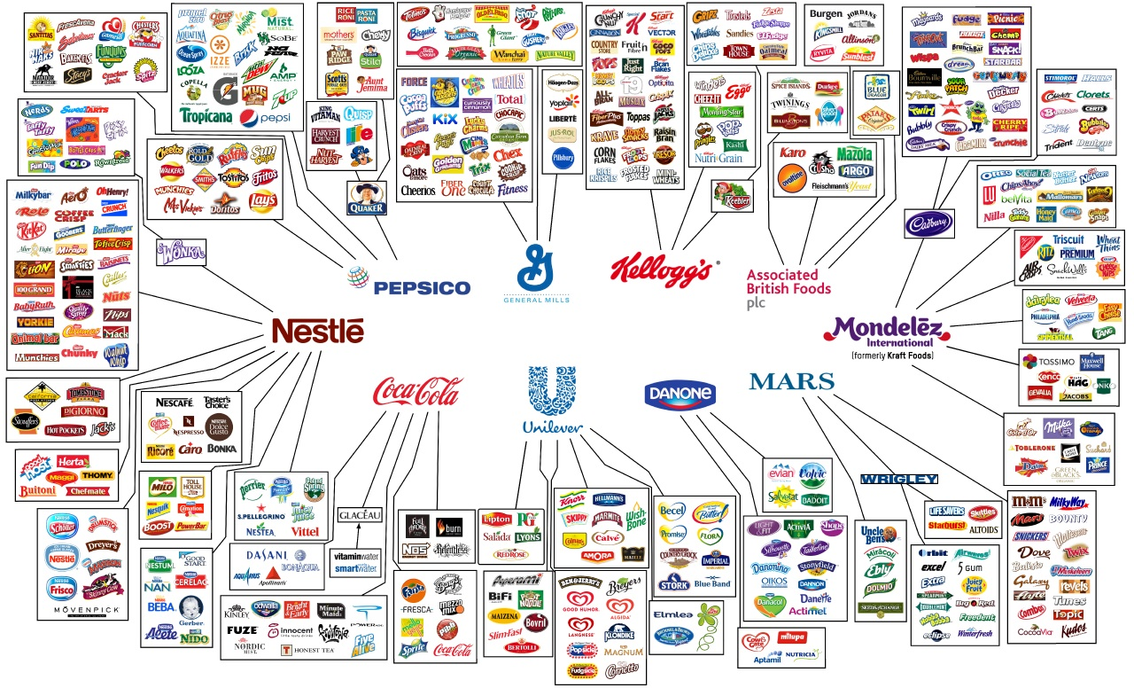
Forms of Branding

Slide 10
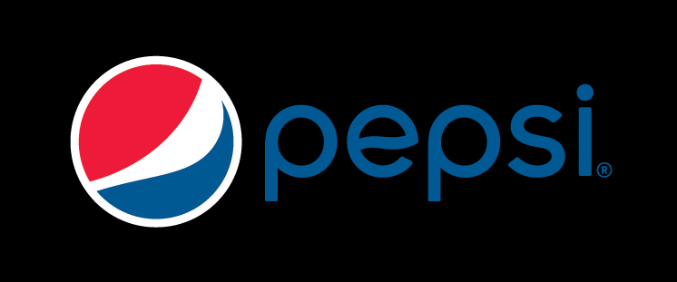
Forms of Branding
Corporate Brand
Represents an entire company or organization
Examples: Pepsi-Cola, McDonalds, Frito-Lay
Product Brand
Represents a particular product of a company or organization
Examples: Diet Pepsi, Chicken McNuggets, Fritos

Slide 11
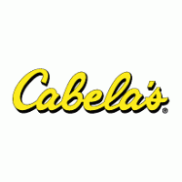
Forms of Branding Cont.
Store Brands (also called Private Labels)
Products retailers sell as their own brands
Examples: Walmart carrying Great Value brands, Hy-Vee carrying Hy-Vee brand, Cabela’s carrying Under Armor and other brand name items, but also have their own “Cabela’s” brand

Slide 12
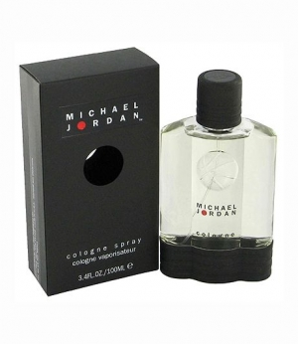
Branding in SEM
Brand Extension
Using a successful brand name to launch a new or modified product or service in a new market
Examples:
P. Diddy and Eminem have used brand extension to develop their own clothing lines (Sean John Clothing and Shady Clothing)
Michael Jordan introducing own brand of cologne
David Beckham – soccer academy in London, male fragrance, movies, Adidas apparel

