Slide 1
BUSINESS EDUCATION & INFORMATION TECHNOLOGY
2017-18
LINCOLN NORTHEAST HIGH SCHOOL
COURSES THAT WILL TAKE YOU PLACES!

Slide 2
What is the most popular major in college?
Did you know it is BUSINESS ADMINISTRATION AND MANAGEMENT?? (according to a number of sources)
What are the top 10 college business majors??
(check this web site--15 best paying jobs for college business majors—2016)

Slide 3
So what are your choices? Which path will you take??
Recommended for ALL! | Path: Business Administration | Path: Information Technology
Take Charge—Graduation Requirement** | Accounting and/or College Accounting | Information Technology 1
Business Economics—meets Economics graduation requirements | Business Economics | Information Technology 2
Information Technology 1 | Business Management (next offered 2018-19) | Intro to Digital Design
World of Business—a great introduction class; an especially important class if TCA is a goal of yours | Sports & Entertainment Marketing (next offered 2017-18) | Digital Media 1
 | College Personal Finance | Digital Media 2
 | Business Law (next offered 2018-19) | Web Page Programming
 |  | Creative Coding through Games & Apps

Slide 4
TAKE CHARGE
Grades
11-12
Graduation Requirement
Money management, budgeting, financial goals, use of credit, insurance, etc.
Personal Finance/Career Planning
Scholarships, Resumes, Interviewing, Job Shadowing

Slide 5
KEYBOARDING
Grades
9-12
1 Semester
5 credits
Improve your touch typing skills!
If you can already type 35 wpm—try another class
This course does NOT meet technology requirements

Slide 6
WORLD OF BUSINESS
Grades 9/10
Explore all areas of business
Course required for many TCA pathways!
Fun and interactive projects!
No homework!
No tests!

Slide 7
ACCOUNTING
Grades
10-12
Accounting is a requirement of most business degrees!
2 Semesters 10 credits
Good Prerequisite before College Accounting
How will you know if your business is making money?
How will you know if someone is stealing from your business?
ANSWER: ACCOUNTING!

Slide 8
BUSINESS ECONOMICS
Grades
10-12
1 Semester
Understanding economics is crucial in making business decisions as a business owner or community leader
Meets Economic Graduation
Requirement
Meet Lincoln business leaders through Junior Achievement

Slide 9
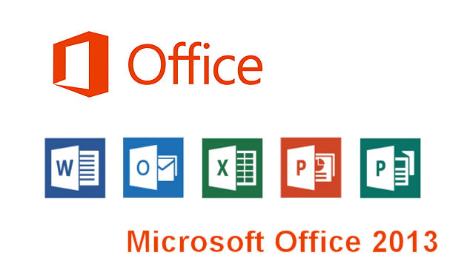
INFORMATION TECHNOLOGY 1
Grades
9-12
MOS Certification possibility! (Microsoft Office Suite)
This is a good first computer course
Does UNL College of Business Administration require that you have Microsoft skills??
1 Semester
Word Processing, Spreadsheet, Database, Presentation

Slide 10
INFORMATION TECHNOLOGY 2
9-12
Prereq-uisite: Info Tech 1
1
Semester
Become certified in MOS!
Does UNL College of Business Administration require that you have Microsoft skills??

Slide 11
INTRO TO DIGITAL DESIGN
Grades
9-12
Create graphics, animations, publications
Typography
Color
Imagery
Create a webpage portfolio of work
Adobe Illustrator, Photoshop, and InDesign

Slide 12
DIGITAL MEDIA 1
Grades
9-12
Adobe Photoshop, Animate, Audition, Premiere
Create videos, animations, graphics, web pages
1 Semester
Create a webpage portfolio of work

Slide 13
DIGITAL MEDIA 2
Grades 9-12
Advanced Projects focusing on student interests/current events of school/community
Prerequisite: Digital Media 1
1 Semester
Create a universal electronic portfolio showcasing your projects

Slide 14
WEB PAGE PROGRAMMING
Grades 10-12
Recommended Prerequisite:
Info Tech 1
Dual Credit with SCC
Learn to use HTML and CSS
Develop/Publish Web Pages

Slide 15
CREATIVE CODING THROUGH GAMES & APPS
Grades 9-12
Learn how to code by working in a real software development environment
Program and Publish Mobile Games & Apps
Create real games or apps

Slide 16
SPORTS & ENTERTAINMENT MARKETING
Grades
10-12
Sports and
Entertain-ment Careers
Fantasy Sports
The Academy Awards!
*Marketing yourself
*Marketing your ideas
*Marketing your business
Create a marketing plan for your own sports franchise!

Slide 17
BUSINESS MANAGEMENT
Grades
10-12
Want to OWN your own business??
Entrepreneurship!
Develop a business plan—you decide your business!
NEXT OFFERED: 2018-19

Slide 18
COLLEGE PERSONAL FINANCE
Grades
11-12
DUAL CREDIT with SCC
A good financial focus class to help juniors/seniors transition to college/independent living
WEIGHTED CLASS—Improve your GPA!
Earn national certification in financial literacy through the W!SE exam

Slide 19
COLLEGE ACCOUNTING
Grades
11-12
2 Semesters—instead of 1 semester in college!
10 LNE credits
4.5 SCC credits
DUAL CREDIT with SCC
Virtually the same class as your first semester of accounting in college—much friendlier pace and strong foundation of skills!
WEIGHTED CLASS—Improve your GPA!
Mr. Glathar says this was his toughest class in college! Take it in high school where success rate is much higher than in college!

Slide 20
**Work Experience**
Grades
11-12
(COURSE CAN BE REPEATED)
You need a pay-check job and you need to average 10 hours of work/week
EARN UP TO 10 ELECTIVE CREDITS/SEMESTER—Max of 20
See your counselor
Limited to those students who need to get caught up on credits OR who are trying to graduate early!

Slide 21
REGISTRATION FOR CLASSES WILL HAPPEN SOON! So. . . .
Jot down on your phone (or open a Doc on your Chromebook) the classes that are most interesting possibilities for you:
1 Business Administration Path class
1 Technology Path class
---------------see next slide for all of your choices--------------------------

Slide 22
Write 1 Business Admin class Write 1 Info Tech class Which path will you take??
Recommended for ALL! | Path: Business Administration | Path: Information Technology
Take Charge—Graduation Requirement** | Accounting and/or College Accounting | Information Technology 1
Business Economics—meets Economics graduation requirements | Business Economics | Information Technology 2
Information Technology 1—your “BEST” first computer class! | Business Management | Intro to Digital Design
World of Business—a TCA first step! | Sports & Entertainment Marketing | Digital Media 1
 | College Personal Finance | Digital Media 2
 | Business Law | Web Page Programming
 |  | Creative Coding through Games & Apps

