Slide 1
Learning Objective
LO1 Prepare an income statement for a merchandising business organized as a corporation.
© 2014 Cengage Learning. All Rights Reserved.

Slide 2
Uses of Financial Statements
Lesson 16-1
LO1
A corporation prepares an income statement and a balance sheet similar to those used by a proprietorship.
A corporation also prepares a statement of stockholders’ equity.

Slide 3
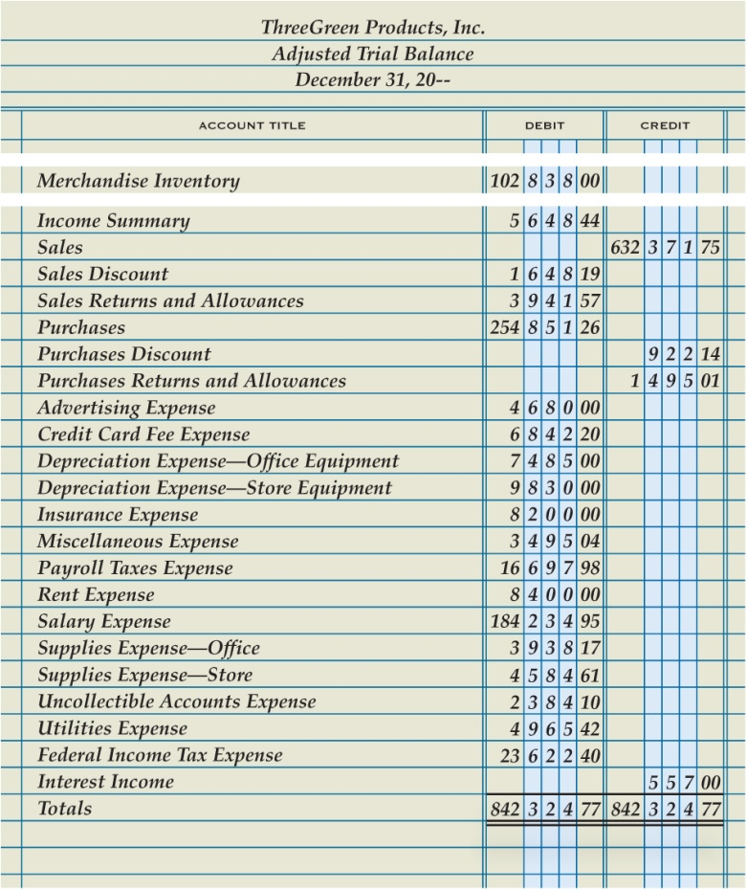
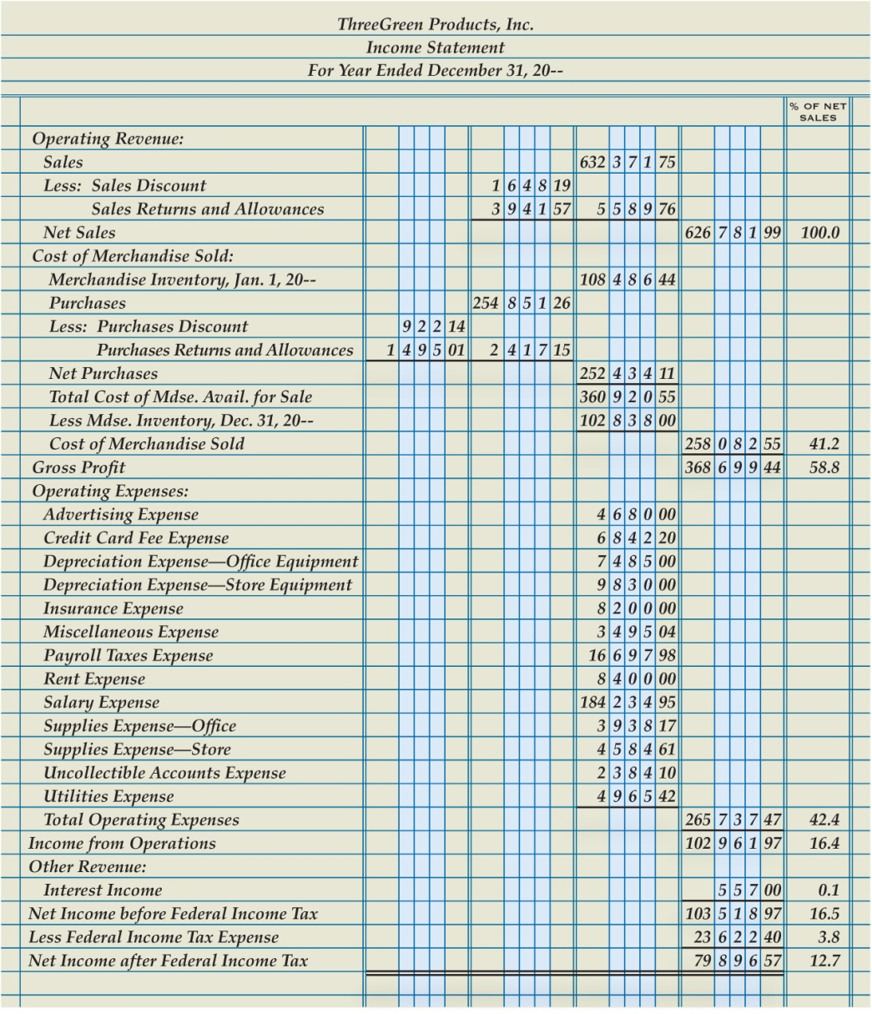
Preparing an Income Statement from a Trial Balance
Lesson 16-1
LO1

Slide 4
Operating Revenue Section of an Income Statement for a Merchandising Business
Lesson 16-1
LO1
The revenue earned by a business from its normal business operations is called operating revenue.
The amount of sales, less sales discounts and sales returns and allowances, is called net sales.

Slide 5
Operating Revenue Section of an Income Statement for a Merchandising Business
Lesson 16-1
LO1
Operating Revenue Section
1
Heading
2
5
Less Contra Accounts
4
Sales Amount
3
Title of Revenue Account
8
Net Sales
Contra Account Amounts
Net Sales
Amount
9
6
Contra Account
Total
7

Slide 6
Cost of Merchandise Sold Section of an Income Statement for a Merchandising Business
Lesson 16-1
LO1
The original price of all merchandise sold during a fiscal period is called the cost of merchandise sold.
Cost of merchandise sold is also known as cost of goods sold or cost of sales.
The operating revenue remaining after cost of merchandise sold has been deducted is called gross profit.
Gross profit is often referred to as gross profit on sales.

Slide 7
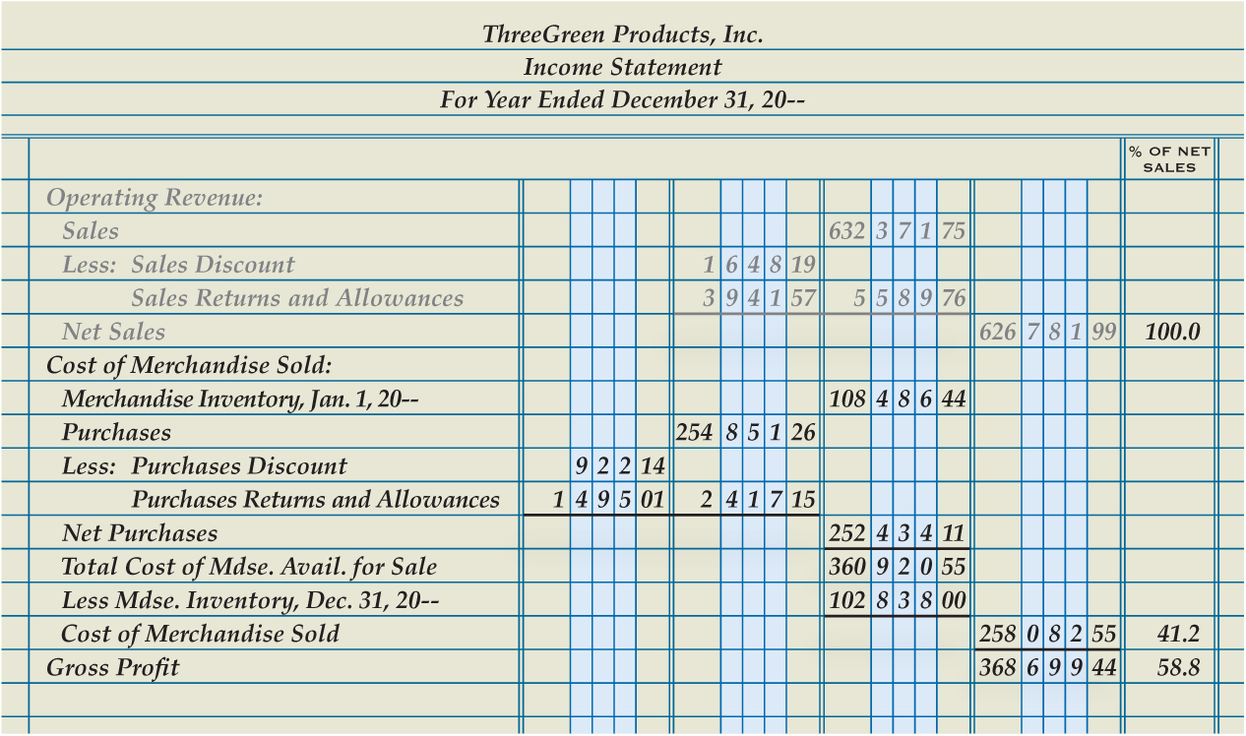
Cost of Merchandise Sold Section of an Income Statement for a Merchandising Business
Lesson 16-1
LO1
Cost of Merchandise Sold Section
Beginning Inventory
Vertical Analysis Percentages
1
2
8
Purchases Section
3
Ending Inventory
5
Gross Profit
7
6
Cost of Merchandise Sold
4
Total Cost of Merchandise Available for Sale

Slide 8
Cost of Merchandise Sold Section of an Income Statement for a Merchandising Business
Lesson 16-1
LO1
Total of adjacent column

Slide 9
Completing an Income Statement for a Merchandising Business
Lesson 16-1
LO1
The expenses incurred by a business in its normal operations are called operating expenses.
The operating revenue remaining after the cost of merchandise sold and operating expenses have been deducted is called income from operations.
Income from operations is also referred to as operating income.

Slide 10
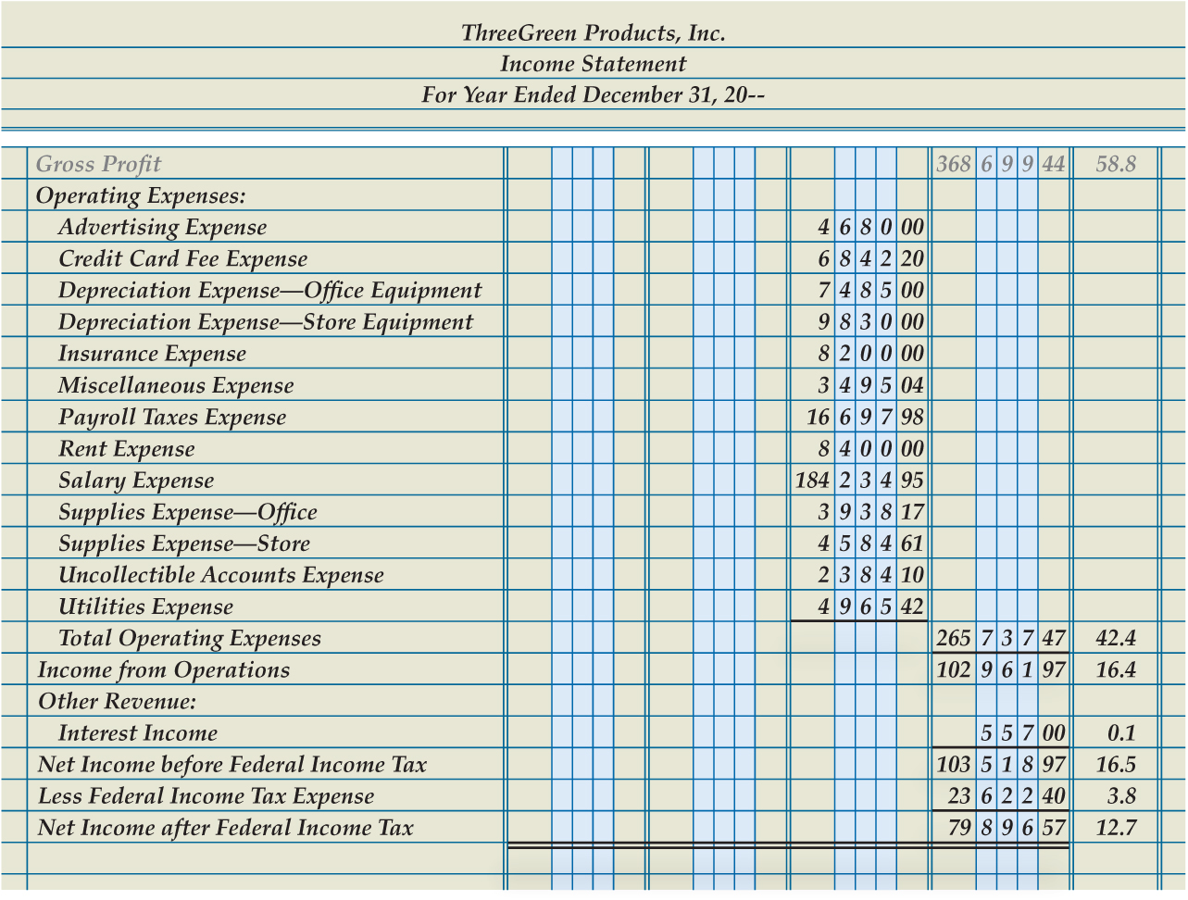
Completing an Income Statement for a Merchandising Business
Lesson 16-1
LO1
Operating Expenses Section
1
8
Vertical Analysis Percentages
Income from Operations
2
Other Revenue Section
3
7
Double Rules
Less Federal Income Tax Expense
6
Net Income after Federal Income Tax
4
Net Income before Federal Income Tax
5

Slide 11
Lesson 16-1 Audit Your Understanding
Lesson 16-1
1. What is the major difference between the income statements for merchandising businesses and service businesses?
ANSWER
The Cost of Merchandise Sold section

Slide 12
Lesson 16-1 Audit Your Understanding
Lesson 16-1
2. How is the cost of merchandise sold calculated?
ANSWER
Beginning merchandise inventory, plus purchases, equals total cost of merchandise available for sale, less ending merchandise inventory, equals cost of merchandise sold.

Slide 13
Lesson 16-1 Audit Your Understanding
Lesson 16-1
3. Why is interest income presented in a section other than Operating Revenue?
ANSWER
The interest earned on notes receivable is not a normal operating activity.

