Slide 1
Learning Objectives
LO6 Complete recordkeeping for a dishonored check.
LO7 Journalize an electronic funds transfer.
LO8 Journalize a debit card transaction.
© 2014 Cengage Learning. All Rights Reserved.

Slide 2
Recording a Dishonored Check on a Check Stub
Lesson 5-3
LO6
A check that a bank refuses to pay is called a dishonored check.
A check dishonored by the bank because of insufficient funds in the account of the maker of the check is called a non-sufficient funds check.
A non-sufficient funds check is also known as an NSF check.

Slide 3
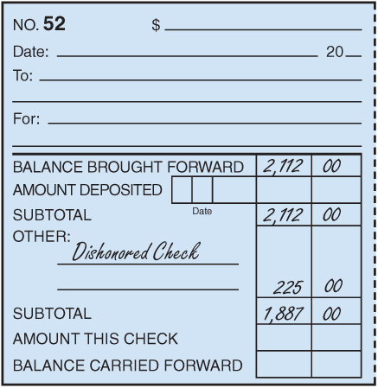
Recording a Dishonored Check on a Check Stub
Lesson 5-3
LO6
2
1
3
1. Write Dishonored Check under the heading Other.
2. Write the total of the dishonored check in the amount column. This is the amount of the dishonored check plus the service fee.
3. Calculate and record the new subtotal.

Slide 4
Journalizing a Dishonored Check
Lesson 5-3
LO6
August 29. Received notice from the bank of a dishonored check from Valley Landscaping, $185.00, plus $40.00 fee; total, $225.00. Memorandum No. 52.
Accts. Rec.—Valley Landscaping
225.00
Cash
225.00
1
Date
2
Debit
4
Source Document
3
Credit
1. Write the date in the Date column.
2. Write the title of the account to be debited in the Account Title column. Record the amount debited in the Debit column.
3. On the next line, indented, write the title of the amount credited in the Account Title column. Write the credit amount in the Credit column.
4. Write the source document number in the Doc. No. column.

Slide 5
Journalizing an Electronic Funds Transfer
Lesson 5-3
LO7
A computerized cash payments system that transfers funds without the use of checks, currency, or other paper documents is called electronic funds transfer (EFT).

Slide 6
Journalizing an Electronic Funds Transfer
Lesson 5-3
LO7
June 5. Paid cash on account to Murniak Enterprises, $380.00, using EFT. Memorandum No. 18.
Accts. Pay.—Murniak Enterprises
380.00
Cash
380.00
1
Date
2
Debit
4
Source Document
3
Credit
1. Write the date in the Date column.
2. Write the title of the account to be debited in the Account Title column. Record the amount debited in the Debit column.
3. On the next line, indented, write the title of the amount credited in the Account Title column. Write the credit amount in the Credit column.
4. Write the source document number in the Doc. No. column.

Slide 7
Journalizing a Debit Card Transaction
Lesson 5-3
LO8
A bank card that automatically deducts the amount of a purchase from the checking account of the cardholder is called a debit card.

Slide 8
Journalizing a Debit Card Transaction
Lesson 5-3
LO8
Supplies
June 8. Purchased supplies, $75.00, using debit card. Memorandum No. 21.
75.00
Cash
75.00
1
Date
2
Debit
4
Source Document
3
Credit
1. Write the date in the Date column.
2. Write the title of the account to be debited in the Account Title column. Record the amount debited in the Debit column.
3. On the next line, indented, write the title of the amount credited in the Account Title column. Write the credit amount in the Credit column.
4. Write the source document number in the Doc. No. column.

Slide 9
Lesson 5-3 Audit Your Understanding
Lesson 5-3
1. List six reasons why a bank may dishonor a check.
Get Audit Your Understanding handout from your teacher. Complete this and turn back into be graded. When correct, move on to Work Together and On Your Own for Lesson 5-3.

Slide 10
Lesson 5-3 Audit Your Understanding
Lesson 5-3
2. Which account is credited when electronic funds transfer is used to pay cash on account?

Slide 11
Lesson 5-3 Audit Your Understanding
Lesson 5-3
3. Which account is credited when a debit card is used to purchase supplies?

