Slide 1
Tuesday, May 5
Bell Ringer:
Which of the following two statements do you most agree with? Support your opinion with 2 to 3 sentences:
The government spends too much of our tax money giving handouts to too many people!
Too many people are suffering! There needs to be more assistance from our government!
Today:
Are your Chap 15 notes complete?
Begin Chap. 16

Slide 2
Government Spends, Collects, and Owes
Chapter 16

Slide 3
Government Growth
The government has grown considerably in the last 85 years. In 1929, the government employed slightly more than 3 million civilian workers.
Today, the government employs over 22 million civilian workers
2.7 million work for the federal government alone
With the Great Depression. . . .

Slide 4
Government Growth
Reasons for the increase:
Number of government functions has risen
Population has grown

Slide 5
Government Economic Involvement
Transportation
Highways
Bridges
Education
Property taxes
Equipment

Slide 6
Bring back the 60s!
State and local governments spent less than the federal government in the 1960s
Federal government paid for:
National defense
Salaries of Congress
Federal Judges
State department employees
Public works projects

Slide 7
Define
Public-works projects: publicly used facilities, such as schools and highways, built by federal, state, or local governments with public money
Paid for with tax dollars

Slide 8
Government Purchases

Slide 9
Why has government grown?
Our nation has become richer
People have demanded more government services to even out certain income inequities
Who should share in what is produced?
Today, total government purchases represent about 19% of GDP
Does NOT include interest payments on national debt or transfer payments such as welfare programs

Slide 10
The true size of government
Any discussion of the government’s size must include where the government spends these funds
Medicare: government program that provides health care for the aged
Government taxes individual workers
Government requires employees to provide this as well

Slide 11
Is growth good or bad?
How much is too much?
Government taxing and spending has opportunity costs
Government activity displaces private economic decision-making
Remember the production possibilities curve?

Slide 12
Government Intervention
Tylenol scare of 1982

Slide 13
Wednesday, May 6
BELL RINGER:
Explain 5 ways you or your family benefit from the government’s spending of our tax dollars. Explain in at least 2 sentences:

Slide 14
Last Junior Achievement session

Slide 15
The Functions of Government
Section 2

Slide 16
General Purpose of the Government
Protect individual rights
Promote a stable legal environment for economic activity
Promote policies that support the general well-being of all citizens

Slide 17
Providing Public Goods
Public Goods: goods or services that can be used by many individuals at the same time without reducing the benefit each person receives
Examples:
Street lights
Property rights

Slide 18
Merit vs. Demerit
Merit goods: goods deemed socially desirable by government leaders
Museums
Ballets
Classical music concerts
Demerit goods: goods which government officials have deemed socially undesirable
Tobacco
Alcohol
Gambling
Tax, regulate, prohibit the manufacture, use, or sale

Slide 19
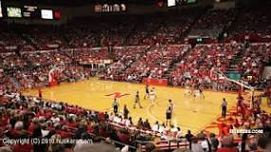
A little history on Nebraska’s cigarette tax. . . .
The cigarette tax is an EXCISE TAX (a tax on the manufacture of a good)
Nebraska tax: 64 cents/pack (20)
The tax started in 1947 as 3 cents/pack
Federal tax: $1.01/pack
In 2013, Nebraska was ranked 38th among states levying a tax (New York—first with $4.35/pack tax)
The Devaney center is the best known capital construction financed by cigarette tax revenue at a cost of $13 million, which opened in 1976.
Nebraska Excise Taxes

Slide 20
Promoting the General Welfare
The government provides assistance to those who do not have sufficient income for a tolerable level of living
Aged
Ill
Poor
Tax dollars are used to subsidize two general categories of assistance:
Social-insurance programs
Public-assistance programs

Slide 21
Government Programs: Help or Handouts
Note—John Stossel is known for his conservative views regarding government
There are always at least 2 sides to the argument; this video clip tries to present both sides of “Handout or Help.”
John Stossel video clip: (approx 7 min)

Slide 22
Video Take Away
Complete the Questions from the video and turn into tray.
Notes:
Feel free to discuss as long as time allows and students are willing to participate.

Slide 23
Promoting the General Welfare
Income redistribution: government activity that takes income from some people through taxation and uses it to help citizens in need

Slide 24
Social-Insurance Programs
Social-insurance programs: government programs that pay benefits to retired and disabled workers, their families, and the unemployed
Financed by tax payers
Example:
Social Security: federal program that provides monthly payments to people who are retired or unable to work

Slide 25
Social-Insurance Programs
Workers’ compensation: government program that extends payments for medical care to workers injured on the job
Unemployment insurance: provide income temporarily to people who are unemployed through no fault of their own.
Must actively be seeking employment
All programs are in place to act as a “safety net” and NOT serve as primary income

Slide 26
Thursday, May 7
Bell Ringer:
Please contrast the difference between merit and demerit goods giving two examples of each (other than those provided in the notes). Be sure you have at least 2 complete sentences.
Continue Section 2
Begin Sections 3/4

Slide 27
Public-Assistance Programs
Public-assistance programs/Welfare: government programs that make payments to citizens based on need
Based on NEED
Doesn’t matter whether or not the individual has paid taxes into the program
Supplemental Security Income: federal programs that include food stamps and payments to the disabled and aged
Covers basic needs for food, clothing, and shelter
SNAP

Slide 28
Supplemental Security
Temporary Assistance for Needy Families: state-run program that provides assistance and work opportunities to needy families

Slide 29
Health Care Costs
Medicaid: state and federal public-assistance program that helps pay health care costs for low-income and disabled persons

Slide 30
Regulating Economic Activity
Externalities: economic side effects or by-products that affect an uninvolved third party; can be negative or positive

Slide 31
Ensuring Economic Stability
Smoothing the ups and downs in the nation’s overall business activity
Shield citizens from the harmful effects of:
Business fluctuations
Unemployment
High inflation
Recessions
Depressions

Slide 32
Government Regulation

Slide 33
Critics of Government Involvement
Opponents of redistribution programs think that most government assistance discourages:
Personal initiative
Affects incentives
Harm self-development
Also believe that most regulations raise the prices of goods and services

Slide 34
The Federal Budget and the National Debt
Section 3

Slide 35
Scarcity!
To carry out all of its functions, government must spend large sums of money.
Because all resources are scarce, an increase in spending in one area will cause a decrease in spending in some other area

Slide 36
The Budget-Making Process
A complicated budget-making process goes on every year, not just in Washington, D.C., but in every state and local government as well.
State and local budgeting processes vary, but the federal government follows the same process every year.

Slide 37
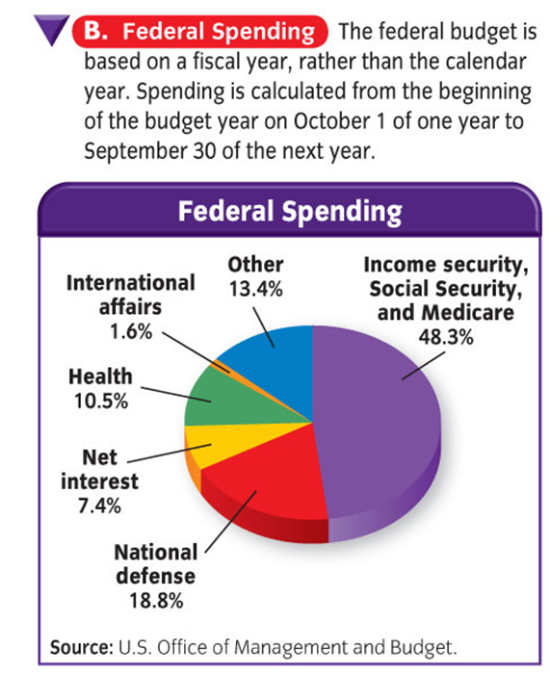
Federal taxation and spending

Slide 38
October 1-September 30
Fiscal year: year by which accounts are kept; for the federal government, October 1 to September 30 of the next year
Roughly 18 months before the fiscal year begins on October 1, the executive branch of the government begins to prepare a budget.
President
Office of Management and Budget (OMB)
Congressional Budget Office (CBO)

Slide 39
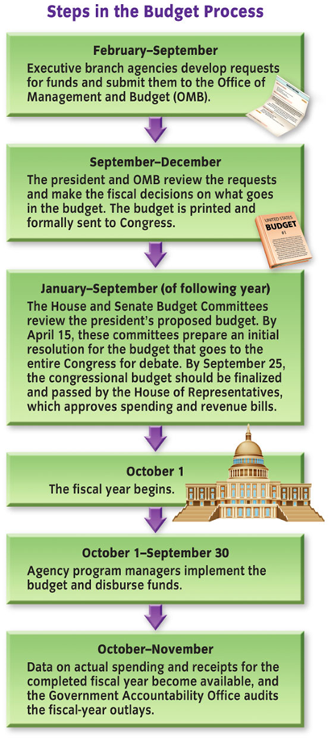
The Process

Slide 40
The National Debt
Most years, the government spends more than it collects in taxes
Budget Deficit: situation when the amount of government spending exceeds its receipts during the fiscal year
When this happens, the government may need to borrow money, similar to a consumer overspending and having to borrow money

Slide 41
The National Debt
Deficit Financing: government policy of spending more money than it is able to bring in through revenues
Government sells securities such as US Savings Bonds
National Debt: total amount of outstanding debt for the federal government
Current national debt = U.S. DEBT CLOCK.ORG
(be sure you get the first 6-8 #s or so)

Slide 42
Friday, May 8
Bell Ringer:
Name as many different taxes you or your family pay (i.e. Sales Tax, . . . . . ., . . . . . . . .)
Today:
Finish Chap 16 (Section 4)
Review types of taxes
Hand out Final Review
Quiz?
Monday:
Chapter 17 segments
Tuesday:
Chapters 14, 15, 16, 17 REVIEW
Wednesday:
Chapters 14-17 EXAM (last summative)
Next Friday (5/15):
LAST DAY TO SUBMIT
BUS ECON ASSIGNMENTS/RETAKE/TAKE TESTS

Slide 43
Bring back the 90s!
In 1998, the government revenues exceeded expenditures during the fiscal year.
Budget surplus: situation when the amount of government receipts is larger than its expenditures during the fiscal year

Slide 44
Flip Flop
When President George W. Bush took office in 2001, the government was projecting a 10-year budget surplus of $5.6 trillion.
In less than three years, the government was projecting deficits totaling $4.4 trillion in the next 10 years.

Slide 45
What happened?!
After the terrorist attacks of September 11th, the federal government began spending a great deal on terrorist-related activities.
They also increased domestic spending at one of the fastest rates in US history, while at the same time cutting taxes
Ouch!

Slide 46
Taxation
Section 4

Slide 47
Show me the money!
YOU, the American tax payer, are the source of most of the funds the government spends.
Almost all federal, state, and local government revenue comes from taxes paid by individuals, small businesses, and corporations.

Slide 48
Principles of Taxation
Benefits-received principle: system of taxation in which those who use a particular government service support it with taxes in proportion to the benefit they receive; those who do not use a service do not pay taxes for it
Example: gasoline tax to pay for highway construction

Slide 49
Principles of Taxation
Ability-to-pay principle: principle of taxation in which those with higher incomes pay more taxes than those with lower incomes, regardless of the number of government services they use
Example:
Property taxes: figured as a percentage of the worth of your home. The more expensive your home, means the more money you have, means you pay more in property taxes each year.

Slide 50
Forms of Taxation
In the United States, there are 3 classifications of taxes.
Proportional Tax: tax that takes the same percentage of all incomes; as income rises, the amount of tax paid also rises; also called FLAT TAX.
Sales tax—everyone pays 7.0% tax no matter their income.

Slide 51
Forms of Taxation
Progressive Tax: tax that takes a larger percentage of higher incomes than of lower incomes; justified on the basis of the ability-to-pay principle
Tax brackets
The more money you make, the more you pay in taxes
Examples: 1. Federal Income Tax is progressive in that the tax rate increases as a person’s income increases. 2. Taxes on luxury items, for example, yachts and private jets, can be considered progressive as they would not normally be paid by lower income people and only paid by people wealthy enough to purchase such items.

Slide 52
Forms of Taxation
Regressive Tax: tax that takes a larger percentage of lower incomes than of higher incomes
A regressive tax is a tax that hits people with low income harder than people with high incomes. Social Security tax is an example. For 2007, you pay 6.2% tax on wages up to a maximum wage of $97,500. Therefore: a. A person who makes $30,000 a year pays $1,860 (30,000*.062) in tax or 6.2% of wages. b. A person who makes $200,000 a year pays $6,045 (97,500*.062) in tax or 3% of wages. c. A person who makes $500,000 a year still pays $6,045 in tax (97,500*.062) or 1.2% of wages. Since the richest people pay the smallest percentage of their income in tax, it is a regressive tax.

Slide 53
Major Taxes

Slide 54
Monday, December 9
Bell Ringer:
Please contrast the difference between merit and demerit goods giving two examples of each (other than those provided in the notes on Friday). Be sure you have at least 2 complete sentences.
Today:
A look at progress reports

Slide 55
Tuesday, April 29
Bell Ringer:
In 2 to 3 sentences, explain how government spending affects your life personally. Be sure to include at least 3 specific examples, i.e. you attend public school.
Today:
Begin Chapter 16, Section 2 notes
(New handout)
Video/Qs

