Slide 1
Splash Screen

Slide 2
Bell Ringer—May 12, 2014
We will do together—a review of Chapter 19 before beginning Chap 20.
Self-check

Slide 3
Bell Ringer—May 15, 2014
Review of Chap 20
Self-check
Today:
Review of Chap 20
Options:
Look over/review Chaps 19 & 20
Missing assignments—today is the last day for many assignments—see board
Self assessments (Chap 12 test or Chaps 13-17 test)
Work on FINAL review
Tomorrow:
Chaps 19&20 Summative (20-30 pts.)
Monday: Review

Slide 4
Chapter Intro 1
http://www.dailyfinance.com/photos/american-icons-that-are-foreign-owned/?photo=2#!slide=986022

Slide 5
Chapter Intro 1
The study of economics helps us deal with global economic issues and global demand on resources.

Slide 6
Chapter Menu
Chapter Introduction
Section 1: Reasons for and Results of Global Integration
Section 2: Direct Foreign Investment—Should We Be Worried?
Section 3: Multinationals and Economic Competition
Visual Summary

Slide 7
Chapter Intro 1
The study of economics helps us deal with global economic issues and global demand on resources.

Slide 8
Chapter Intro 2
How are you personally affected by activities in the global economy? In this chapter, read to learn why global integration is now a fact of life.

Slide 9
Section 1-Main Idea
Section Preview
In this section, you will learn about the technological developments that have led to the growth of the global market, as well as some of the outcomes of globalization.

Slide 10
Section 1-Key Terms
Content Vocabulary
global integration
telecommunications

Slide 11
Section 1
Improved Telecommunications
Advances in telecommunications have significantly reduced the cost of business.

Slide 12
Section 1
Improved Telecommunications (cont.)
Global integration has increased dramatically over the past several decades.
Improved telecommunications is one reason for this increase.
View: Decreasing Costs

Slide 13
Section 1
Improved Telecommunications (cont.)
Other inventions and factors that have influenced the rapid improvement in worldwide telecommunications:
Communications satellites
Fiber optic cables
The Internet

Slide 14
Section 1
Improved Telecommunications (cont.)
This increase in communications affects the world in many ways:
Other nations are changing their cultural tastes and buying habits.
Many people want to learn English as a second language.

Slide 15
Bell Ringer—Wednesday, May 14, 2014
What if. . .
you worked for a company that was some day purchased by a foreign company.
Predict your concerns, the advantages and disadvantages of working for a company owned by foreign investors.
Explain in 2 to 3 sentences
Today:
Finish Chap. 20 notes
Thursday:
SELF ASSESSMENT/REVIEW FOR FINAL
Friday:
Chap 19 & 20 Summative and Review for FINAL
Monday:
FINAL Review

Slide 16
Section 1
The Globalization of Financial Markets
U.S. government securities, foreign exchange, and stocks are now traded continuously around the world.

Slide 17
Section 1
The Globalization of Financial Markets (cont.)
Because of the speed and power of computers and the affordability of telecommunications, the world has become one financial market.
Trading in U.S. government securities is the world’s fastest growing 24-hour market.

Slide 18
Section 1
The Globalization of Financial Markets (cont.)
One problem with the worldwide stock market is that when the U.S. stock market falters, so do the stock markets worldwide.
An advantage is that it’s possible now to spread both banking and investment risks around the globe.

Slide 19
Section 2-Main Idea
Section Preview
In this section, you will learn about the advantages and drawbacks of foreign investment in the United States.

Slide 20
Section 2-Key Terms
Content Vocabulary
direct foreign investment (DFI)

Slide 21
Section 2
Foreign Investment, Then and Now
Direct foreign investment in the United States has continued to grow as global integration of economic activity has progressed.

Slide 22
Section 2
Foreign Investment, Then and Now (cont.)
There is a long history of foreign investment in the U.S.
Today, direct foreign investment (DFI) has increased in the U.S. to the point where some Americans want to restrict it.

Slide 23
Section 2
Foreign Investment, Then and Now (cont.)
Foreign corporations cannot directly influence the government, but may indirectly have an influence.
The U.S. government cannot make the business climate in America too difficult for these corporations or they will go elsewhere.

Slide 24
Section 2
Foreign Investment, Then and Now (cont.)
The U.S. government has control over foreigners because they own 50% of the U.S. public debt.
View: Foreign Ownership of Debt

Slide 25
Section 2
Investment Here and Abroad
Consumers usually care more about the quality and price of a company’s product than about the extent to which foreigners control that company.

Slide 26
Section 2
Investment Here and Abroad (cont.)
Foreign ownership of American industries is about 10%.
The U.S. share of worldwide direct investment is more than 40%.
Economic imperialism is when one culture takes over everyone else’s culture.

Slide 27
Section 2
Investment Here and Abroad (cont.)
Some consumers argue that we should encourage direct investment and debt purchases by foreigners.

Slide 28
Section 3-Main Idea
Section Preview
In this section, you will learn why American firms do business in other countries and sometimes form alliances with foreign companies.

Slide 29
Section 3-Key Terms
Content Vocabulary
multinationals
foreign affiliates

Slide 30
Section 3
The Size and Number of Multinationals
The top 100 multinational firms account for almost 50 percent of all cross-border assets.

Slide 31
Section 3
The Size and Number of Multinationals (cont.)
The top 100 multinationals and their foreign affiliates account for almost 50% of all cross-border assets.
Most of the larger multinationals invest in regions that are closest to home.
View: The Largest American Multinationals

Slide 32
Section 3
The Size and Number of Multinationals (cont.)
Firms in different countries are forming alliances—joint ventures or licensing deals.
Alliances can be seen as each firm’s acceptance of its own limitations, whether they are financial, technological, or geographical.

Slide 33
Section 3
The Global Village and Tolerance
Economic globalization has the potential to promote greater tolerance of diversity within society.

Slide 34
Section 3
The Global Village and Tolerance (cont.)
One of the social results of the globalization of our world is increased immigration.
Because of this, the need for tolerance and open-mindedness is more important today than it ever has been.

Slide 35
Section 3
The Global Village and Tolerance (cont.)
Another result of globalization has been the hiring of firms from other countries to handle calls for customer service.

Slide 36
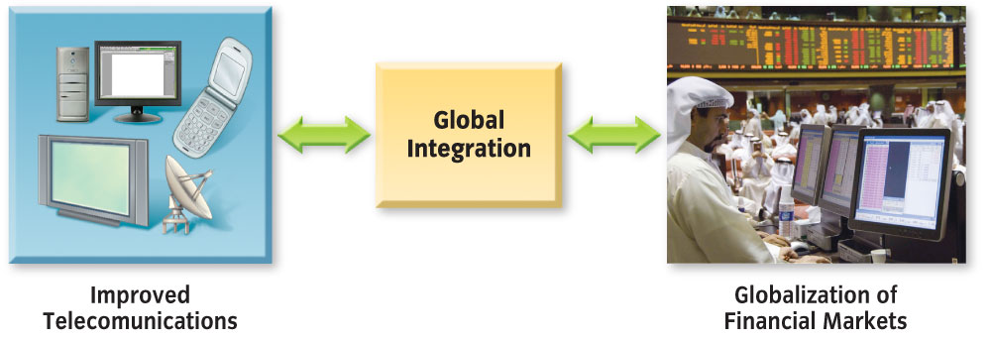
VS 1
Developments in technology are strongly tied to the growth of the global market.

Slide 37
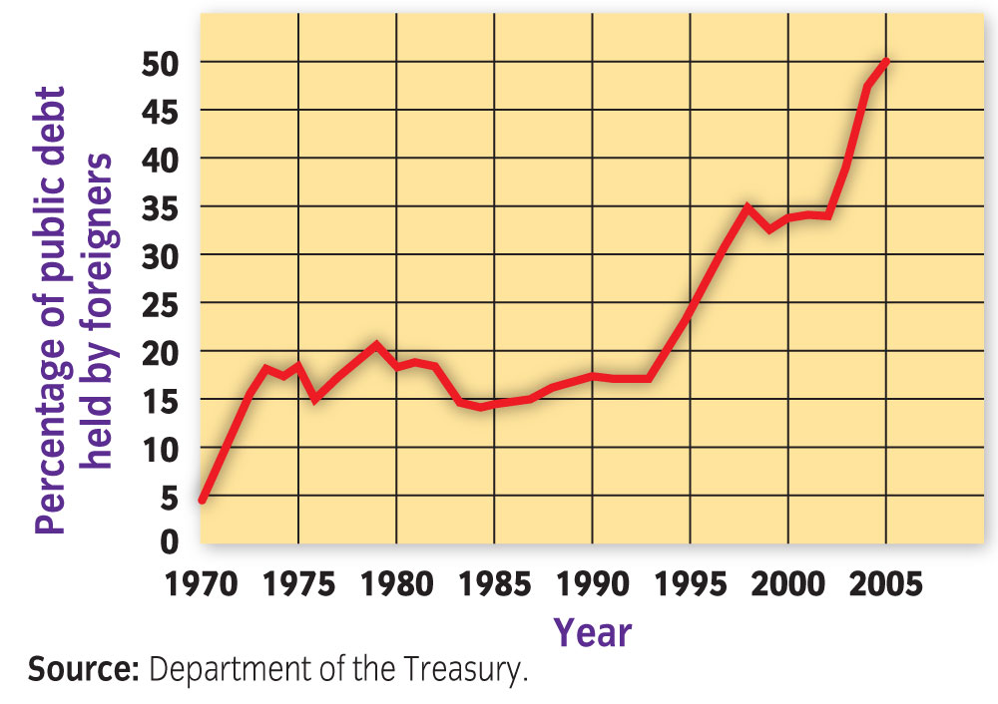
VS 2
Foreign investment and foreign ownership of U.S. debt have grown significantly over the past few decades.

Slide 38
VS 3
Multinationals are firms that do business in many countries. Today, there are over 60,000 multinational corporations in the world.

Slide 39
VS-End

Slide 40
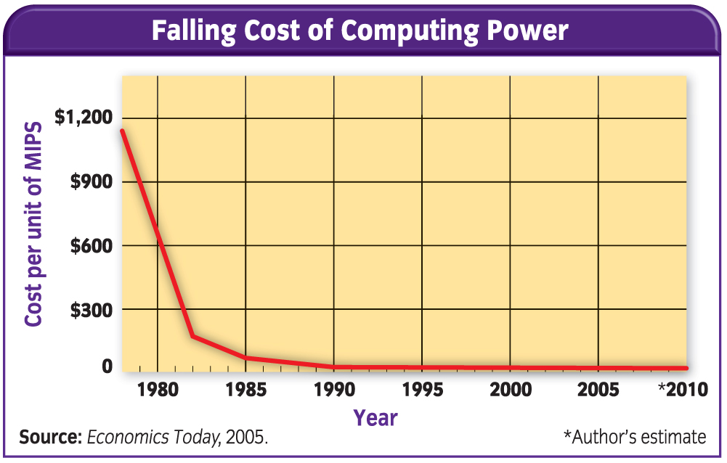
Figure 1

Slide 41
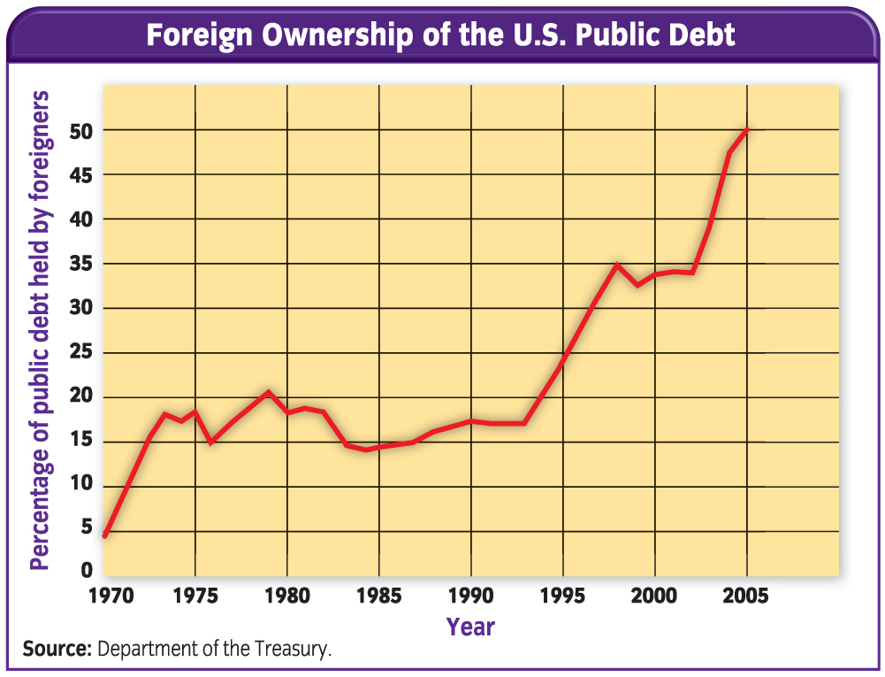
Figure 2

Slide 42
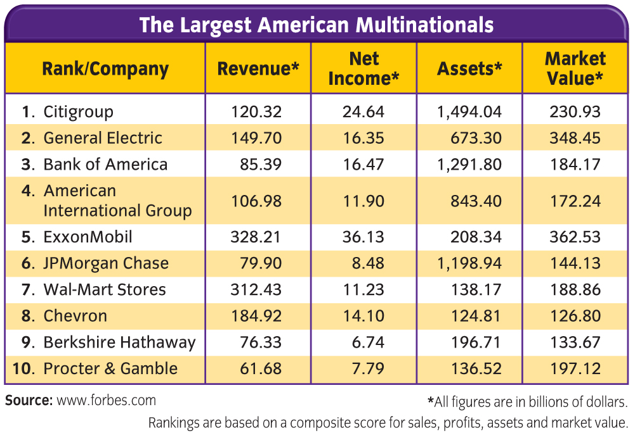
Figure 3

Slide 43
Concept Trans Menu
Economic Concepts Transparencies
Transparency 22 International Aspects of Growth and Stability
Select a transparency to view.

Slide 44
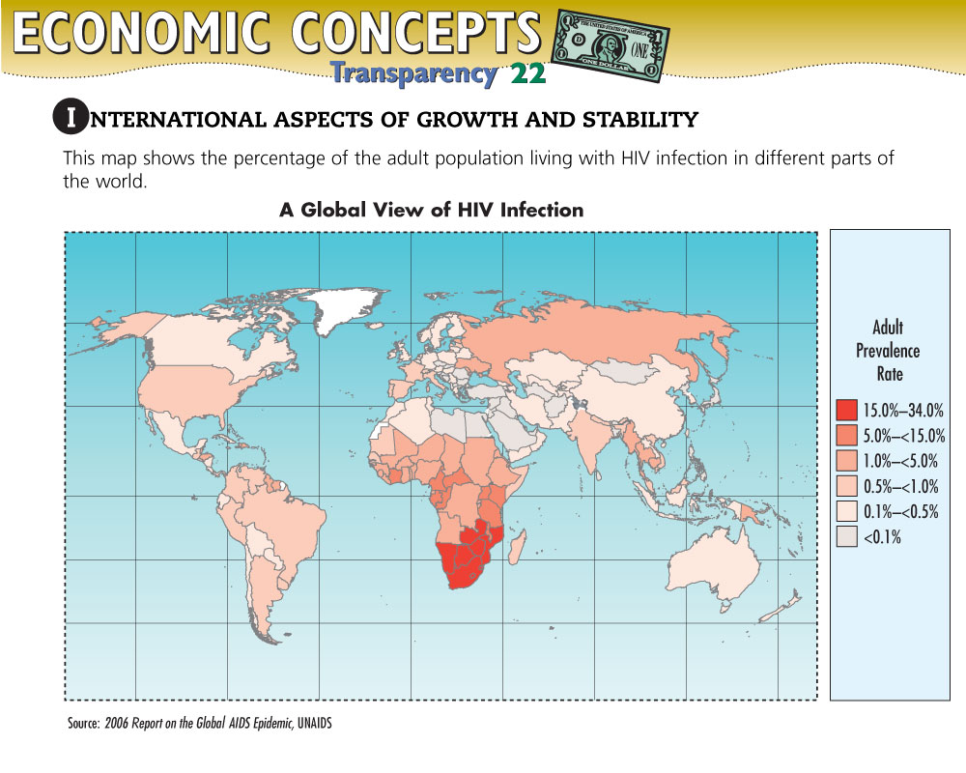
Concept Trans 1

Slide 45
DFS Trans 1

Slide 46
DFS Trans 2

Slide 47
DFS Trans 3

Slide 48
Vocab1
global integration: interdependency among the countries of the world, especially within financial markets and telecommunications

Slide 49
Vocab2
telecommunications: long-distance communication, usually electronic, using communications satellites and fiber-optic cables

Slide 50
Vocab3
direct foreign investment (DFI): the purchase by foreigners of real estate and businesses in another country

Slide 51
Vocab4
multinationals: firms that do business and have offices or factories in many countries

Slide 52
Vocab5
foreign affiliates: branches of multinational firms

Slide 53
Help
To use this Presentation Plus! product:
Click the Forward button to go to the next slide.
Click the Previous button to return to the previous slide.
Click the Home button to return to the Chapter Menu.
Click the Transparency button from the Chapter Menu or Chapter Introduction slides to access the Economic Concepts Transparencies that are relevant to this chapter. From within a section, click on this button to access the relevant Daily Focus Skills Transparency.
Click the Return button in a feature to return to the main presentation.
Click the Economics Online button to access online textbook features.
Click the Reference Atlas button to access the Interactive Reference Atlas.
Click the Exit button or press the Escape key [Esc] to end the chapter slide show.
Click the Help button to access this screen.
Links to Presentation Plus! features such as Graphs in Motion, Charts in Motion, and relevant figures from your textbook are located at the bottom of relevant screens.

Slide 54
End of Custom Shows
This slide is intentionally blank.

