Slide 1
Splash Screen

Slide 2
May 14, 2015
The United States sends a lot of money (assistance) to other countries in the form of foreign aid. Why? Do you think it is a good idea? Explain in 2 to 3 sentences.
How much does the U.S. send to other countries?
Award winners. . . .
Tomorrow is the last day to turn in assignments. . . . .

Slide 3
Chapter Menu
Chapter Introduction
Section 1: Characteristics of Developing Nations
Section 2: The Process of Economic Development
Section 3: Obstacles to Growth in Developing Nations
Section 4: Economic Development in China
Visual Summary

Slide 4
Chapter Intro 1
Economists look at a variety of factors to assess the growth and performance of a nation’s economy.

Slide 5
Chapter Intro 2
What do you think it would take to improve economic conditions in less developed nations? In this chapter, read to learn how developing countries are working to become a bigger part of the global economy.

Slide 6
Section 1-Main Idea
Section Preview
In this section, you will learn why many nations have less industrial development and a lower standard of living than the United States.

Slide 7
Section 1-Key Terms
Content Vocabulary
developed nations
developing nations
subsistence agriculture
infant mortality rate

Slide 8
Section 1
Developed and Developing Nations
Developed nations have increased their standards of living by moving from agricultural to industrialized economies.

Slide 9
Section 1
Developed and Developing Nations (cont.)
There are more than 190 nations in the world. 35 are considered developed nations.
The U.S., all European countries, Japan, Australia, and New Zealand are examples.

Slide 10
Section 1
Developed and Developing Nations (cont.)
The remaining people in the world live in developing nations.
Religion influences economic policies in some developing countries.

Slide 11
Section 1
Economic Characteristics
Developing nations are usually characterized by low GDP per capita, emphasis on agriculture, poor health conditions, low literacy rates, and rapid population growth.

Slide 12
Section 1
Economic Characteristics (cont.)
Economists often use per capita GDP as a rough measure of a nation’s prosperity.
Some characteristics of developing nations:
A low GDP
Reliance on subsistence agriculture
There are some reports that the average American farmer feeds 155 people/year.
View: Measuring GDP

Slide 13
Section 1
Economic Characteristics (cont.)
Poor health conditions, including a high infant mortality rate
Low literacy rate
Rapid population growth
View: Economic and Social Statistics for Selected Nations

Slide 14
Section 1
Weak Property Rights
A weak system of legally protected property rights frequently undermines economic development.

Slide 15
Section 1
Weak Property Rights (cont.)
Economists have found that governments in developing countries generally do not support a system of strong, well-defined property rights.
Without specifically defined private-property rights, individuals cannot exchange land, and no large-scale farming can take place.
There is also little incentive to improve value of the property they farm.

Slide 16
Section 1-End

Slide 17
Section 2-Main Idea
Section Preview
In this section, you will learn how foreign investment and aid help nations to develop economically.

Slide 18
Section 2-Key Terms
Content Vocabulary
confiscation
foreign aid
economic assistance
technical assistance
military assistance

Slide 19
Section 2
Financing Economic Development
The major outside sources of capital for developing nations are foreign investment and aid from developed nations.

Slide 20
Section 2
Financing Economic Development (cont.)
The two major outside sources of capital for developing nations are:
Investment by foreign businesses
Risks include:
Unstable governments and terrorist groups threaten stability
Foreign businesses may lose their investment through confiscation

Slide 21
Section 2
Financing Economic Development (cont.)
Foreign aid from developed nations
Types of foreign aid include:
Economic assistance
Technical assistance
Military assistance

Slide 22
Section 2
Who Supplies Foreign Aid
The United States devotes a smaller fraction of its GDP to foreign aid than many other countries.

Slide 23
Section 2
Who Supplies Foreign Aid (cont.)
Many developed nations, such as the U.S., offer some type of foreign aid to developing nations.
The United States channels much of its foreign aid to other nations through the U.S. Agency for International Development (USAID).
Funds are also channeled through United Nations agencies, including the World Bank and the International Monetary Fund (IMF).
View: Sources of Aid

Slide 24
Section 2
Reasons for Giving Foreign Aid
Foreign aid is motivated by both humanitarian and political considerations.

Slide 25
Section 2
Reasons for Giving Foreign Aid (cont.)
The basis for giving foreign aid includes:
Humanitarianism
Economics—encourages international trade and opportunities for private investment
Politics—stop communism, promoting democracy
Protect national security—foreign aid can promote military alliances

Slide 26
Section 4-Main Idea
Section Preview
In this section, you will learn about the reasons for the rapid growth of China’s economy over the past several years.

Slide 27
Section 4-Key Terms
Content Vocabulary
five-year plans

Slide 28
Section 4
Development of China’s Economic System
China’s rapid economic growth is a result of recent free-market reforms.

Slide 29
Section 4
Development of China’s Economic System (cont.)
In 1953, the Chinese government began an economic system based on five-year plans.
Plan was eventually transformed to a regional planning system and then to a limited free enterprise.

Slide 30
Section 4
Development of China’s Economic System (cont.)
Due to various reforms in 1978, such as private individuals permitted to rent land for up to 15 years, overall farm productivity increased dramatically.
Rural residents moved to cities to work in factories and offices.
Overseas companies invested in business ventures.
Economic growth remains at 7 to 10 percent per year.

Slide 31
Section 4
The Transition Toward a Mixed Economy
The legal protection of some private property has encouraged the private investment necessary for China’s transition to a mixed economy.

Slide 32
Section 4
The Transition Toward a Mixed Economy (cont.)
Countries shifting from non-capitalist to capitalist systems all face the same problem—how to establish rule of law.
Throughout China there is an atmosphere of lawlessness and unpredictability for anyone in the business world due to a lack of specific property rights.

Slide 33
Section 4
The Transition Toward a Mixed Economy (cont.)
As a result of quick economic growth, China is the second biggest producer of undesirable gas emissions in the world. In addition, about 70% of China’s rivers and lakes are polluted.

Slide 34
Section 4
Prospects for China’s Economic Future
China has encouraged foreign investment in its economy to promote growth and access to global markets.

Slide 35
Section 4-End

Slide 36
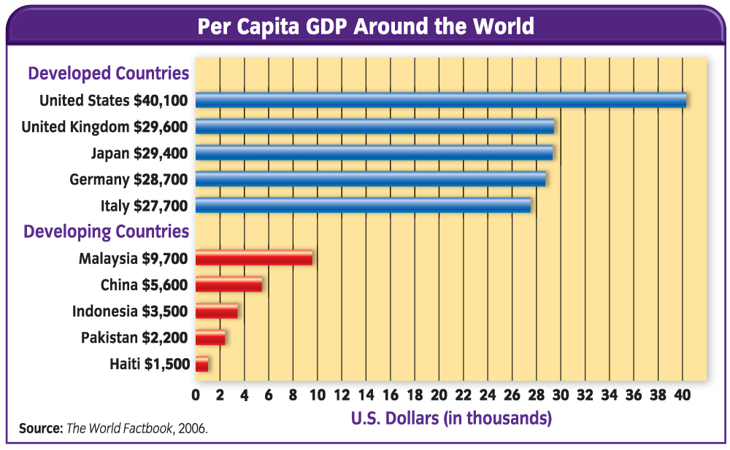
VS 1
Economists use per capita GDP as a measure of a nation’s prosperity. There is a huge difference in per capita GDP between developed and developing nations.

Slide 37
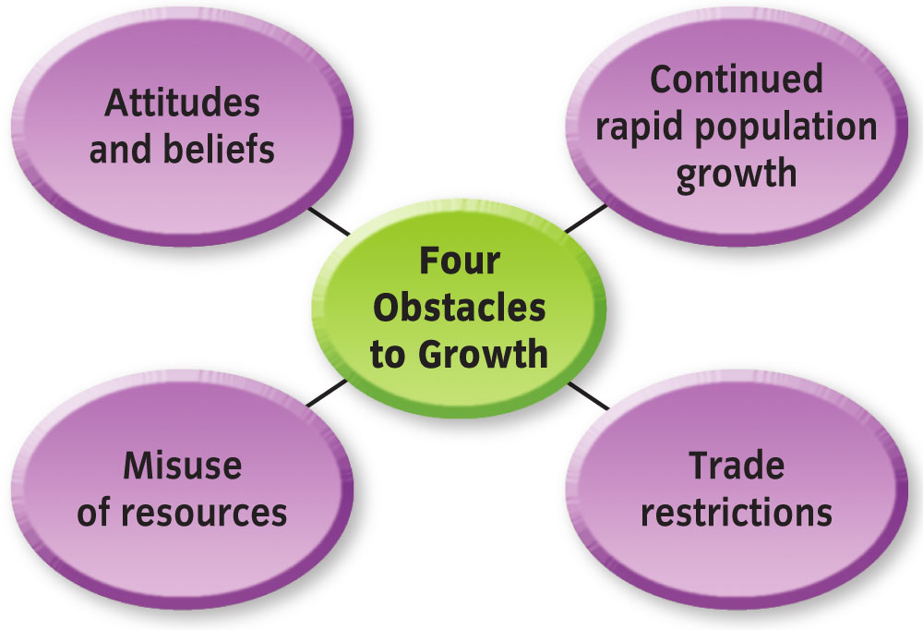
VS 2
Although developing nations receive capital from developed nations in the form of foreign investment and aid, they still face obstacles to growth.

Slide 38
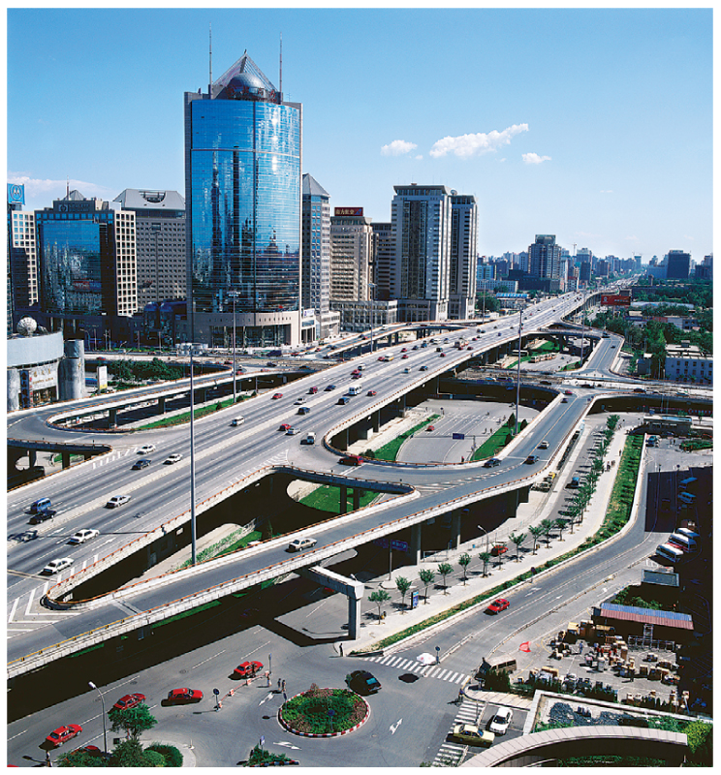
VS 3
China’s rapid economic growth is a result of recent free-market reforms. An American visitor to Beijing would find that city to be very much like large cities in the United States.

Slide 39
Figure 1

Slide 40
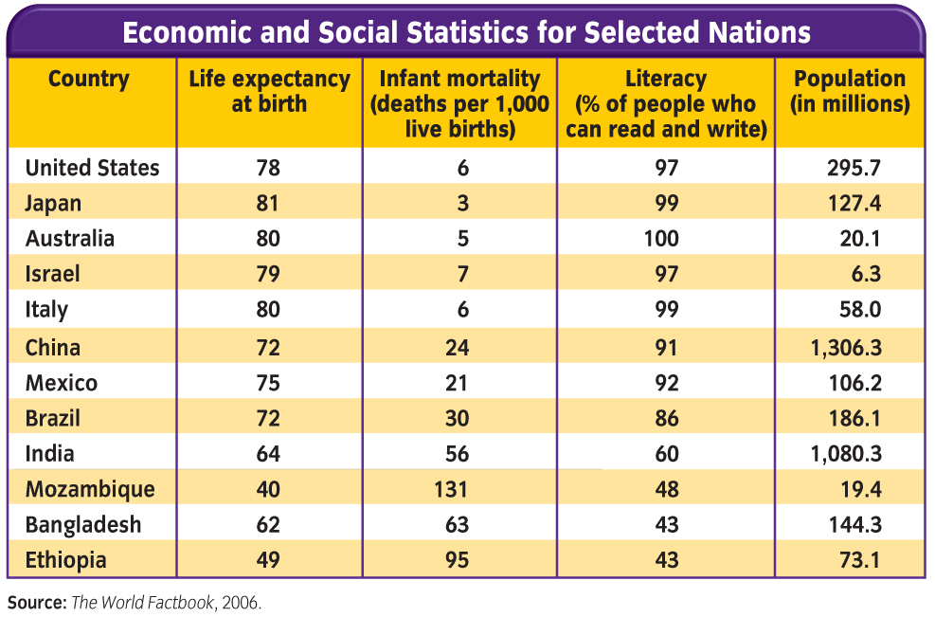
Figure 2

Slide 41
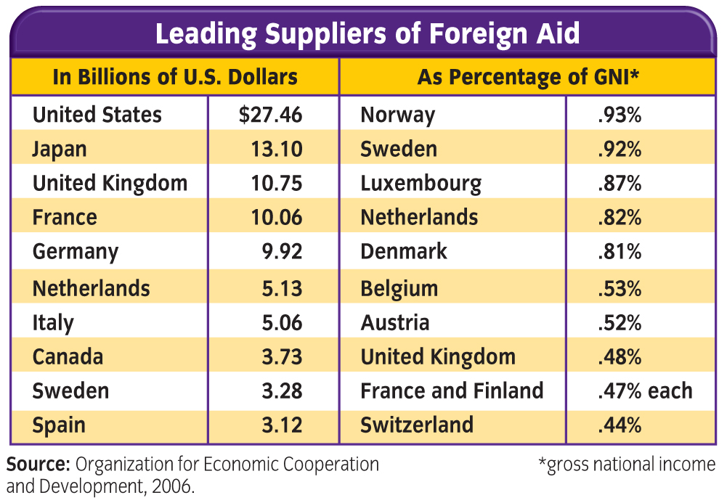
Figure 4

Slide 42
Figure 5

Slide 43
Figure 6

Slide 44
Concept Trans Menu
Economic Concepts Transparencies
Transparency 22 International Aspects of Growth and Stability
Select a transparency to view.

Slide 45
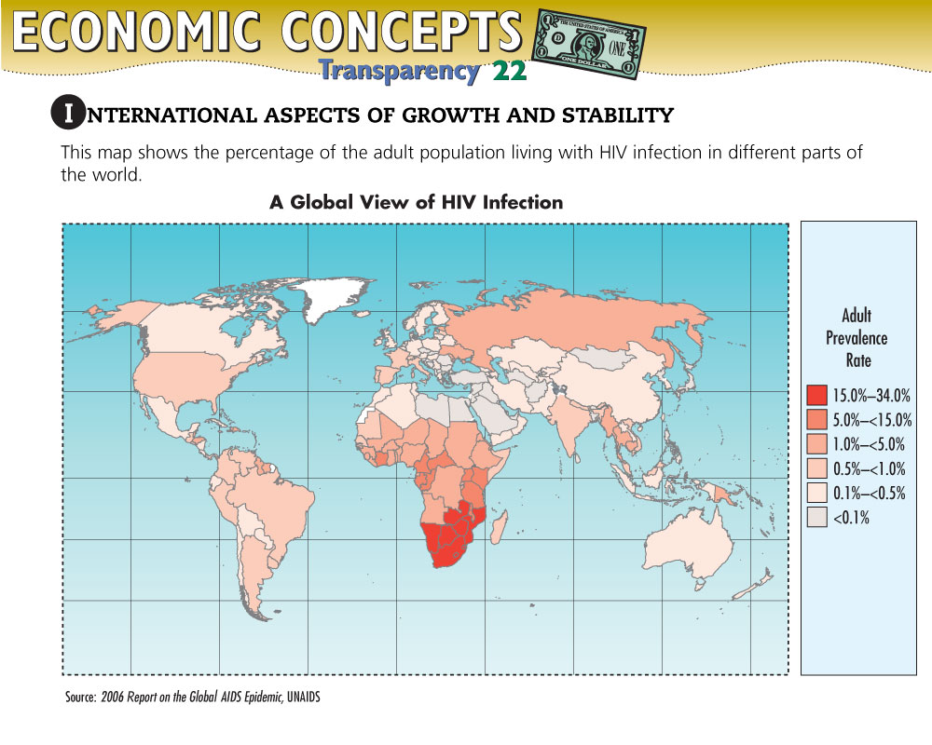
Concept Trans 1

Slide 46
DFS Trans 1

Slide 47
DFS Trans 2

Slide 48
DFS Trans 3

Slide 49
DFS Trans 4

Slide 50
Vocab1
developed nations: nations with relatively high standards of living and economies based more on industry than on agriculture

Slide 51
Vocab2
developing nations: nations with little industrial development and relatively low standards of living

Slide 52
Vocab3
subsistence agriculture: growing of just enough food by a family to take care of its own needs; no crops are available for export or to feed an industrial workforce

Slide 53
Vocab4
infant mortality rate: death rate of infants who die during the first year of life

Slide 54
Vocab5
confiscation: taking over industries by governments without paying for them

Slide 55
Vocab6
foreign aid: funds, goods, and services given by governments and private organizations to help other nations and their citizens

Slide 56
Vocab7
economic assistance: loans and outright grants of funds or equipment to other nations

Slide 57
Vocab8
technical assistance: aid in the form of engineers, teachers, and technicians to teach skills to individuals in other nations

Slide 58
Vocab9
military assistance: aid given to a nation’s armed forces

Slide 59
Vocab10
bureaucracies: offices and agencies of the government that each deal with a specific area

Slide 60
Vocab11
capital flight: the legal or illegal export of currency or money capital from a nation by that nation’s leaders

Slide 61
Vocab12
five-year plans: centralized planning system that used to be the basis for China’s economic system; eventually was transformed to a regional planning system leading to limited free enterprise

Slide 62
Help
To use this Presentation Plus! product:
Click the Forward button to go to the next slide.
Click the Previous button to return to the previous slide.
Click the Home button to return to the Chapter Menu.
Click the Transparency button from the Chapter Menu or Chapter Introduction slides to access the Economic Concepts Transparencies that are relevant to this chapter. From within a section, click on this button to access the relevant Daily Focus Skills Transparency.
Click the Return button in a feature to return to the main presentation.
Click the Economics Online button to access online textbook features.
Click the Reference Atlas button to access the Interactive Reference Atlas.
Click the Exit button or press the Escape key [Esc] to end the chapter slide show.
Click the Help button to access this screen.
Links to Presentation Plus! features such as Graphs in Motion, Charts in Motion, and relevant figures from your textbook are located at the bottom of relevant screens.

Slide 63
End of Custom Shows
This slide is intentionally blank.

