Slide 1
On the back of your packet, please answer these questions:
Do you have a checking account?
How long have you had this checking account? (approx)
Do you take advantage of online banking?
What best do you like about online banking?
If you don’t have a checking account, would you consider opening an account?
When?
Why/Why not?

Slide 2
Do you need a checking account??
Video
During the short video clip, write down 5 main ideas/take-aways from the information shared on the back of your packet.

Slide 3
Checking Account & Debit Card Simulation
Understanding Checking Accounts and Debit Card Transactions

Slide 4
What is a Checking Account?
Common financial service used by many consumers
Funds are easily accessed
Check
ATM (automated teller machine)
Debit card
Telephone
Internet
Services and fees vary depending upon the financial institution

Slide 5
Why Do People Use Checking Accounts?
Reduces the need to carry large amounts of cash
Convenience – useful for paying bills
Spending Plan Tool
Keeps a record of where money is spent
Safety – using checks is safer than carrying cash

Slide 6
What is a Check?
Used at the time of purchase as the form of payment
Piece of paper pre-printed with the account holder’s:
Name
Address
Financial institution
Identification numbers

Slide 7
Bouncing a Check
Check written for an amount over the current balance held in the account
‘Bounces’ due to insufficient funds, or not enough money in the account to cover the check written
A fee will be charged to the account holder
Harm future opportunities for credit

Slide 8
Other Checking Components
Checking Account Register
Place to immediately record all monetary transactions for a checking account
Written checks, ATM withdrawals, debit card purchases, deposits and additional bank fees
Checkbook
Contains the checks and the register to track monetary transactions

Slide 9
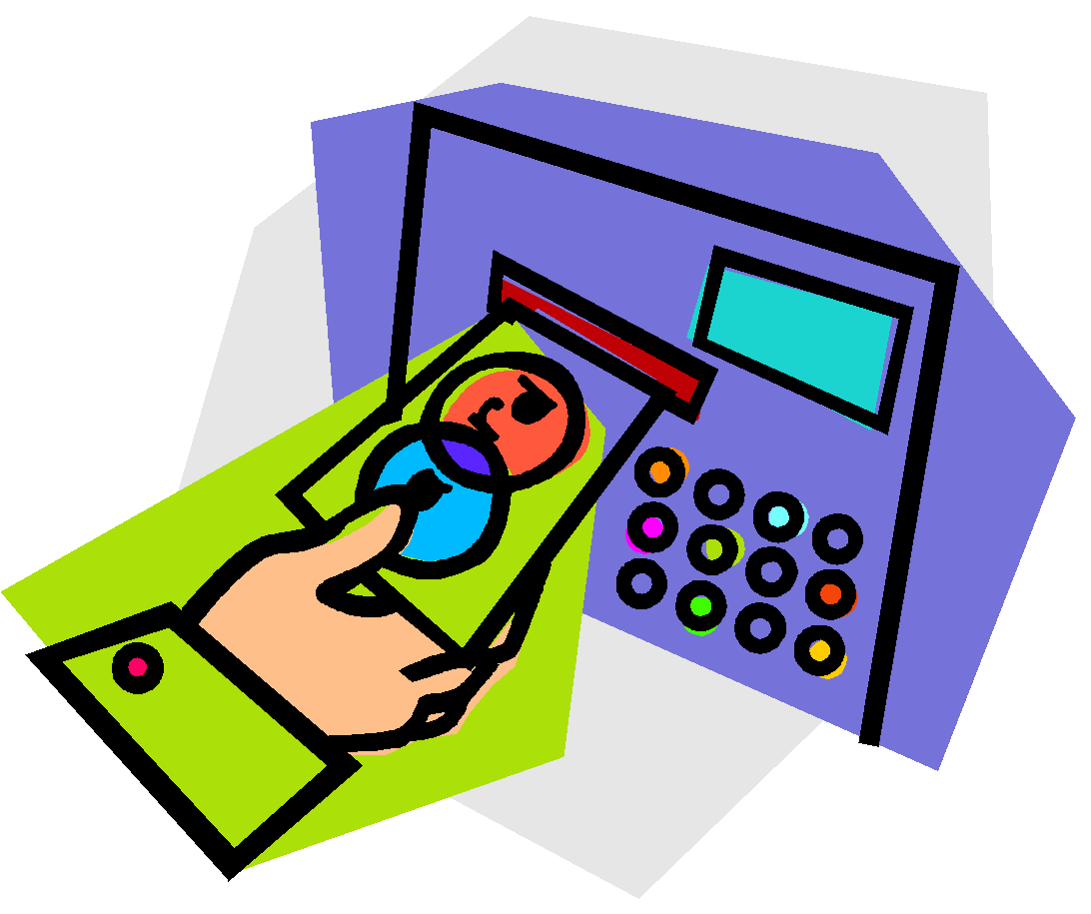
ATM
Automated teller machine, or a cash machine
Can be used to withdraw cash and make deposits
Additional fees may be assessed if the ATM used is not provided by the financial institution sponsoring the card

Slide 10
Debit Card
Plastic card that looks like a credit card
Electronically connected to a bank account
Money is automatically taken from the bank account when purchases are made
Requires a PIN (personal identification number)
Confirms the user is authorized to access the account

Slide 11
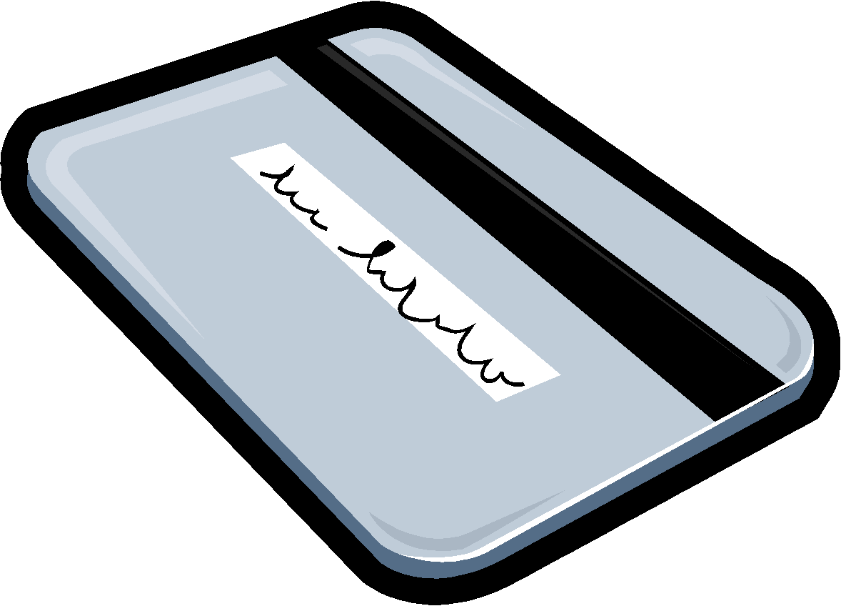
To Use A Debit Card
Swipe it through the store machine or put into an ATM
Enter the PIN
Complete transaction

Slide 12
Pros and Cons - Debit Cards
Pros Cons
Convenient
Small
Can be used like a credit card
Allows a person to carry less cash
Does not allow overspending
Can lose track of balance if transactions are not written down
Opens checking account up to credit fraud
Others can gain access to the account if the card is lost and PIN is known

Slide 13
Endorsing a Check
Endorsement
Signature on the back of a check to approve it to be deposited or cashed
A check must be endorsed to be deposited
Three types
Blank
Restrictive
Special

Slide 14
Blank Endorsement
Receiver of the check signs his/her name
Anyone can cash or deposit the check after has been signed

Slide 15
Restrictive Endorsement
More secure than blank endorsement
Receiver writes “for deposit only” and account number above his/her signature
Allows the check to only be deposited

Slide 16
Special Endorsement
Receiver signs and writes “pay to the order of (fill in person’s name)”
Allows the check to be transferred to a second party
Also known as a two-party check

Slide 17
Worksheet Answers
Blank
Restrictive
Endorse Here
Endorse Here
For Deposit Only—Acct. # 987654321
Student’s Signature
X
Student’s Signature
X
Special
Endorse Here
Pay to the Order of Jonathon Smith
Student’s Signature
X

Slide 18
Making a Deposit
Deposit slip
Contains the account holder’s account number and allows money (cash or check) to be deposited into the correct account
Located in the back of the checkbook
Complete a deposit slip to make a deposit
Deposited amount must be recorded in the checking account register to keep the balance current
Deposits can be made at an ATM or with a bank teller

Slide 19
Completing a Deposit Slip
Date
The date the deposit is being made

Slide 20
Completing a Deposit Slip
Signature Line
Sign this line to receive cash back

Slide 21
Completing a Deposit Slip
Cash
The total amount of cash being deposited

Slide 22
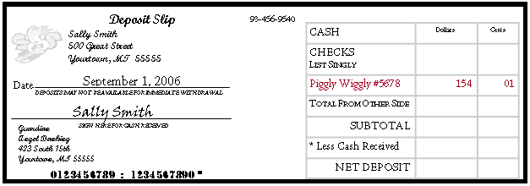
Completing a Deposit Slip
Checks
List each check individually
Identify each check on the deposit slip by abbreviating the name of the check writer

Slide 23
Completing a Deposit Slip
Checks
If more checks are being deposited than number of spaces on the front, use the back
List each check
Add the total, enter it on the front

Slide 24
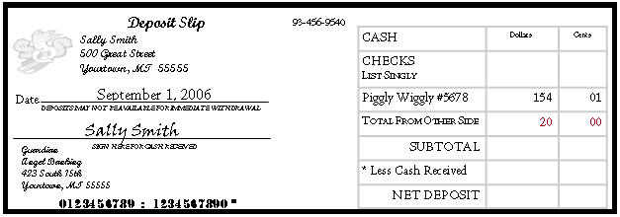
Completing a Deposit Slip
Total from Other Side
The total amount from all checks listed on the back

Slide 25
Completing a Deposit Slip
Subtotal
The total amount of cash and checks

Slide 26
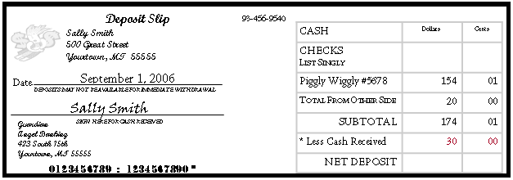
Completing a Deposit Slip
Less Cash Received
The amount of cash back being received
This amount is not deposited into account

Slide 27
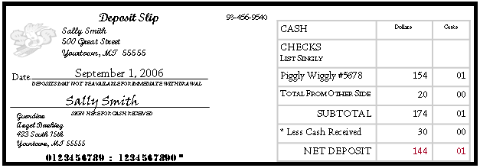
Completing a Deposit Slip
Net Deposit
The amount being deposited into the account
To calculate the amount, subtract the cash received from the subtotal

Slide 28
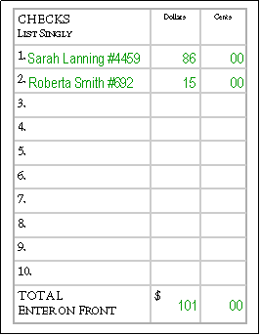
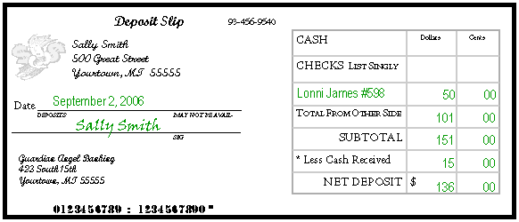
Worksheet Answer

Slide 29
Writing a Check
To pay for items using a checking account
A check is given as a form of payment
Must be completed and given to the person or business
Pre-printed items on a check
Name and address of account holder
Name and address of financial institution
Check number
Identification numbers (account, routing)

Slide 30
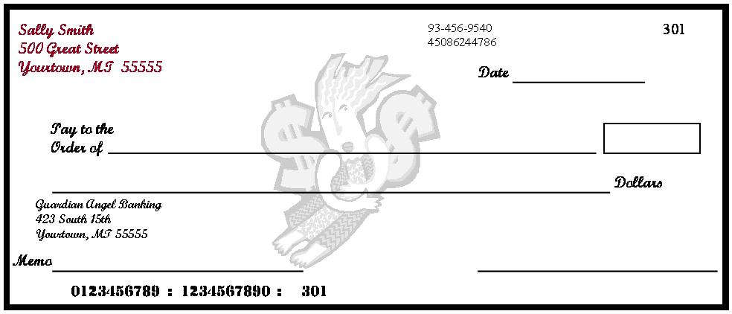
Writing a Check
Personal Information
Account holder’s name and address
May include a phone number, not required
DO NOT list a social security number for safety reasons

Slide 31
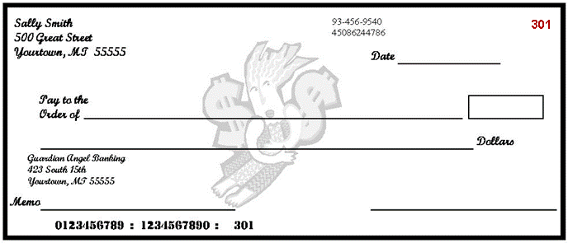
Writing a Check
Check Number
Numbers used to identify checks
Printed chronologically

Slide 32
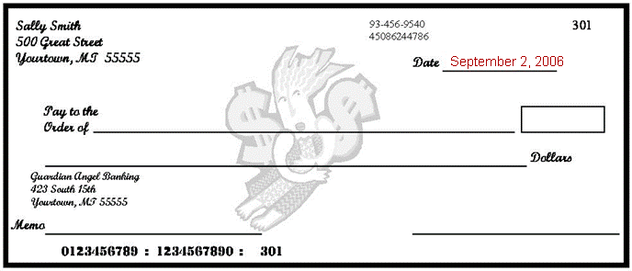
Writing a Check
Date
The date the check is written

Slide 33
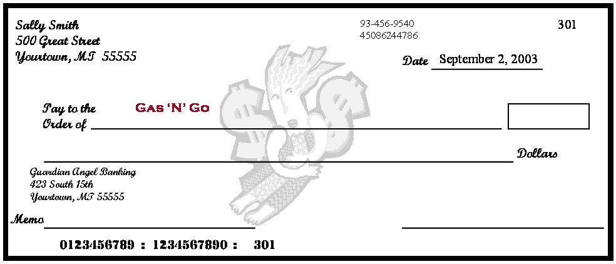
Writing a Check
Pay to the Order of
The name of the person or business to whom the check is being written

Slide 34
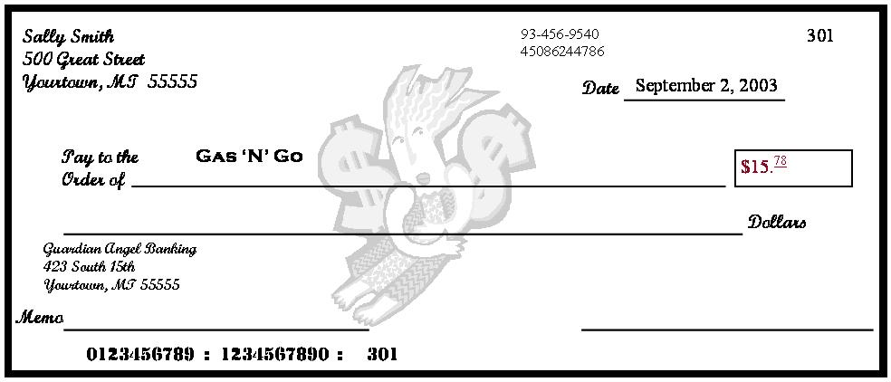
Writing a Check
Amount of the Check in Numerals
The amount of the check written numerically in the box
Write the cents smaller and underline
Write the numbers directly next the dollar sign to prevent someone else from adding numbers to change the amount

Slide 35
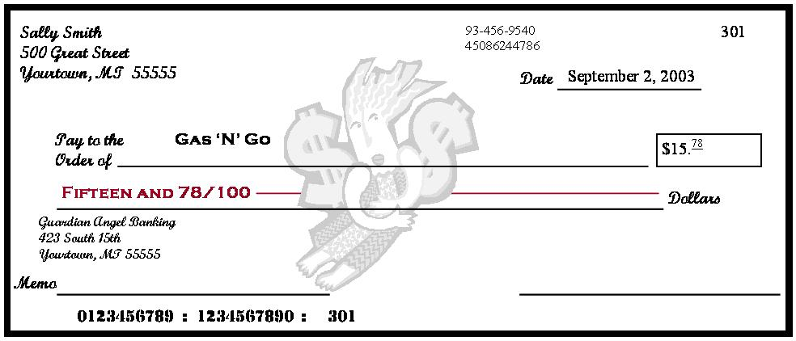
Writing a Check
Amount of the Check in Words
The amount of the check written in words on the second line
Start at the far left of the line, write the amount in words, followed by ‘and’, and the amount of cents over 100; draw a line from the end of the words to the word ‘dollars’

Slide 36
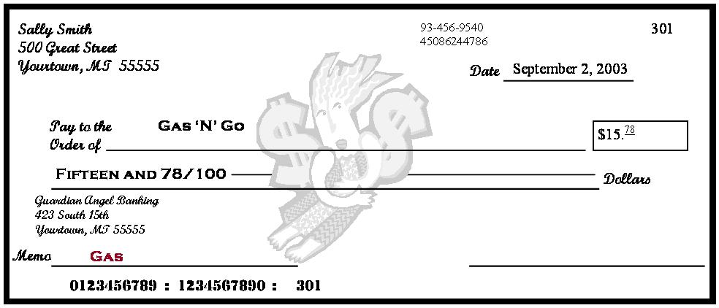
Writing a Check
Memo
Space used to identify the reason for writing a check; optional
Good place to write information requested by a company when paying a bill, generally the account number

Slide 37
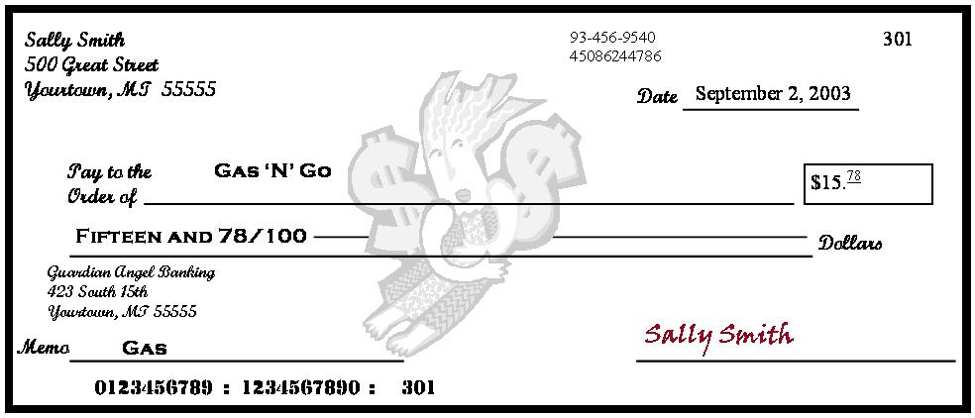
Writing a Check
Signature
The account holder’s signature agreeing to the transaction

Slide 38
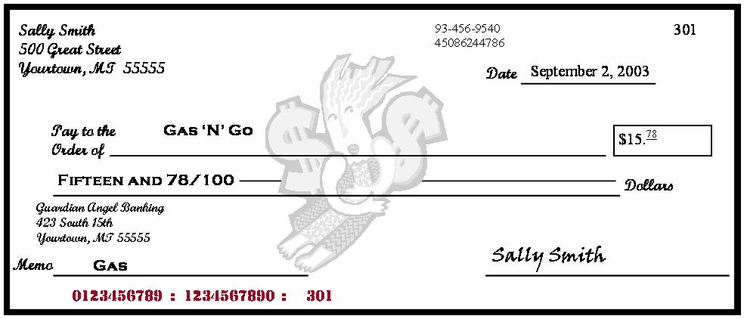
Writing a Check
Identification Numbers
First - routing numbers to identify the account’s financial institution
Second - account number
Third - check number

Slide 39
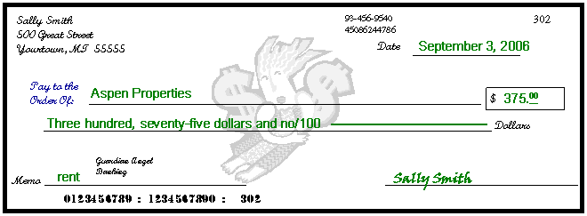
Worksheet Answers

Slide 40
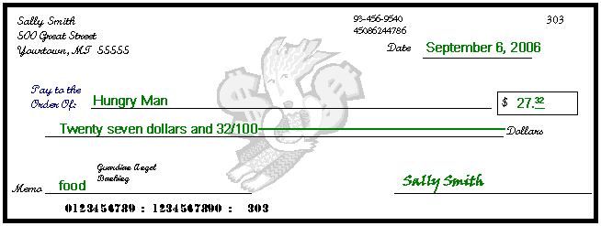
Worksheet Answers

Slide 41
Check 21
Check Clearing for the 21st Century Act (Check 21)
When a check is written, the money is automatically withdrawn from a bank account
Makes “bouncing checks” difficult

Slide 42
Debit Card
Account Number—Links all purchases made with the card to a designated bank account
Expiration Date— The debit card is valid and may be used until this date
Cardholder’s Name— The cardholder’s full name is written out and displayed.
Magnetic Strip— When the debit card is swiped, the magnetic strip automatically withdraws funds from the cardholder’s account.

Slide 43
Debit Card
Authorized Signature— Sign in the signature box on the back of the debit card to authorize payments
Should also write, “See ID” in the signature box
Ensures the person using the card is authorized to do so
Verification Number—This three digit code is located on the back of the card in the signature area
Help ensure the card is in the cardholder’s possession when making purchases
Prevents unauthorized use

Slide 44
Checking Account Register
Place to record all monetary transactions for a checking account
Deposits, checks, ATM use, debit card purchases, additional bank fees
Used to keep a running balance of the account
Remember
Record every transaction!

Slide 45
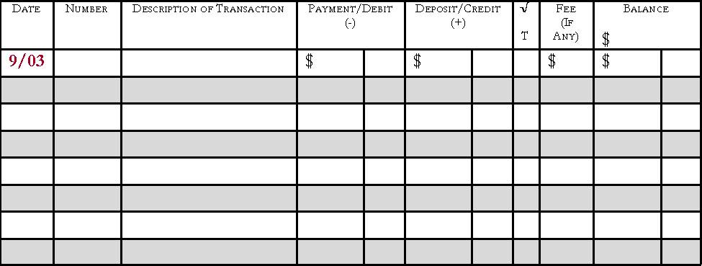
Check Register
Date
The date the check was written or transaction was made

Slide 46
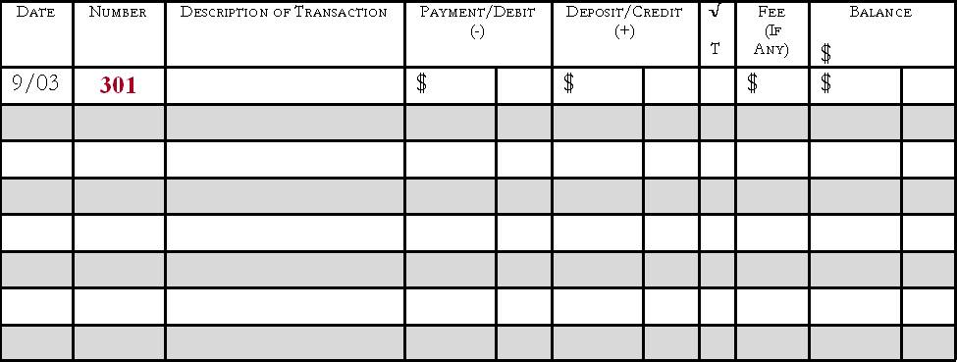
Check Register
Number
The number of the written check; if a debit card or ATM was used, write DC or ATM

Slide 47
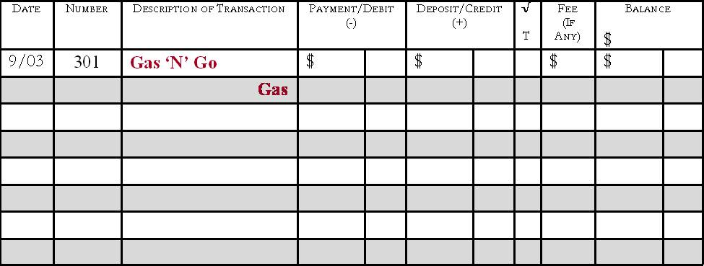
Check Register
Description of Transaction
The person/business the check was written to or where the debit card was used
Gray line can be used to write the memo

Slide 48
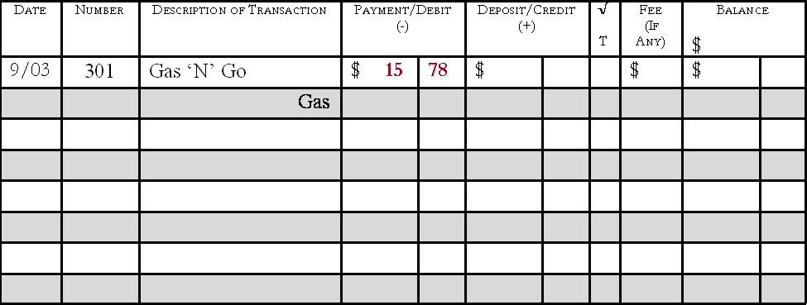
Check Register
Payment/Debit(-)
Amount of the transaction
Deducted from the balance

Slide 49
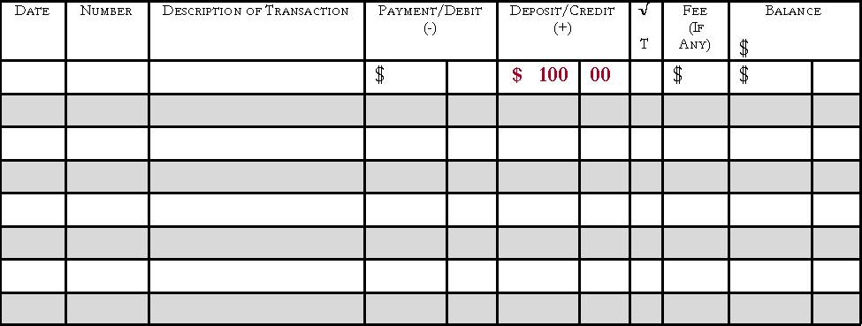
Check Register
Deposit/Credit(+)
Amount of the transaction
Added to the balance

Slide 50
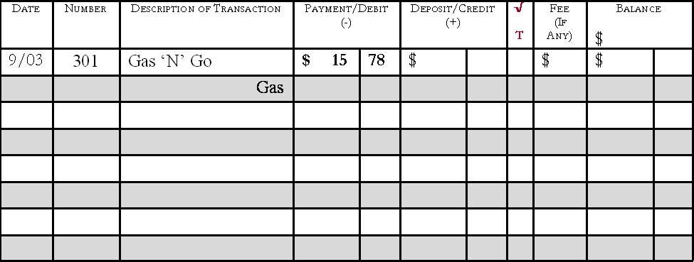
Check Register
√ T
A box used to track whether the check has cleared on the monthly bank statement when reconciling at the end of each month

Slide 51
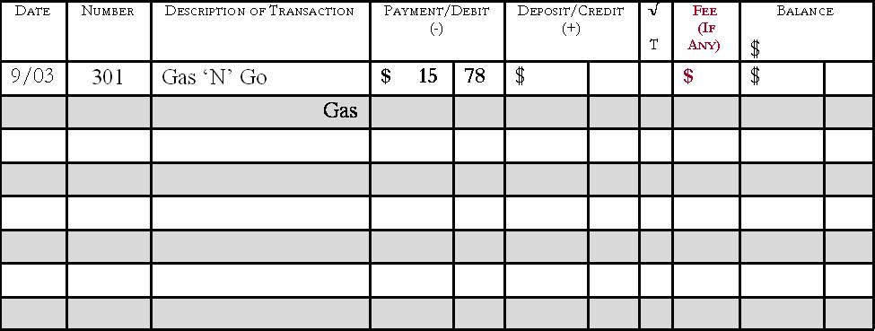
Check Register
Fee (if any)
Any extra fees charged to the account
Listed on the bank statement

Slide 52
Check Register
Balance
The running total of the checking account
Calculated by adding or subtracting each transaction
Keep this updated

Slide 53
Monthly Bank Statement
Lists each monetary transaction and the current account balance for a specified time period
Includes:
Dates
Identification for each transaction (number or type, date, amount)
Transaction amounts for withdrawals and/or deposits
Interest earned (if applicable)
Fees or charges (if applicable)

Slide 54
Monthly Bank Statement
Lists each transaction and current account balance
Deposits
Checks
Debit Card transactions
ATM transactions
Additional fees

Slide 55
Reconciling a Checking Account
Reconcile
Balance the checkbook register each month to the balance shown on the statement
Do this every month to ensure the correct balance in the checkbook
Knowing the correct balance can help to avoid bouncing checks

Slide 56
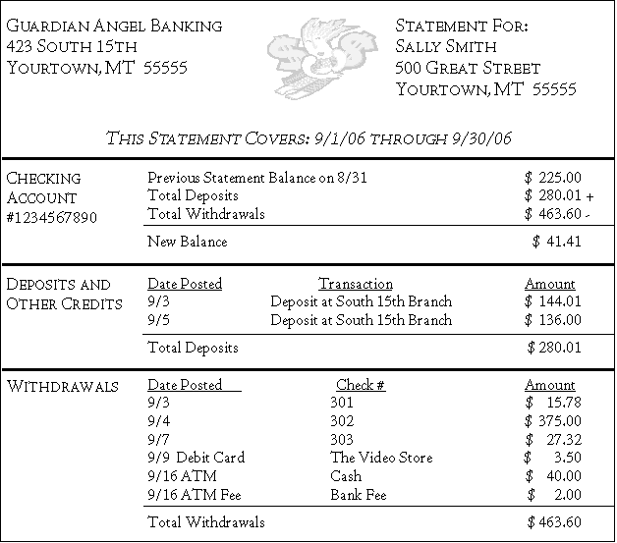
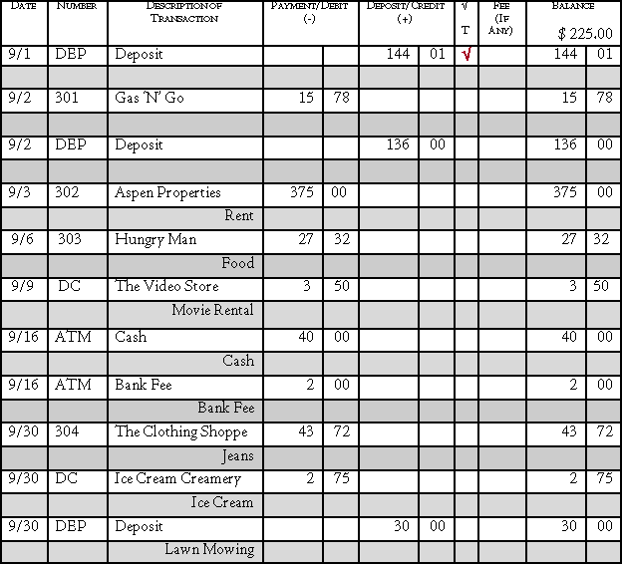
Steps for Reconciling
View the monthly bank statement and check register

Slide 57
Place a check mark in the √ T column for all transactions that have been cleared and are shown on the bank statement
√
√
√
√
√
√
√

Slide 58
Determine the current account balance from the bank statement

Slide 59
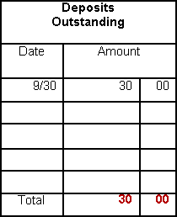
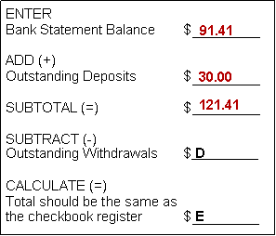
Add any outstanding deposits – transactions that have not cleared the bank
Calculate the Subtotal

Slide 60
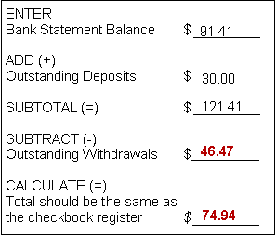
Subtract any outstanding withdrawals and calculate
Compare the total with the checkbook register. If the totals are different, double check the math and make sure all service fees and bank charges are recorded in the check register.

Slide 61
Checking Account Safety
If a checkbook, ATM, and/or debit card becomes lost or stolen
Immediately report it to the financial institution
File a report with the police
Reported lost/stolen checkbook:
Financial institutions generally do not hold the account holder liable for any fraudulent charges

Slide 62
Safety continued
Reported lost/stolen ATM/debit card:
Within 2 business days
Cardholder is only liable for $50.00
Longer than 2 business days
Could be liable for up to $500.00
Varies depending upon the financial institution
May not charge the account holder anything if the correct steps were taken to report the lost/stolen card

Slide 63
Questions?

