Slide 1
Creation of Offers

Slide 2
1. Offer and Acceptance
Offerer
person who makes the offer
Offeree
person to whom the offer is made
Notes:
The offerer starts the ball rolling when considering contracts. The offeree has the choice to accept or reject the offer.

Slide 3
2. Genuine Assent
The agreement MUST NOT be based on
one party’s deceiving another
an important mistake
The use of unfair pressure exerted to obtain the offer or acceptance
Notes:
Genuine assent means taking action on your own free will.

Slide 4
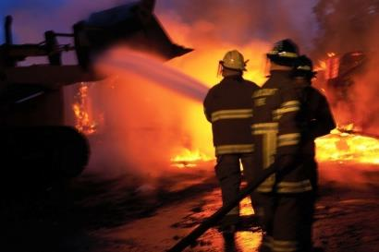
3. Legality
Agreement cannot involve a crime.
Agreement cannot involve a tort.
Notes:
Contracting someone to commit a crime or tort is illegal. Examples of unenforceable contracts include hiring a person to kill or burn down a business.

Slide 5
4. Consideration
Both sides receiving what the law considers value in some form as a result of the transaction
Notes:
Employment contract: Employee receives monetary value, Employer receives

Slide 6
5. Capacity
Parties must have the legal ability to contract for themselves.
Parties without capacity:
Not legal age to enter the agreement
Under the influence when signing the contract
Lack the mental capability to enter the contract

Slide 7
6. Proper Form
Contracts should be in writing to be enforced by the court of law.
Notes:
Getting something in writing is ALWAYS a good idea.

Slide 8
An Offer
Proposal by an offeror to do something, provided the offeree does or refrains from doing something in return
The basis of the bargain

Slide 9
Offer Elements
1) Contractual intent must be present in the offer
2) The offer must be communicated to the offeree
3) The essential terms of the offer must be complete and definite

Slide 10
Requirements of an Offer
Must have Contractual Intent
Jests: The law is not concerned with what is actually in the mind of a persona making what might be considered an offer. Jokes can be upheld as offers.
Statements made in anger or terror are not legally enforceable.
Notes:
Jokes can sometimes be held as legal offers. Entering a legal contract is not a joking matter.

Slide 11
Requirements of an Offer
Preliminary Negotiations
Communication to induce someone to initiate bargaining
Not seen by the law as an intent to contract
Based on objective tests
Are advertisements offers?
When are advertisements offers?
Notes:
READ TSB p. 114
Read WYV p. 114 and use TSB to talk about wording when discussing objective tests
No: Invitations are not offers. Most advertisements are invitations for someone to make an offer.
If it asks the offeree to perform an act as a way of accepting “Be the first one at the door to receive a free...”
OR in an ad that has limited product for numerous people and is clear about the conditions

Slide 12
Requirements of an Offer
Social Agreements are Not Enforceable
Date to the movies
Dinner date
Notes:
Can’t sue a boy for asking you on a date and not following through

Slide 13
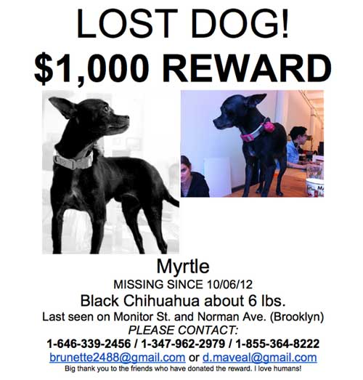
Other Requirements of an Offer
Offer Must Be Communicated to the Offeree
Email, phone, person, fax, etc.
Not considered an offer until offeree has seen the offer
What if you find this dog and do not see the poster?
Notes:
Contracts must be clear to the offeror and offeree. Specific terms in a contract must be met or the contract can be broken.
Then you do not get the reward: You have not seen or heard about the reward offer

Slide 14
Other Requirements of an Offer
Essential Terms Must Be Definite
Essential Terms Must Be Complete
Proper legal description of the real estate
Price
Full terms for payment
Date for delivery of possession
Date for delivery of the deed
At Minimum: price, subject matter, and quantity

