Slide 1
Welcome to Info Tech

Slide 2
A little bit about Mr. Mercer….

Slide 3
Where am I from?
I have lived in Lincoln all my life!!!
Attended LNE
Attended Nebraska Wesleyan
Majored in Secondary Education and Business Administration
Entering my 14th year of teaching!!!

Slide 4
What are my interests?
I like sports
I am the Head Boys Basketball coach here at LNE
Teams: Cubs, Bears, Huskers, Boston Celtics
I enjoy playing golf but I’m not very good
I enjoy doing work around my house
I enjoy going to movies and concerts
I enjoy exercising
I love time at home with my family!!
I love going to Kansas City to see my sisters and nieces!!

Slide 5
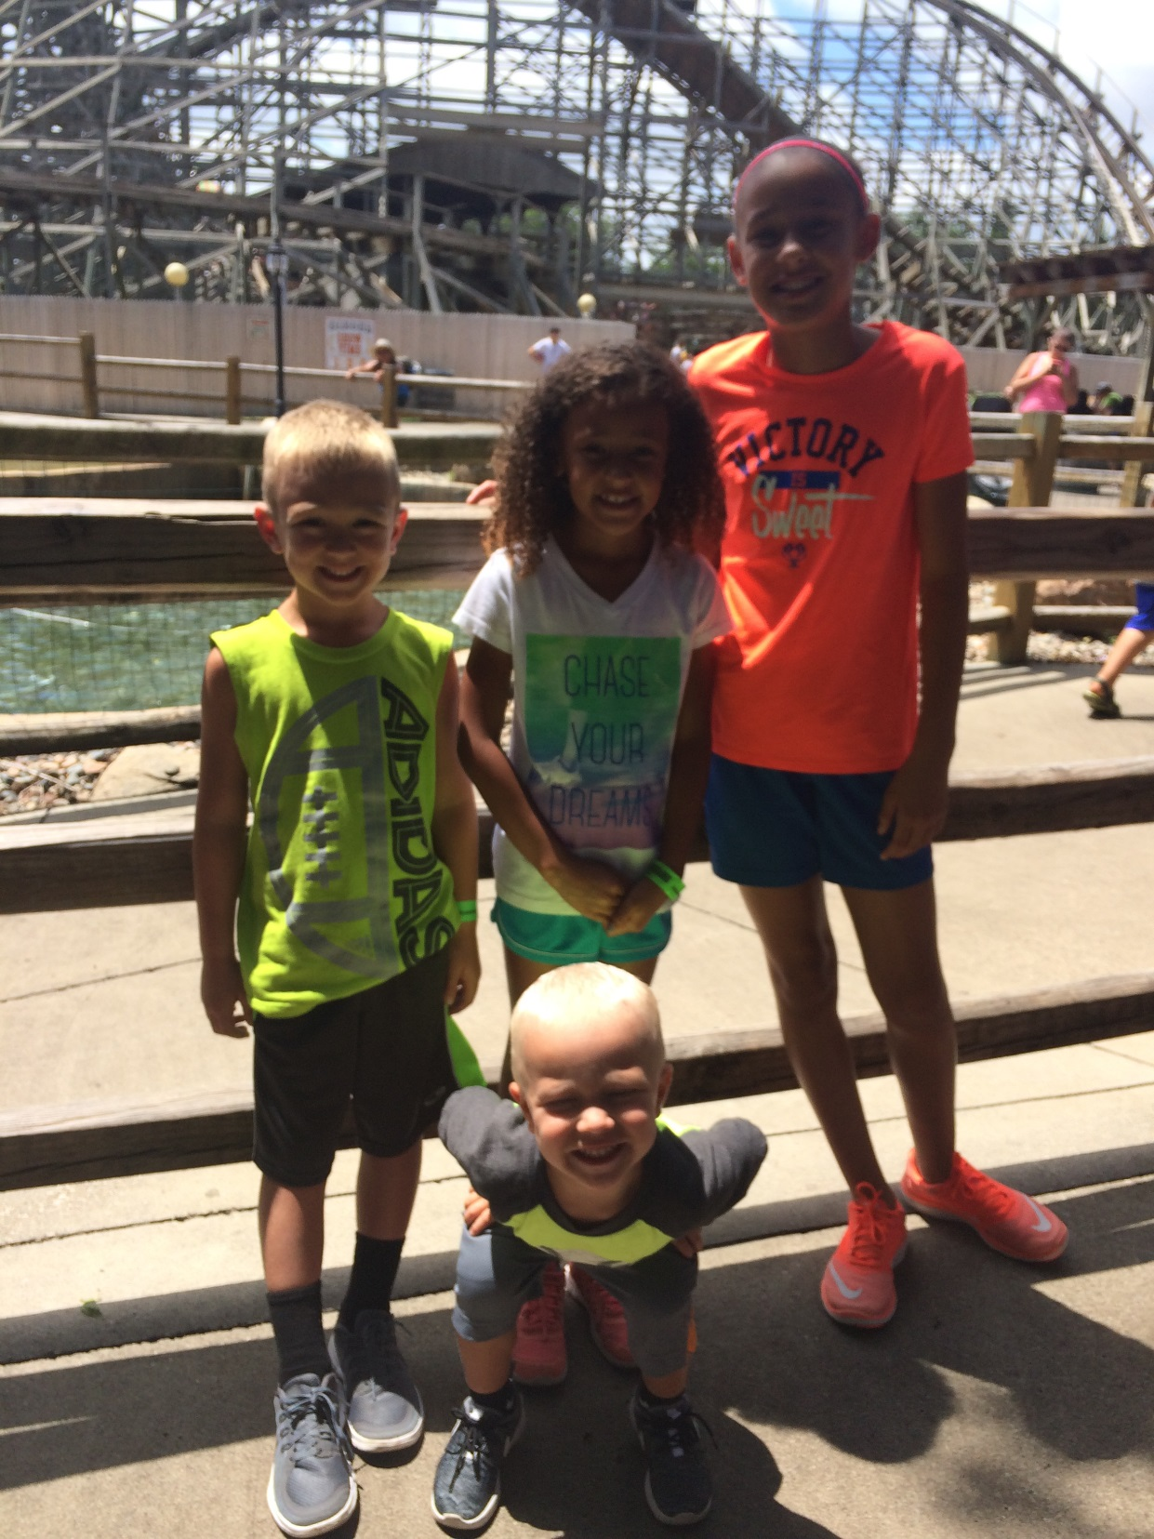

Slide 6
What are my dislikes/pet peeves??
Negativity!!!!!!
Complaining
Laziness
A lot of vegetables

Slide 7
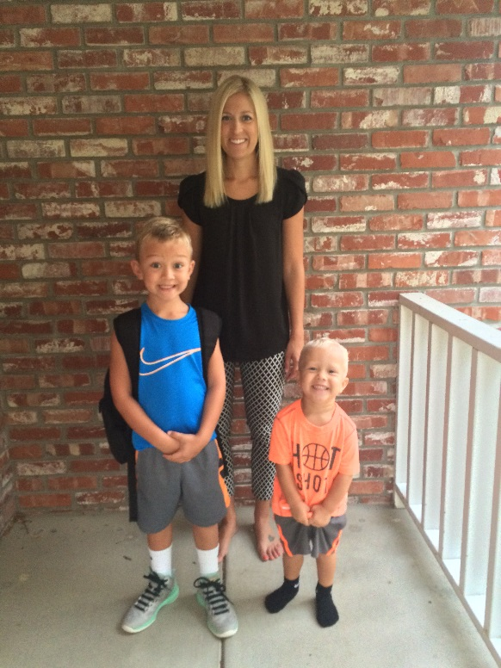
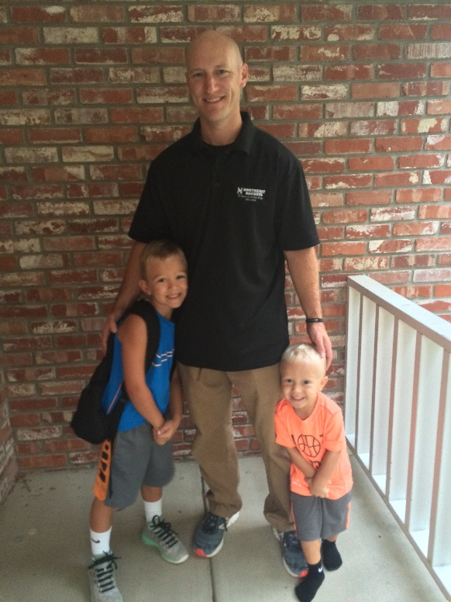
Family!!
I have a 6 year old son – Kyson
2 and a half year old son - Micah
My wife Jenny is an 8th grade counselor at Lefler

Slide 8
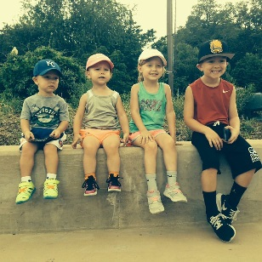
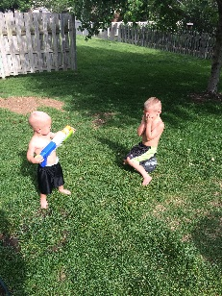
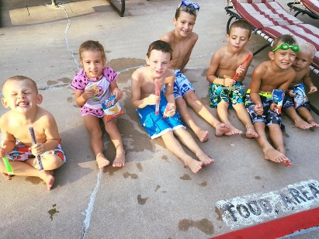
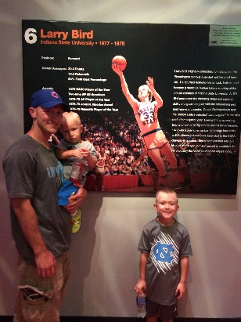
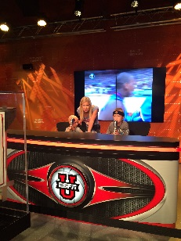
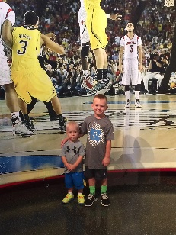
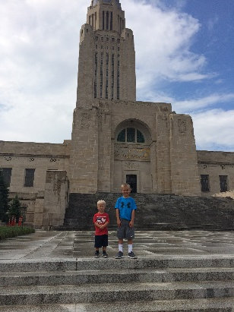
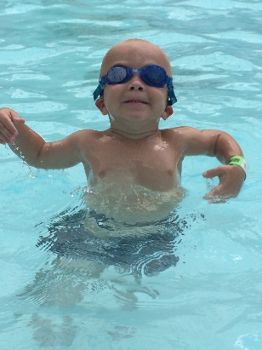
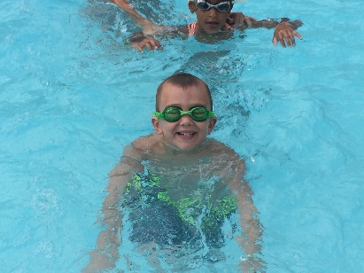
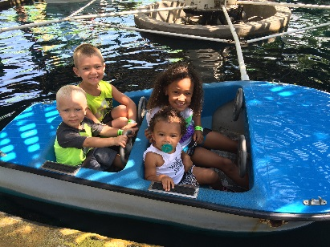
Pictures of my fam….

Slide 9
Questions?

