Slide 1
A little bit about Mr. Mercer….

Slide 2
Where am I from?
I have lived in Lincoln all my life!!!
Attended LNE
Attended Nebraska Wesleyan
Majored in Secondary Education and Business Administration
14th year of teaching!!!

Slide 3
What are my interests?
I like sports
I am the Head Boys Basketball coach here at LNE
Teams: CUBS!!!!!!! Bears, Huskers, Boston Celtics
I enjoy playing golf but I’m not very good
I enjoy doing work around my house
I enjoy going to movies and concerts
I enjoy exercising
I love time at home with my family!!
I love going to Kansas City to see my sisters and nieces!!

Slide 4
What are my dislikes/pet peeves??
Negativity!!!!!!
Complaining
Laziness
A lot of vegetables

Slide 5
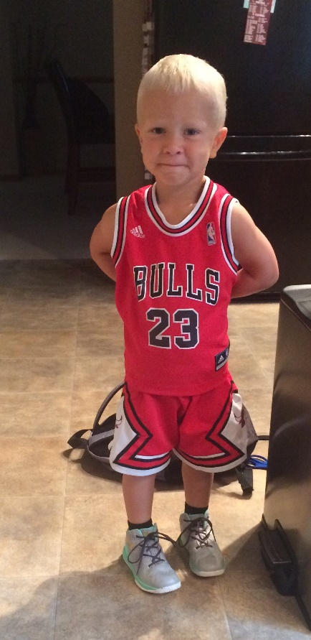
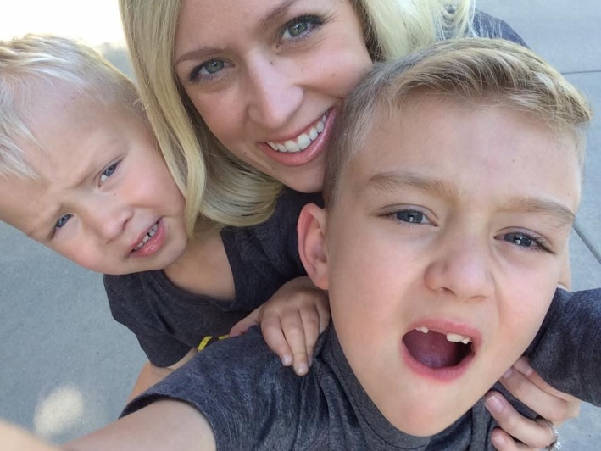
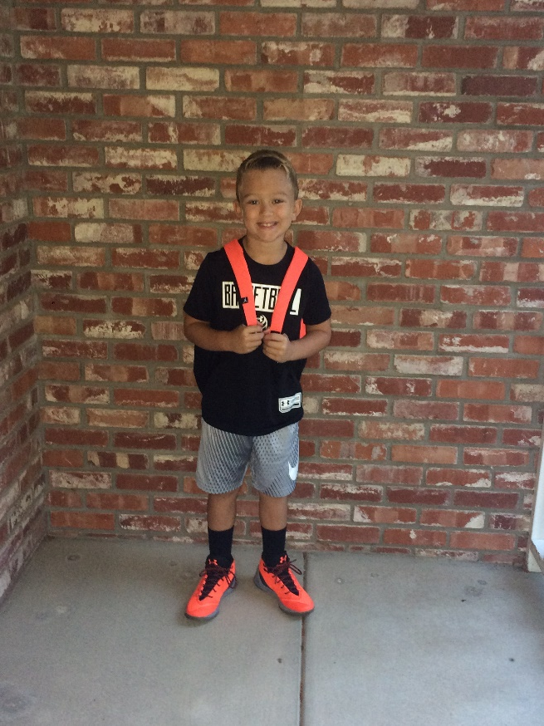
Family!!
I have a 7 year old son – Kyson
3 and a half year old son - Micah
My wife Jenny is an 6th grade counselor at Lefler

Slide 6
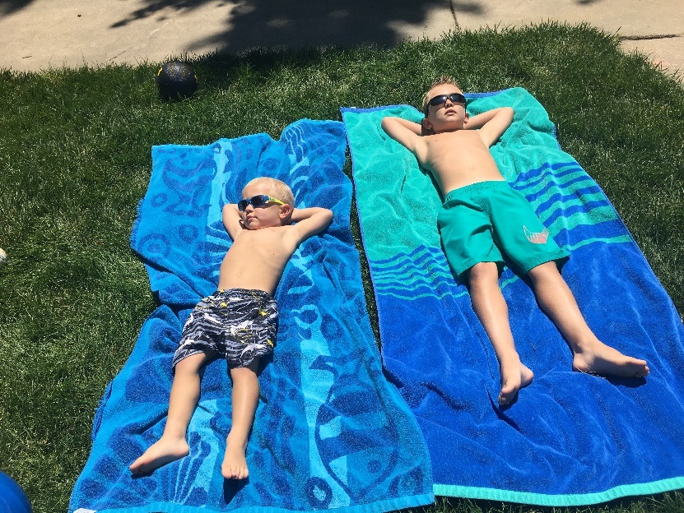
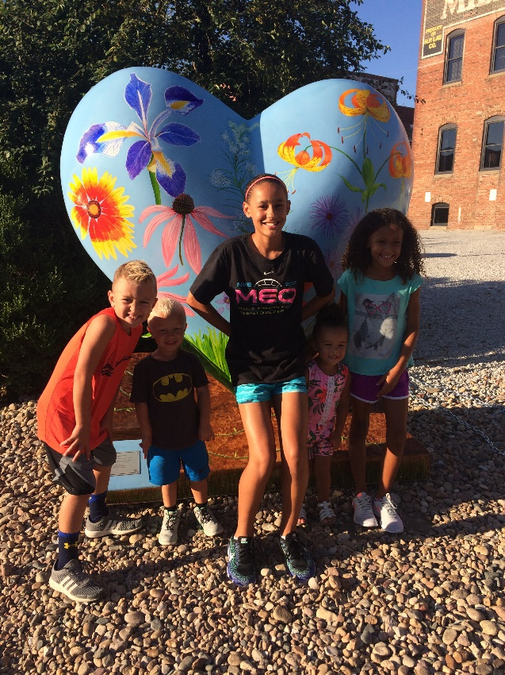
Pictures of my fam….

Slide 7
Questions?

