Slide 1
Personification
Giving humanlike qualities to objects and things

Slide 2
What is personification?
Personification is the act or giving of humanlike qualities to something that is not human or, in some cases, to something not even alive.
You use personification everyday without even knowing it.
“Time _______________ when you’re having fun!”
There are many reasons to use personification:
It can be used as a method of describing something so that others can understand it.
It can be used to emphasize a point.
It can be used in literature to create imagery.

Slide 3
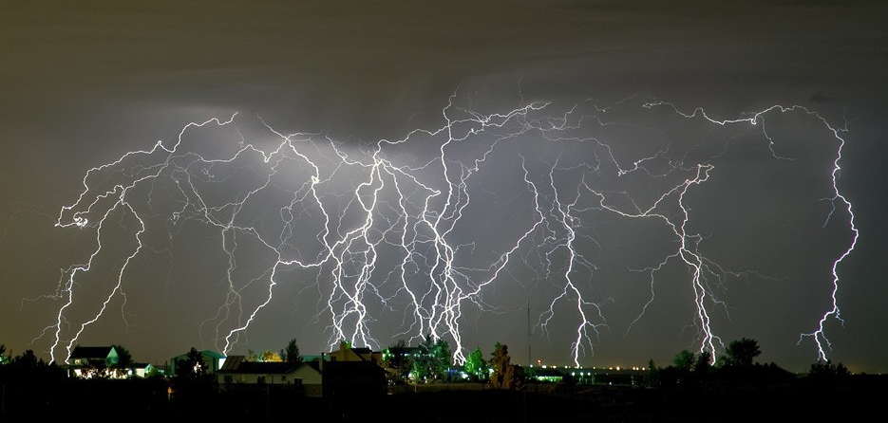
The lighting danced across the sky

Slide 4
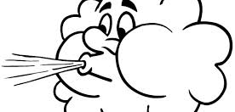
Can you hear the wind _________________?

Slide 5
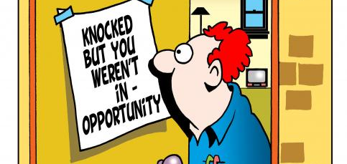
When opportunity knocks, open the door.

Slide 6
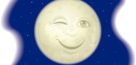
The moon__________ at me through the clouds above.

Slide 7
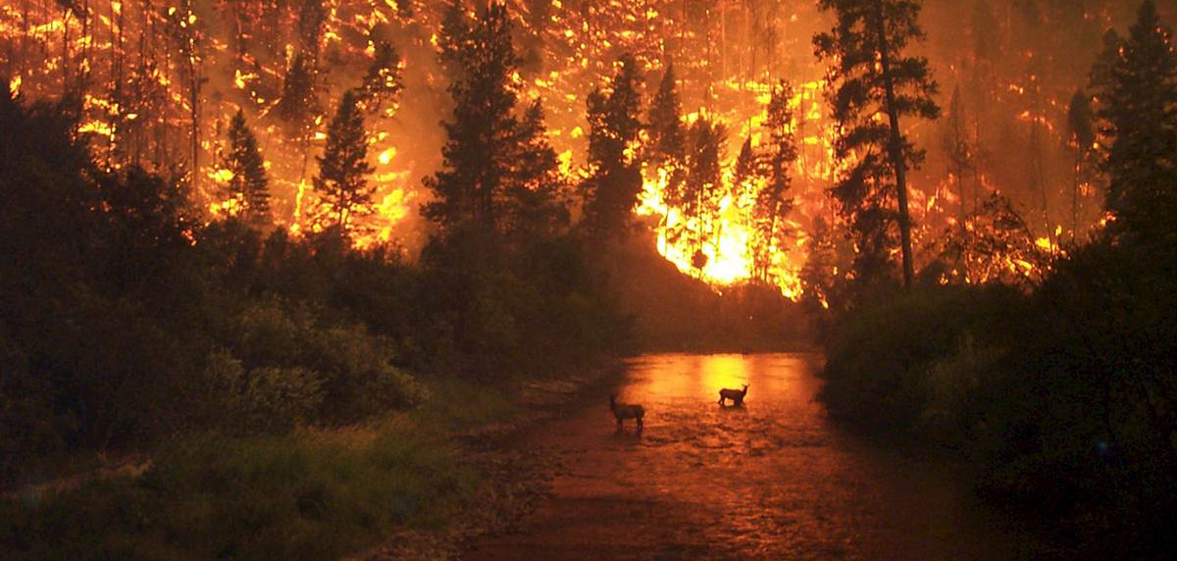
The fire ran wild.

Slide 8
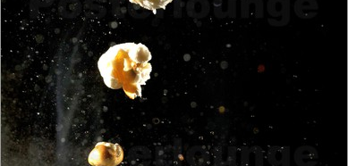
The popcorn __________ out of the pan.

Slide 9
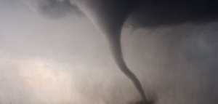
The tornado______through town without a care.

Slide 10
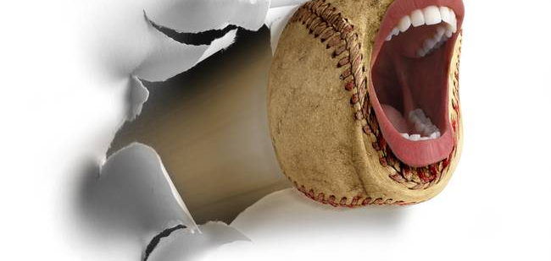
The baseball __________ all the way into the outfield.

Slide 11

When the books went on sale, they______ off the shelves.

Slide 12
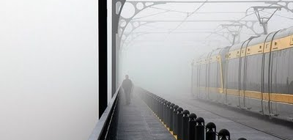

Slide 13
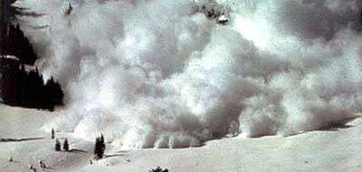

Slide 14
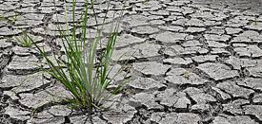

Slide 15
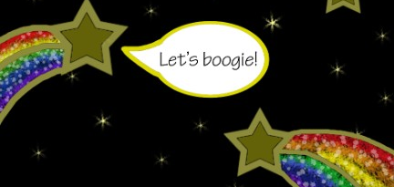

Slide 16
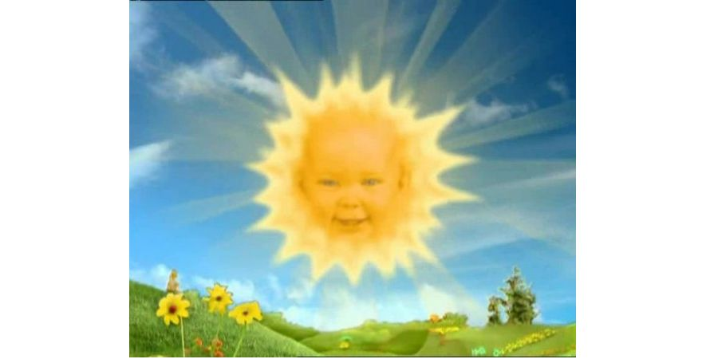

Slide 17
