Slide 1
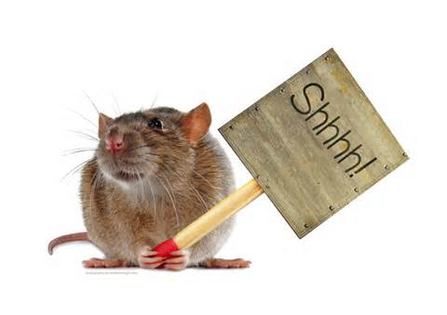
The kids tiptoed in as quiet as a mouse.
A. The kids likes cheese.
B. The kids are quiet or don’t talk.
C. The kids’ voices are squeaky.

Slide 2
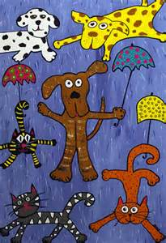
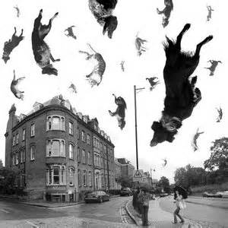
It’s raining cats and dogs!
A. Everyone should run and hide.
B. Dogs and cats escaped from the pound.
C. It’s pouring rain outside.

Slide 3
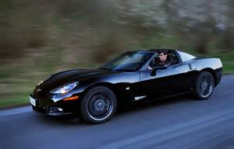
When Jon won the Corvette, he said, "Eat your heart out, guys."
A. Jon is a vampire.
B. Jon wants his friends to have a heart attack.
C. Jon wants others to wish they had a Corvette too.

Slide 4
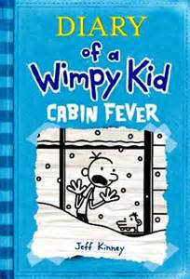
After three weeks of cold weather, I have cabin fever.
A. I am feeling depressed because I have to stay inside.
B. I have a rare kind of flu.
C. It means I am having a house party.

Slide 5
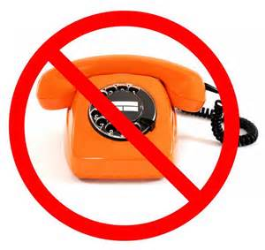
The doctor hasn't phoned. No news is good news.
A. The newspaper was not delivered.
B. If there is no news there is still a chance of good news.
C. The doctor is not a very good doctor.

Slide 6
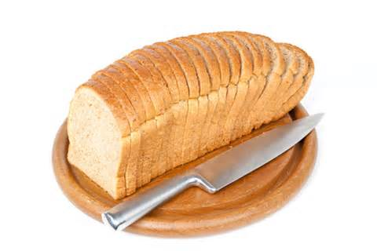
No matter how you slice it, we have to hire more help.
A. Everyone gets pie.
B. They must work late and not get paid.
C. It does not matter how you look at it, they need more help.

Slide 7
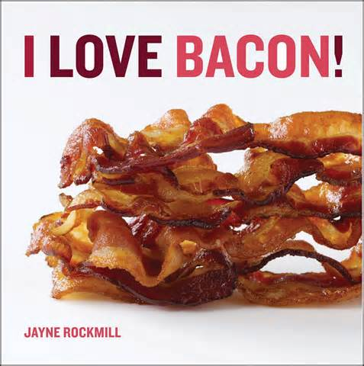
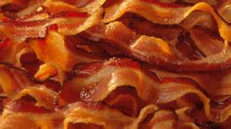
Since Stan lost his job, Louise is bringing home the bacon.
A. Louise is at the grocery store.
B. Louise is bringing home the paycheck.
C. Stan was a butcher.

Slide 8
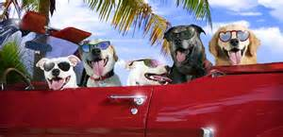
We like to watch baseball during the dog days of summer.
A. We like to watch baseball during the hottest days of summer.
B. August 1st is national dog day.
C. Baseball season starts during the summer.

Slide 9
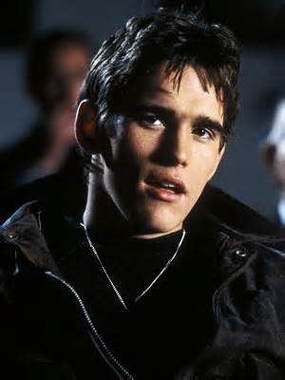
Amy is dying to know the name of the guy in the leather jacket.
A. Amy is scared of the man in the jacket.
B. Amy is taking attendance.
C. Amy is very curious about the man and she wants to know more about him.

Slide 10
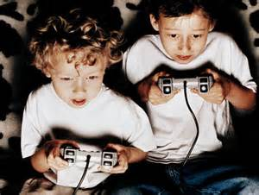
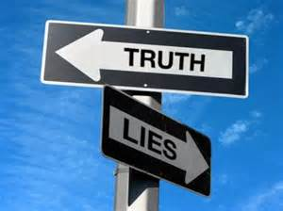
He's been playing games with us. We can't believe what he says.
A. He is a fun guy and he likes to play games.
B. He is a professional gambler.
C. He is dishonest and deceives people.

Slide 11
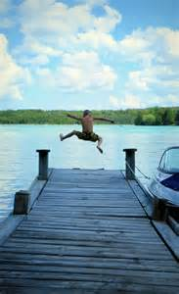
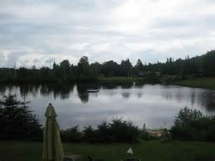
If he expects us to clean this mess, he can go jump in the lake.
A. He is dirty and needs to take a swim.
B. He is asking too much and he can go away.
C. He has a cabin on a lake.

Slide 12
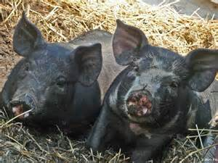
When the Huskers won the game, the fans went hog wild.
A. The fans ate ham.
B. The fans had a celebration.
C. The fans went hunting wild hogs.

Slide 13
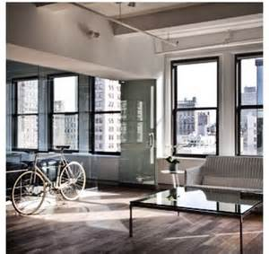
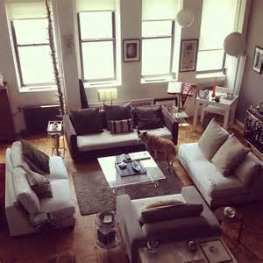
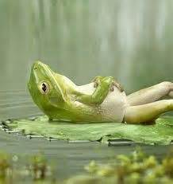
You have a nice pad, Nora. I love your leather furniture!
A. Nora has a nice apartment.
B. Nora is staying at a hotel.
C. Nora is shopping with a friend.

Slide 14
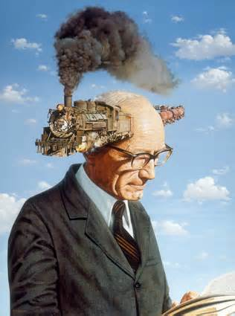
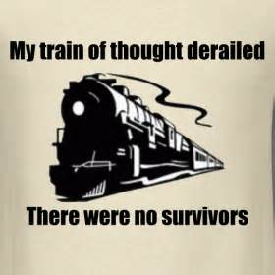
Don't interrupt me because I may lose my train of thought.
A. There is a noise in my head.
B. It’s too loud outside.
C. I forget the order of my words.

Slide 15
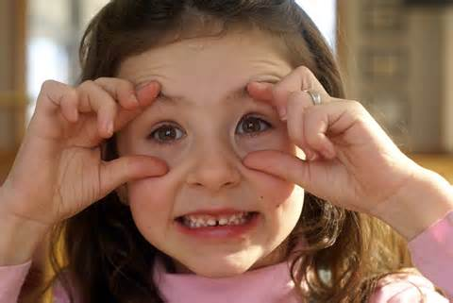
Keep your eyes peeled for birds. Watch for animals, too.
A. Put your contacts in you eyes.
B. Touch your eyeballs with your finger.
C. Watch carefully and pay attention.

Slide 16
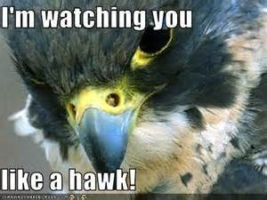
I couldn't do anything. The teacher was watching me like a hawk!
A. The teacher was watching carefully.
B. The teacher was teaching about hawks.
C. The teacher was looking out the window.

