Slide 1
Genres

Slide 2
A person’s account of his or her own life or part of it.
http://www.youtube.com/watch?v=-pKwD7ZTlfE&safety_mode=true&persist_safety_mode=1&safe=active

Slide 3
Autobiography

Slide 4
An account of a person’s life or of part of it, written or told by another person.
http://www.youtube.com/watch?v=pJWJbheBv9A&safety_mode=true&persist_safety_mode=1&safe=active

Slide 5
Biography

Slide 6
A story or novel that involves a contemporary time period (for when it was written) and realistic characters, events, and theme.
http://www.youtube.com/watch?v=pczPeIUHjps

Slide 7
Contemporary/realistic Fiction

Slide 8
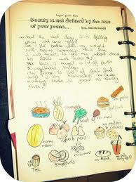
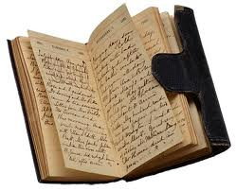
A written account of a persons daily events, experiences, and observations, with some reflection on personal relationships and concerns.

Slide 9
Diary

Slide 10
A short piece of nonfiction prose that examines a single subject.
http://www.youtube.com/watch?v=xx2Slxp0TkM

Slide 11
Essay

Slide 12
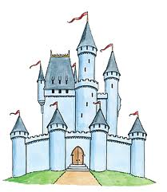
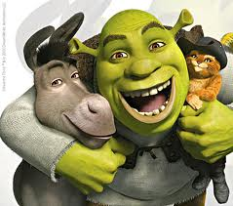
A highly imaginative story about characters, places, and events that, while sometimes believable, do not exist.

Slide 13
Fantasy

Slide 14
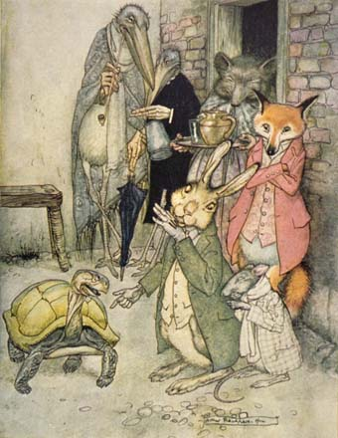
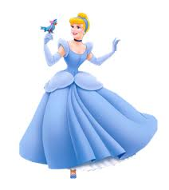
A story that has no known author and was originally passed on from one generation to another by word of mouth.

Slide 15
Folk Tale

Slide 16
A novel, story, or play set during a real historical era.

Slide 17
Historical Fiction

Slide 18
A written transcript of talking with someone who has expert knowledge about or experience with a certain topic.
http://www.youtube.com/watch?v=GCM5xSoXpus&feature=fvst

Slide 19
Interview transcript

Slide 20
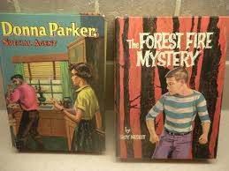
A narrative in which the chief element is usually a crime around which the plot is built.

Slide 21
Mystery

Slide 22
A story that explains something about the world and typically involves gods or other superhuman beings.
http://www.youtube.com/watch?v=PQxlwzWOXFE&feature=results_main&playnext=1&list=PL2481C50C37E4CF14

Slide 23
Myth

Slide 24
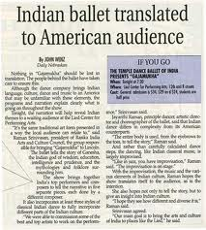
An essay or prose composition of nonfiction material published in a magazine.

Slide 25
Magazine article

Slide 26
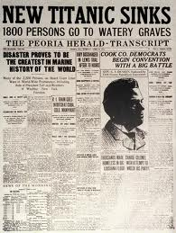
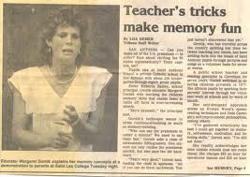
An essay or prose composition of nonfiction material published in a newspaper.

Slide 27
Newspaper article

Slide 28
Imaginary writing based on current or projected scientific and technological developments.

Slide 29
Science Fiction

Slide 30
A written transcript of spoken language for a particular purpose.
President Barack Obama delivered his State of the Union address Tuesday night. Below is a transcript of the speech.
Obama: Thank you so much. Thank you very much. Thank you. Thank you. Please, be seated.
Mr. Speaker, Mr. Vice President, members of Congress, distinguished guests, and fellow Americans, last month I went to Andrews Air Force Base and welcomed home some of our last troops to serve in Iraq. Together, we offered a final, proud salute to the colors under which more than a million of our fellow citizens fought, and several thousand gave their lives

Slide 31
Speech Transcript

