Slide 1
CLOSE UP WASHINGTON, DC
What Happens Here Can Change Your World!

Slide 2
Close Up: History and Mission
Non-profit and non-partisan organization founded in 1971.
Over 825,000 student and teacher alums.
Welcome nearly 17,000 students to DC each year.
Mission is to inform, inspire, and empower students to become more active citizens.

Slide 3
The Basics
Sunday, March 26 through Thursday, March 30, 2017
5 days/4 nights and includes a visit to Philadelphia
Focus on American History and how it impacts our lives today
Students from around the country (CO, MT, AZ, IL, CA, NE)

Slide 4
Schedule Walkthrough
Sunday, March 26
Fly from Lincoln (LNK) to Washington, DC
Our staff will be at the airport to meet the group at baggage claim.
Check-in at hotel
Meet your PI and workshop
Principles of Democracy activity
Room check
*Nighttime security/supervision

Slide 5
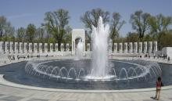
Schedule Walkthrough (cont.)
Monday, March 27
World War II and MLK Memorial Study Visits
Lunch in downtown DC
DC’s hidden gems
Arlington National Cemetery
White House photo-op
Dinner in the city
Mock Congress

Slide 6
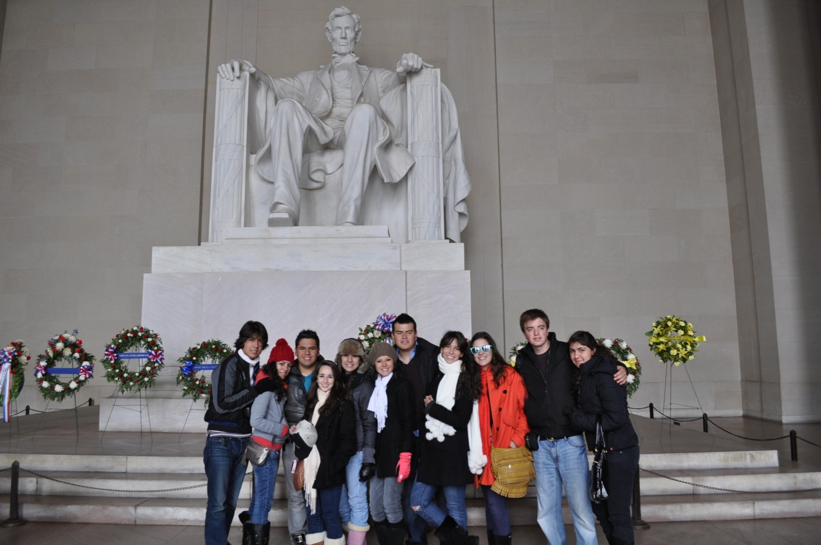
Schedule Walkthrough (cont.)
Tuesday, March 28
Capitol Hill Walking Workshop
See live debate
Committee Hearings
Supreme Court/Library of Congress
Lunch at a Smithsonian Museum
Lincoln Memorial, Korean War Memorial, and Vietnam Veterans Memorial
Night tour of Washington

Slide 7
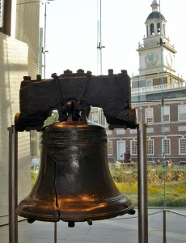
Schedule Walkthrough (cont.)
Wednesday, March 29
Coach bus trip to Philadelphia
National Constitution Center
Liberty Bell
Independence Hall
Congress Hall
President’s House
Return to DC and dinner

Slide 8
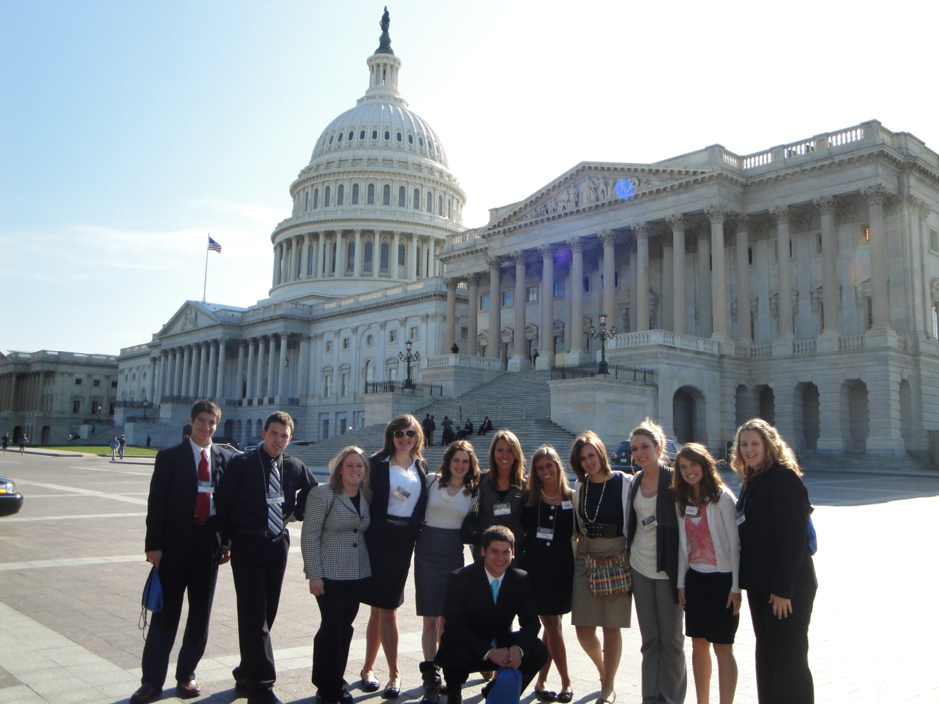
Schedule Walkthrough (cont.)
Thursday, March 30
Citizenship Send-Off
National Archives
American History Smithsonian Museum
Fly back to Lincoln

Slide 9
Security and Supervision
Close Up Program Instructors are with the students throughout each day.
All instructors have over 140 hours of training, criminal background checks, CPR/First Aid training, and a passion for education. These are NOT contracted tour guides.
Night monitors are in the hotel hallways from room check through breakfast the next morning.
‘Students’ Needs Assistant’ available to assist with sick students, on-call nurses, and special relationship with Georgetown University Medical Center.
Close Up Emergency Hotline number printed on schedules/nametags and operates throughout the week.

Slide 10
Price and What’s Included
Total student price is $1782
Airfare from LNK (excluding baggage fees)
Academic materials and instruction
Hotel accommodations
Three meals per day starting with dinner on Sunday, ending with lunch on Thursday.
All in-town transportation and transportation to/from Philly
24-hour supervision including night monitors
All admission fees
Secondary medical coverage and access to Georgetown University Medical Center
Close Up souvenir backpack, water bottle, and group photo
Travel insurance is optional but STRONGLY encouraged

Slide 11
Pricing and Deadlines
Total price is $1782.
$400 deposit is due no later than December 16, 2016.
ALL deposits are non-refundable and non-transferable when made.
Final payment due no later than March 2, 2017.
Cancellations after March 2, result in a 100% cancellation penalty.
You will need to get your participant ID and password from Mr. Bayne enroll at CloseUp.org.
Limited financial aid based on financial need (free/reduced lunch) is available.
Close Up is a 501(c)(3) organization…donations can be tax- deductible.

Slide 12
Shannon Ahrens| sahrens@closeup.org
800.CLOSEUP x3672 | www.CloseUp.org

