Slide 2
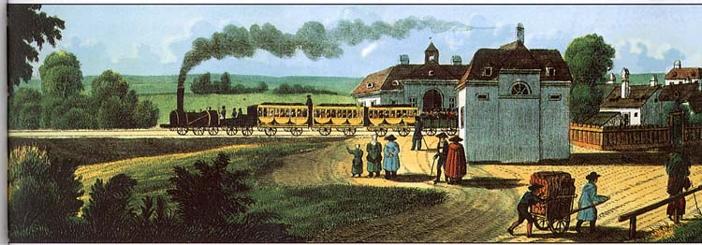
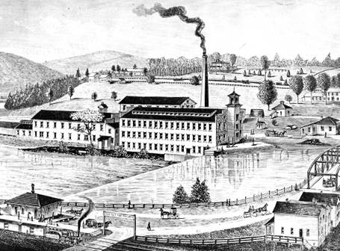
Industrial Growth
(1865-1914)
‹#›

Slide 3
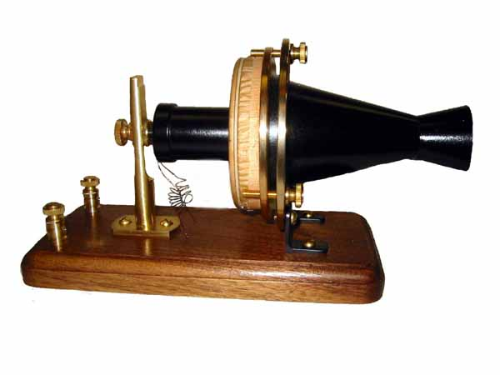
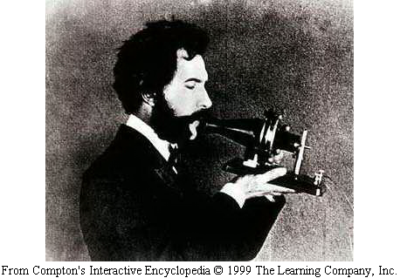
1. Railroads Spur Industry
In 1876 America held a giant exhibition showing off its industrial progress. In the past industrial growth lagged behind the Europeans. By 1900, things would change and Americans would produce more goods than any other country in the world.
1st Telephone
Alexander Graham Bell Alexander Graham Bell Shows off his invention called the telephone in 1876
‹#›

Slide 4
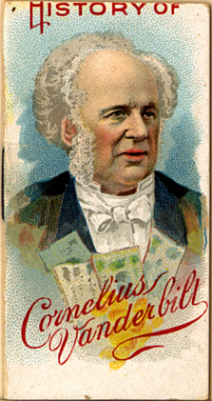
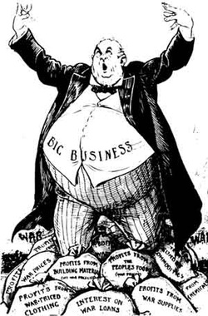
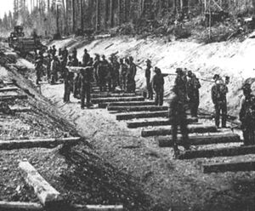
Consolidation
As railroads grew, they looked for other ways to become more efficient. Many railroad companies consolidated, or combined.
‹#›

Slide 5
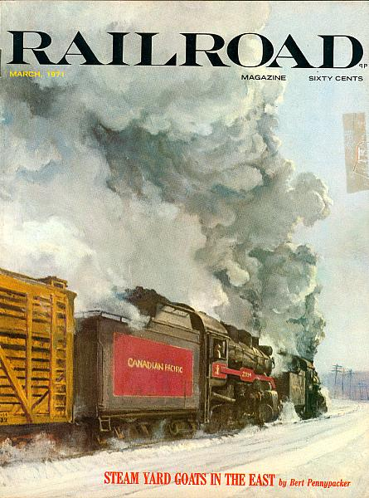
Soon there were too many railroad lines in some parts of the country. There were not enough people to use the trains so the companies could not make a profit. This created a cutthroat system. Cutthroat competition meant that the railroad owners would create programs to try to get people to ride their railroad line , exclusively! Some railroad companies had to consolidate, or combine to stay in business.
Who benefits from companies competing against one another?
‹#›

Slide 6
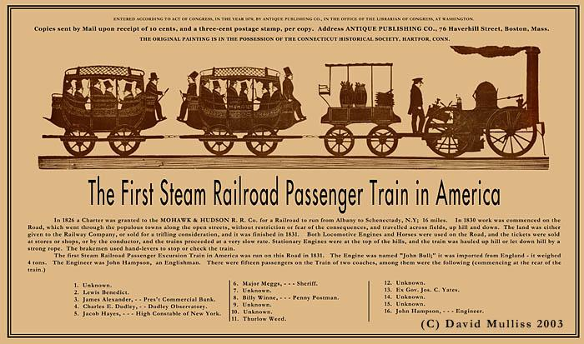
Railroad owners soon realized that cutthroat competition was hurting even larger lines. They looked for ways to end the competition. One method was pooling. In a pool, several railroad companies agreed to divide up the business in one area. They then fixed the prices at a high level. Collusion.
‹#›

Slide 7
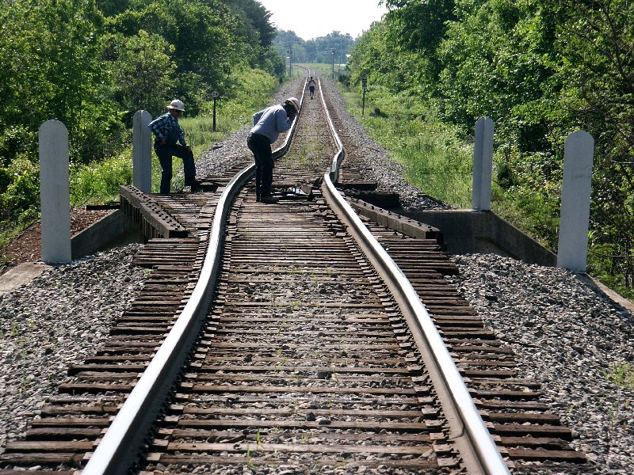
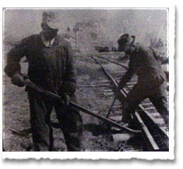
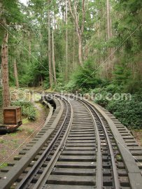
Railroads Fuel the Economy
Steelworkers turned millions of tons of iron into steel for tracks and engines. Railroads helped the lumber industry because lumberjacks cut down whole forests to supply the wood for railroad ties. Miners worked in mine shafts digging up coal to be used by the railroad engines. New towns grew where the railroad lines crossed. Railroads opened every corner of the country to settlement and growth. It brought people together, especially in the West.
‹#›

Slide 8
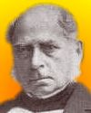
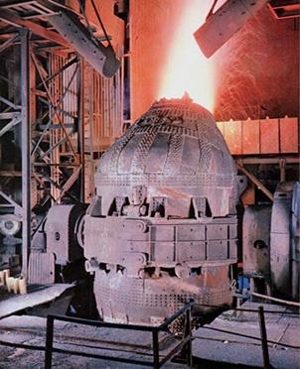
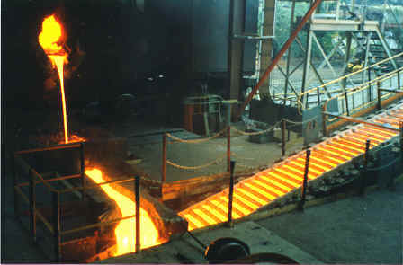
2. The Rise of Big Business
In the late 1850's William Kelly and Henry Bessemer In the late 1850's William Kelly and Henry Bessemer discovered a new way to make steel. It was called the Bessemer Process. It enabled steel makers to produce strong steel at a very low cost. As a result railroads laid lines of steel that would not rust easily and would last a long time.
I love
steel
‹#›

Slide 9
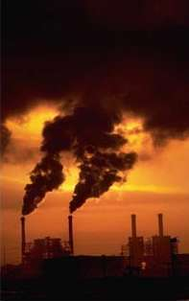
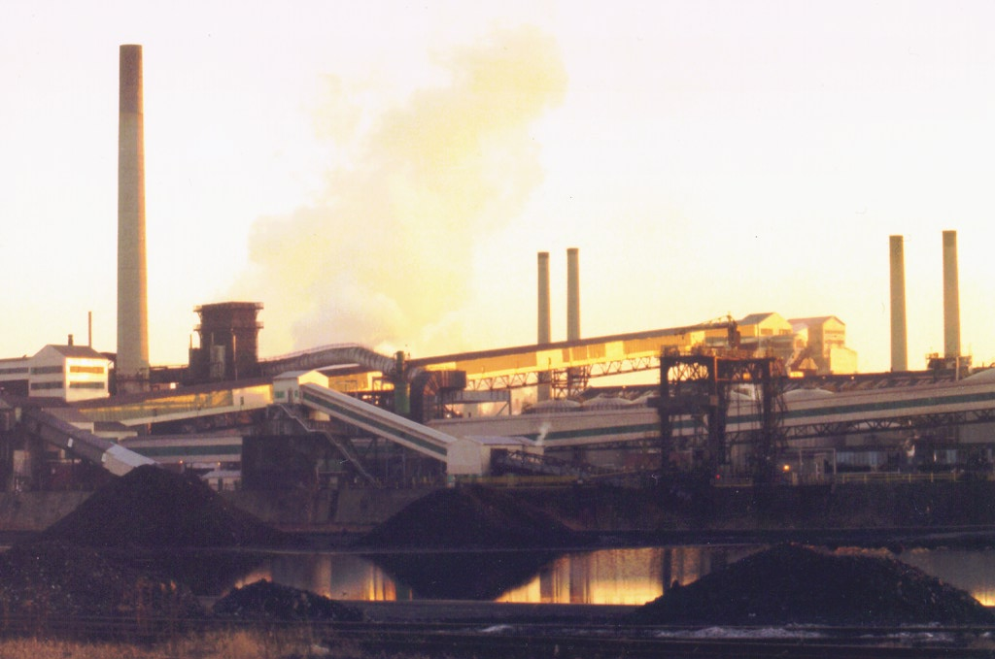
With this development, steel mills sprang up all over the country. Pittsburgh became the steel capital of the country. The steel mills brought jobs and prosperity to Pittsburgh. It also brought thick black smoke that covered the land called soot.
‹#›

Slide 10
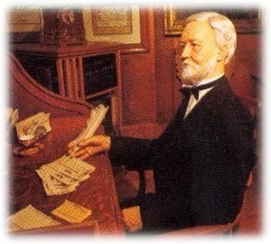
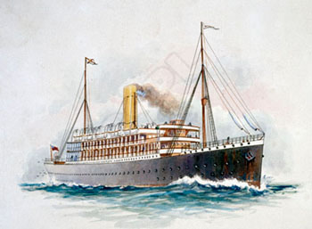
Andrew Carnegie made his fortune in the steel industry. In the 1870's he became familiar with the Bessemer Process. After borrowing money he built a steel mill in his hometown in Pennsylvania. Within a short time, Carnegie was earning huge profits from his steel mill.
‹#›

Slide 11
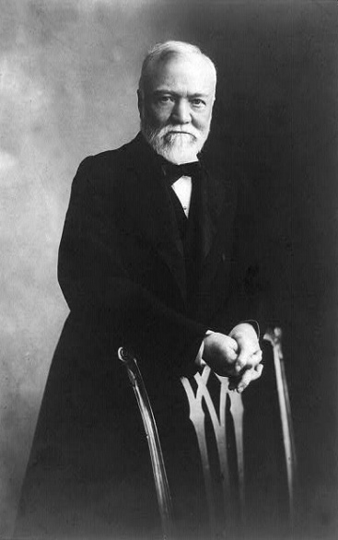
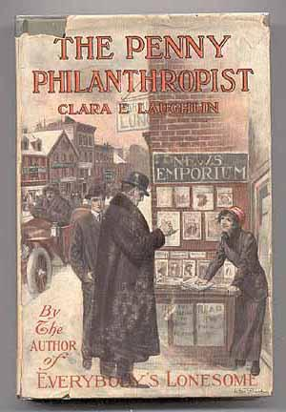
Carnegie also bought out steamship lines and warehouses. Soon Carnegie controlled all the steamship lines and warehouses. By 1900, Carnegie produced more steel than any country in the world.
Carnegie
Carnegie was a philanthropist; he believed the rich had the duty to improve society so he gave $60 million dollars to build public libraries. He donated millions of dollars to other charities.
Many people considered Carnegie a Robber Baron. A Robber Baron was a person that became rich through an unethical means.
‹#›

Slide 12
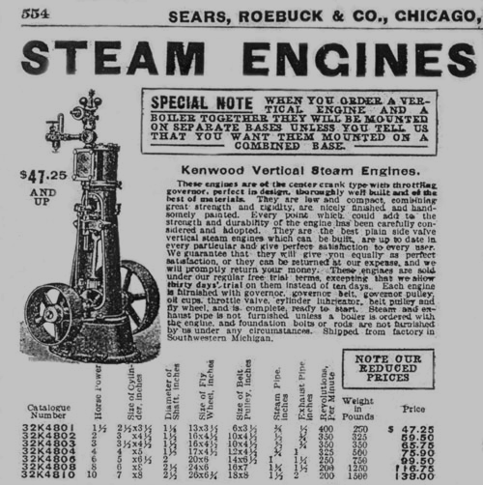
As railroads enabled big factories to produce items cheaper, many small local factories closed. When many local factories closed, big factories increased their products or output. Companies such as Montgomery Ward and Sears Roebuck sold products to western farmers by mail order in a catalog.
‹#›

Slide 13
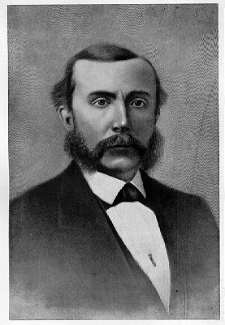
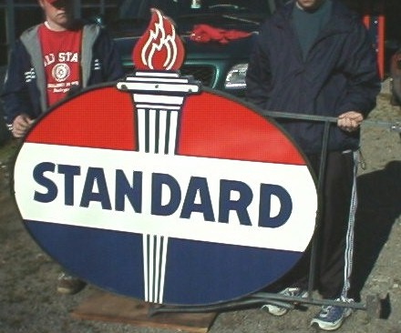
Oil Boom
In 1859, Americans discovered a valuable resource called oil in Pennsylvania. This product called oil could be used to power railroad trains and machines.
It the age of 23, David D. Rockefeller purchased his first oil refinery. He used his profits to buy other oil refineries. In 1865, Rockefeller purchased a company called the Standard Oil Company.
His company dominated the oil industry. He lowered his prices on oil to drive other oil companies out of business. When he drove other oil companies out of the business he created a monopoly. A monopoly is a company that controls all or nearly all the business of an industry.
‹#›

Slide 14
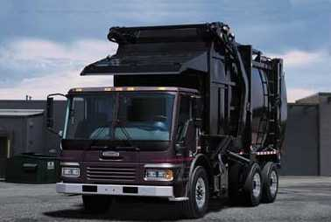
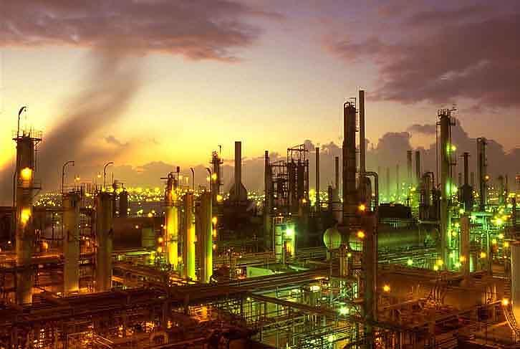
3. Inventions That Changed the Nation
The Patent Office had never seen a year like 1897. Averages of nearly 60 patents, or licenses for new inventions, were being generated every day. The United States had become the land of invention. These inventions made life easier in American homes. There were inventions and improvements in every area. Some of the inventions were:
An air brake for railroad engines invented by Granville Wood
A shoe-making machine invented by Jan Matzeliger
A device for refining oil invented by Elijah McCoy
‹#›

Slide 15
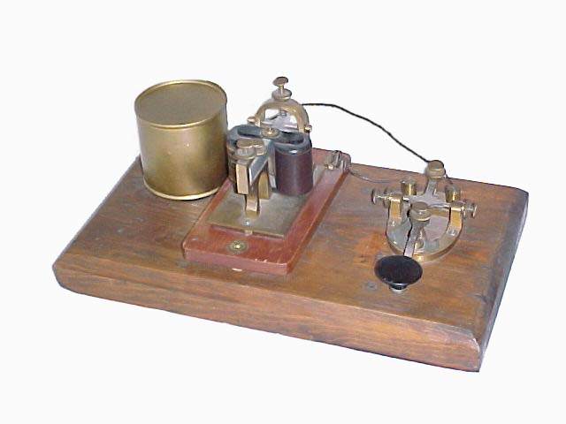
Speeding up Communication
Better communication was important to American businesses. The telegraph Better communication was important to American businesses. The telegraph helped quicken communication. Samuel Morse Better communication was important to American businesses. The telegraph helped quicken communication. Samuel Morse invented the telegraph. Morse's invention speeded up communication in the United States. It took weeks to get a message to Europe to arrive by boat. In 1858, Cyrus Field completed the layout for an underwater telegraph cable across the Atlantic Ocean. It wasn't until 1866, that the cable was completed and the first message was sent to Europe.
‹#›

Slide 16
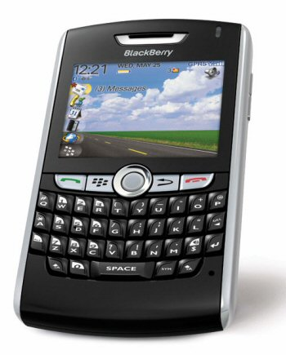
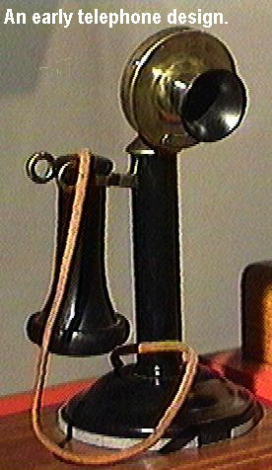
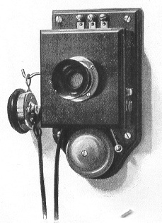
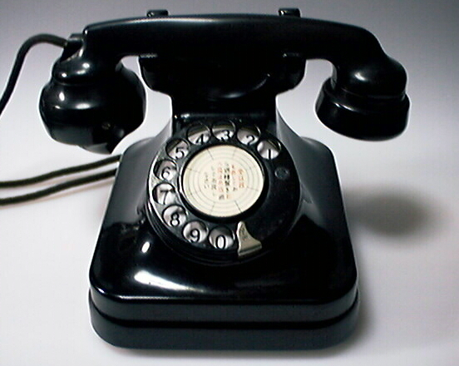
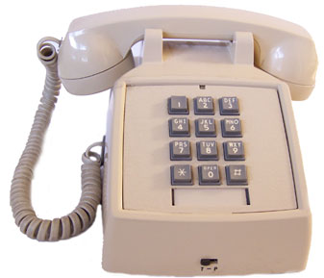
The Telephone
In 1876, Alexander Graham Bell invented the first telephone. Bell started the company called the Bell Telephone Company and made millions with his invention of the telephone. People no longer had to go to a telegraph office to send a message. Now they can talk on a telephone in their own home.
‹#›

Slide 17
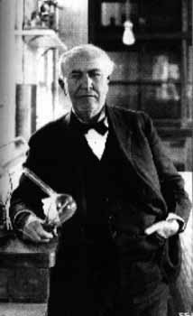
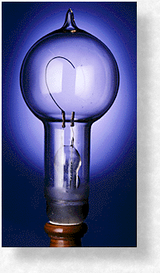
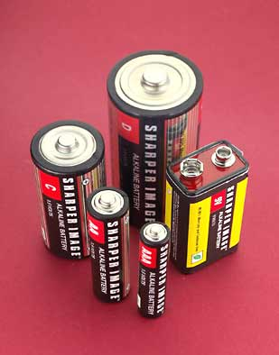
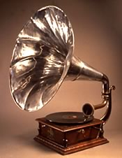
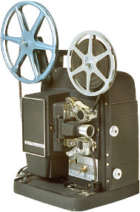
Electric Power
Thomas Edison invented the light bulb, In 1876, Thomas Edison opened a laboratory in New Jersey. Edison has a new approach to inventing. He turned inventing into a system. He had teams of people refine his ideas and come up with an invention. Thomas Edison invented the light bulb, the phonograph, the movie projector, and batteries.
‹#›

Slide 18
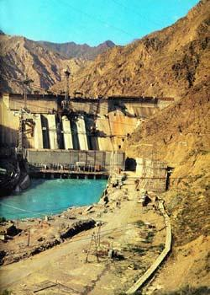
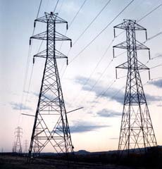
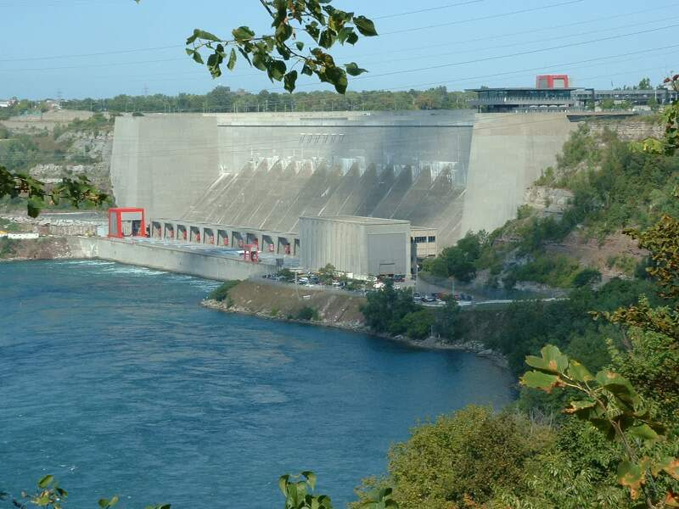
One of Edison's most important inventions was the creation of the electric power plant in 1882. Within a year Edison's invention was supplying electric power to homes and more power plants were built. Steam powered engines were soon replaced with safer electric motors.
‹#›

Slide 19
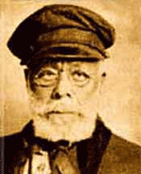
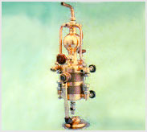
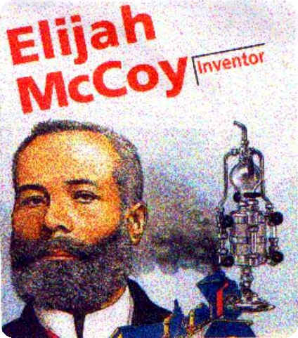
African American Inventors
Many African Americans contributed to the flood of inventions.
Elijah McCoy created a special device that oiled engines automatically in 1872. This device was widely used on railroad engines.
‹#›

Slide 20
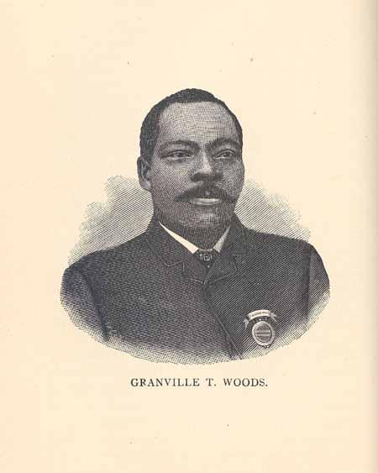
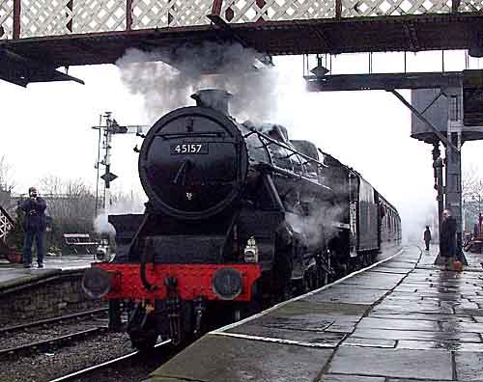
Granville T. Woods found a way to send telegraph messages between moving trains.
‹#›

Slide 21
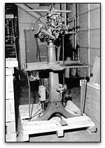
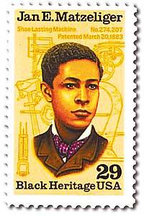
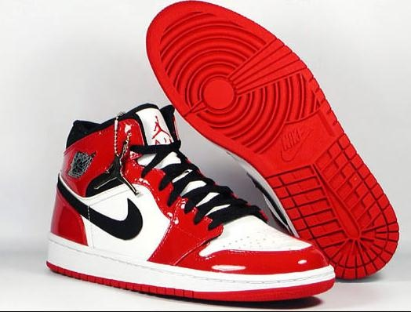
Jan Matzeliger Jan Matzeliger invented a machine that made shoes by machine. When an inventor created a new invention he registered it with the American government so no one else could create the same machine. This was called a patent.
‹#›

Slide 22
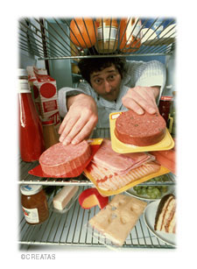
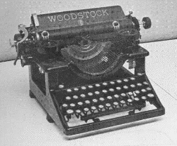
Other inventions were created for everyday use. Here are a few of them:
Christopher Sholes Christopher Sholes perfected the typewriter in 1868.
George Eastman George Eastman invented the lightweight Kodak Camera in 1888.
Gustavus Swift Gustavus Swift introduced refrigeration to the meat industry in the 1880's. As a result meat could be shipped across the country. Americans now ate more meat now.
‹#›

Slide 23
The Automobile
No single person invented the automobile. Europeans produced motorized vehicles as easily back as the 1860's. Americans began building cars in the 1890's. However, only the wealthy could afford them.
‹#›

Slide 24
Henry Ford Henry Ford revolutionized auto making. He wanted to build an automobile that everyone could afford. In 1913 he introduced the assembly line. On the assembly line car frames edged along a moving belt. Workers added the parts as the cars passed by. Soon other industries adopted his idea.
‹#›

Slide 25
Why the assembly line is awesome
This is my dog Red’s future house.
It has taken me three days to do this by myself. Not even close to being done.

Slide 26
Henry Ford's assembly line allowed the mass production of cars. Mass production means making large quantities of a product quickly and cheaply. Because of mass production, Ford could sell his cars at a lower price than the other automakers could.
‹#›

Slide 27
Cars became very popular. Slowly attitudes changed and “horseless carriages” or cars were accepted by the American people. In 1900, only 8,000 Americans owned cars. By 1917, more than 4.5 million autos were chugging along American roads.
‹#›

Slide 28
The Airplane
In Ohio, two bicycle mechanics, Orville and Wilbur Wright were experimenting with another new method of transportation, flying. The Wright brothers tested hundreds of designs. Finally, on December 17, 1903, they were ready to test their first “flying machine.”At Kitty Hawk, North Carolina a plane powered by a small engine stayed in the air for 12 seconds and 120 feet. Soon afterwards, pioneers built better planes and made longer flights.
We can fly!
‹#›

Slide 29
4. The Rise of Organized Labor
The factories of 1800 drew workers from many different backgrounds. Millions of immigrants coming to the United States from Europe and Asia in the late 1800's also found job and factories. During the 1870's to 1880's, the friendly relationship between the worker and boss declined. In giant factories workers did not chat with their employers.
African American, immigrants, women, and children were paid less than native-born white men were.
‹#›

Slide 30
Factories were filled with dangerous conditions. Owners spent little time to improve the safety and comfort of workers. Some workers were killed or seriously injured on their jobs in factories. Here are some of the problems workers faced:
Textile workers inhaled dangerous lung-damaging dust and fibers.
Coal miners had “cave ins” that buried workers.
Steelworkers were injured by red-hot vats of steel.
I would rather be in school
‹#›

Slide 31
In 1900, two million children under the age of 15 worked throughout the country. Many factory owners hired children to work for lower wages, or pay.
Children did many hazardous jobs. They worked in textile mills, coal mines, tobacco factories, and garment workshops. Working children could not attend school.
‹#›

Slide 32
The Pullman Strike
Starting in the 1870's many workers went on strike. Owner felt free to crush unions in any way they could. The biggest strike was called the Pullman Strike. In 1894 George Pullman cut the pay workers at his railroad factory. He did not lower rents for people paid for company owned houses.
Workers walked off the job in protest. The federal judge issued an injunction to the workers walking off the job. An injunction is a court order to do something. Leaders of the Pullman Strike were jailed for violating the injunction.
‹#›

Slide 33
UNIONS
Some argue Unions help workers get better wages. Others argue they hurt unemployment and prices.
The result of these conditions and so many people working together is Labor Unions.
Unions are different in other parts of the country and in different jobs.

