Slide 1
Understanding Plagiarism
Donna Anderson
Lincoln High School

Slide 2
Defining Plagiarism
Presenting someone else’s words or ideas as your own
Examples:
Quoting or paraphrasing material without citing a source
Quoting a source without using quotation marks
Buying or downloading a paper online
Copying work done by another person
Citing sources you didn’t use
Turning in the same paper for more than one class without the permission from both teachers
Source: Put an End to Plagiarism in Your Classroom. (2002). Retrieved August 14, 2016, from http://www.educationworld.com/a_curr/curr390.shtml

Slide 3
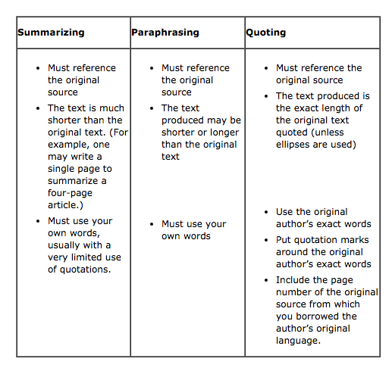
Source: Elder, C., Pflugfelder, E., & Angeli, E. (10, November 30). Handout: Summary, Paraphrase, and Quotation in Context. Retrieved August 14, 2016, from https://owl.english.purdue.edu/owl/section/3/

Slide 4
What do I cite?
Must Cite
Don’t need to Cite
Sources of every quote, every paraphrased passage and summarized idea you use in a paper
If it’s not your own idea you must cite it!
Commonly known facts, dates, or definitions

Slide 5
How do I cite information?
Depends on the class or instructor
Commonly used citations are MLA, APA & Chicago
If it is summarized…include author name before or after the idea, use footnotes, do not need to include quotations
If it is paraphrased… include author name before or after the idea, use footnotes, do not need to include quotations
If it is a direct quote…must be enclosed in quotations and name the author immediately before or after the quote
Notes:
Break this down to make it more interactive

Slide 6
MLA vs. APA
MLA
APA
Author
Title of source
Title of container
Other contributors
Version
Number
Publisher
Publication Date
Location
Author (only initial)
Publication Date
Title of Source
Title of container
Location
Publisher

Slide 7
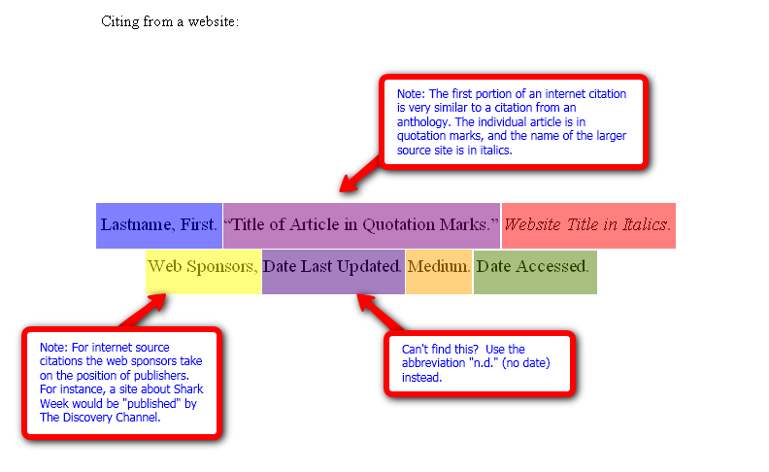
MLA

Slide 8
In-text Citations - MLA
Examples:
Wordsworth stated that Romantic poetry was marked by a “spontaneous overflow of powerful feelings” (263).
Romantic poetry is characterized by the “spontaneous overflow of powerful feelings” (Wordsworth 263).
Wordsworth extensively explored the role of emotion in the creative process (263).

Slide 9
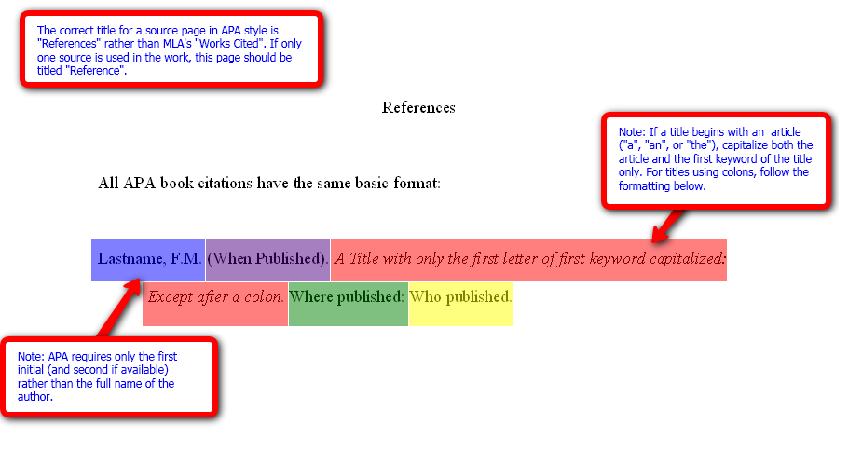
APA

Slide 10
In-Text Citations - APA
Examples:
One study found that the most important element in comprehending non-native speech is familiarity with the topic (Gass & Varonis, 1984).
Gass and Varonis (1984) found that the most important element in comprehending non-native speech is familiarity with the topic.
One study found that “the listeners familiarity with the topic of discourse greatly facilitates the interpretation of the entire message” (Gass & Varonis, 1984, p 85).

Slide 11
Tools
TurnItIn.com
CitationMachine.net

Slide 12
References
Put an End to Plagiarism in Your Classroom. (2002). Retrieved August 14, 2016, from http://www.educationworld.com/a_curr/curr390.shtml
Elder, C., Pflugfelder, E., & Angeli, E. (10, November 30). Handout: Summary, Paraphrase, and Quotation in Context. Retrieved August 14, 2016, from https://owl.english.purdue.edu/owl/section/3/
Diagrams for MLA & APA Citations. (n.d.). Retrieved August 16, 2016, from http://www.roanestate.edu/owl/mla-format4websites.htm
Penn State University Libraries. (n.d.). Retrieved August 16, 2016, from http://psu.libguides.com/apaquickguide/intext

