Slide 1
Exploration

Slide 2
Motivations
God, Gold, & Glory

Slide 3
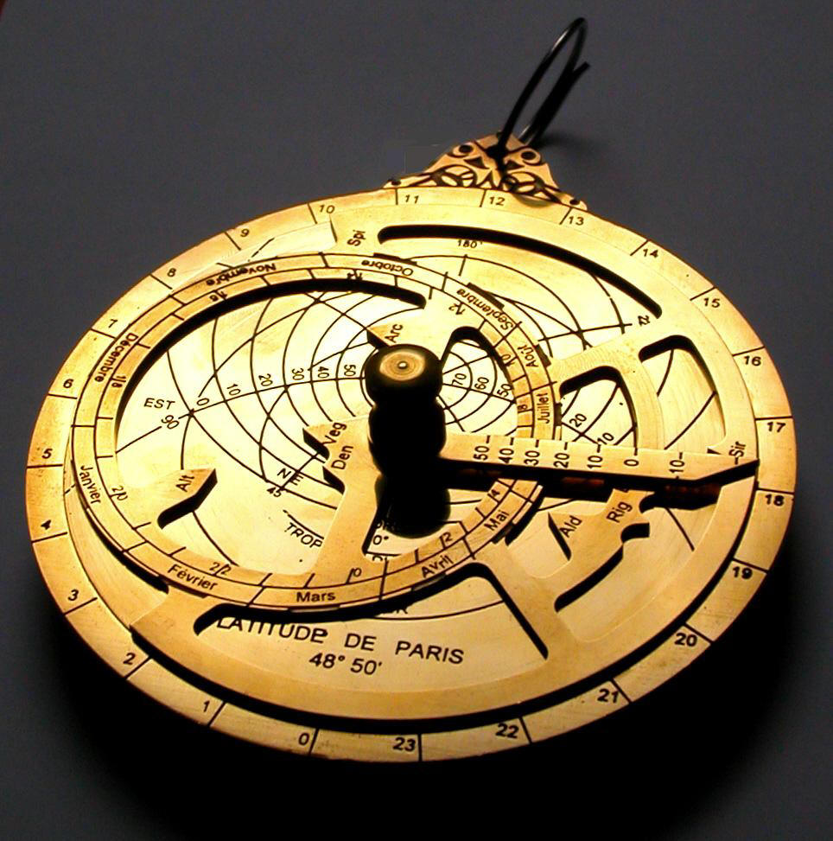
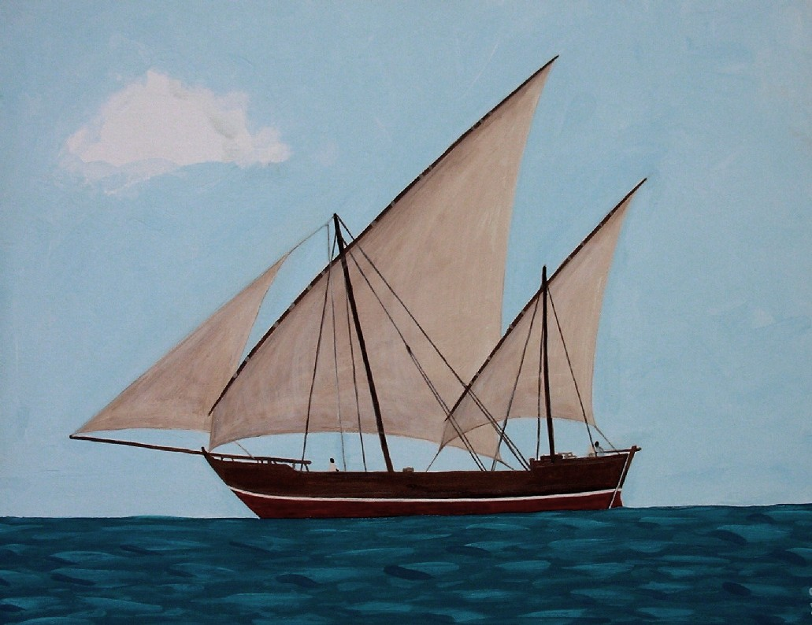
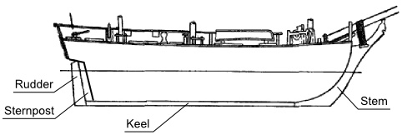
Technology
Astrolabe, Compass, Sternpost rudder, Lateen sails

Slide 4
Prince Henry the navigator

Slide 5
PORTUGESE EXPLORATION

Slide 6
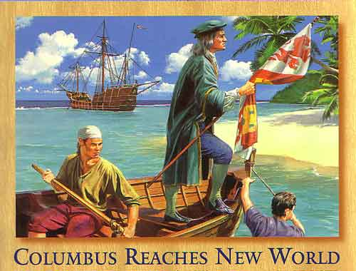
Columbus
Ferdinand & Isabella
Pinta, Nina, Santa Maria
Bahamas, Hispanola
4 voyages

Slide 7
Magellan

Slide 8
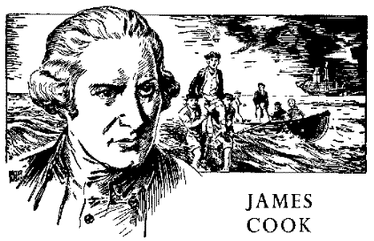
James cook
Hawaii & Australia

Slide 9
Dutch Trading Posts

Slide 10
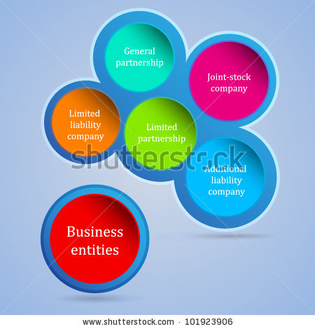
Joint stock companies
Spread risks, government supported, privately owned

Slide 11
Columbian exchange

Slide 12
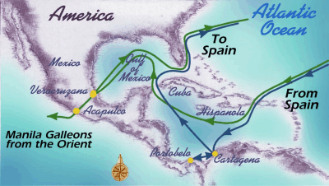
Silver extract
Pacific trade of silver

