Slide 1
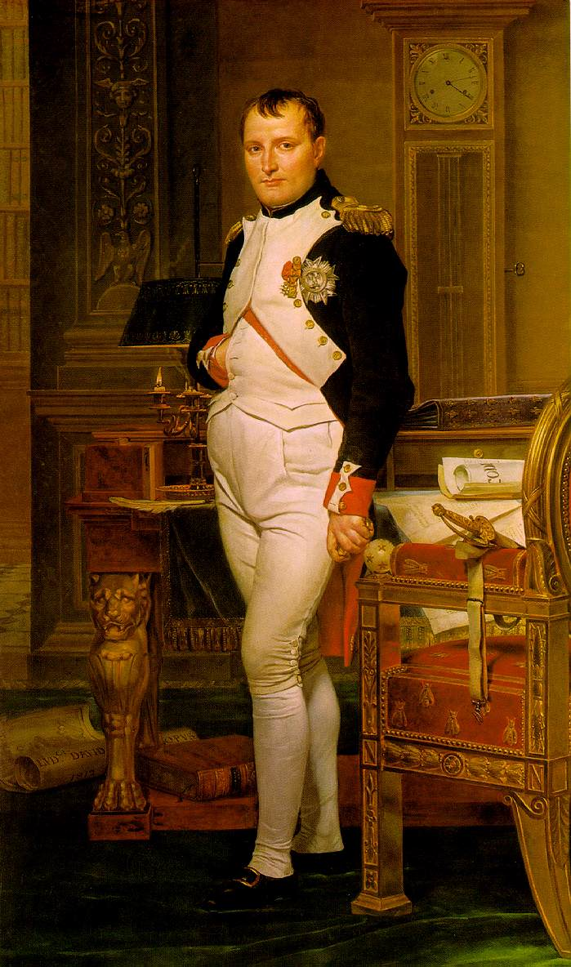
The Age of Napoléon
1799-1815

Slide 2
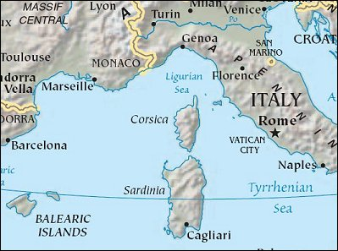
Napoléon Bonaparte
Born 1769 - Corsica
Military School
Army

Slide 3
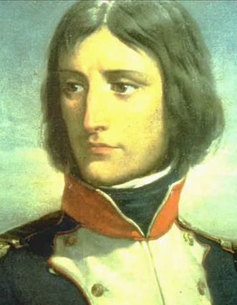
Early Military Career
1792 - Captain
1794 - Brigadier General
1796 - Commander of the French Armies in Italy
Original “Blitzkrieg”
Easily defeated enemies
Strong leader

Slide 4
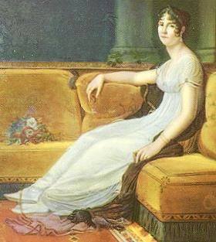
Love Life
Joséphine Beauharnais
Widow
French Revolution
Married 1796

Slide 5
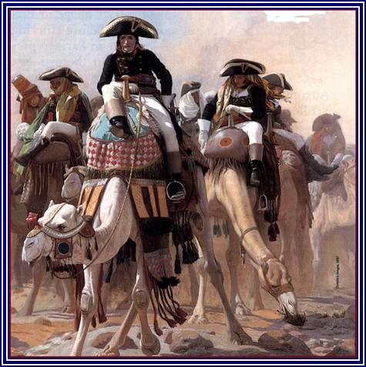
Egyptian Campaign
1797 - attempt to strike Britain indirectly
If France could secure Egypt, it would cripple Britain’s trade route to India
Disaster strikes
Professional
Personal

Slide 6
Return Home
1799 - defeated, but did bring home the Rosetta Stone
Divorce?
Stayed with Josephine, but had numerous affairs over the years as a payback

Slide 7
Coup d’État
1799 - overthrew Directory
Became “First Consul”
1802 - “Consul for Life”
1804 - Emperor of France

Slide 8
Concordat of 1801
Negotiated peace with the Catholic Church
Napoléon recognized Catholicism as the national religion & in turn, pope allowed state to keep property seized during revolution

Slide 9
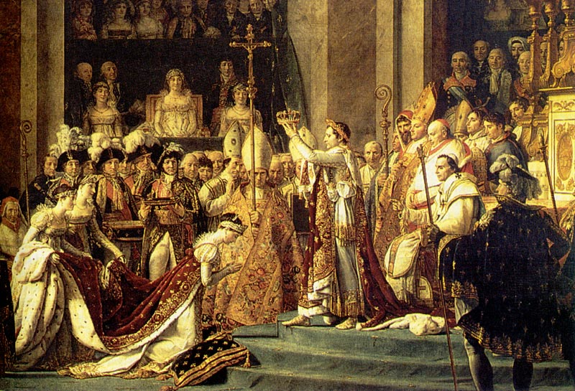
Becoming Emperor

Slide 10
Legal System
Prior to the FR, France had over 300 different legal systems
Under Napoleon, 7 law codes were created
Most important = the Civil Code, or Code Napoléon

Slide 11
Code Napoléon (1804)
Preserved many revolutionary principles:
Equality of all citizens before the law
Right of the individual to choose a profession
Religious toleration
Abolition of serfdom/feudal system

Slide 12
Women and the Code
Civil Code was a step back for women
More difficult to:
Divorce husbands
Inherit property
Not allowed to testify in court
Women = officially “less equal than men”

Slide 13
New Bureaucracy
Created a strong centralized administration
Officials hired on merit, not birthright

Slide 14
New Aristocracy
1808 - 1814 - created 3,200 new nobles
Based on meritorious service to France
Most (60%) were military officers and were middle class in origin
Only 22% were from “old” aristocratic families

Slide 15
Napoleonic Wars
From 1807 - 1812, Napoleon was the master of Europe
Empire comprised of 3 major parts:
The French Empire
Dependent States
Allied States

Slide 16
Napoleon’s Nemesis: Great Britain
One place Napoleon just couldn’t defeat
England = strong navy
France + Spain = invasion of GB (1805)
Failed (infamous Battle of Trafalgar)
Implemented Continental System to disrupt GB’s trade & cripple it economically
Failed (allies didn’t want Napoleon telling them what to do)

Slide 17
Nationalism
A sense of unique identity of a people based on common language, religion, and national symbols
Napoleon created a sense of nationalism throughout the places he conquered (commonality = their hatred of him)

Slide 18
The Russian Campaign
June 1812 - 600,000 French troops invaded Russia
Expected quick victory
Russians refused to fight

Slide 19
Russian Campaign
Russians retreated deeper into their own country
Burned their own villages & countryside
WHY???

Slide 20
Defeat in Russia
French were:
Deep in Russia
Winter (no proper clothes)
Without food/supplies
Demoralized
What do you think Napoleon did?

Slide 21
The Great Retreat
As Napoleon and his troops retreated, many died of starvation and freezing
When they reached Poland in January 1813, only 40,000 of the original 600,000 were alive

Slide 22
Napoleon Falls
Other European states attacked France while it was weak
Paris was captured in March 1814
Napoleon was sent into exile on the island of Elba (off NW Coast of Italy)
Monarchy restored - Louis XVIII (Louis XVI’s brother) now king

Slide 23
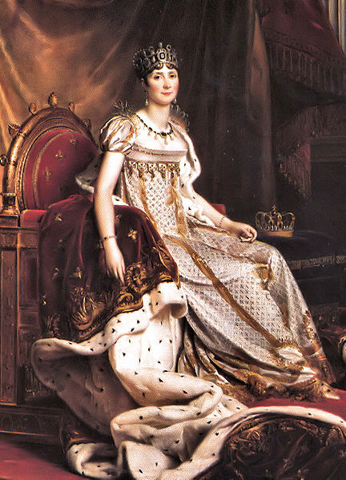
What About Josephine?
Because she could not produce an heir, Napoleon divorced her January 10, 1810
He remarried Marie-Louise of Austria 2 months later (who did give him a son)
Josephine died of pneumonia on May 29, 1814

Slide 24
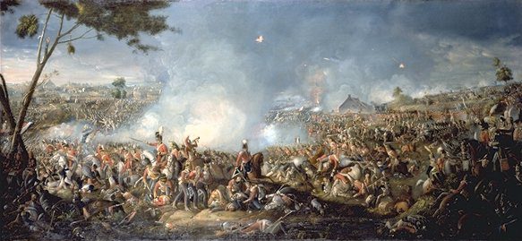
He’s Baaaack…
Napoleon returned March 20, 1815
He would rule for 100 days
He raised an army and proceeded to Waterloo, Belgium

Slide 25
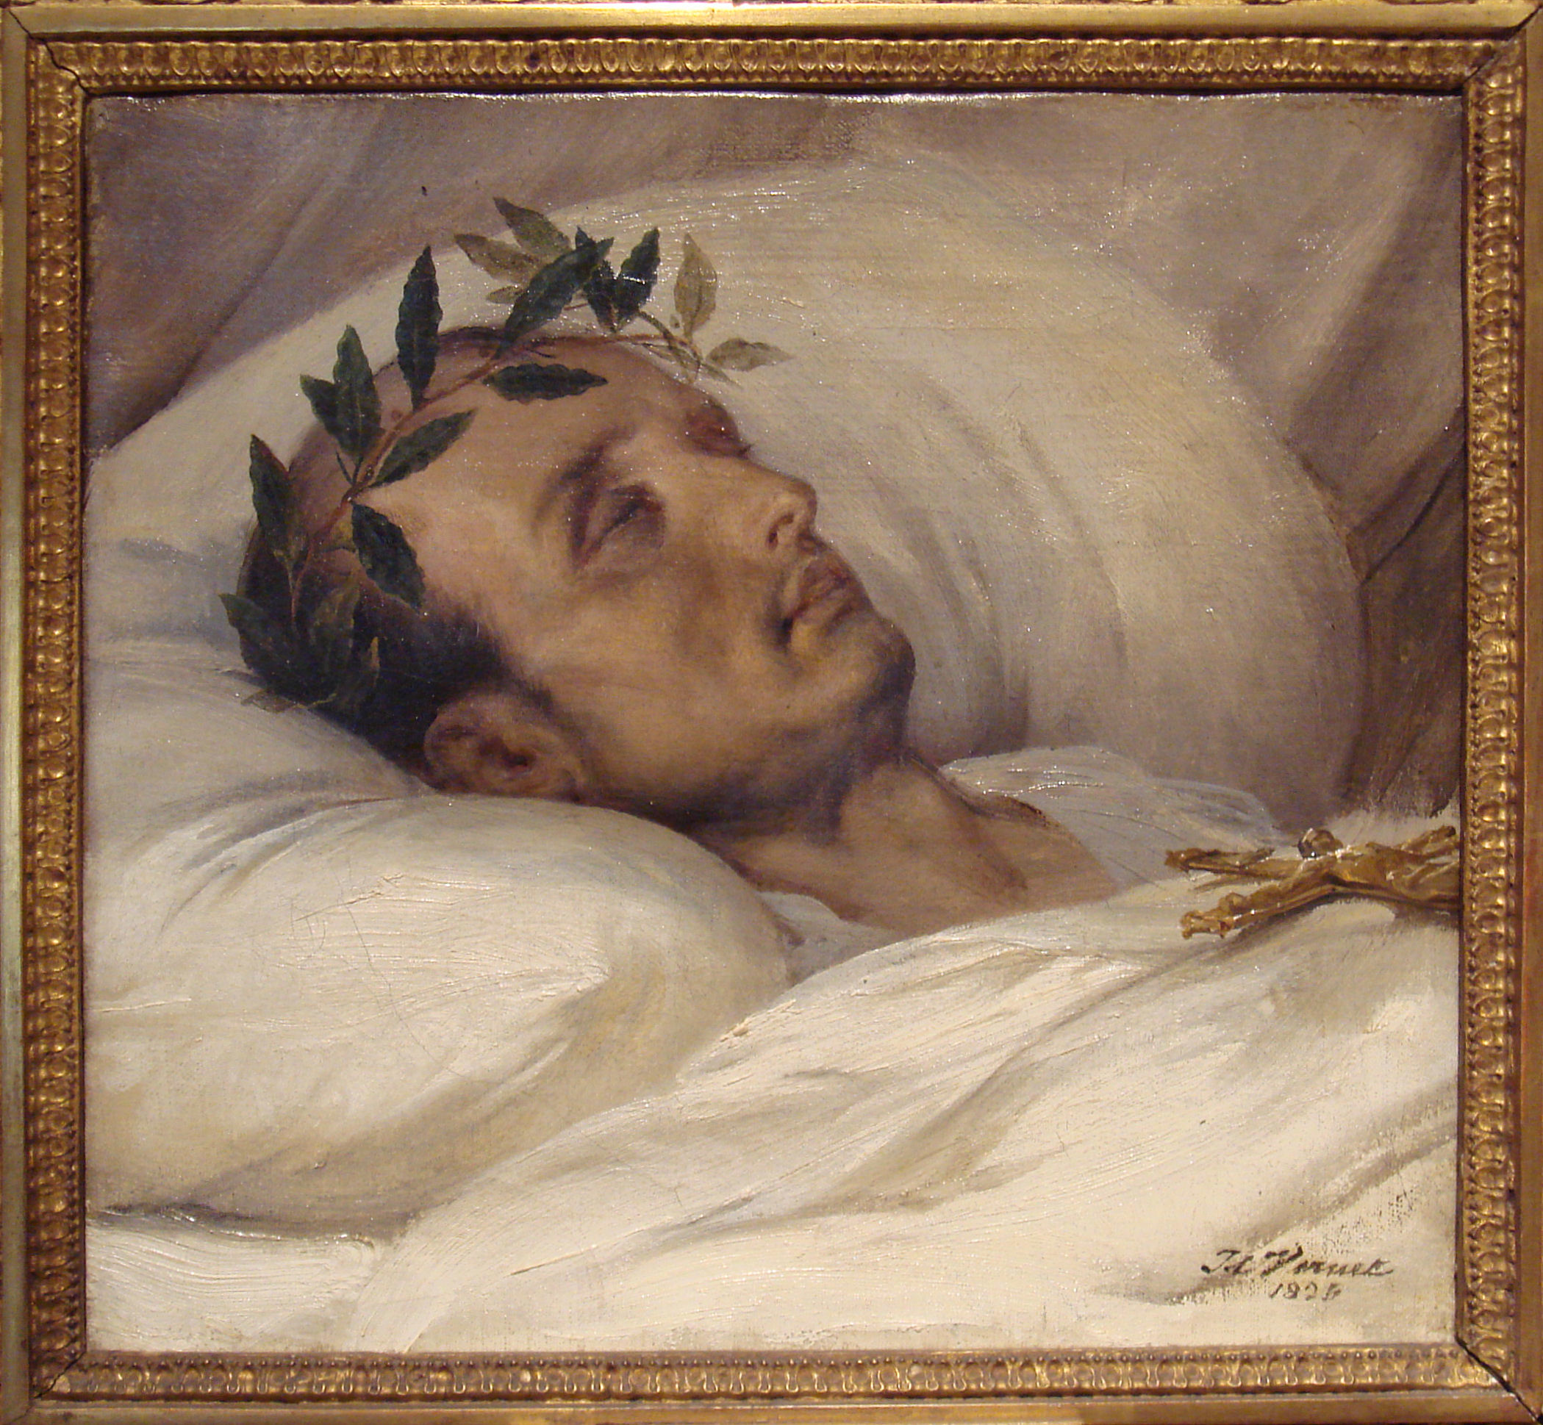
Waterloo
Napoleon was defeated by the Duke of Wellington (commanding Prussian & British armies)
Exiled to St. Helena
He died there in 1821 of stomach cancer
Last words, “France, the army, Josephine…”

Slide 26
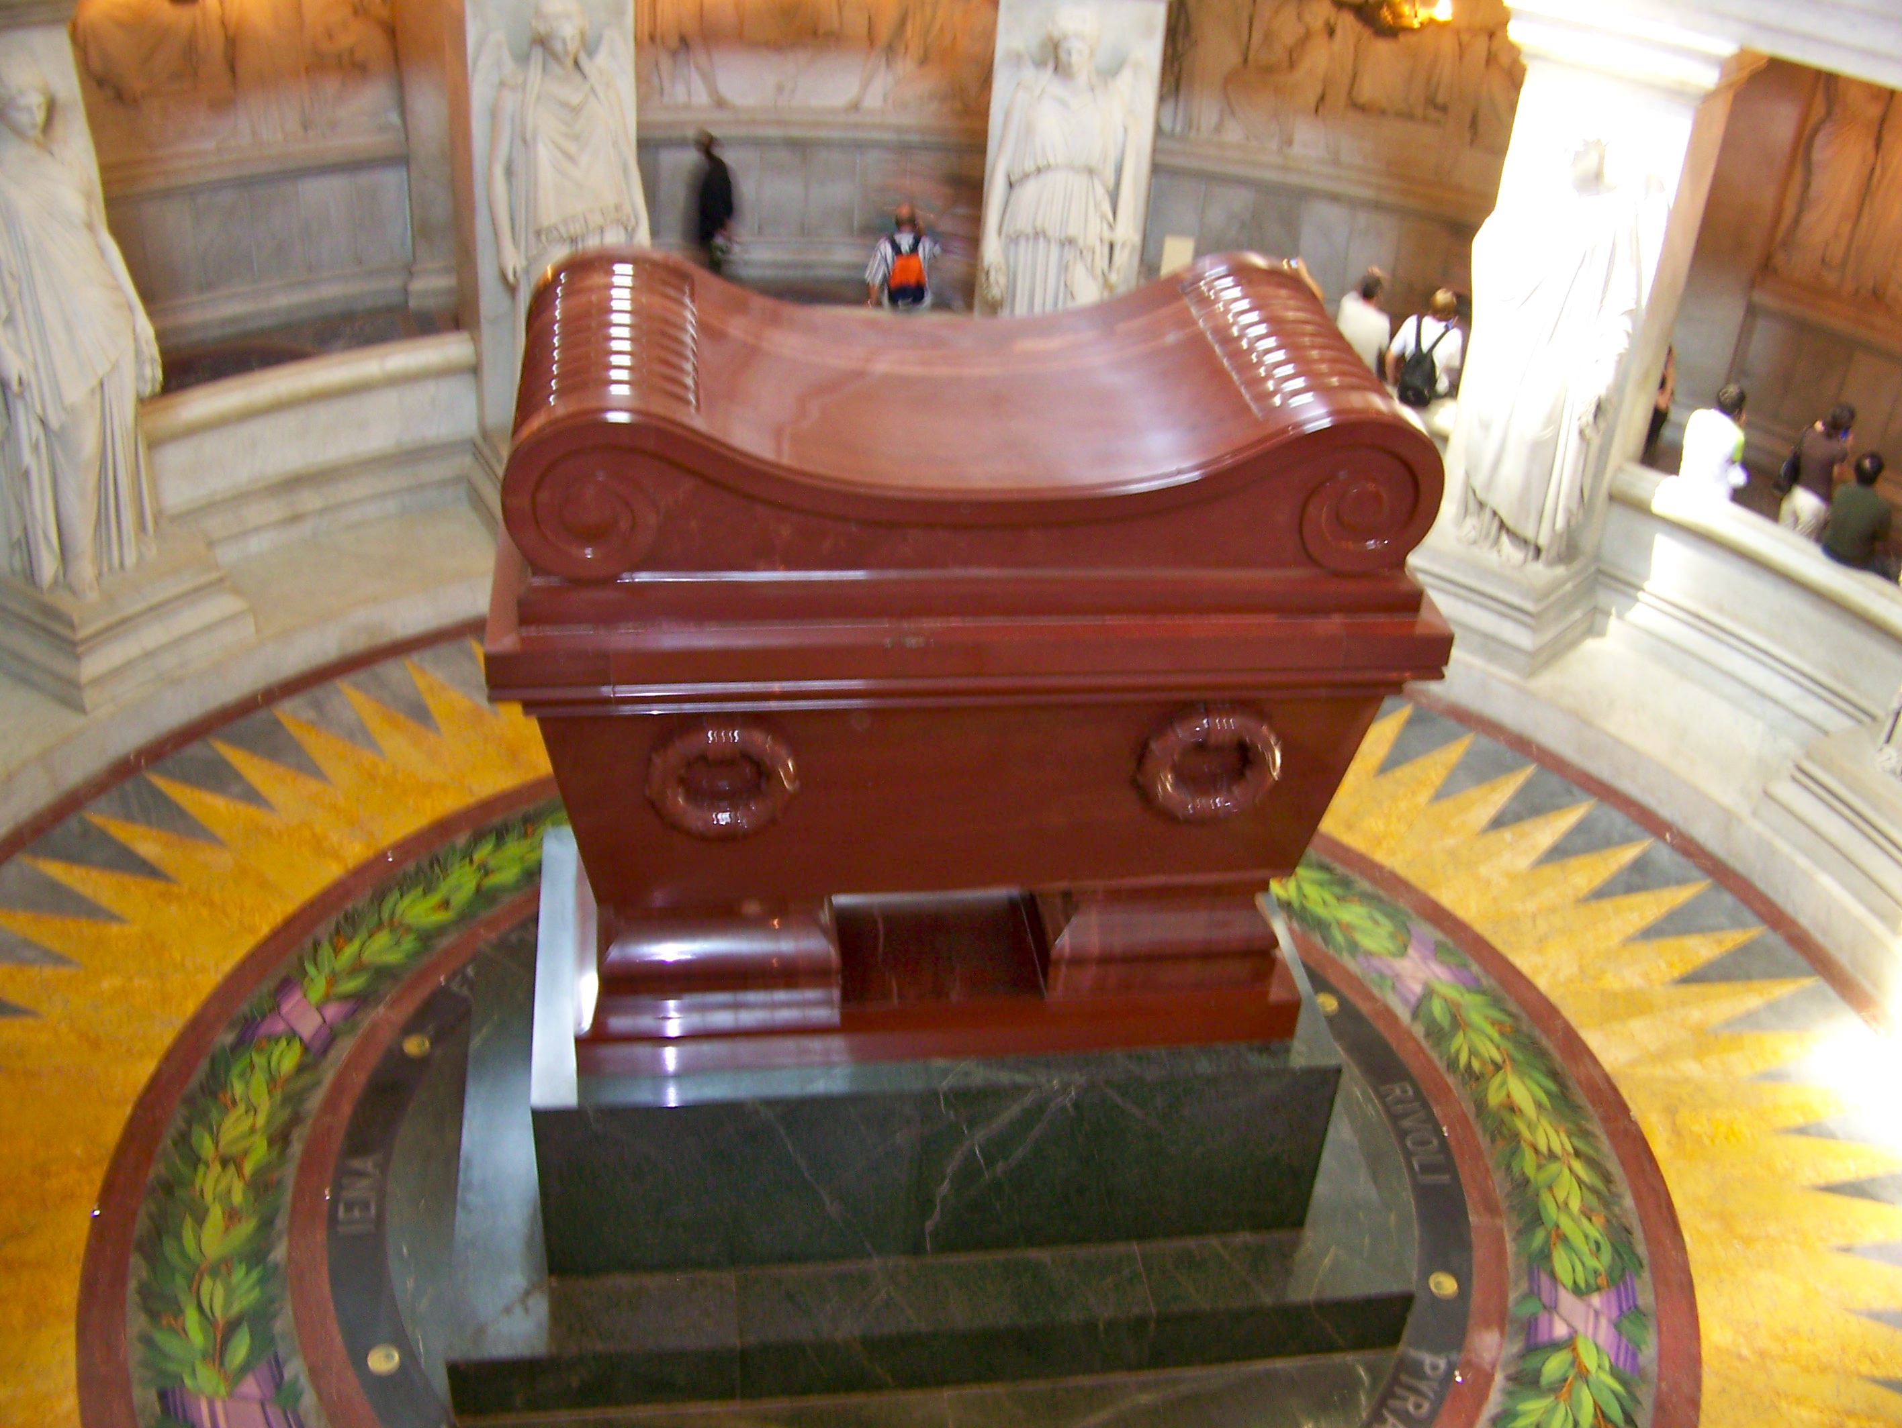

Slide 27
