Slide 1
Watergate

Slide 2
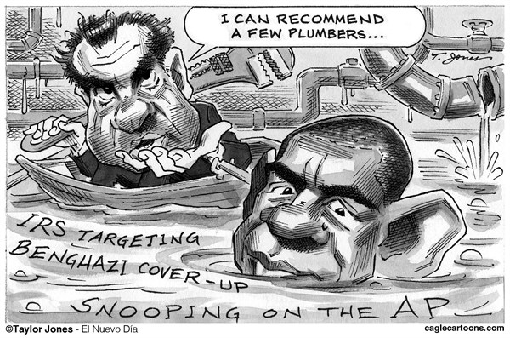
White House Plumbers
Secret group meant to prevent information leaks from happening in the White House
Would use illegal tactics if necessary to protect state secrets or the President’s image
Pentagon Papers

Slide 3
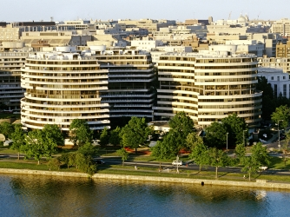
Watergate Hotel
The Watergate Complex included several buildings, including the Democratic National Committee’s Headquarters and the Watergate hotel
The men involved in the Watergate Scandal would stay at the hotel under false names and use it as their base

Slide 4
1st Break in
The first break in went off without a hitch and the men successfully wire taped a couple of phones
However, within a couple of weeks, these bugs started to malfunction and it was decided that they needed to be replaced

Slide 5
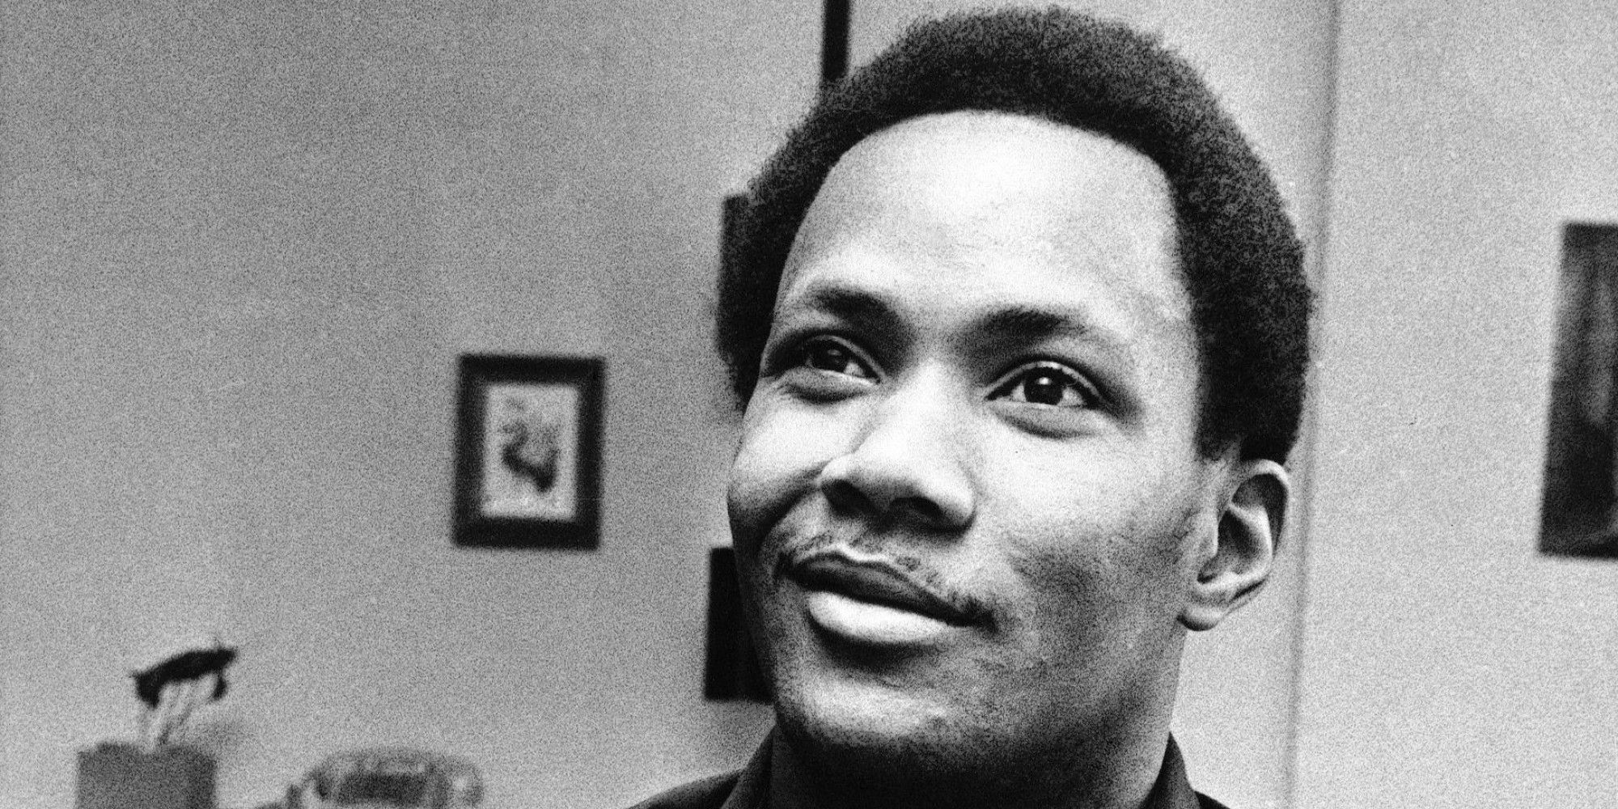
June 17, 1972
Night shift security guard Frank Wills noticed a piece of tape preventing a door from locking. He returned a few minutes later to find someone had replaced the tape and called the police.
5 men were found and arrested within the DNC headquarters.

Slide 6
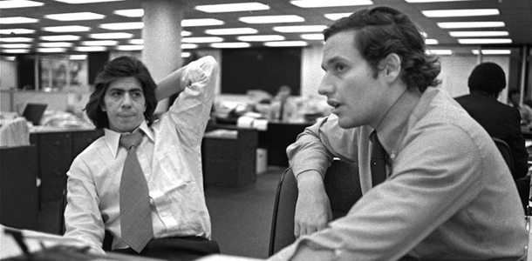
The Washington Post
Immediately, the government tries to prevent newspapers from looking further into the story
FBI, classified, threats, etc.
Two reporters at the Washington Post, Bob Woodward and Carl Bernstein, don’t listen
They start to follow the money

Slide 7
Pressure on the Washington Post
Nixon’s administration openly states that the Washington Post is a biased and unreliable newspaper
Woodard and Bernstein had an informant that they only defined as “Deep Throat” who kept feeding them information
Deep Throat was later revealed to be FBI Associate Director Mark Felt

Slide 8
Evidence Adding Up
Burglars
Bernard Barker: Real Estate Tycoon with a $25,000 check from the CRP
Virgilio R. Gonzales: Cuban refugee and locksmith
James McCord: Security Coordinator with RNC former CIA and FBI agent
Eugencio R. Martinez: Cuban Refugee with ties to CIA. Works for Barker
Frank Sturgis: Another employee of Barker with CIA ties

Slide 9
Masterminds
G. Gordon Liddy and Howard Hunt led the break in from the Watergate Hotel
Liddy was a former FBI Agent
Hunt was a former CIA Agent
Both of these men are going to be found guilty in addition to the burglars

Slide 10
Nixon’s knowledge of it?
https://www.youtube.com/watch?v=Krvs_qiCG-o&feature=youtu.be

Slide 11
CRP
Committee to Re-elect the President
AKA CRP or Creep
Led by former Attorney General, John Mitchell
Every one of the burglars have some connection to CRP or the Republican Party

Slide 12
Select Committee on Presidential Campaign Activities
Investigative group within Congress to investigate what’s going on
Ask President to turn over tapes
He doesn’t, claims executive privilege
The Senate sues him for the tapes!
United States v. Nixon

Slide 13
Saturday Night Massacre
Nixon fired Archibald Cox, his own special investigator in the Watergate Scandal when he requested the tapes
Sets off this whole series of firing and resignations

Slide 14
Watergate Tapes
Nixon finally hands over the transcripts of the White House tapes
These are greatly censored
The public is pleased until they start to read the transcripts

Slide 15
Watergate Tapes
Finally Nixon releases the tapes. These include conversations with John Dean, the President’s counsel, about paying hush money
Implicate several people by name, including John Mitchell
Reveal Howard Hunt was blackmailing the President for hush money

Slide 16
Impeachment Process Begins
The House of Representatives creates a committee to create articles of impeachment
3 charges
Obstruction of Justice
Abuse of Power
Contempt of Congress

Slide 17
Smoking Gun Tape
Partway through the House’s investigation the “smoking gun tape” is released
Describes how the CRP paid everyone
The President discusses Mitchell’s plan to have the CIA lie to the FBI that it was a matter of national security and decides to go along with it

Slide 18
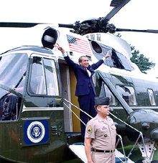
Resignation
Realizing he was now getting impeached without a doubt, Nixon resigned on August 8th, 1974

Slide 19
Continued controversy
After investigating all of the tapes, it was discovered the 18 ½ minutes are missing
To this day, we do not know what is on those tapes

