Slide 1
In the criminal justice system, the Supreme Court has the final say. In the 1960s, the dedicated Justices who heard these cases were members of an elite squad known as the Warren Court.
WARREN
COURT
These are their stories…

Slide 2
The Warren Court
The Warren Court is the name given for the Supreme Court while Earl Warren was Chief Justice (1953-1969)
The Warren Court passed a number of groundbreaking cases
This was an incredibly liberal court for its time

Slide 3
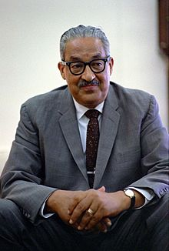
Why so many changes?
Supreme Court Justices serve for life
With the make up of the court, Earl Warren could almost always count on a 6-3 ruling in his favor
One of the other liberal Justices was Thurgood Marshall, a former leader in the NAACP and the first black Supreme Court Justice

Slide 4
Civil Rights Movement
Brown v. Board of Education

Slide 5
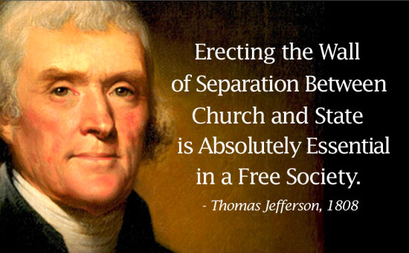
First Amendment
The Warren Court really started to enforce the separation of church and state
Engel v. Vitale took group prayer out of the public school system

Slide 6
Reapportionment
Reapportionment: redistributing representation in the legislature
Two votes per state isn’t fair when some states have 10x the population of others
Reapportionment ensures “one man, one vote,” guaranteeing each citizen has equal say in the government, no matter where they live
Reynolds v. Sims

Slide 7
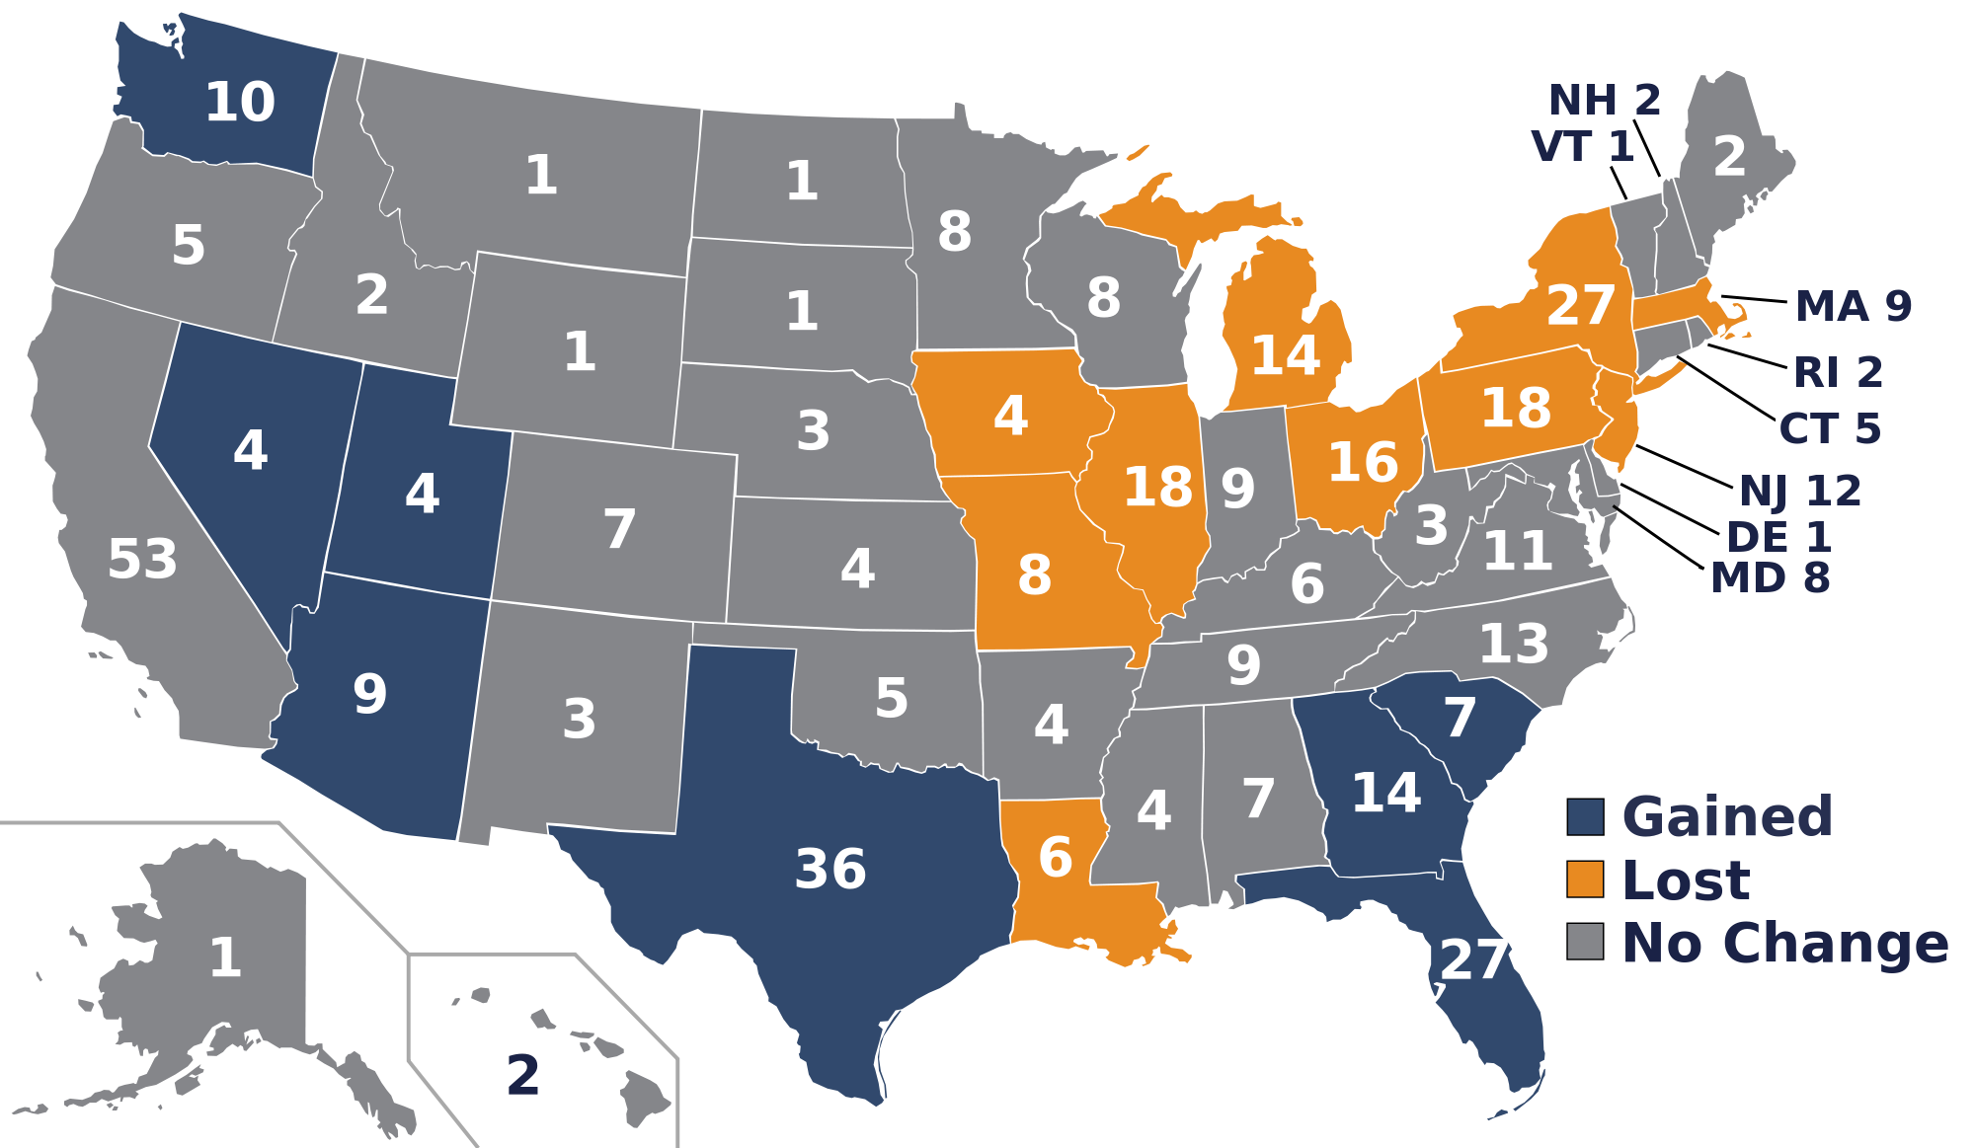
Reapportionment at work

Slide 8
Due process
Due process: everything that happens to a suspect after they are arrested through when they stand trial
Several cases the Warren Court heard dealt with expanding the rights of an arrested citizen
These included the right to an attorney during questioning (Escobedo v. Illinois) and a court appointed attorney if you cannot afford it (Gideon v. Wainwright)

Slide 9
Due process continued
In 1963, Ernesto Miranda was arrested for kidnapping, rape, and robbery
Since he didn’t know his Constitutional Rights, he immediately confessed everything
He later said he wouldn’t have done that if he knew
In Miranda v. Arizona, the Supreme Court declared everyone must be read their rights during arrest
Known as Miranda Rights

