Slide 1
Violence vs. Nonviolence

Slide 2
Nonviolent Protests
Nonviolent protest: a peaceful way of protesting against restrictive racial policies
Greatly inspired by the teachings of Mohandas Gandhi
Many of the leaders in the Civil Rights Movement adopted nonviolence as an alternative to the racial violence they already faced

Slide 3
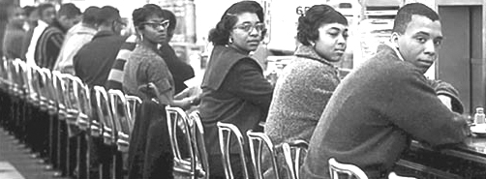
Sit-ins
Sit-ins were one of the most popular forms of nonviolent protests in the Civil Rights Movement
Protests would simply sit at lunch counters and refuse to leave until they were served
Sit-in were widely used by SNCC

Slide 4
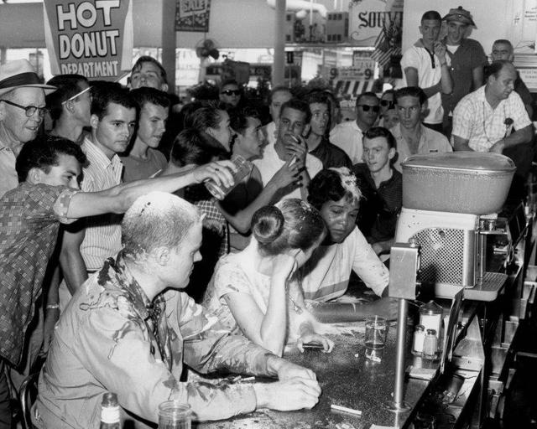
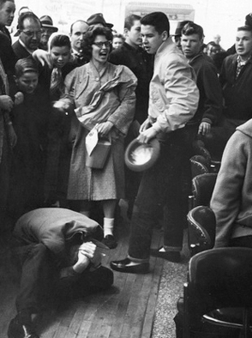
Sit-ins
Sit-in participants were often harassed or even assaulted by others
The nonviolent sit-in participants would often be arrested, but their attackers would not
The most famous sit-ins took place in Nashville, TN and Greensboro, NC
Most sit-ins did not target restaurants, but lunch counters at department stores

Slide 5
Boynton v. Virginia / Freedom Rides
Boynton v. Virginia declared that it was illegal for both interstate buses AND bus stations to be segregated
In 1961, CORE organized a group of interracial riders to make the trip from Washington D.C. to New Orleans together to test if states were following the law
The group was led by James Farmer and Jim Peck

Slide 6
The Birmingham Campaign
Martin Luther King Jr. once referred to Birmingham, Alabama as “the most segregated city in America.”
In 1963, King and the SCLC began the Birmingham Campaign to desegregate the city.
This was to be done through boycotting local businesses, organizing sit-ins, and peaceful marches.

Slide 7
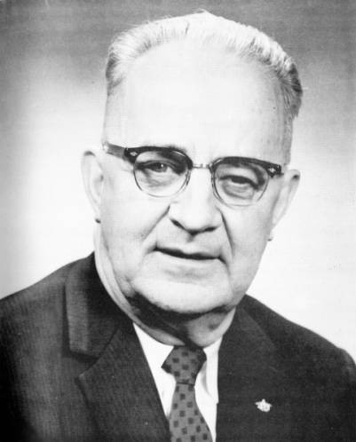
Bull Connor vs. MLK
Eugene “Bull” Connor was the Commissioner of Public Safety in Birmingham, meaning he controlled both the police and fire departments.
All-around bad dude
Known for his violent and illegal tactics of handling protestors
Arrested MLK

Slide 8
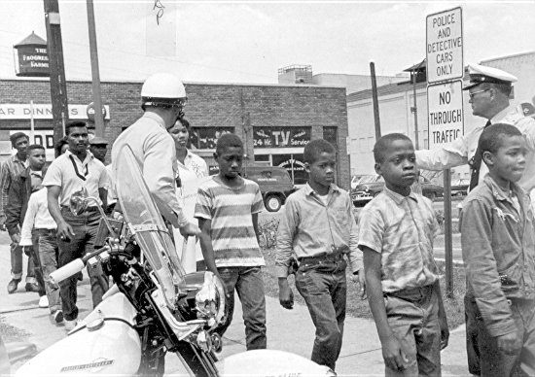
Children’s Crusade
On May 2nd, 1963, thousands of children left their schools to join in a pre-planned series of demonstrations across Birmingham
7-18 year olds
One high school actually locked the gates to prevent students
from leaving

Slide 9
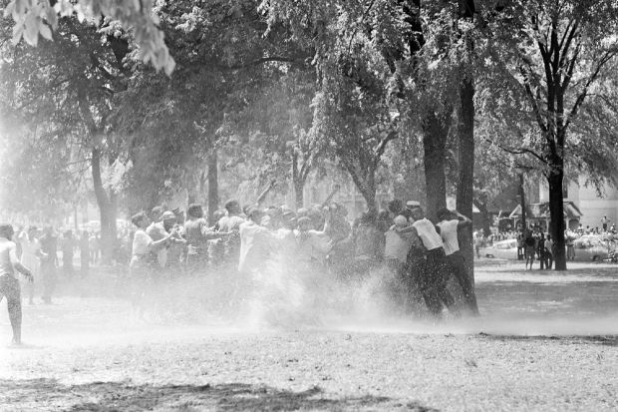
Children’s Crusade
Despite the protestors being children, the police still reacted with some violence
Hundreds of children were arrested, to the point where the jail was full
Fire hoses were used in some cases on the students

Slide 10
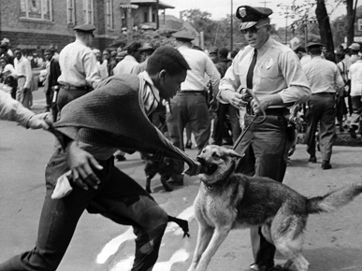
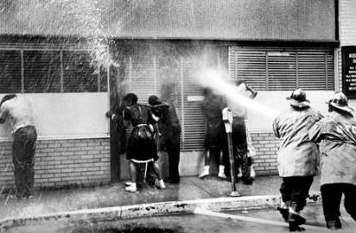
Violence in Birmingham
With the jail full, Bull Connor ordered that instead of gathering and arresting protestors, the police were to prevent them from entering downtown
Fire hoses and police dogs were set loose on the crowds

Slide 11
Result
President Kennedy urged local unions to raise over a quarter of a million dollars in bail for the protestors, including Dr. King
Lunch counters and local businesses were desegregated
Unfortunately, the police, fire department, and Birmingham Bar Association still remained strictly comprised of white men

