Slide 1
Vietnam War: Background

Slide 2
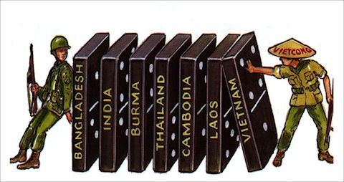
Domino Theory
Domino Theory: the idea that if one country falls to communism in Southeast Asia, the rest would soon follow

Slide 3
First Indochina War
Basically Vietnam’s War for independence
Had been ruled by the French
French vs. Viet Minh
Viet Minh led by Ho Chi Minh
Ended with a siege at the French fortress of Dien Bien Phu

Slide 4
Geneva Accords
The Geneva Accords were the peace agreement reached between France, China, and the Vietnamese
Vietnam was to be temporarily split in half along the 17th parallel (with the Ben Hai River as the border)
North Vietnam was ruled by Ho Chi Minh

Slide 5
Ngo Dinh Diem
South Vietnamese leader
Lived in the U.S. for a period
United States in favor of him because of his Western thinking
His people thought he was too Western, which was made worse by the fact that we was Catholic

Slide 6
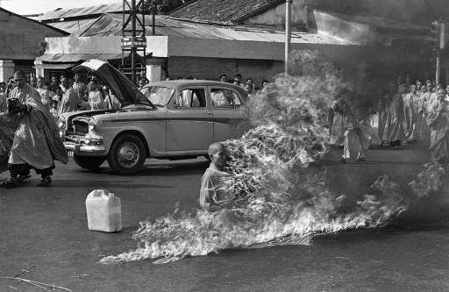
Buddhist Monks
To protest Diem, numerous Buddhist Monks set themselves on fire

Slide 7
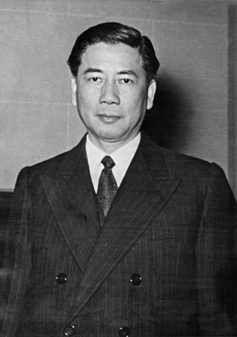
Diem Assassination
Ngo Dinh Diem was assassinated November, 1963 by his own men
U.S. was ok with this
This was 3 weeks before the Kennedy assassination
Related?
Either way, that is two major opponents of communism killed back-to-back

