Slide 1
Unheard Voices of the Civil Rights Movement
Mexican-American and Native American History

Slide 2
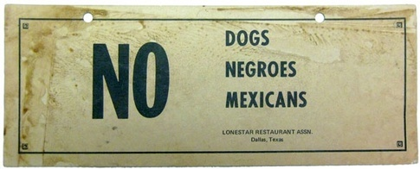
Plessy v. Ferguson’s impact
The “separate but equal” ruling of Plessy v. Ferguson applied to all races, not just African Americans
In Texas and the Southwest, racial segregation widely targeted Mexican-Americans

Slide 3
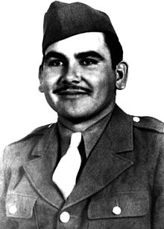
Felix Longoria
Felix Longoria was a Mexican-American man who was killed during WWII
The only funeral home in his hometown in Texas refused to give him a wake or bury him in the nicer cemetery in town because of his race
The American GI Forum and Senator Lyndon B. Johnson had Longoria’s body moved to Arlington National Cemetery, where he was buried with honor

Slide 4
LULAC
The League of United Latin American Citizens (LULAC) was founded in 1929 to promote the rights of the Hispanic population of the United States
LULAC works within the legal system, very similarly to the NAACP, to achieve racial equality for Hispanic people
LULAC helped with Delgado v. Bastrop, which outlawed the segregation of Mexican-American students in Texas public school in 1948, six years before Brown v. Board
Today, LULAC works towards building better communities and provides college scholarships for Hispanic students

Slide 5
Urban Indian Relocation Plan
In 1952, the federal government created the Urban Indian Relocation Plan to assist Native Americans from reservations with finding jobs in major U.S. cities
Native Americans on reservations were making about ¼ the income of their white counterparts
Because of this program, over half of the Native American population in the United States now live in urban areas
Cultural assimilation: the process in which a group or individual’s language and culture come to resemble those of another group

Slide 6
Occupation of Alcatraz
On November 20, 1969, a group of 89 Native Americans (men, women, and children) took over the island of Alcatraz and set up their own society there
Cited the 1868 Treaty of Fort Laramie
Offered to pay for it with $24 in glass beads and red cloth
Called “the cradle of the modern Native American civil rights movement” because it brought nationwide attention and support to their cause
At its peak, the occupied Alcatraz had 600 full-time residents and over 1,000 visitors daily

Slide 7
Occupation of Alcatraz
The occupiers promoted “Red Power,” very similarly to the African American movement of “Black Power”
Several celebrities of the time visited the island and supported their cause
Celebrated Un-Thanksgiving
The final protestors were removed by the federal government 14 months after the original occupation

Slide 8
The American Indian Movement
The American Indian Movement (AIM) was founded in 1968 to promote Native American’s rights
They sought to hold the federal government accountable for all of the treaties they had signed with Native Americans over the past two centuries
Tried unsuccessfully to get rid of the Bureau of Indian Affairs, but instead enacted change within the bureau to now, where most of the staff and all of the leadership are Native American

