Slide 1
The Space Race

Slide 2
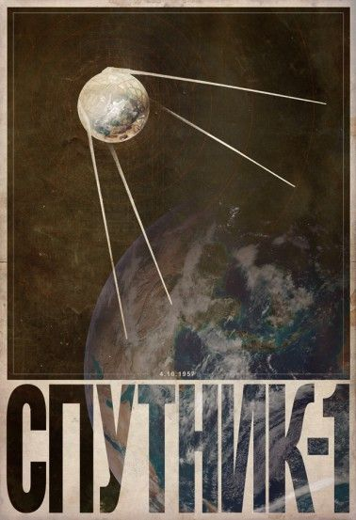
Sputnik
The Soviet Union launched Sputnik on October 4, 1957
A month later, they sent Sputnik II into space
Laika: this dog was the first living creature in space
Laika didn’t make it home…

Slide 3
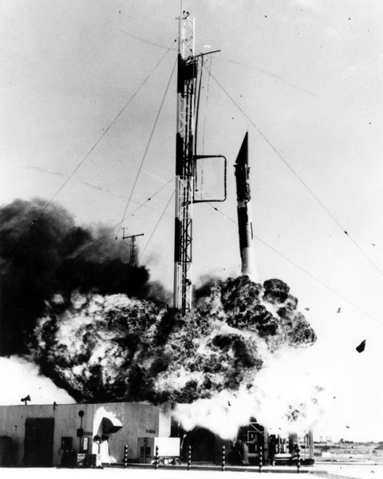
U.S. Satellites
The United States first attempt in sending a satellite into space ended in a huge explosion
Televised, so the U.S. was embarrassed worldwide
The U.S. didn’t get its first satellite into space until 6 months after the Soviets

Slide 4
NASA
NASA was created in 1958 when it became apparent that the U.S. was greatly trailing the Soviet Union in the Space Race
Shifted responsibility of space exploration from the military to the citizens
Werner von Braun
A lot of the first astronauts were still members of the military due to flight experience

Slide 5
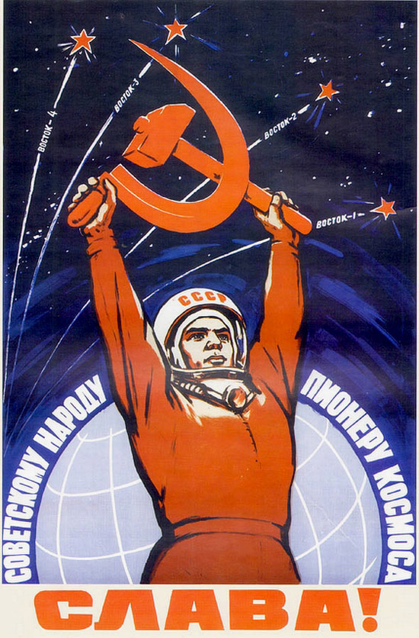
People Make it to Space
Yuri Gagarin, a Soviet cosmonaut, became both the first man in space, and the first to orbit the earth on April 12, 1961
May 5, 1961: Alan Shepard becomes first American in space
It isn’t until John Glenn in February of the following year that an American orbits earth

Slide 6
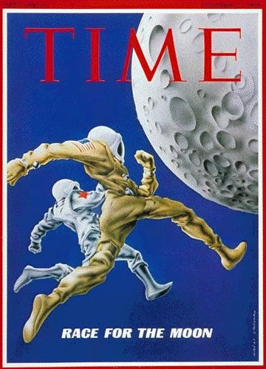
Why Kennedy and the Moon?
President Kennedy declared after the Gagarin and Shepard flights that the United States was going to land a man on the moon by the end of the decade
Instead of just trying to catch up to the Soviets, we were looking beyond their current goals

Slide 7
Where the Soviets beat us…
First:
Satellite
Living creature
Woman in space
Spacewalk
Unmanned spacecraft on the moon

Slide 8
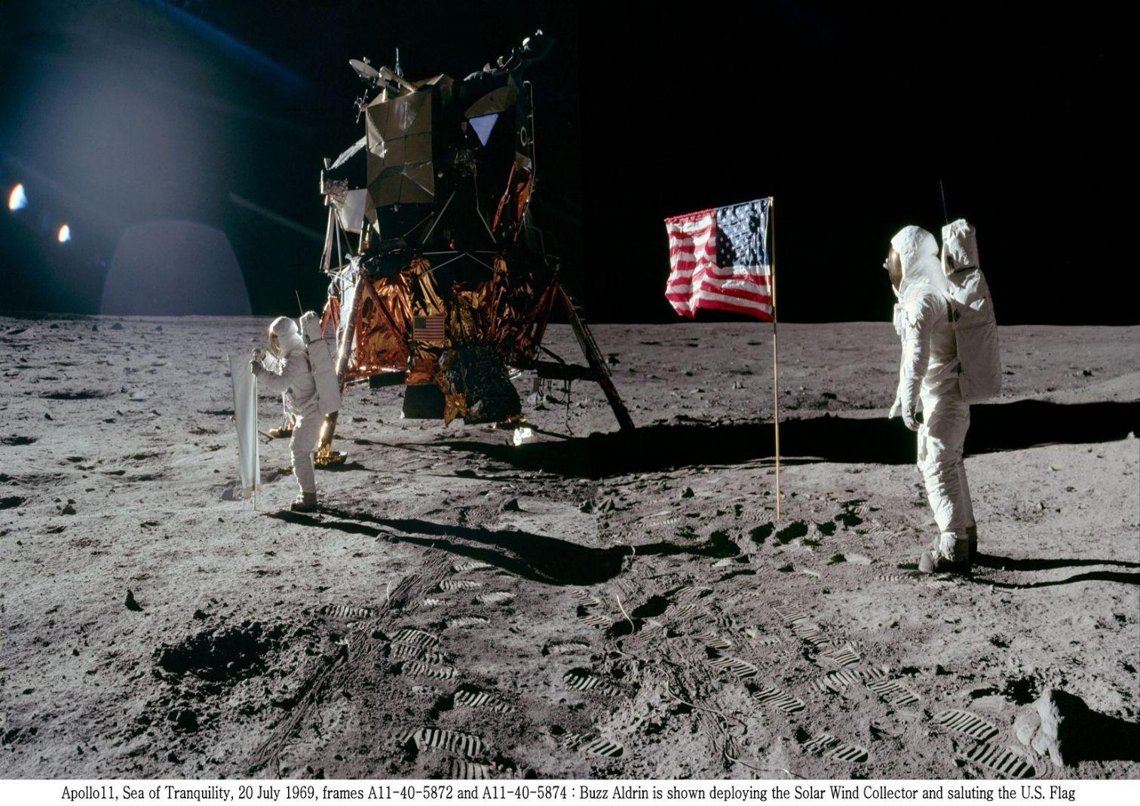
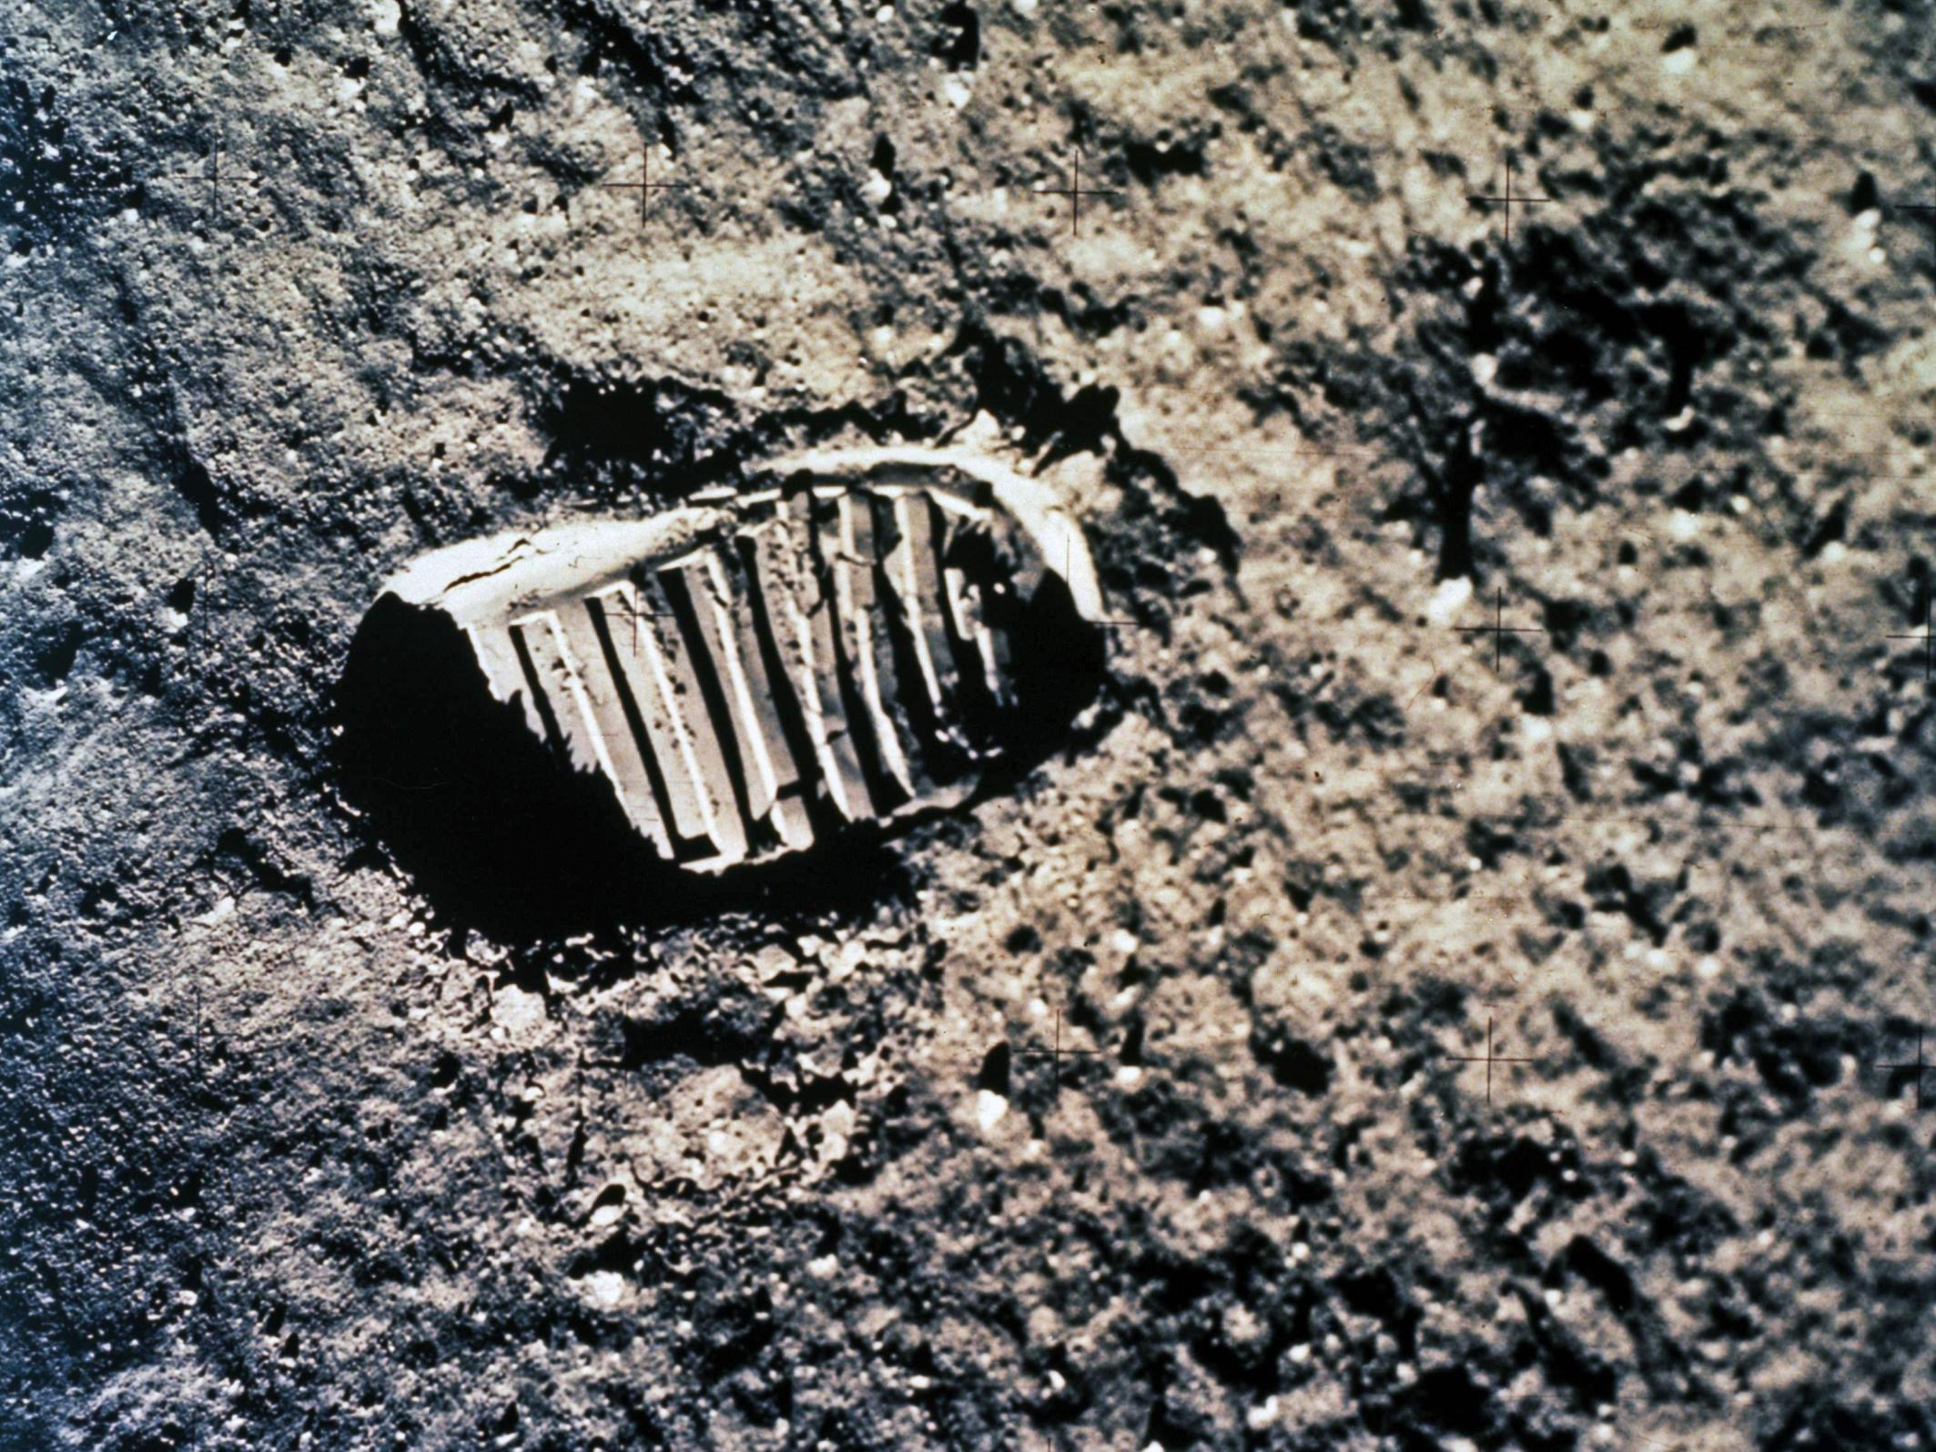
Apollo 11
On July 20, 1969 Apollo 11 landed on the moon carrying Neil Armstrong and Buzz Aldrin
Neil Armstrong became the first man to walk on the moon

Slide 9
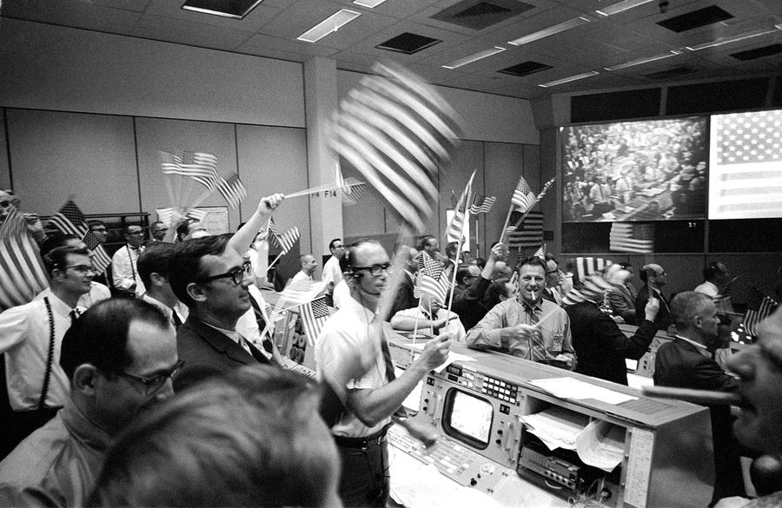
Take that Soviets!
A total of 12 men have walked on the moon
Apollo missions lasted from 1969-1972
The United States is the ONLY country in the world to have landed people on the moon

