Slide 1
Turning Points
The Tet Offensive and My Lai Massacre

Slide 2
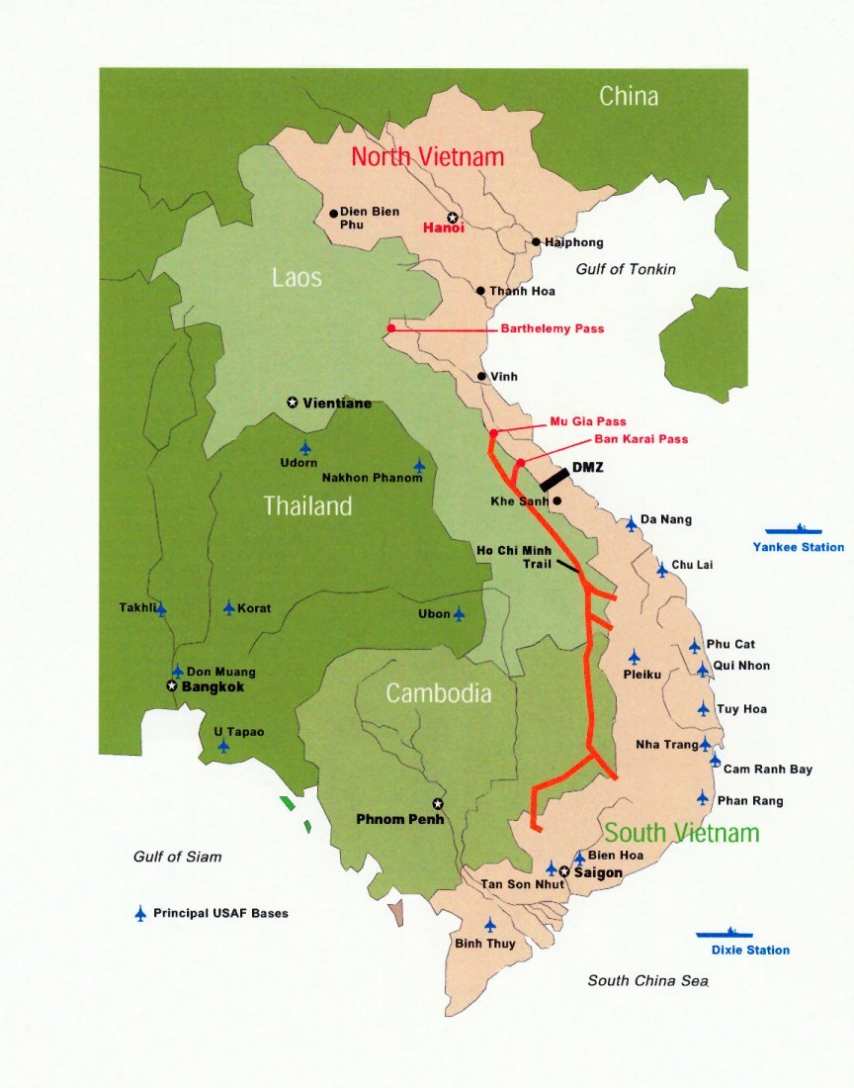
Khe Sanh
Khe Sanh was a U.S. military base in South Vietnam, near the border
On January 21st, 1968, the North Vietnamese Army launched an attack on the base
Lasted until July
NVA used artillery, mortars, and rockets
U.S. bombed surrounding area

Slide 3
Khe Sanh
30,000 American troops fought at Khe Sanh
The base was abandoned to pursue the enemy into Laos
Around 300 Americans were killed
It is estimated up to 15,000 NVA were killed, but military officials believe it was closer to 6,000

Slide 4
Who wins battles?
The Vietnam War was mostly fought in a jungle against guerilla fighters that would disappear once a skirmish ended
There are no fronts, except the DMZ
Land doesn’t really change hands
Instead, the U.S. would determine who was winning based off of casualties. Losers were doing more of the dying.
How do you think that changed soldiers’ goals?

Slide 5
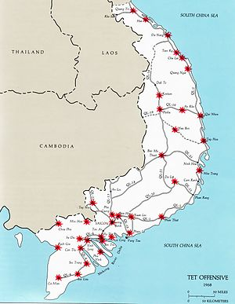
The Tet Offensive
On January 30th, 1968 the North Vietnamese Army and the Viet Cong started a series of simultaneous attacks across the entirety of South Vietnam
Vietnamese New Year
126 towns and cities were hit

Slide 6
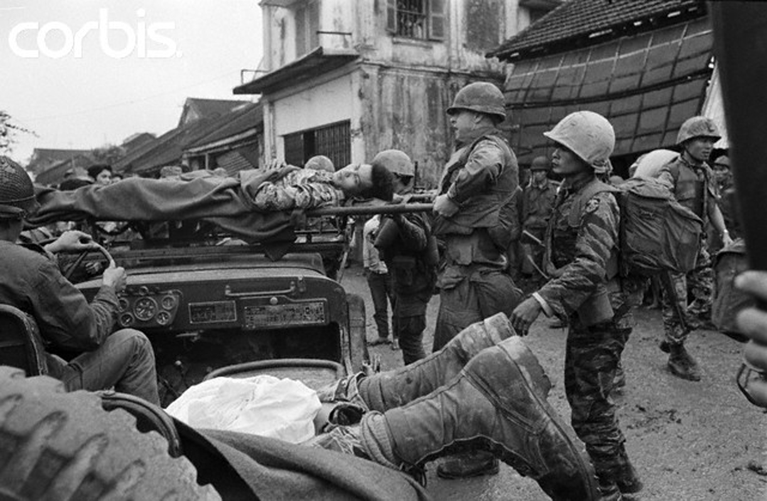
Hue
Hue was a city close to the the DMZ in South Vietnam
Was completely occupied by the NVA during the Tet Offensive
U.S. troops had to go house to house to get the city back
“Longest and bloodiest ground action of the Tet Offensive”

Slide 7
Aftermath of the Tet Offensive
Deaths: 3,470 Allied soldiers and 33,249 North Vietnamese & Viet Cong soldiers
Over 14,000 civilians were killed

Slide 8
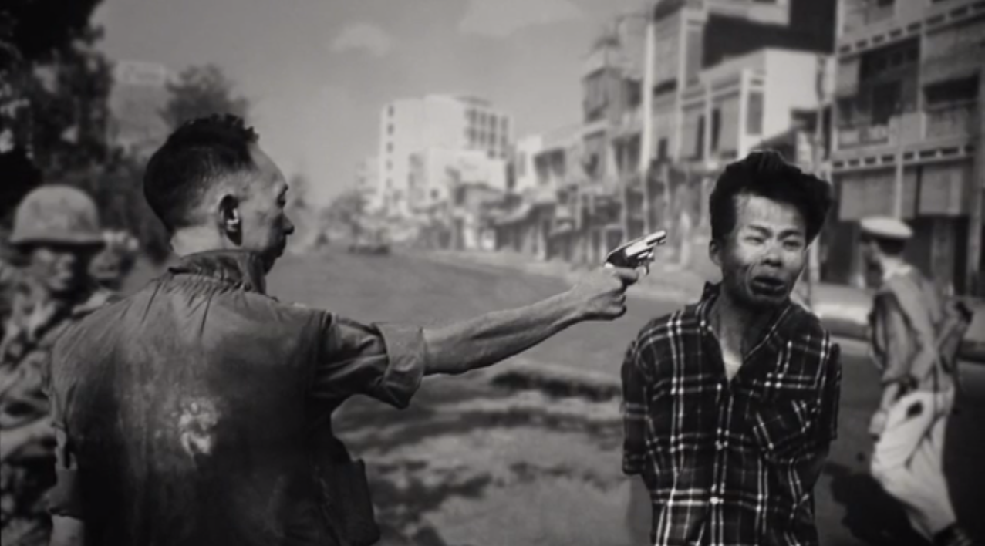
American Public Turns on War
Viet Cong execution photo/video
Showed on the evening news with no warning
Walter Cronkite declares he doesn’t believe this will end in anything but a stalemate

Slide 9
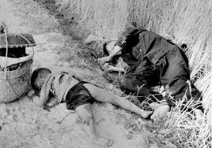
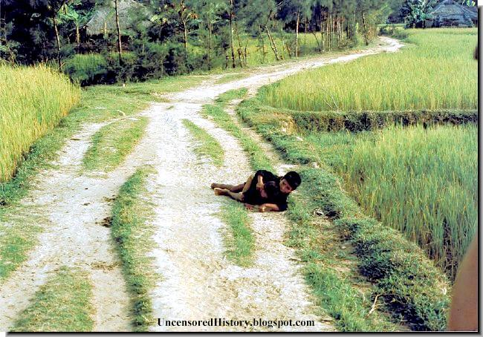
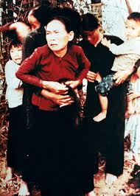
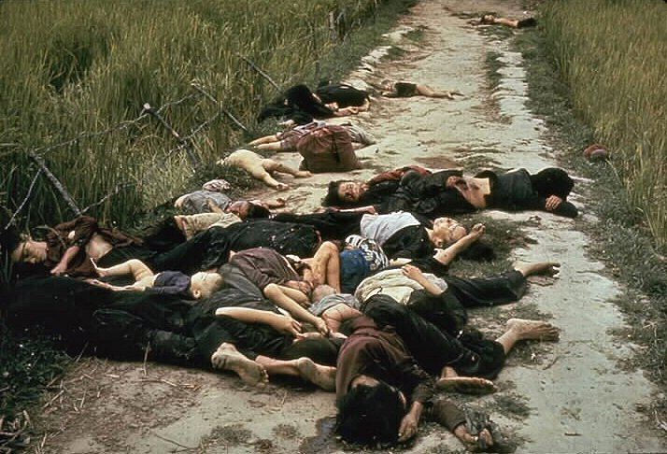
My Lai- “There was no mercy that day”

Slide 10
My Lai Massacre
March 1968
Covered up; American public didn’t learn until over a year later
504 women, children, and elderly Vietnamese civilians were killed
Not a single draft-aged man was found there
Led Lt. William Calley
Only Calley was found guilty

