Slide 1
School Integration

Slide 2
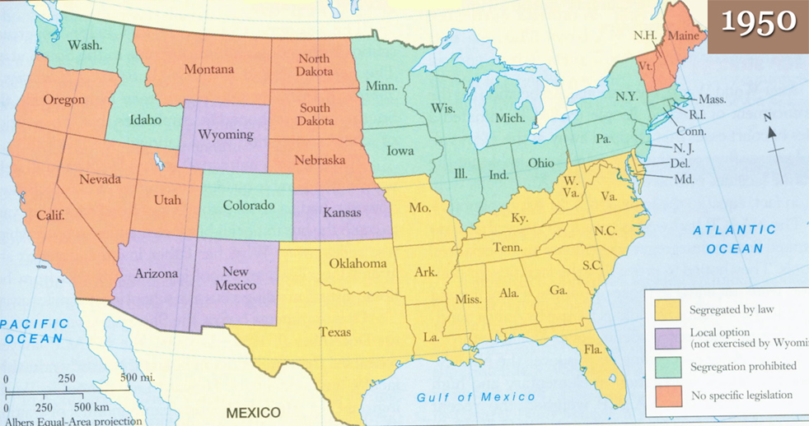
School Segregation before Brown vs. Board of Education

Slide 3
Brown v. Board of Education
Brown v. Board of Education (1954) declared state-sponsored segregation in public schools unconstitutional
Overturned Plessy v. Ferguson
Unanimous decision under Chief Justice Earl Warren
Did not provide any timeline for when schools were to be integrated. Local school boards were instructed to desegregate “with all deliberate speed.”

Slide 4
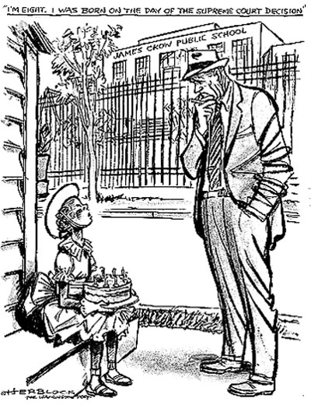
Desegregation Process
SLOOOOOOOOOW
1964 in the North: 90% of schools were integrated
1964 in the South: only 1 out of every 85 African American students went to an integrated school

Slide 5
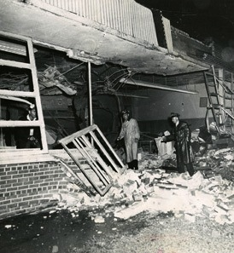
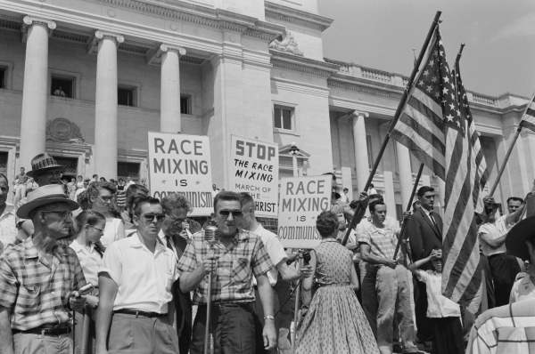
Backlash
The outrage over the Supreme Court’s decision led to protests, violence, and an increase in support for the Ku Klux Klan

Slide 6
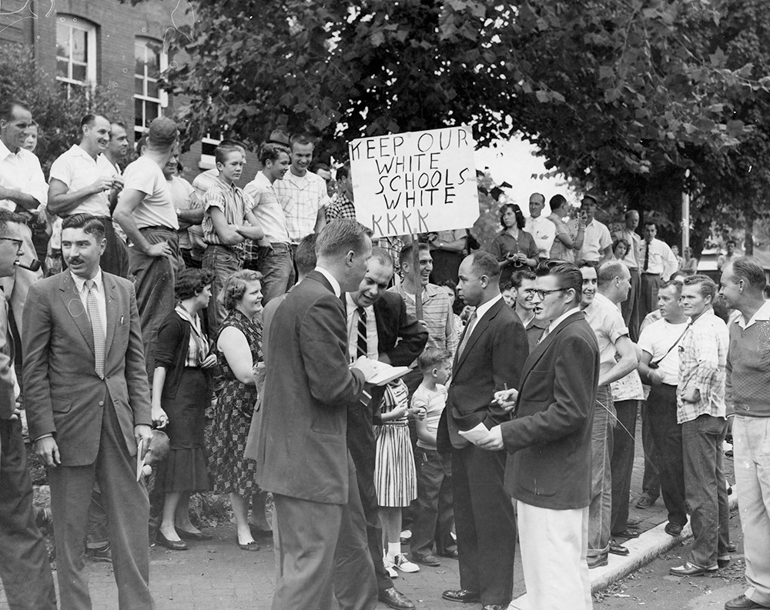
Backlash

Slide 7
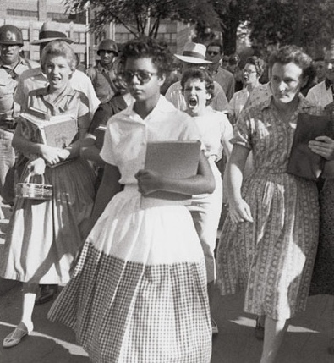
Little Rock Nine
In 1957, 9 African-American teenagers enrolled at Little Rock Central High School.
Governor, Orval Faubus called in the Arkansas National Guard to prevent the students from entering the building.
15 year old Elizabeth Eckford arrived first, all alone. She was heckled by the crowd, spat on, and forced back to the street by the armed guardsmen.

Slide 8
Little Rock Nine
The Little Rock Nine were unable to go to school for two weeks because of the National Guard in front of the school
They were removed from their first day of class by the local police due to an angry mob outside the school
President Eisenhower placed the Arkansas National Guard under federal control and sent in the Army’s 101st Airborne to restore order in Little Rock

Slide 9
James Meredith/Ole Miss
James Meredith applied to the University of Mississippi in 1961. He was denied twice.
Medgars Evers, a leader in the NAACP, encouraged Meredith to sue the school.
As a state-funded university, Ole Miss was required to integrate.
Meredith won his case and the University of Mississippi was instructed to register him the following fall

Slide 10
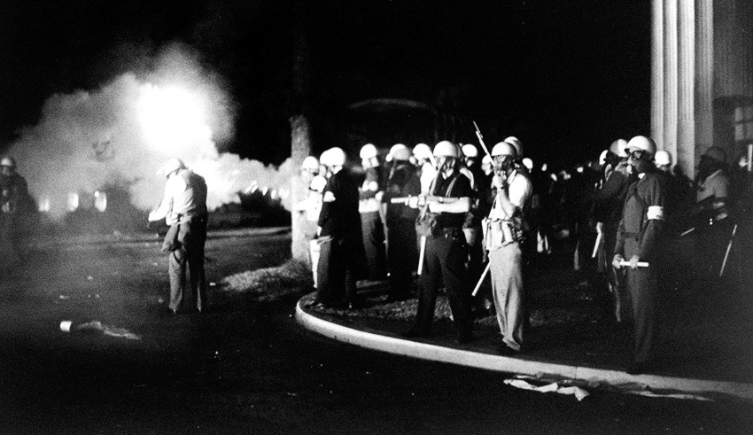
James Meredith/Ole Miss
The governor attempted to bar Meredith from registering at Ole Miss
U.S. Attorney General Robert Kennedy ordered 500 U.S. Marshalls to escort Meredith to the university
A state senator withdrew their police from the area, allowing a large mob to gather

Slide 11
Ole Miss Riots
Riots broke out on September 29th, 1962 at Ole Miss.
Multiple units of federal troops were called in the middle of the night
The crowd attempted to break into the building where James Meredith was staying
By morning, two men were dead
Hundreds of U.S. Marshalls stayed to protect Meredith for the entire year he attended the University of Mississippi.

Slide 12
School Segregation in Nebraska
Nebraska has never had state-supported school segregation
The two segregated school in Nebraska were closed in 1872 and 1879
In Omaha and Nebraska City
Recent controversy: LB1024 in Omaha
Repealed in 2008

