Slide 1
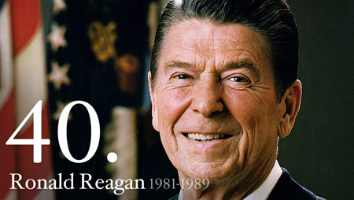

Slide 2
Biography
Born in Tampico, IL in 1911
Eureka College
Economics, sociology, football
Sports announcer
U. of Iowa football
Chicago Cubs
Hollywood career begins in 1937
Appeared in 53 films over 2 decades
“The Gipper” in Knute Rockne, All American
First wife—Jane Wyman, an actress
2 children
2nd wife—Nancy Davis, an actress
2 more children
Served as SAG President from 1947-1952, 1959
Fervent anti-communist; testified before HUAC

Slide 3
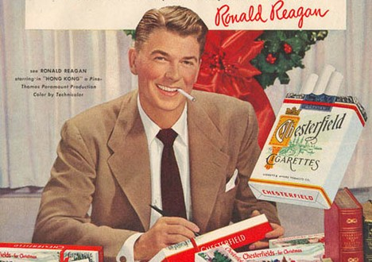
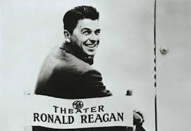
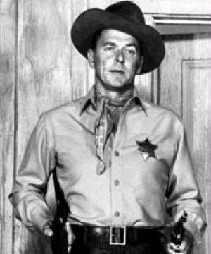
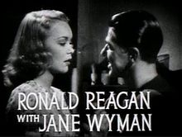

Slide 4
Political Career
An admirer of FDR, a Democrat
Shifted to the right during the ’50s, after marrying Nancy
Formally switched to GOP in ‘62
Campaigned for Goldwater in ‘64

Slide 5
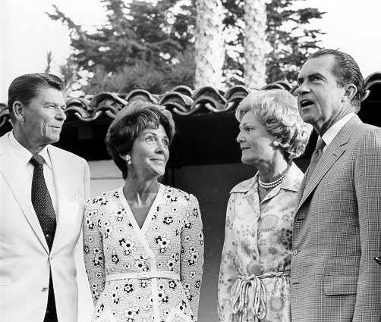
Governor of CA (1967-1975)
Won election in 1966
Conservative, tough on war protesters @ Cal-Berkeley, pro-life
Re-elected in 1970
Advocated against the welfare state
Less gov’t regulation of the economy

Slide 6
Presidential Election of 1976
Reagan challenged incumbent Ford in bid to be GOP candidate
Ford narrowly beat Reagan for Republican nod
Ford loses to Carter that November

Slide 7
Election of 1980
Carter’s approval rating was low
Iranian hostage crisis
Weak economy
Reagan chose primary opponent George H.W. Bush as running mate
Promised lower taxes, less gov’t interference & strong national defense
Reagan wins 50.7% of the popular vote to Carter’s 41%
Reagan wins 44 states & 489 electoral votes
Oldest man elected ever, 69 y.o.a.

Slide 8
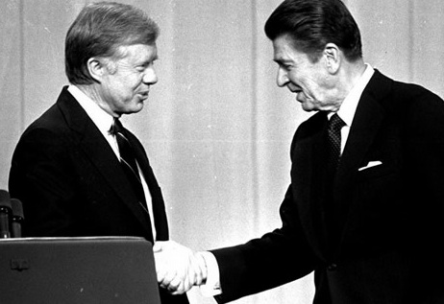
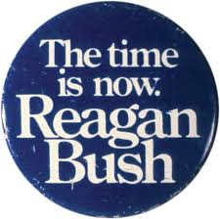
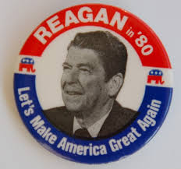

Slide 9
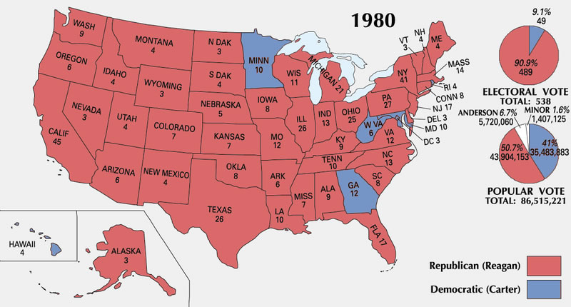

Slide 10
First Term (1981-1985)
Inaugural address—”Government is not the solution to our problems; government is the problem.”
Assassination attempt
March 30, 1981
John Hinckley, Jr.
Near Washington Hilton Hotel
Shot in chest & right arm
Hinckley was obsessed w/ Jodie Foster
Found not guilty, insanity

Slide 11
First Term (1981-1985)
Reagan joked in operating room, “I hope you are all Republicans”
Released after two weeks
Helped his approval rating
Up to 73%

Slide 12
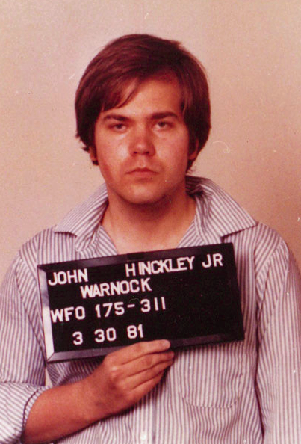
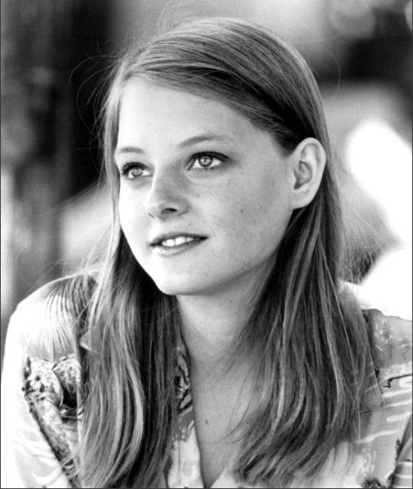
The Reagan Shooting
CBS Clip
Reagan Shooting: A Closer Call Than We Knew

Slide 13
First Term (1981-1985)
Air Traffic Controllers’ Strike, summer of ‘81
PATCO, union of federal air traffic controllers
Sought better working conditions, including better pay & a 32-hour workweek
Reagan: If they “do not report for work w/in 48 hrs. they have forfeited their jobs & will be terminated.”
11K+ were fired by Reagan

Slide 14
“Reaganomics”
Supply-side economics & free-market fiscal policy
Hoped to stimulate the economy w/ tax cuts
Economic Recovery Tax Act of 1981
Top bracket of income taxes reduced from 70% to 50%
“Peace through strength”
Defense spending increases 40% between ‘81 & ‘85

Slide 15
“Reaganomics”
Inflation during Carter’s Presidency=12.5%; Reagan=4.4%
Unemployment rate in ‘81=7.5%; ‘89=5.4%
10.8% in ’82
GDP grew rapidly
Critics labeled policies “trickle-down economics”
Gap between rich & poor continued to grow
Minorities/poor felt Reagan was indifferent to their plight
Froze minimum wage @ $3.35
Cut gov’t spending in many areas, including: Medicaid, Food Stamps, & the EPA

Slide 16
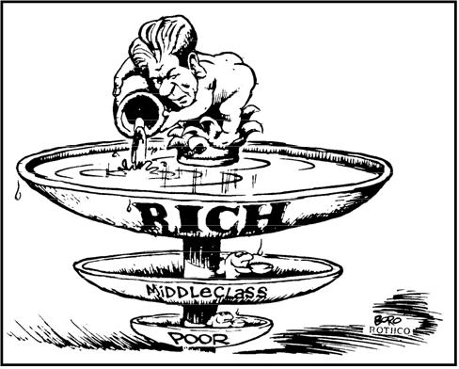

Slide 17
First Term (1981-1985)
Reversal of détente
Massive military/defense build-up
June 8, 1982, in front of British Parliament, “the forward march of freedom & democracy will leave Marxism-Leninism on the ash-heap of history.”
Calls the Soviet Union an “evil empire”
Reagan Doctrine: support for anti-Communist revolutions around the world
1983, Strategic Defense Initiative (SDI), “Star Wars”
Potential missile defense system

Slide 18
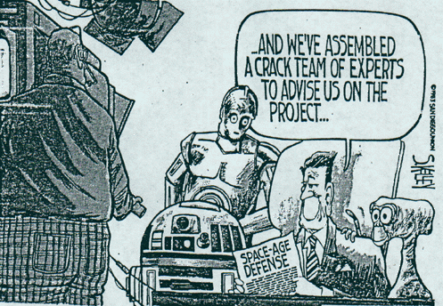
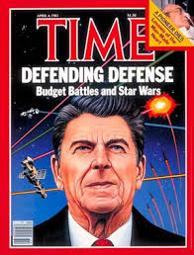
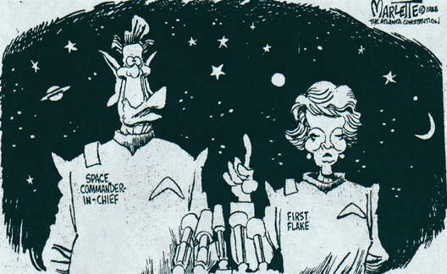
“Star Wars”

Slide 19
First Term (1981-1985)
U.S. forces in Grenada, 1983
U.S. victory w/in weeks—constitutional gov’t
19 American casualties
U.S. forces in Lebanon, 1983
Peace-keeping mission
Beirut barracks bombed—241 American servicemen killed
Marines withdrawn
1984 Summer Olympics in Los Angeles
USSR boycotts
Americans dominate

Slide 20
Election of 1984
Reagan proclaims it is “morning again in America”
Democrats choose former VP Walter Mondale
Mondale chooses Geraldine Ferraro as his VP candidate
1st female on major party ticket
Some questioned Reagan’s age (73)
He seemed confused & forgetful at times
Rumors of Alzheimer’s swirled
Reagan, “I will not make age an issue of this campaign. I am not going to exploit…my opponent’s youth & inexperience.”

Slide 21
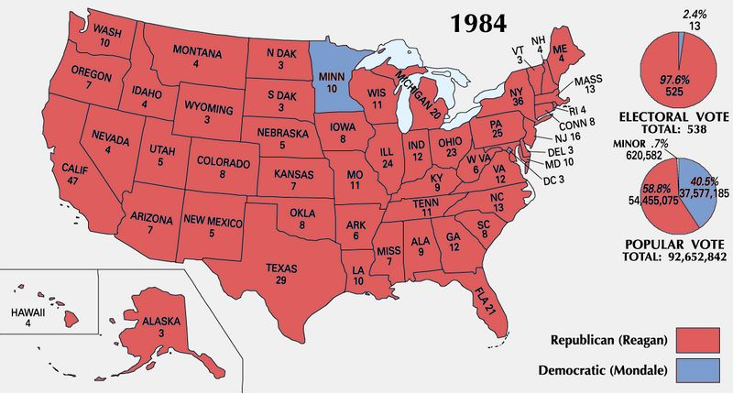
Reagan wins 49 states

Slide 22
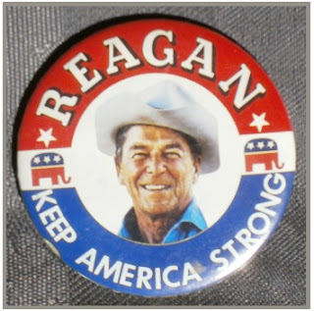
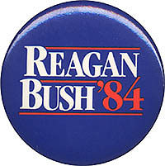
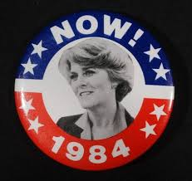
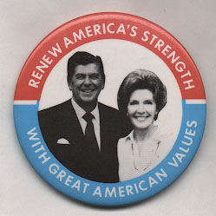
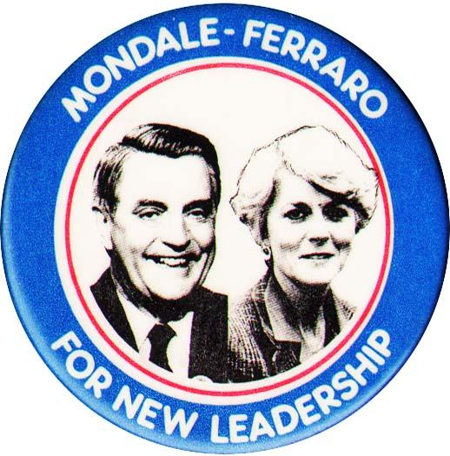

Slide 23
Second Term (1985-1989)
Challenger explosion, Jan. of ‘86
7 killed, including teacher Christa McAuliffe
Many saw it live on TV
Reagan had announced a “war on drugs” in 1982
Passed a drug enforcement bill in ’86; budgeted $1.7 billion
1st Lady Nancy founded the “Just Say No” drug awareness campaign

Slide 24
Second Term (1985-1989)
Iran-Contra Affair, 1986
Scandal that shook Reagan administration
Proceeds from secretive arms sales to Iran were used to fund Contras in Nicaragua, even though funding this group had been made illegal by Congress
Contras were fighting the Cuban-supported Sandinistas
Reagan proclaimed he knew nothing of the plot
An investigation found no evidence linking Reagan to the plan
Lost some of America’s trust; popularity fell

Slide 25
Second Term (1985-1989)
Heavy military spending, collectivized farming & planned manufacturing had put a burden on Soviet spending
Soviet economy was stagnant under Gorbachev
Reagan had 4 summits w/ Gorbachev between ‘85 & ’88
INF & START I
Is the Soviet Union still an “evil empire”? “No!”
“Mr. Gorbachev, tear down this wall!”—1987
Wall torn down in November of ’89
Cold War declared over in December of ’89
Soviet Union collapsed in 1991

Slide 26
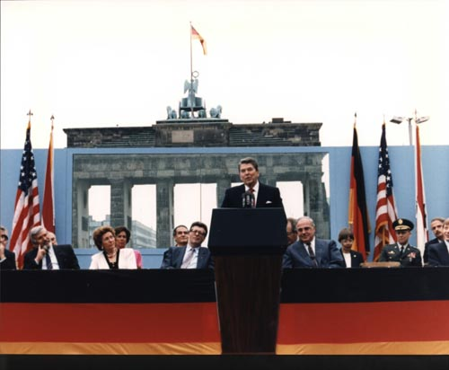

Slide 27
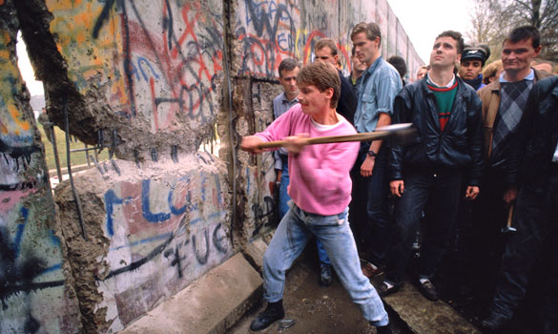
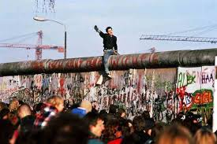

Slide 28
Supreme Court
Appointees
Sandra Day O’Connor, 1981
1st female on SC
Antonin Scalia, 1986
Died: February 13, 2016
William Rehnquist raised to Chief Justice, 1986
Anthony Kennedy, 1988
Still in office
SC became more conservative

Slide 29
Etc.
Revival of patriotism
Resistance to civil rights & women’s movement grew
ERA rejected in ‘82
Fight for homosexual rights increasingly polarized
Backlash as AIDs spread
Farm crisis
Falling prices, oversupply
Bankruptcies, foreclosures, debt
Gov’t spending on ag. increases greatly, $20 billion/year
Farm Aid concerts, est.1985
1987 @ Memorial Stadium

Slide 30
Etc.
Economy shifts away from manufacturing
Downsizing
Hits Northeast & Upper Midwest
“Rust Belt”
Wealth inequality
Nation’s richest 400 tripled their wealth during the Reagan years
S & L Scandal
Deregulation
Savings & loans banks took advantage of new laws, made huge fortunes for themselves
Risky investments
Entitlements continue to grow as America ages
Reagan tried, but could not restrain these programs

Slide 31
Reagan’s Lasting Legacy????
The Good….
The Bad…

