Slide 1
Nixon Administration
And a little bit of Kissinger in there, too

Slide 2
Economy
The economy was struggling when Nixon became president due to money vacuum that was Vietnam
Inflation was a real problem

Slide 3
How to fix it
Nixon took action through 2 methods:
Deficit spending: the government spends more than it makes in a given year in order to stimulate the economy
Price freezes: Nixon attempted to freeze all rents, wages, and prices across the country. This backfired because labor unions didn’t want their wages frozen.

Slide 4
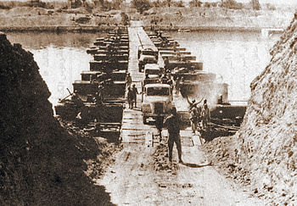
Yom Kippur War
In 1973, Syria and Egypt attacked Israel
Fighting lasted 3 weeks
The U.S. backed Israel in
Syria and Egypt are part of OPEC
OPEC put an embargo on the U.S. and refused to ship oil there

Slide 5
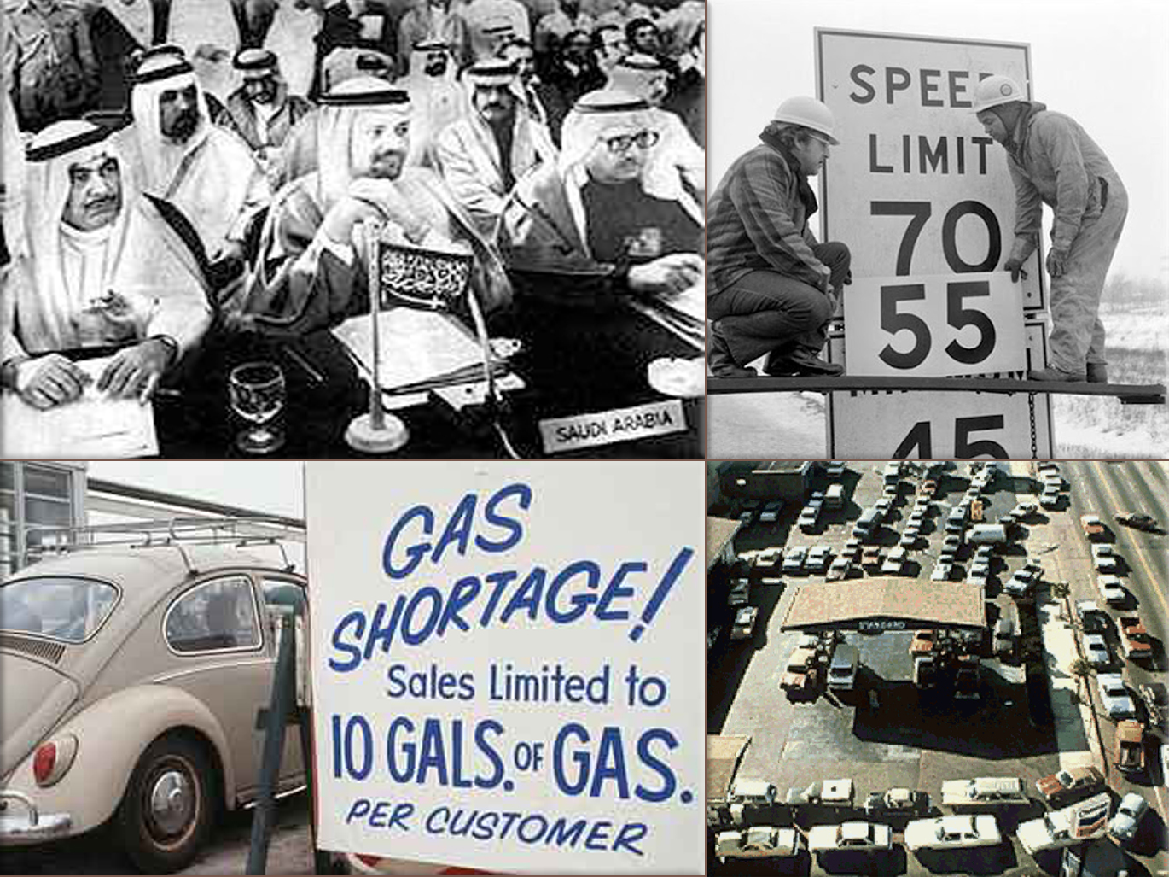
Oil Embargo
1973
Gas prices almost quadrupled
Other prices followed and inflation was out of control

Slide 6
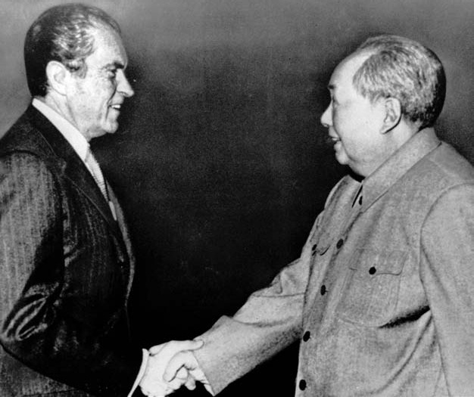
China
Henry Kissinger went to China in a series of secret diplomatic missions
Richard Nixon followed in a very public visit that eased tensions in the Cold War

Slide 7
SALT
The U.S. and the U.S.S.R. met in 1972 and signed the Strategic Arms Limitation Treaty, agreeing to slow their building of nuclear arms
HUGE step in the Cold War

