Slide 1
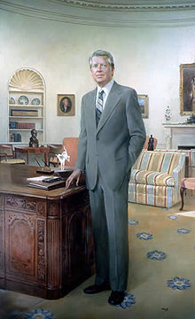
President Jimmy Carter

Slide 2
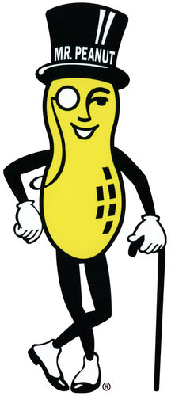
Overview
First Democratic President since LBJ
Took office during the recession and détente
Possibly best remembered for being a peanut farmer

Slide 3
Camp David Accords
Camp David is a Presidential retreat in Maryland
6 Day War between Egypt and Israel
The Prime Minister of Israel and the President of Egypt met with President Carter
Refused to directly talk to one another
Carter was trying to do everything

Slide 4
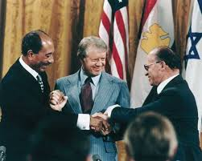
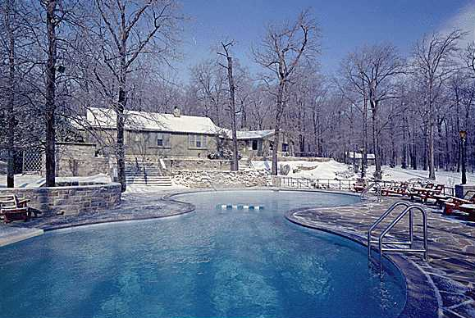
Camp David Cont.
Eventually came to an agreement with the Egypt-Israel Peace Treaty
Created an autonomous government in the Gaza Strip

Slide 5
End of Détente
In 1979, the Soviet Union invaded Afghanistan
Lasts 10 years, Soviets lose
President Carter condemned this, marking the end of détente

Slide 6
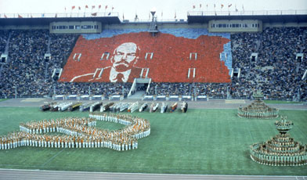
1980 Summer Olympics
65 countries boycotted the 1980 Summer Olympics in Moscow
Boycott was led by President Carter

