Slide 1
Rise of Feudalism and Mongol Invasion
A.D. 1185- 1333

Slide 2
A Threat from Outside
1. Mongol Invasion
1274 – 450 Mongol ships carried 15,000 troops to attack Japan. Typhoon devastated Mongol invasion force.

Slide 3
A Threat from Outside
1281 – 150,000 Mongols took on Japan’s new navy when another typhoon destroyed the Mongol fleet.

Slide 4
A Threat from Outside
Japan calls the typhoons: Kamikaze, or “divine winds” because they felt gods and ancestors sent the typhoons to defend them.

Slide 5
Inside Japan
1. Zen Buddhism
The religion was popular in Japan; strict meditation led to personal salvation with an emphasis on dedication and discipline.

Slide 6
Inside Japan
2. Rise of Feudalism
Land in exchange for service and defense.
Emperor acted only as religious leader of Japan.
Samurai warriors dominated Japanese society.

Slide 7
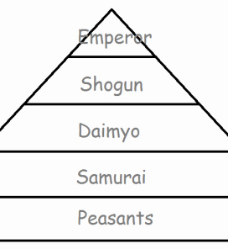
Inside Japan

Slide 8
Inside Japan
Shogun: military and political leader.
Daimyo: high-ranking samurai lords who provided shoguns with warriors
Samurai: low-ranking warriors who served daimyo
Peasants: lowest class workers

