Slide 1
JFK
Camelot and the New Frontier

Slide 2
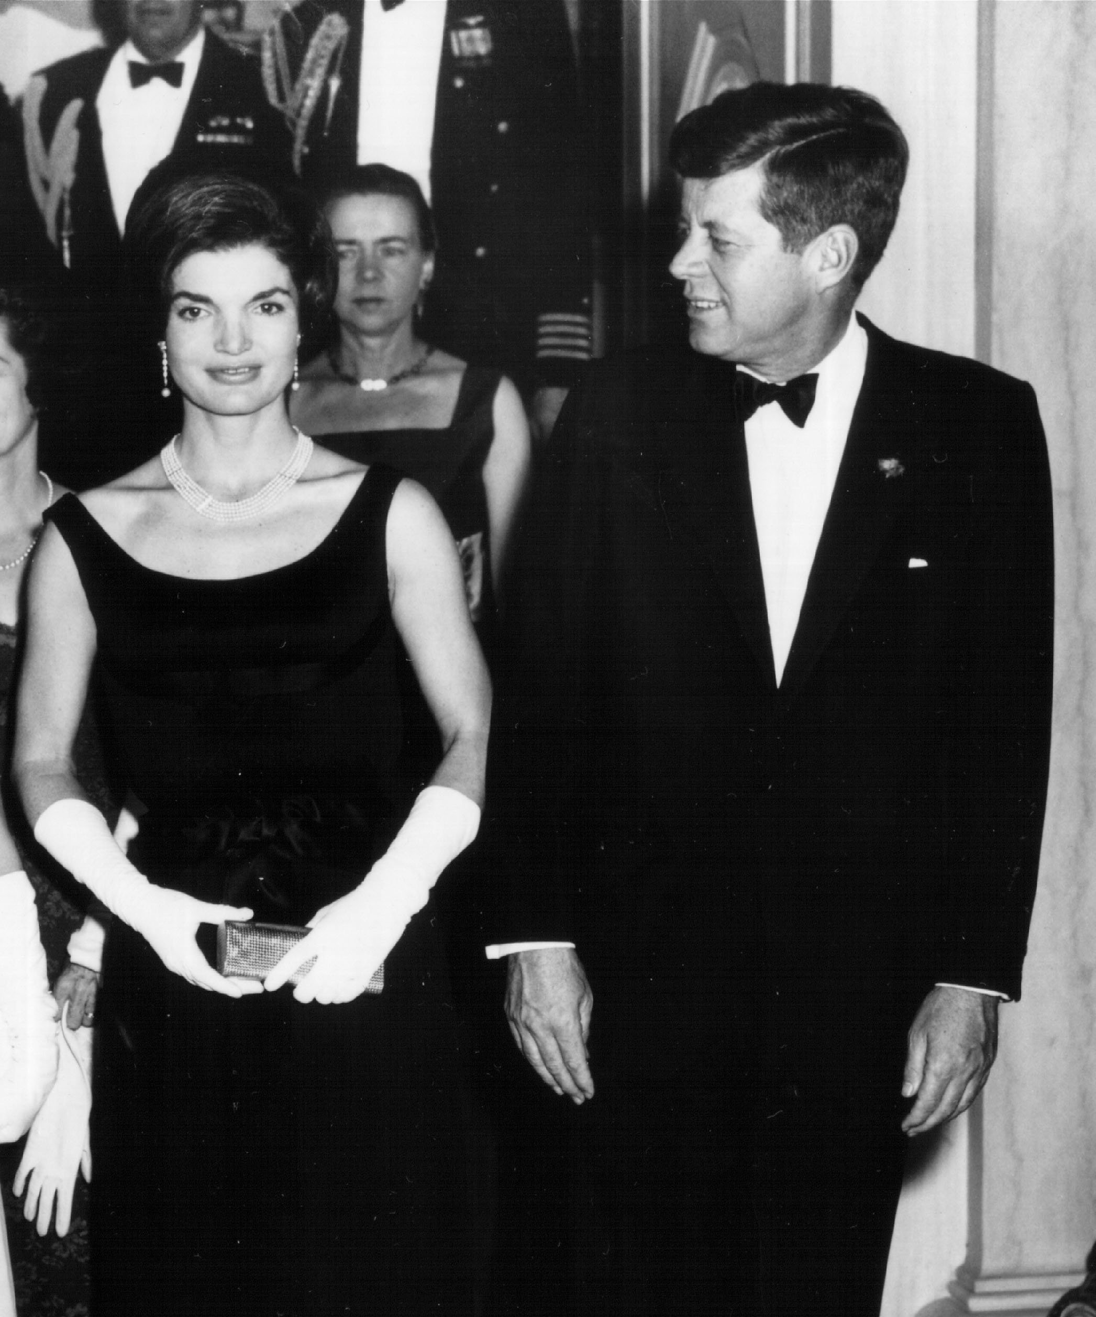
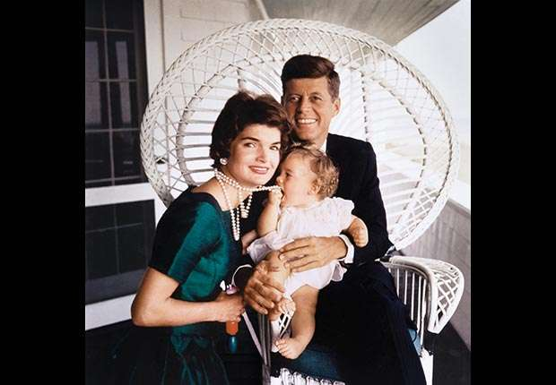
Camelot
After his death, the term “Camelot Era” became popular to describe his administration.
JFK was a different kind of president. He was young and attractive, with a super fashionable wife, and two young children.
Kennedy’s entire time as President has been romanticized since his death to build him into this flawless hero.

Slide 3
New Frontier
Kennedy’s plan for the country was called the New Frontier
It included economic reform, assisting the poor, and the space program
We can’t also forget his involvement in the Civil Rights Movement

Slide 4
New Frontier cont.
A lot of Kennedy’s initiatives added to previous Presidents’ plans
Expanded Social Security and the National Parks System, increased minimum wage, and immense military build up, and made welfare more accessible for families

Slide 5
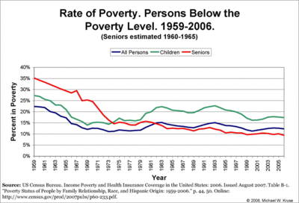
Fighting Poverty

Slide 6
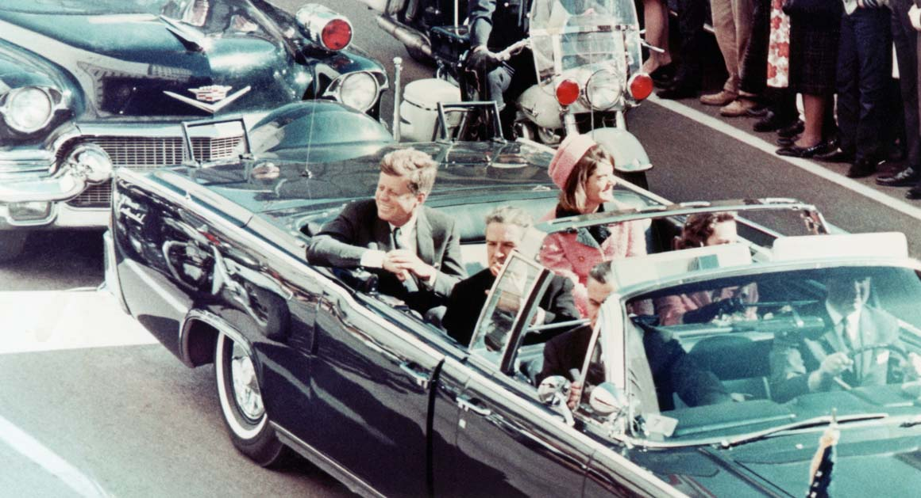
Assassination
JFK was assassinated in Dallas, TX on November 22nd, 1963
Lee Harvey Oswald was arrested for the murder, but was killed himself before he ever faced trial
This led to giant controversy. Was Oswald hired by a foreign enemy? Was he the real/only shooter?

Slide 7
Warren Commission
President LBJ ordered an investigation into Kennedy’s assassination
Led by Supreme Court Justice Earl Warren
After a 10 month investigation, the Warren Commission determined that Lee Harvey Oswald had acted alone
LBJ made the Warren Report public

