Slide 1
Ford’s foreign policies
Détente and the Helsinki Accords

Slide 2
Détente
Really started under Nixon
Henry Kissinger played a major role in this
Détente refers to all efforts to relieve tensions between the U.S. and the Soviet Union
Ford continued this policy, but faced a lot of scrutiny for it

Slide 3
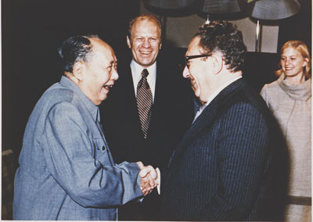
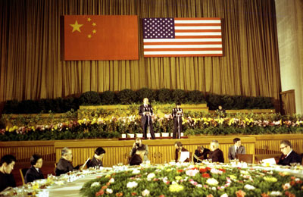
Effects of Nixon’s resignation
The Soviets couldn’t quite understand how the top leader of the U.S. was essentially fired
Ford eventually builds a good personal relationship with Soviet Premier, Leonid Brezhnev
Ford already had a relationship with China
Had been sent there as the House Minority Leader
His liaison to China was George HW Bush

Slide 4
Middle East
Ford continued to try and fix the tensions in the Middle East after the Yom Kippur War
Called the Arab-Israeli Conflict
This only increased the strain on our relationship with the Soviet Union, who sided with the Arab countries

Slide 5
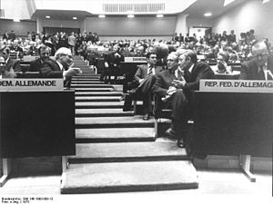
Helsinki Accords
In 1975 35 countries, including the U.S. and the Soviet Union, met in Helsinki, Finland to repair the relationship between the east and west
Ford and Kissinger disagreed about being involved in the Helsinki Accords

Slide 6
Helsinki Accords
The Helsinki Accords acknowledged the borders that were established in Europe post-WWII
Means the Soviets got to keep everything they took
However, it wasn’t a binding treaty, so no one really had to follow it…

Slide 7
Helsinki Accords
The most lasting part dealt with humans rights
“The participating states will respect human rights and fundamental freedoms, including the freedom of thought, conscience, religion or belief, for all without distinction as to race, sex, language, or religion.”

