Slide 1
Black panthers

Slide 2
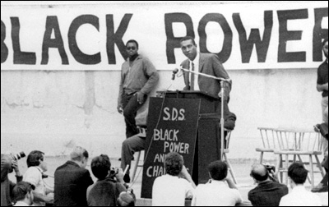
Stokely Carmichael
The Black Panthers were founded in 1966 by Huey Newton and Bobby Seale
Newton and Seale were greatly inspired by Malcolm X, as well as Stokely Carmichael
Stokely Carmichael, former chairman of SNCC, was a proponent of Black Power

Slide 3
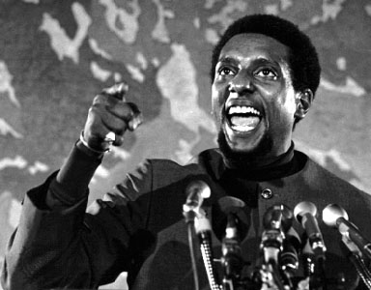
Stokely Carmichael
http://digital.library.nashville.org/cdm/singleitem/collection/nr/id/1165/rec/1

Slide 4
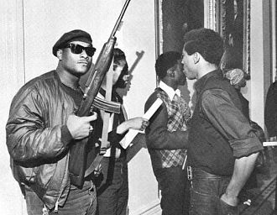
Bad reputation
The Black Panthers were a militant group that felt justified in using violence to achieve its goals
Huey Newton, one of the FOUNDERS, was arrested for killing a police officer
Promoted socialism and were quick to quote Chairman Mao
Racist?

Slide 5
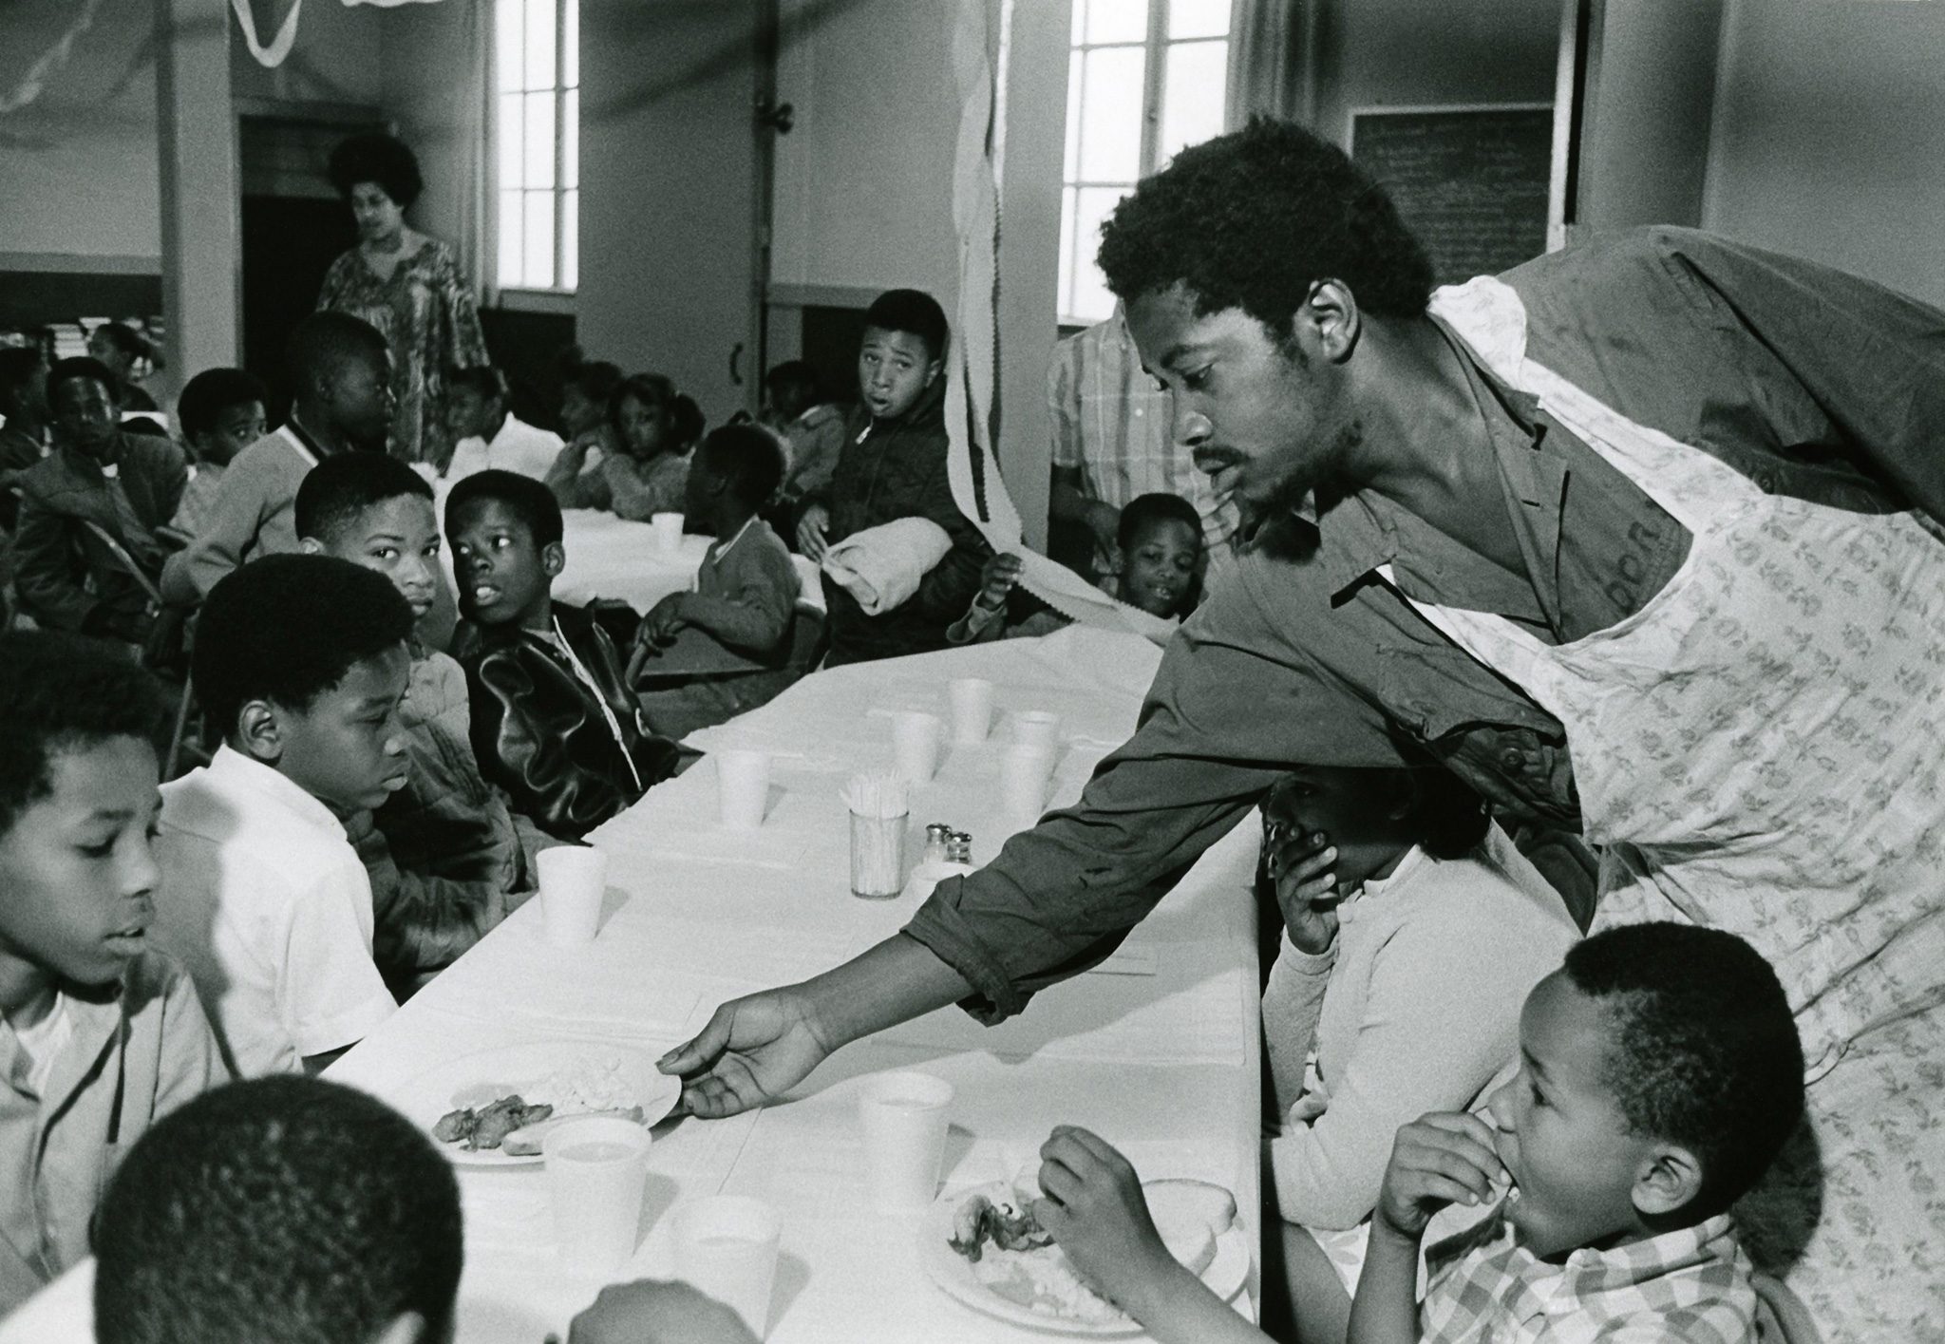
The good they did
The Black Panthers advocated for racial equality, gender equality, and economic equality for the working class
Started the nationwide Free Breakfast for Schoolchildren Program that feed 10,000 underprivileged African American students every day before school

Slide 6
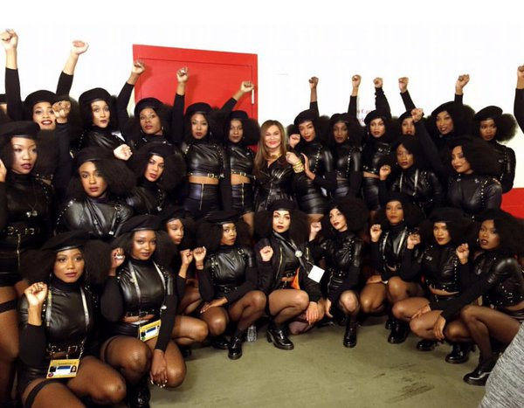
Legacy Today
Most of the leadership of the Black Panthers were killed, imprisoned, or left the country
Still controversial

Slide 7
De Jure vs. De Facto Segregation

Slide 8
De Jure Segregation
De jure segregation is racial separation created by law
Most of this can be accounted to Plessy v. Ferguson’s “separate but equal” ruling
Examples: separate water fountains for blacks and whites, segregated public schools

Slide 9
De Facto Segregation
De facto segregation is racial separation created by social conditions.
Most of this can be attributed to poverty. African Americans and other minorities make up a larger portion of those living below the poverty line.
Examples: inner city schools being poorly equipped, a predominately black ghetto, higher crime rates among minorities
Is cyclical

Slide 10
To Recap…
De jure segregation is BY LAW
De facto segregation is BY SOCIETY

Slide 11
Practice Time!

Slide 12
Having separate water fountains for blacks and whites
De jure

Slide 13
An inner city high school in a predominately black neighborhood does not have enough resources for its students
De facto

Slide 14
A young boy can’t go to the elementary school near his house because it is for “whites only”
De jure

Slide 15
An African American man has to pay a poll tax to vote
De jure

Slide 16
A poor ghetto is made up entirely of African American residents
De facto

Slide 17
A restaurant refuses to serve black customers unless they come around to the back entrance
De jure

Slide 18
A black senior from a poor neighborhood can’t go to college solely because her family can’t afford it
De facto

Slide 19
Because she couldn’t go to college, this young woman can only receive a low-paying job
De facto

Slide 20
Without a higher-paying job, this woman cannot afford to move out of her poor neighborhood
De facto

Slide 21
Which type of segregation is harder for a society to destroy?
De facto

