Slide 1
Age of Activism
Students and the Counterculture

Slide 2
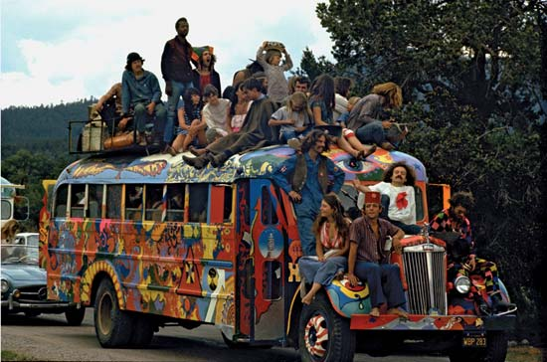
Hippies
“Make love, not war”
Very anti-war effort
Promote love and unity

Slide 3
Draft resistance
The Selective Service Act was created after WWII and required men between 18 and 26 to register for the draft
Those who opposed the war (usually for moral reasons) could be forced into military service
Deferment: young men could postpone being drafted by going to college
What do we think this did to the number of people in college?
Others would flee the country or simply burn their draft cards

Slide 4
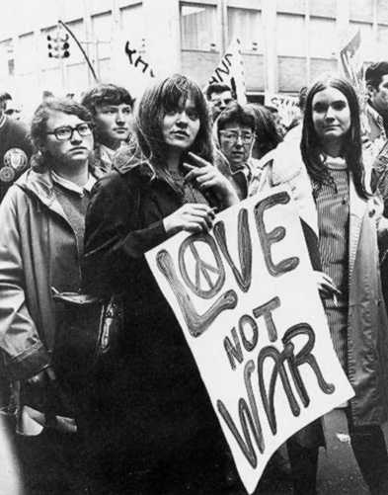
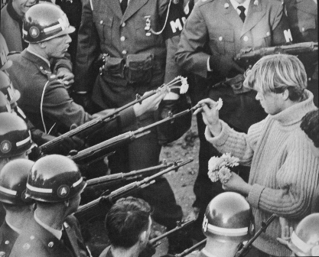
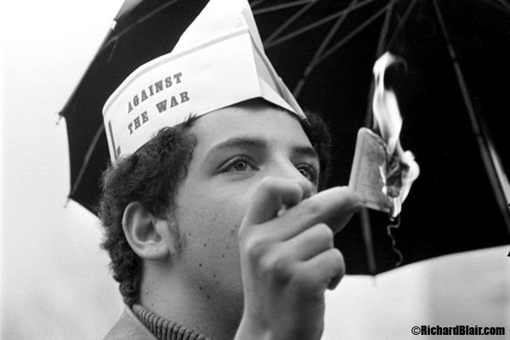

Slide 5
Students for a Democratic Society
Students for a Democratic Society (SDS) was created to enact drastic social change
Criticized nuclear armament, racism, and economic inequality
These ideas formed the political movement known as the New Left
Sound familiar?

Slide 6
Free Speech Movement
Started at University of California Berkeley when students were prevented from taking part in the Civil Rights Movement
Students across the country took part in the Free Speech Movement
Their goal was to ensure colleges weren’t restricting their rights and to get students involved in campus policy making
The Teach-in Movement

