Slide 1
Choosing Abstinence
Chapter 6 Section 4

Slide 2
Risks of Sexual Intimacy
NOT RISK FREE
Effects emotional health
Effects your relationship
Risk of pregnancy
Risk of STI’s/STD’s

Slide 3
Effects on Emotional Health
Based on your values
May go against a person’s values
Media helps shape values
Result of making snap decisions about sex is often a loss of self-respect
May feel you let your parents down

Slide 4
Effect on your Relationship
Alters the way couples spend time together
Changes the way couples relate to friends
One partner may expect sex every time they are together
Couples are not prepared for sexual complications

Slide 5
Risk of Pregnancy
Babies born to teen mothers are usually smaller and less healthy
Teenage mothers are more likely to have health problems during pregnancy
What effect does a baby have on a teenage couple?
Parents are legally responsible
Often feel overwhelmed and trapped
Many teenage mothers drop out of school

Slide 6
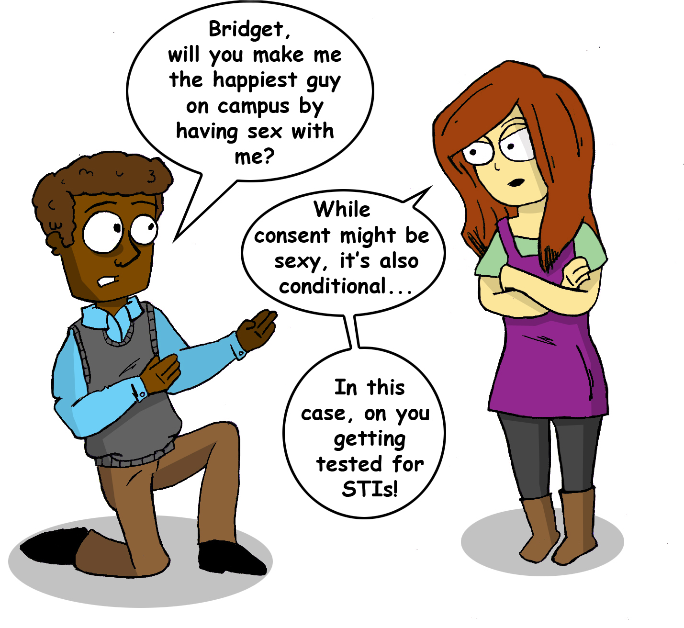
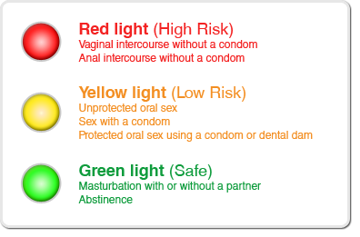
Risks of STI’s
Some infections can be passed, or transmitted from one person to another during sexual activity

Slide 7
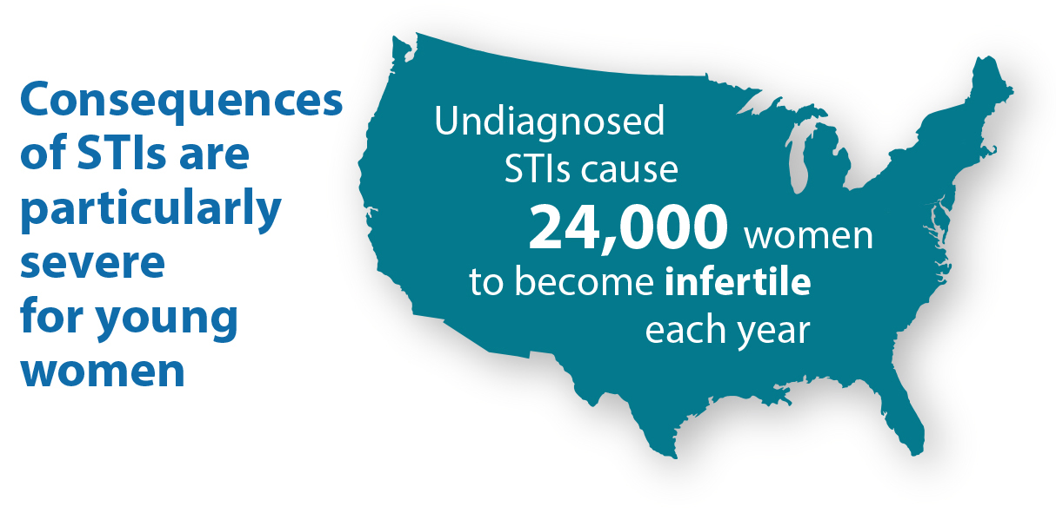
Emotional Intimacy
Definition – refers to the openness, sharing, affection, and trust that can develop in a close relationship
A couple can have a close relationship without being sexually intimate
It is hard for them to keep a relationship close if there is no emotional intimacy

Slide 8
Abstinence Skills
Abstinence – Act of refraining from, or not having sex
Skills include:
Setting clear limits
Communicating your limits
Avoiding high-pressure situations
Asserting yourself

Slide 9
Abstinence Skills cont.
Set Clear limits
It’s easier to stick to limits and feel comfortable about them
Communicate your limits
Don’t wait until situation arises
Talk honestly to partner
Avoid high-pressure situations
Unsupervised parties – pressure to have sex
Assert yourself
Make sure partner knows what you mean

