Slide 1
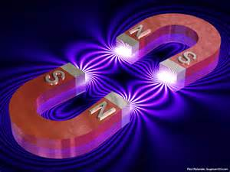
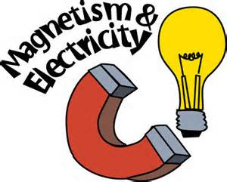
Unit 8 Lecture
Chapter 21

Slide 2
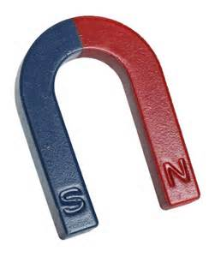
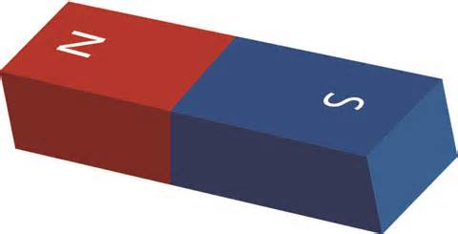
Magnetic Force
The amount of magnetic force depends on distance
Closer magnets are, the stronger the force
On a magnet, the force is the strongest at both poles (North and South)
Like poles repel, opposite poles attract
If you break a magnet in half, you get 2 magnets

Slide 3
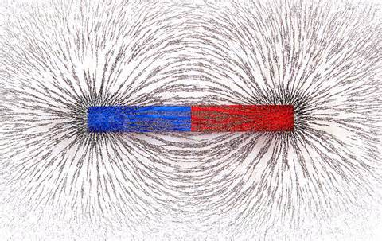
Magnetic Fields
The magnetic field comes out of the north end of a magnet and travels into the south end
The strength of the field can be seen using iron filings

Slide 4
Earth is a giant magnet!
The Earth is a giant magnet and is surrounded by a magnetic field which protects us from solar radiation
The south magnetic pole is located in Canada
On a compass, the north end of the magnetized needle is attracted to Earth’s south magnetic pole in Canada
This is why your compass points North towards Canada

Slide 6
Magnetic Domains
Iron, Nickel, and Cobalt can become magnetized temporarily by rubbing it with a magnet in one direction
This causes the domains inside the metal to align so that all the north ends are in the same direction and all the south ends are in the same direction

Slide 7
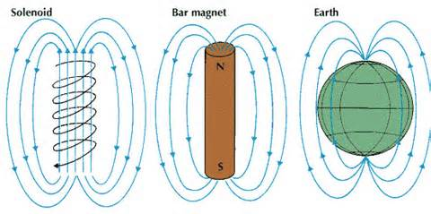
Electromagnetism
Moving electric charges can create a magnetic field
A magnetic field can create electricity

Slide 8
To make an electromagnet:
1. Place an iron nail inside a magnetic field or wrap wire around the piece metal
2. Then attach the wire to a power source
3. The magnetic domains inside the nail will line up and now you have a temporary magnet
To make it stronger:
1. Increase the current
2. Increase the number of coils around the nail

Slide 10
3 electromagnetic devices
1. Galvanometer- measures the amount of electric current ex: gauges on a dashboard
2. Electric Motor- takes electrical energy and converts it into mechanical energy, inside is a commutator which reverses the direction of the current
3. Loudspeakers- the AC moves an electromagnet which vibrates a membrane

Slide 11
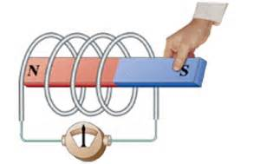
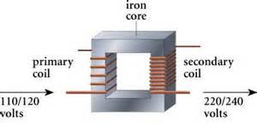
Making Electricity
Electromagnetic induction- moving a magnet through a wire coil which produces electricity
This is how generators and transformers work

Slide 12
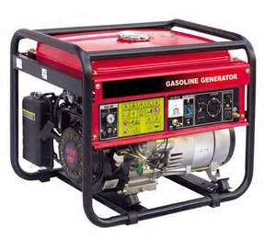
Generators
Generators take mechanical energy and convert it into electrical energy
2 types:
1. AC generators- produce alternating current, and are basically the opposite of a motor
2. DC generators- produce direct current

Slide 13
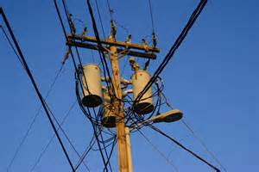
Transformers
Transformers change the voltage and current using electromagnetic induction
2 types:
1. Step up- increase the voltage flowing out before it enters a large business, has more turns in the secondary coil
2. Step down- decrease the voltage flowing out before it enters your house, has more turns in the primary coil

Slide 15
The flow of electricity
Coal is burned at the power plant which creates steam which turns the turbines and creates electricity
The electricity leaves the power plant and flows at a high voltage through the power lines (25,000 V)
The voltage flows through a step down transformer and decreases to 120 V or 240 V before it enters your house

